Slide 1
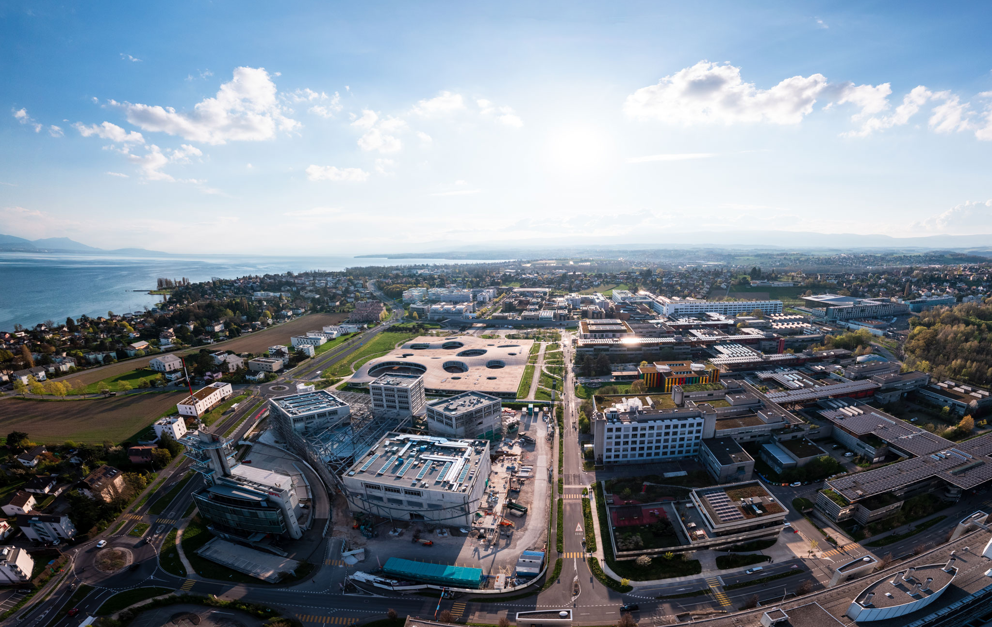

Self-Suprervised Skeleton-based Action Recognition
Student: Ruihang Jiang (Master in Computer Science)
Supervisor: Mohamed Abdelfattah
Alexandre Alahi
Optional Semester Project: 8 Credits
June 2024

Slide 2
Problem
How to classify or predict actions with limited supervised data?
Self-Supervised Learning
How to construct models with promising performance in various down-stream tasks?

Slide 3
Problem
How to construct models with promising performance in various down-stream tasks?
Pretraining Stage
Input: Joints Coordinates
Output: High-level Representation features
Finetuning Stage
Input: Joints Coordinates
Output based on distinct down-stream tasks:
Action Classification

Slide 4
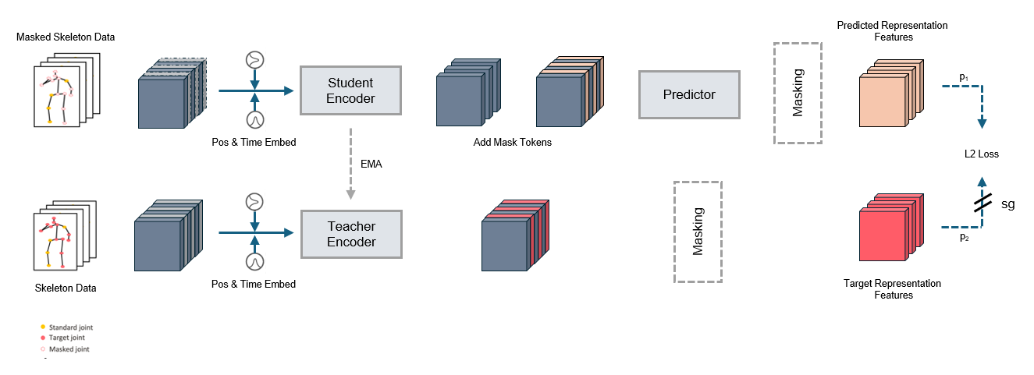
Proposed Method
Pretrained Stage: Spatial / Temporal Encoder
Knowledge Distillation^{[2]}: Predictor + EMA
[1] Caron, Mathilde, et al. "Emerging properties in self-supervised vision transformers." Proceedings of the IEEE/CVF international conference on computer vision. 2021.

Slide 5
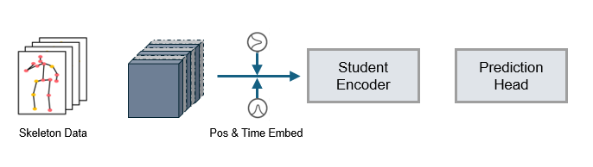
Proposed Method
Finetune Stage: Spatial/Temporal Student Encoder + Simple MLP

Slide 6
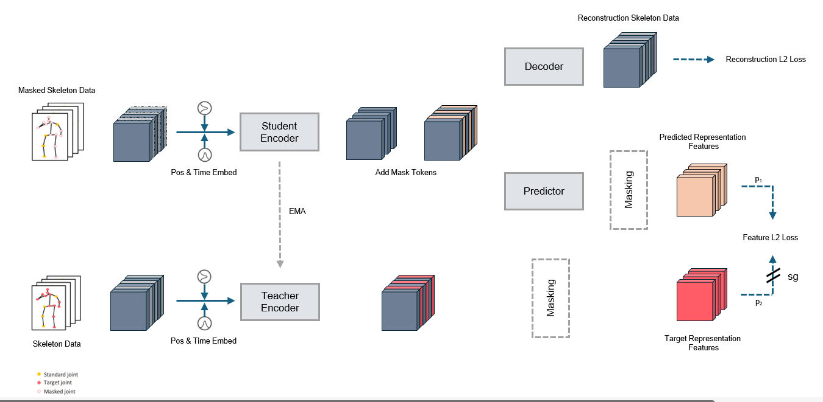
Proposed Method 2
Pretrained Stage: Add Decoder in Student Network
Motivation: Guarantee the Learned High Dimension Representation Features

Slide 7
Experiment
Dataset: ¼ NTU-60 X-sub
Pretrained Stage: MSE
Finetune Stage:
Action Classification: Top-1 Accuracy; Top-5 Accuracy

Slide 8
Experiment
Model (similar #parameters in finetune stage) | Top-1 Accuracy | Top-5 Accuracy | Running Time (Pretrain + Finetune)
Baseline: Supervise Learning (Vanilla Encoder) | 58.8 | 89.3 | 14.5 min / Epoch
Spatial Encoder (Simple) | 54.6 | 81.1 | 5 min / Epoch
Temporal Encoder (Simple) | 59.3 | 84.7 | 3.6 min / Epoch
Spatial Encoder (Patches & Masking Token) | 68.2 | 90.0 | 1 min / Epoch
Temporal Encoder (Patches & Masking Token) | 65.8 | 88.8 | 0.85 min / Epoch
Spatial Encoder (Patch & Masking Token) + Decoder | 82.3 | 95.0 | 1.58 min / Epoch
MAMP^{[2]} (Previous work) | 80.8 | 95.0 | 1.45 min / Epoch
[2] Mao, Yunyao, et al. "Masked motion predictors are strong 3d action representation learners." Proceedings of the IEEE/CVF International Conference on Computer Vision. 2023.

Slide 9
Discussion
Spatial Encoder > Temporal Encoder: Accuracy increase 2-3%
Increase more when using data patches
Our model 2% accuracy comparing with previous MAMP model
Left to work
Try other downstream works
MPJPE(Mean per joint position error )
Human Mesh Recovery
Test with the whole dataset and other datasets
X-sub
Modify network structure
Change EMA update

Slide 10

Thank you

