Slide 1

Abstract ID: #152843, A33D-0249 Session: A32B Improving Physical Process Representation in Global Models Dependence of Estimated Precipitation Frequency and Intensity on Data Resolution Di Chen and Aiguo Dai University at Albany, SUNY, Albany, NY

Slide 2
Motivation
Importance of Precipitation Frequency (F) and Intensity (I)
F and I values vary with the spatial and temporal resolutions of the data (Dai 2006; Biasutti 2013).
Quantify and explain the dependence of F & I on the spatial and temporal resolutions of data.
Facilitate proper comparisons of them between models and observations.
Methods
Data
TRMM 3B42 (3-hourly)
CMORPH_V1_ADJ (3-hourly)
Methods
Spatial & temporal averaging
Simple probability-based model

Slide 3
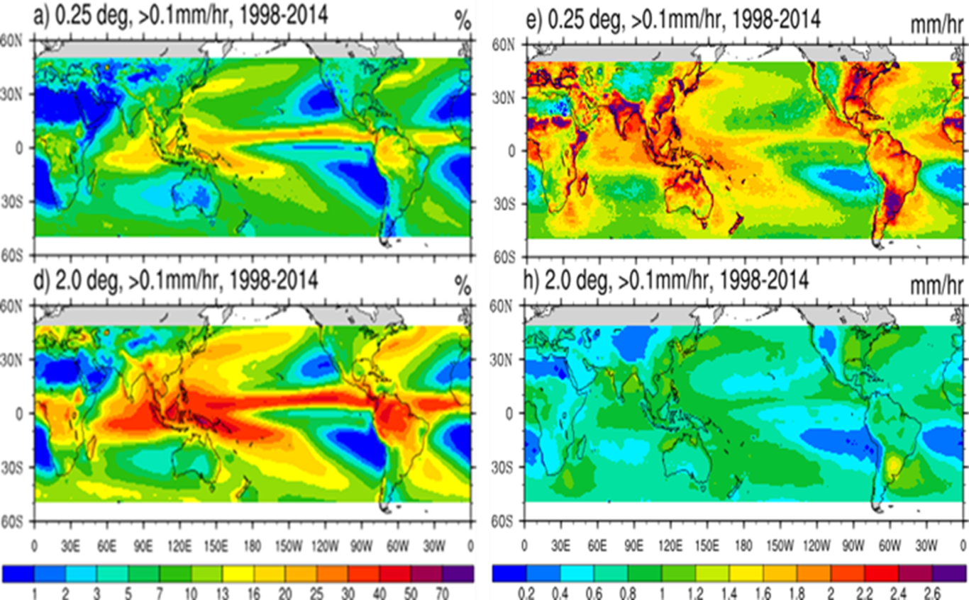
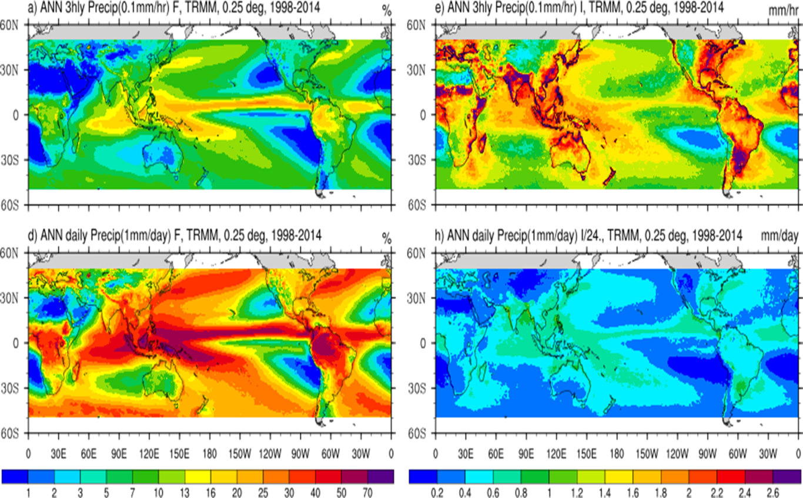
Results—Spatial & Temporal Resolution Dependence
Frequency (%)
Intensity (mm/hr)
Spatial: F (I) increases (decreases) greatly as the data are averaged over larger areas.
.25º
Frequency (%)
3hrly
Intensity (mm/hr)
2º
Daily
Temporal: F (I) increases (decreases) greatly as the data are averaged over longer time periods.

Slide 4
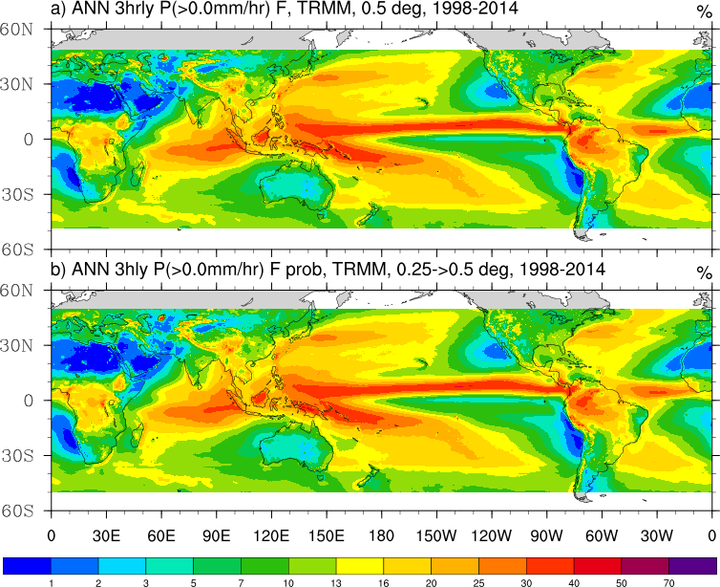
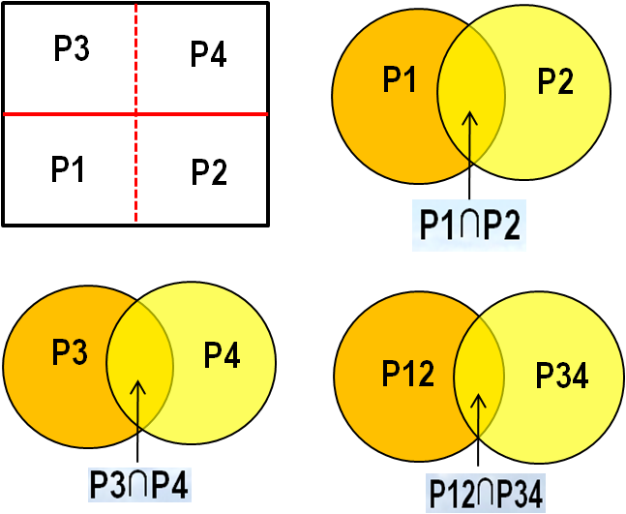
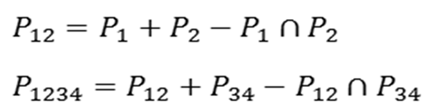
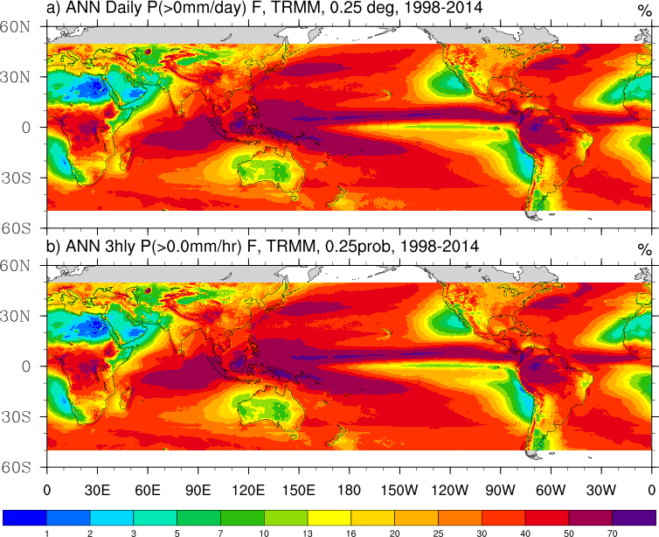
Results—Probability-based model
F on 0.5º grid
Direct Estimate
Model
Estimate
F of Daily P
Direct Estimate
Model
Estimate
Px = probability of precipitation over box x
The dependence can be explained by the simple model

