Slide 1

PANIMALAR ENGINEERING COLLEGE
Department of Computer Science and Engineering
Project Review III , DATE : 16/06/21
Title of the Project:
pyELFer-python tool for analyzing and exploiting ELF binaries.
Team Members with Register number
AJAY SK -211417104008
ABISHEK R-211417104003
AJAY KUMAR R-211417104009
Project Guide: Mr.Sathish N
Batch Number:E14

Slide 2
INTRODUCTION
Computer security represents a challenge to education because of its interdisciplinary nature. Topics in computer security are drawn from areas ranging from theoretical aspects of computing to applied aspects of knowledge technology management. On concept for this measure has emerged because the ‘capture the flag’ competition. Attack-oriented CTF competitions attempts to distill the essence of the various aspects of professional computer security work into one short exercise that's objectively measurable. The areas that CTF competitions operate anvulnerability exposure, exploit creation, toolkit creation, and operational tradecraft.

Slide 3
LITERATURE SURVEY
Author | Year | Topic | Findings
1. Popa Marius | 2012 | Binary code disassembly for reverse engineering | The paper highlights the features of the binary executable files under the x86 architecture and portable format, presents issues of disassembly process of a machine code file and intermediate code, disassembly algorithms which can be applied to a correct and complete reconstruction of the source file written in assembly language, and techniques and tools used in binary code disassembly.
2.Aleph One | November 1996 | Smashing The Stack For Fun And Profit | `smash the stack` [C programming] n. On many C implementations it is possible to corrupt the execution stack by writing past the end of an array declared auto in a routine. Code that does this is said to smash the stack, and can cause return from the routine to jump to a random address. This can produce some of the most insidious data-dependent bugs known to mankind.

Slide 4
Author | Year | Topic | Findings
3. Nergal | December 2001 | The advanced return-into-lib(c) exploits | First, the advanced return-into-lib(c) techniques are described. The second part is devoted to methods of bypassing PaX in case of stack buffer overflow (other types of vulnerabilities are discussed at the end)
4. Dr. Hector Marco-Gisbert | 2018 | return-to-csu: A New Method to Bypass 64-bit Linux ASLR | The major contributions of this paper are as follows: • return-to-csu: A new method to bypass the ASLR in 64-bit systems • An universal µROP chain present in all applications to leak arbitrary memory. • A proof of concept of how to use this universal µROP to leak libc addresses. • An approach to enrich automatic ROP-chain generators

Slide 5
ABSTRACT
Reverse Engineering of Binary is a process that hackers use it to figure out a program’s components and functionalities and sometimes even get access to the program’s partial source code by decompiling it using a decompiler in order to find vulnerabilities in the program. This concept can also be used in capturing the flag contest reverse engineering challenges where a participant has to find the flag secretly hid inside the binary. Our project “pyELFer” is a python program that reverses an ELF binary (ELF-Executable and Linkable Format) and gives information about the binary and mainly optimized for CTF’s challenges where the binary itself find the flag for the challenge and even looks out whether the binary is vulnerable to any overflow attacks.

Slide 6
TECHNOLOGY STACK
Python libraries
Subprocess
pwntools
angr
platform
os
sys
pyelftools
optparse

Slide 7
SYSTEM ARCHITECTURE
System architecture is the conceptual model that defines the structure, behavior, and more views of a system. An architecture description is a formal description and representation of a system, organized in a way that supports reasoning about the structures and behaviors of the system.
We have two modes of operation –
a. REVERSE ENGINEERING MODE
b. BINARY EXPLOITATION MODE
At the starting of the application the user is prompted for entering the CTF ELF executable binary. After that these two modes will be displayed and ask the user for the mode of use at the beginning. The user after being prompted for the mode chooses one and goes into that mode.

Slide 8
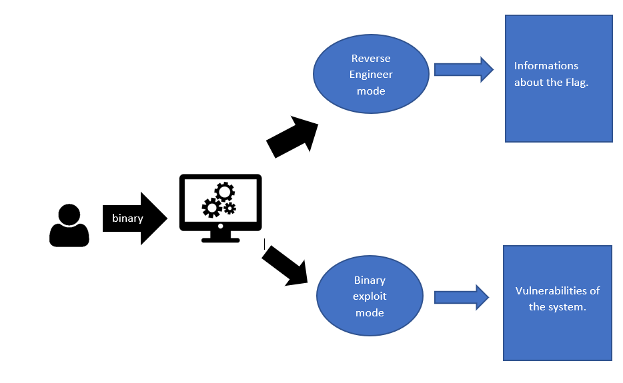
System Architecture Diagram

Slide 9
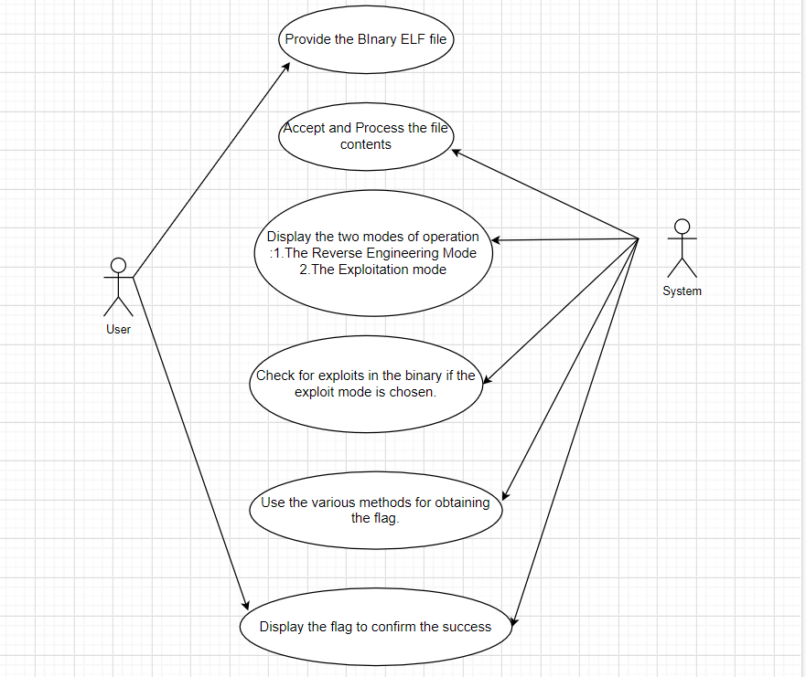
SYSTEM DESIGN
USE CASE DIAGRAM

Slide 10
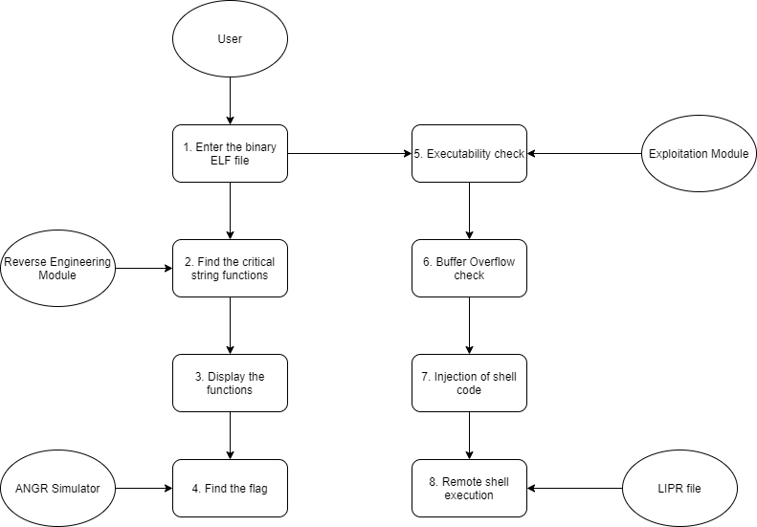
DATA FLOW DIAGRAM

Slide 11
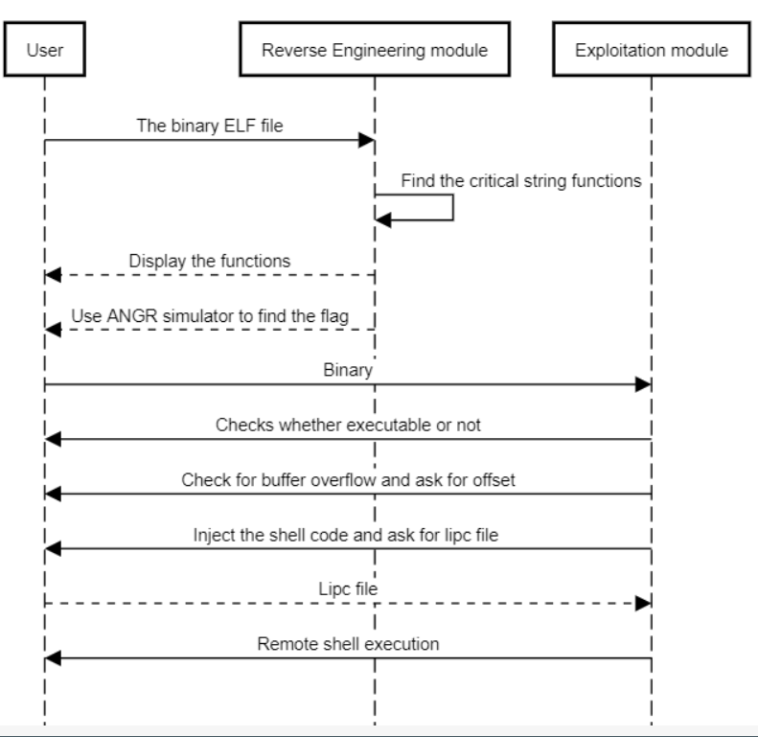
SEQUENCE DIAGRAM

Slide 12
MODULES
1. Reverse Engineering Mode
Ltrace
Strace
Critical String functions
Input comparison and Modified Input comparison
Angr

Slide 13
2. Exploitation Mode
Ret2win
Injection of Shellcode in .bss
Straight ret2libc
Ret2csu→ret2libc(only applicable for 64 bit)

Slide 14
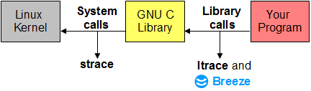
Reverse Engineering Mode
1. Ltrace:-
Prints out the library calls the binary makes to the libc present in the local system with their arguments to the functions.

Slide 15
2. Strace:-
Prints out the system calls made by the binary.
3. Critical String functions:-
It detects the presence of critical string functions used to validate the flag and display its arguments being used.

Slide 16
4.Input Comparison and Modified Input Comparison:-
Used to print the comparison characters that are being compared with the user input string and also detects the comparison characters even if the strings are modified or masked with byte operations..
5.Angr Simulator:-
A simulation engine that tries a bruteforce to get the flag or keygen using various methods.

Slide 17
Exploitation Mode
Ret2win
A exploitation method where the hidden function has the shell(super user shell maybe) present in them or the flag displaying function. This technique is also called code execution redirection.
Ret2libc:-
If our binary has NX bit enabled. The stack and .bss section is not executable where no injected instructions can be executed.By using a memory leak and some ROP gadgets we can get to system function and get shell.

Slide 18
Ret2csu→Ret2libc:-
A complex method which involes a 64 bit binary with a memory leak function that has more than 2 arguments to leak memory addresses.And then use the memory addresses to calculate offset to perform a classical ret2libc.

Slide 19
TESTING
Test Case Id | Test Cases | Priority | Input Test Data | Test Case Description | Expected Results | Actual Results | Pass/Fail
TU01 | File Upload | A | Enter the location of ELF Binary | Checks whether the provided file is ELF binary | If the file is not ELF binary. The program should exit with an error message. | File is analyzed successfully. | Pass
TU02 | Mode Selection | A | Enter 1 or 2 | Check for Mode selection | File should be processed according to the mode | File is processed according to the mode | Pass
TU03 | Offset and Extra Data input (Exploitation Mode) | A | Enter the offset to reach ret address and if any extra input | Program should use the offset correctly and extra input | If offsets are correct and binary is vulnerable to buffer overflow, It should pop a shell | Shell is popped | Pass

Slide 20
TU04 | Remote libc file upload (Exploitation Mode) | A | Enter the location of remote libc file.. | Checks whether it is a shared library file | If uploaded file is a shared library file it should process the file successfully. | The upload Shared library file is processed successfully. | Pass
TU05 | Remote Ubuntu Server (Exploitation mode) | B | - | The program should try upto 4 times by incrementing 1 ret gadget everytime trying to place a remote shell | The shell should be popped under a maximum of 4 tries. | The shell is popped under 4 tries. | Pass

Slide 21
CONCLUSION
In summary, the term ‘capture the flag’, shortly ‘CTF’ and the concepts used in it have been discussed. Also the program is designed to do two different operations, one to find the flag using Reverse Engineering and another one to check vulnerability for any buffer overflow attacks using Binary Exploitation Method.
FUTURE ENHANCEMENT
In the further enhancement we are planning to make the reverse Engineering mode and add some more features to Exploitation mode like a shellcode ROPchain useful when exploiting a statically linked binary.

Slide 22
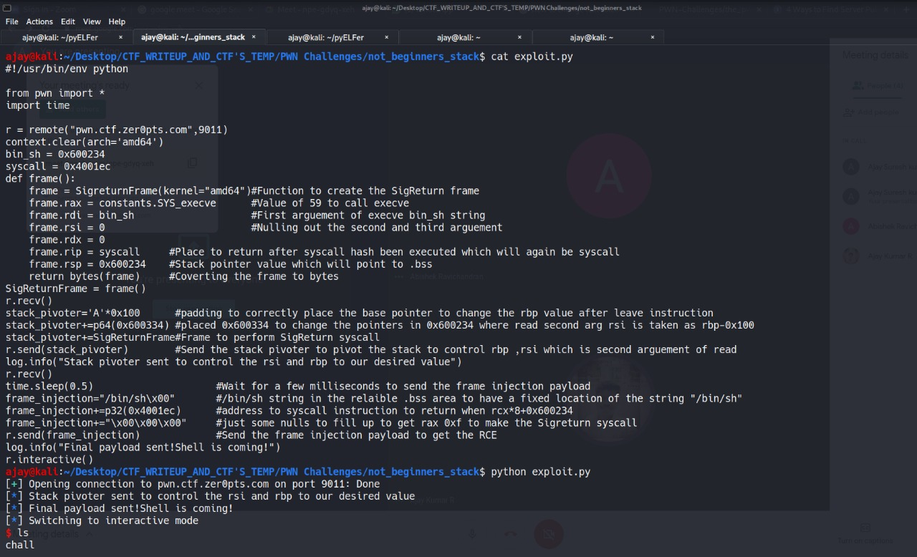
Live exploit

Slide 23
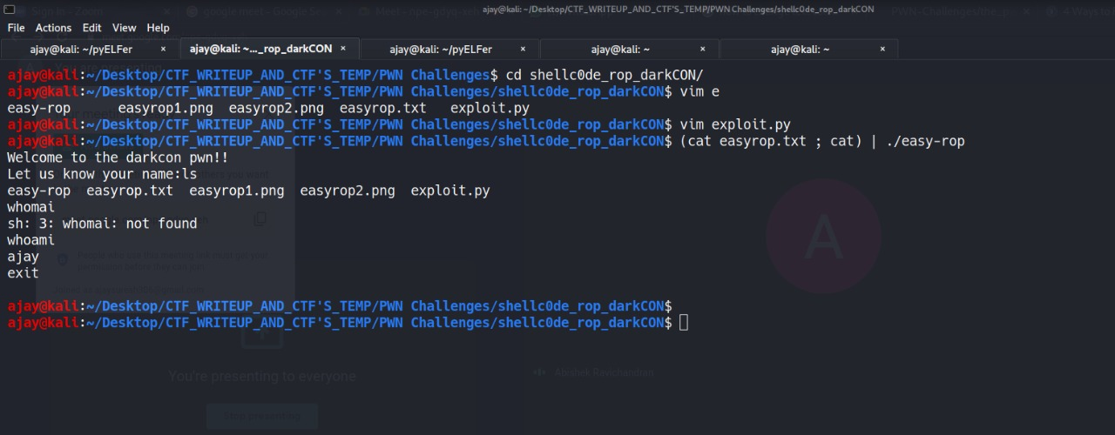
Remote exploit

Slide 24
PUBLICATION DETAILS
Published and presented the paper in EASYCHAIR ICONIC National Conference which was held on 27/03/2021 at Panimalar Engineering College.
The Paper title was pyELFer : PYTHON TOOL FOR ANALYZING AND EXPLOITING ELF BINARIES
The paper submission ID was 292.

Slide 25
REFERENCES
Popa Marius, Binary Code Disassembly for Reverse Engineering, December 2012, [https://www.researchgate.net/publication/235611044_Binary_Code_Disassembly_for_Reverse_Engineering]
Aleph One, Smashing The Stack For Fun And Profit, Phrack Magazine, November 1996[http://phrack.org/issues/49/14.html] Nergal, The Advanced return-into-lib(c) exploits (PaX case study), December 2001,[http://phrack.org/issues/58/4.html]
Dr. Hector Marco-Gisbert and Dr. Ismael Ripoll-Ripoll, Address Space Layout Randomization (ASLR), 2018, [https://i.blackhat.com/briefings/asia/2018/asia-18-Marco-return-to-csu-a-new-method-to-bypass-the-64-bit-Linux-ASLR-wp.pdf]
ANGR – A Python Framework for analyzing binaries, [https://angr.io/]

