Slide 1




Practical Deep Learning
Episode 0
ML recap. Intro to deeplearning

Slide 2
Linear Regression
Model:
Objective function:
Optimization (exact):
pred
X
Wx +b
Y

Slide 3
Linear Regression
Model:
Objective function:
Optimization (iterative):
pred
X
Wx +b
Y

Slide 4
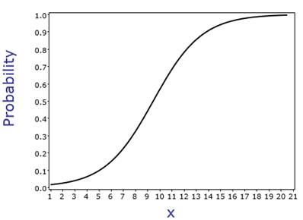
Logistic Regression
X
Wx +b
P(y)
Objective function ?

Slide 5
Logistic Regression
Model:
Objective function:
Optimization (iterative):
You guessed it!
X
Wx +b
P(y|x)

Slide 6
Logistic Regression
Model:
Objective function:
P(y=a|X)
P(y=b|X)
P(y=c|X)
X

Slide 7
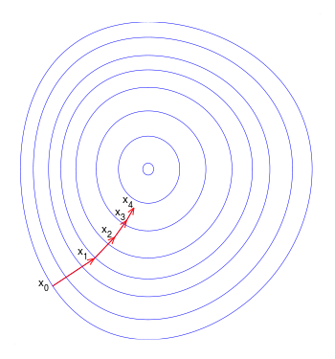
Gradient descent
Update:
a – learning rate a<<1
L – loss function
Can we do better?

Slide 8
Gradient descent
Update:
a – learning rate a<<1
L – loss function
Can we do better?

Slide 9
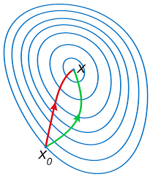
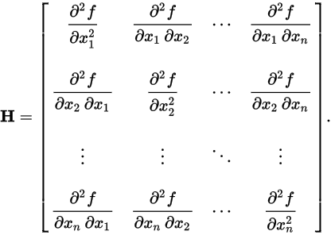
Newton-Raphson
Parameter update
Hessian:
Red: Newton-Raphson
Green: gradient descent
Any drawbacks?

Slide 10
Stochastic gradient descent
Loss function is mean over
all data samples.
Approximate with 1 or few random samples.
Update:
E – expectation
Learning rate should decrease
sgd
gd

Slide 11
SGD with momentum
Idea: move towards “overall gradient direction”,
Not just current gradient.
Helps for noisy gradient / canyon problem

Slide 12
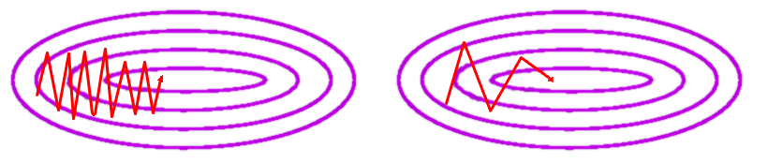
SGD with momentum
Idea: move towards “overall gradient direction”,
Not just current gradient.

Slide 13
AdaGrad
Idea: decrease learning rate individually for each parameter in proportion to sum of it's gradients so far.
“Total update path length”
(for each parameter)

Slide 14
RMSProp
Idea: make sure all gradient steps have approximately same magnitude (by keeping moving average of magnitude)

Slide 15
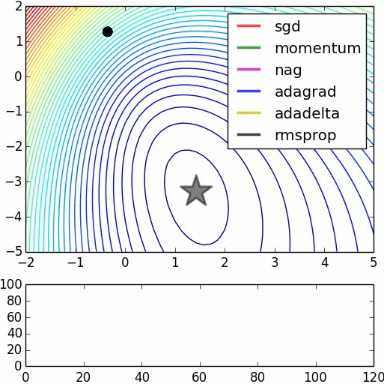
Alltogether

Slide 16
Moar stuff
Without Hessian
Adadelta ~ adagrad with window
Adam ~ rmsprop + momentum
Nesterov-momentum
Hessian-free (narrow)
Conjugate gradients
Estimate inverse Hessian
BFGS
L-BFGS
****-BFGS

Slide 17
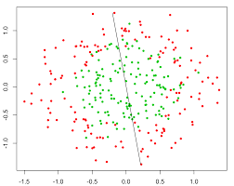
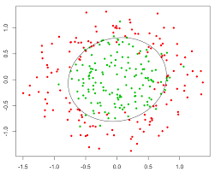
Nonlinear dependencies
What we have What we want
How to get that?

Slide 18
Feature extraction
Loss, for example:
Model:
Feature
Extractor
(manual)
Classifier
Ɵ1~{W,b}
X
Prediction
Training:

Slide 19

Features would tune to your problem automatically!

Slide 20
What do we want, exactly?
Loss, for example:
Model:
Feature
Extractor
Ɵ2
Classifier
Ɵ1~{W,b}
X
Prediction
?
Training:

Slide 21
What do we want, exactly?
Loss, for example:
Model:
Feature
Extractor
Ɵ2 ~ {?!}
Classifier
Ɵ1~{W,b}
X
Prediction
Gradients:

Slide 22
Try linear
Model:
Linear
model
Logistic
Regres-
sion
X
Prediction

Slide 23
Try linear
Model:
Linear
model
Logistic
Regres-
sion
X
Prediction
Output:
Is it any better than logistic regression?

Slide 24
Try linear

Slide 25
Try linear
Model:
Linear
model
Logistic
Regres-
sion
X
Prediction
Output:
Is it any better than logistic regression?

Slide 26
Nonlinearity
Model:
Linear
model
σ(h)
Logistic
Regres-
sion
X
Prediction

Slide 27
Nonlinearity
Model:
Linear
model
σ(h)
Logistic
Regres-
sion
X
Prediction
Output:

Slide 28
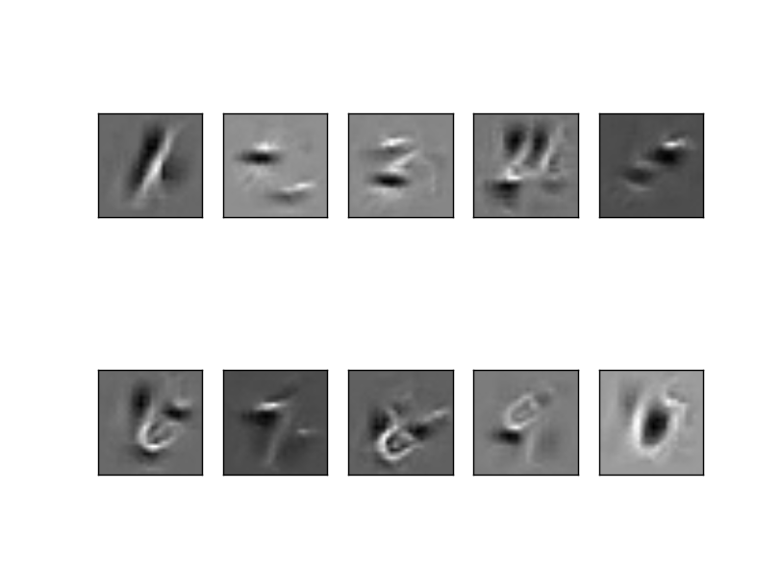
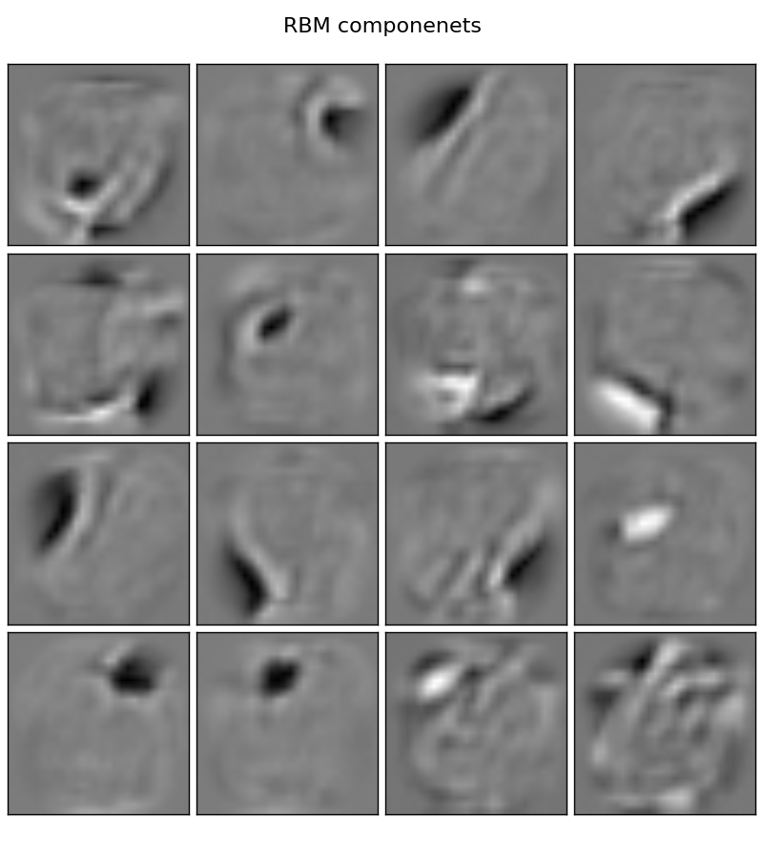
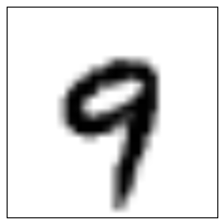
Nonlinearity
Model:
Linear
model
σ(h)
Logistic
Regres-
sion
X
Prediction
P(“1”)
P(“2”)
...
P(“9”)

Slide 29
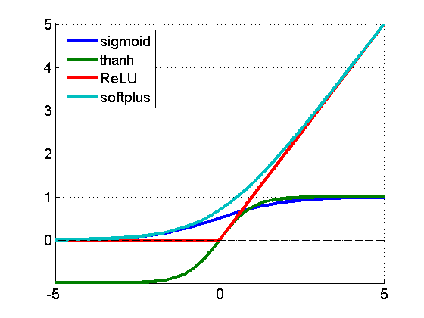
Nonlinearity
f(a) = 1/(1+e^a)
f(a) = tanh(a)
f(a) = max(0,a)
f(a) = log(1+e^a)
f(a)
a

Slide 30
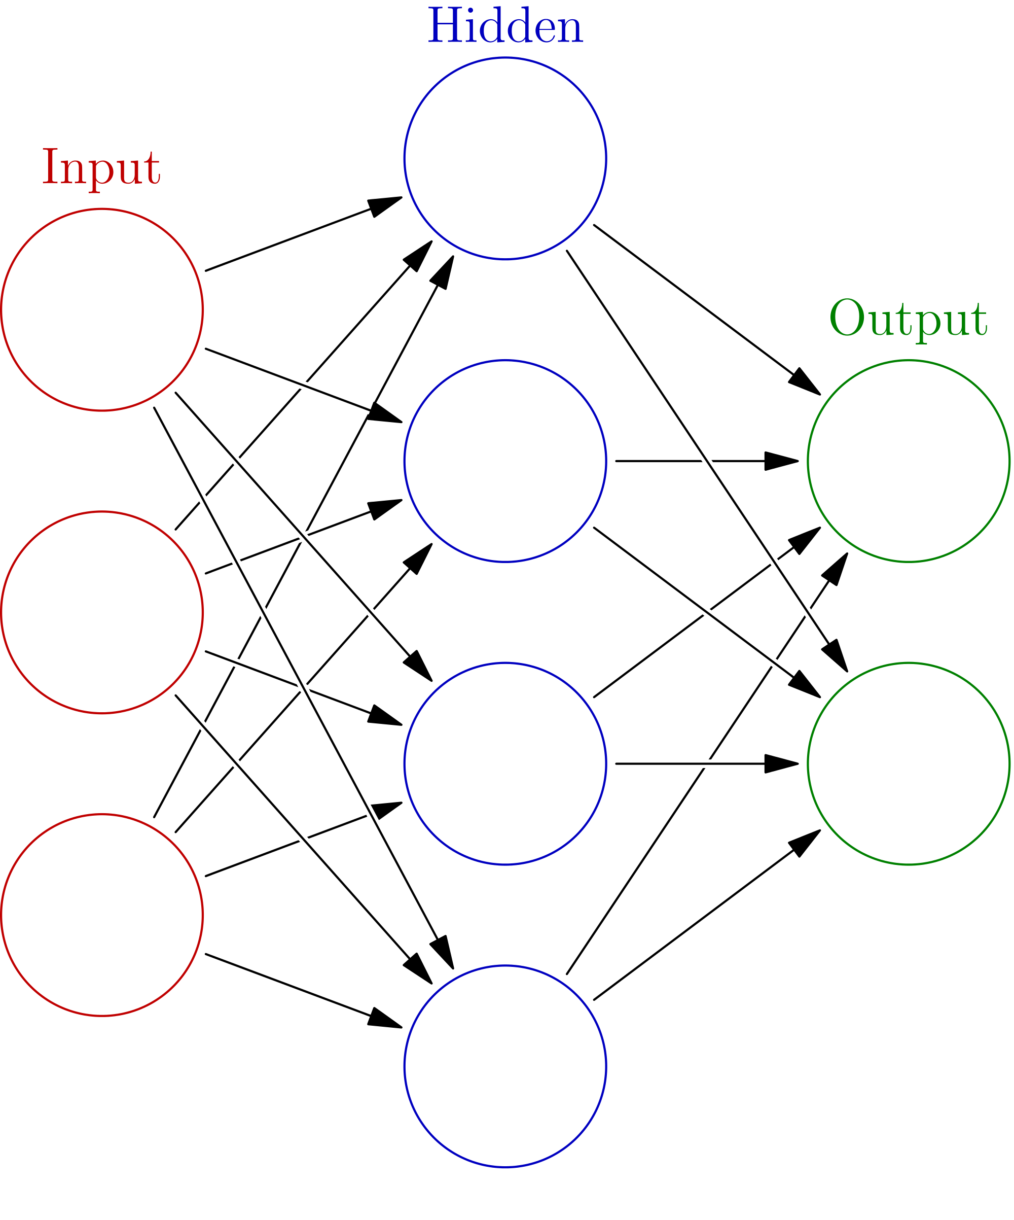
Initialization, symmetry problem
h0
Initialize with zeros
W ← 0
What will the first step look like?
x0
h1
y0
x1
h2
y1
h2
x2
h3

Slide 31
Initialization, symmetry problem
h0
Break the symmetry!
Initialize with random numbers!
W ← N(0,0.01)?
W ← U(0,0.1)?
Can get a bit better for deep NNs
x0
h1
y0
x1
h2
y1
h2
x2
h3

Slide 32
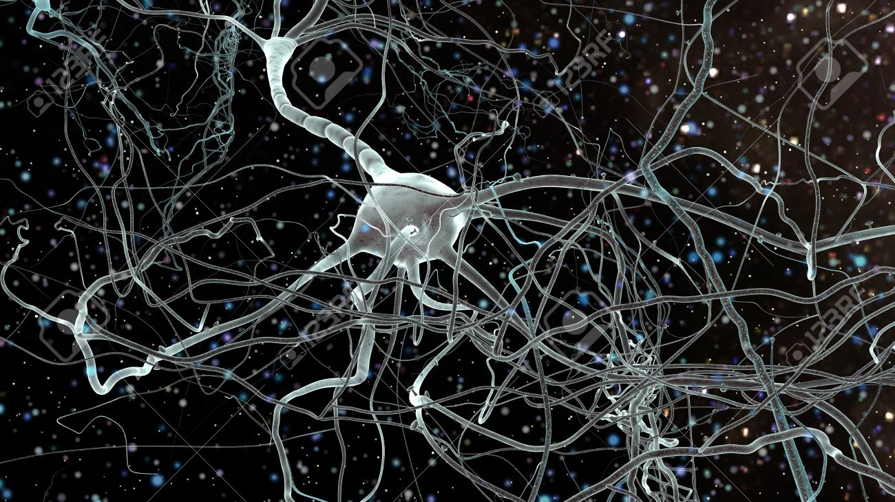
Biological inspiration

Slide 33
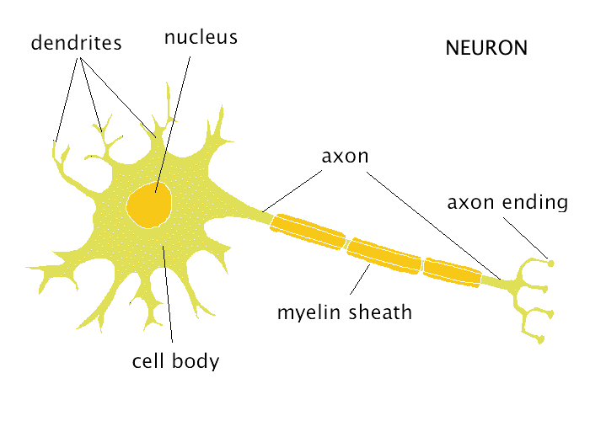
Biological inspiration

Slide 34
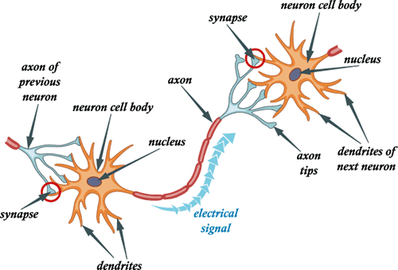
Biological inspiration

Slide 35
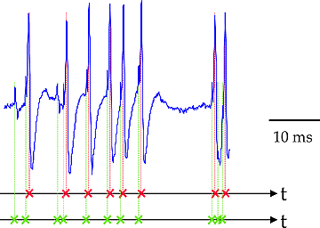
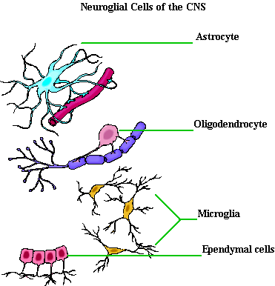
Not actual neurons :)
Neurons react in “spikes”,
  not real numbers
Neurons maintain/change
  their states over time
No one knows for sure how
they “train”
Neuroglial cells are important
  But noone knows, why

Slide 36
Connectionist phrasebook
Layer – a building block for NNs :
    “Dense layer”: f(x) = Wx+b
    “Nonlinearity layer”: f(x) = σ(x)
    Input layer, output layer
    A few more we gonna cover later
Activation – layer output
    i.e. some intermediate signal in the NN
Backpropagation – a fancy word for “chain rule”

Slide 37
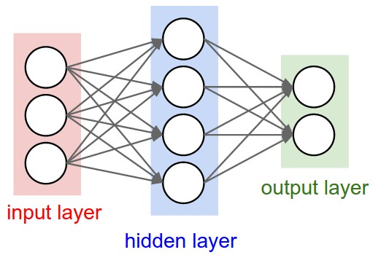
Connectionist phrasebook
Dense layer
with a nonlinearity
“Train it via backprop!”

Slide 38

Connectionist phrasebook
How do we train it?

Slide 39


Slide 40
Potential caveats?

Slide 41
Potential caveats?
Hardcore overfitting
No “golden standard” for architecture
Computationally heavy

Slide 42
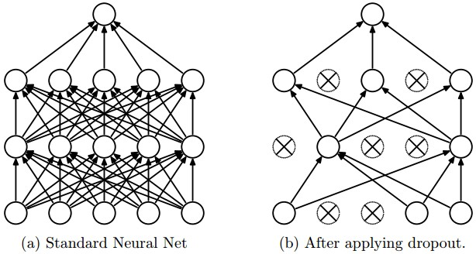
Regularization
L1, L2, as usual
Dropout

Slide 43
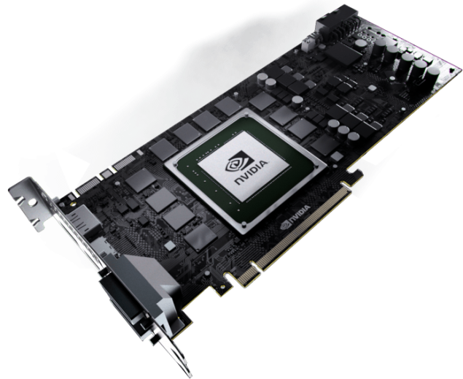
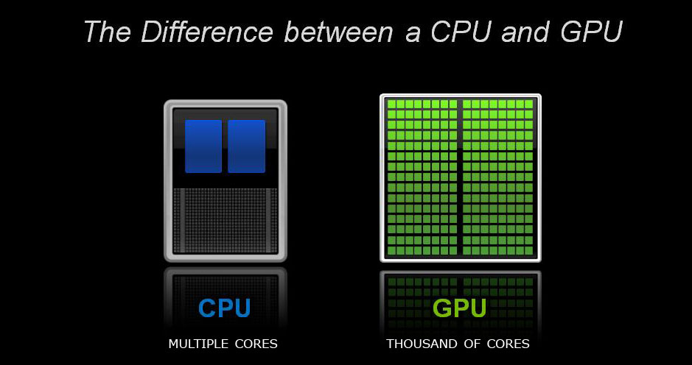
Computation

Slide 44

Nuff
Let's go implement that!

