Slide 1



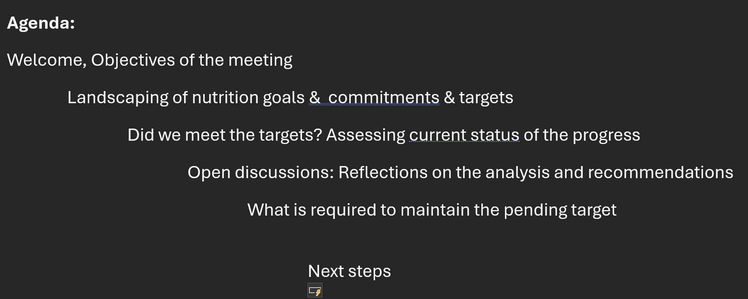
Nourishing Futures: Empowering Nepal's Next Generation of Nutrition Leaders in Data Analytics, Research and Innovation
Data camp to assess WHA nutrition targets
An initiative of
Supported by Innveda
Notes:
A vibrant and modern logo symbolizing capacity building in nutrition education for students in Nepal. The design features the silhouette of Nepal's map placed on top of stylized Himalayan mountains, representing the nation's geography. Below, elements such as books, a graduation cap, a bowl of fruits, and data graphs symbolize education, nutrition, and research. Bright and optimistic colors like green, orange, and blue are used to evoke growth, health, and knowledge. The overall composition conveys empowerment, innovation, and a forward-looking vision for Nepal's nutrition landscape.

Slide 2
Road map for the Initiative
Call to Action by Nutrition Fellowship
Conceptualization and workshop with key collaborators to shape with the initiative
Data Camps in colleges
Interaction with Advisory group +international advisors
Dissemination - with Gatekeepers
End of Feb

Slide 3
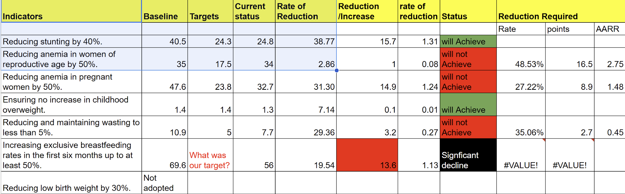
Key Analysis findings
Nepal will only meet 2 out 5 indicators
There has been significant decline in exclusive breastfeeding rate -14% down

Slide 4
Support Activities agreed
Monthly Data Camps
Individual Coaching linked with Fellowship leadership
Realtime monitoring of Vitamin A campaign
Interaction with NPC and UNICEF
Reasach & fund raising support
Interaction with global research institutions
Use of IT technology –innovation
Optimizing application of social media

Slide 5


Slide 6
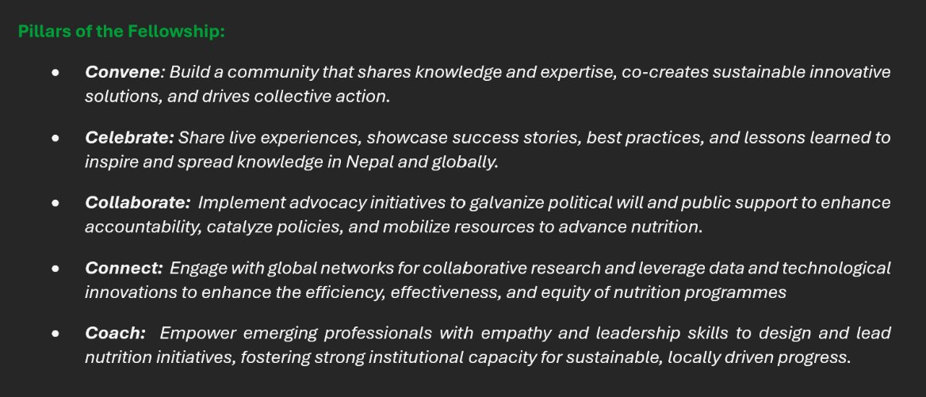

Slide 7
Overall Goal
Develop understanding and skills of young professionals in data analytics
Camp objectives: Assess and Analyze the country’s Global Commitments using real country data and recommend actions

Slide 9
Road map for the Initiative
Call to Action by Nutrition Fellowship
Conceptualization and workshop with key collaborators to shape with the initiative
Data Camps in colleges
Interaction with Advisory group +international advisors
Dissemination - with Gatekeepers
End of Feb

Slide 10
Road map for the Initiative
Call to Action by Nutrition Fellowship
Conceptualization and workshop with key collaborators to shape with the initiative
Data Camps in colleges
Interaction with Advisory group +international advisors
Dissemination - with Gatekeepers
End of Feb

Slide 11
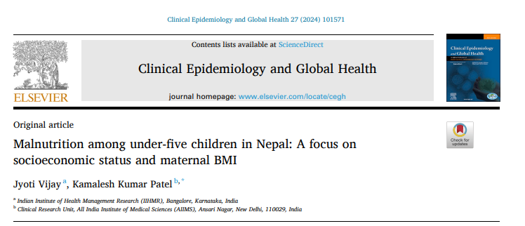
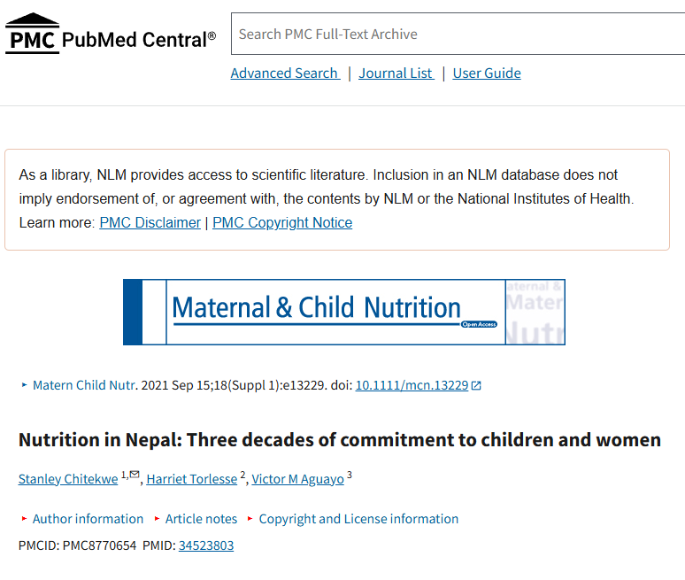
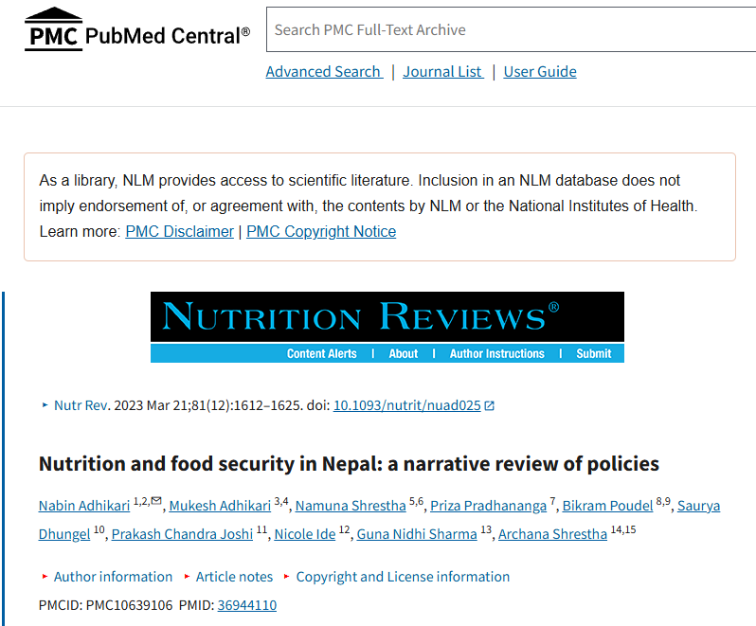
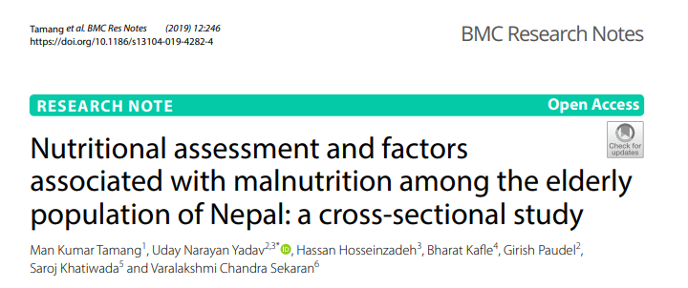

Slide 12
Nutrition Targets
Nutrition Targets By 2025
Reduction in stunting by 40%.
Reduction in anemia among women of reproductive age by 50%.
Reduction in low birth weight by 30%.
Ensuring no increase in childhood overweight.
Reduction and maintenance of wasting to less than 5%.
Increment in exclusive breastfeeding rates in the first six months up to at least 50%.

Slide 13
Nutrition Targets By 2030
Reduction in stunting among children under 5 by 50%.
A 50% reduction anemia among women of reproductive age remains the goal, maintaining the 2025 target due to challenges in achieving significant reductions.
Continuation in the goal of a 30% reduction in low birth weight.
Reducing the prevalence of child overweight to less than 3% globally.
Reduction in childhood wasting to below 3% prevalence.
Increased ambition in exclusive breastfeeding rates in the first six months beyond the progress rate between 2012 and 2025.

Slide 14
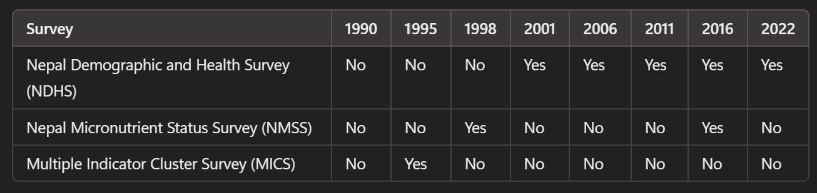
Survey Conducted

Slide 15
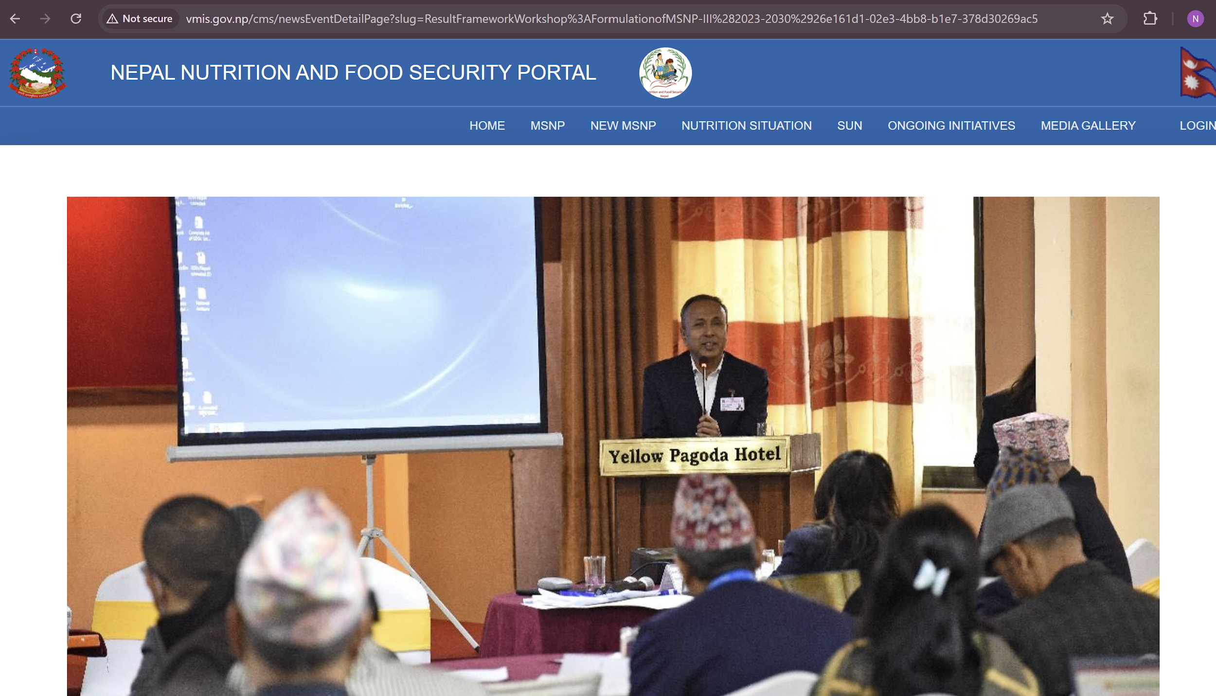
https://globalnutritionreport.org/resources/nutrition-profiles/asia/southern-asia/nepal/
https://www.unicef.org/nepal/nutrition
http://vmis.gov.np/cms/newsEventDetailPage?slug=ResultFrameworkWorkshop%3AFormulationofMSNP-III%282023-2030%2926e161d1-02e3-4bb8-b1e7-378d30269ac5

Slide 16
Tribhuvan University – Central Campus of Technology
Dharan, Nepal
Offers a Bachelor of Science in Nutrition and Dietetics (B.Sc. ND), a four-year program designed to produce graduates with clinical, public health, and management skills in nutrition.
Tribhuvan University – Central Department of Home Science
Kathmandu, Nepal
Provides a one-year Post Graduate Diploma in Dietetics and Public Health Nutrition, focusing on clinical and public health nutrition. CDHSC
College of Applied Food and Dairy Technology (CAFODAT)
Lalitpur, Nepal
Affiliated with Purbanchal University, CAFODAT offers a Master of Science in Nutrition and Dietetics, along with bachelor's programs in Food Technology and Dairy Technology. Cafodat
Tribhuvan University – Central Department of Public Health
Kathmandu, Nepal
Offers a Master in Public Health Nutrition, designed for individuals seeking professional training in nutrition applied to public health. Central Department of Public Health
Padma Kanya Multiple Campus
Kathmandu, Nepal
Offers a Master of Arts degree with a specialization in Food and Nutrition, focusing on community nutrition, dietetics, and applied nutrition.
Institute of Medicine (IoM) et al ???
Nutrition Academic Institution flora

Slide 17
Over the past two decades, Nepal has made significant investments in nutrition through various programs and initiatives. However, comprehensive data detailing the total financial investment in nutrition, specifically the portion allocated to monitoring, evaluation, and research, is limited.
While Nepal has demonstrated a commitment to improving nutrition through various programs and plans, obtaining precise figures on total investments and the specific amounts dedicated to monitoring, evaluation, and research remains challenging. Enhanced financial tracking and transparent reporting mechanisms are essential to better understand and optimize the allocation of resources in the nutrition sector.
Combining both bachelor's and postgraduate programs, Nepal may produce approximately 75 new nutritionists and dietitians annually.

Slide 18

30 Years of Vitamin A in Nepal: Celebrating FCHVs
Webinar-3
New value preposition of community-based vitamin A distribution & importance of community volunteers
Vitamin A campaign
Media/ FCHV/Youth interactions
Advocacy Month
&
Vit A campaign
WHA
side event
-Reinforce value of Vitamin A Supplementation and Call to Action
-Global Launch of FCHV documentary
Webinar-2
Contribution of NVAP in shaping public health
National FCHV day
Webinar-1
NVAP-saving millions of children in Nepal
National & Global blog and Article on FHCV
Advocacy meeting.
Media/ FCHV interactions
Culminating fund-raising event
FCHV installment WHA, Geneva
Global blog:
Vit A distribution-opportunity to address multiple deprivations
Inception & Cocreation
Ama ko Mukhernay
(Mothers Day)
Global Citizen Festival: New York
Jan
July
OCT
Feb
MAY
Mar
April
Activation of social media and public support campaign
Initiate Global Award Applications for FCHVs
-Concept note and road map
-Case studies from 3 districts (Nov)
-SMS survey to document youth awareness
-Content & COM strategy
-Media & social media campaign content
-FCHV/VItA Article based on case studies
Comm document on NVAP
-Policy Brief on NVAP
#InspitingWomenOfNepalFCHV launch
Case studies: different interventions delivered by FCHVs
-Joint #United4Nutrition statement with nutrition priorities
-5 M social media engagements appreciating 50,000 FHCVs contribution
-NRs 50M raised to contribute to
-Peer Journal on NVAP programme
-Communication Brief :
Vit A programmes where other services have been integrated, also to highlight opportunity to reach ZD and malnourished children
-10 countries participate in global webinar and agree to organize national advocacy campaign based on Nepal ‘s experiences (Diffusion)
-FCHV documentary
-Call to Action to Member States :
Value preposition of community-based Vit A distribution & to strengthen, scale and sustain Vit A distribution in x countries
Outputs & Products
Technical workstream
Advocacy/Com workstream

Slide 19
Students from colleagues
Road Map and Structure of the Group
Advisory Group
Ram dai Rajkumar ji Maharjan dai R.P Bicha
Steve ?? Purnima ?? ?? JHU/Parul Micheal DibblY ?? TUFFS ??
Technical Leads
Kalpana & 2 students Dibya & 2 students Sujay & 2 stundents PK campus
collaborators
Over 200 students from participating Universities & colleges
User Gate Keepers/ Beneficaries of the initative
NPC, UN Govt and I/NGOs & CSO
Coordination and support –Pragya Mathema & Sonu GC

Slide 20
Upcoming activities
Monthly Data Camps
Individual Coaching linked with Fellowship leadership
Realtime monitoring of Vitamin A campaign
Interaction with NPC and UNICEF
Reasach & fund raising support
Interaction with global research institutions
Use of IT technology –innovation
Optimizing application of social media

