Slide 1

Camel
On
Practice
VITALI KVIATKOUSKI

Slide 2
AGENDA
What is Apache Camel?
Async Processing
Reliability with Camel
Testing with Camel
Notes:
The main goal of this talk is share practical advices we’ve collected during work on our project that requires high reliability and fault tolerance. What issues we faced with and how we solved it.
As result, our plan is:
If you are not familiar with Camel, hopefully short introduction gives you insight on what it is, how it helps to deal with async processing issues. If you are experienced with Camel, it may uncover some advanced tips on raising reliability of your application. Also if you are familiar with Camel, but avoid testing the parts you write in it – I hope I can convince you this is pretty easy task.

Slide 3
Route
Message
Endpoint 1
Endpoint 2
Channel
Component1
Component2
Notes:
Apache Camel – framework for system integration. It helps to link different systems together establishing connections between systems called routes.
Simple route in camel consists of following parts:
Endpoints – in source endpoint application sends a message which is transferred on the channel to the target endpoint
On the way of transferring by the route, message can be intercepted, copied to another route, transformed and so on
Each endpoint is implemented by camel component which abstracts a particular system

Slide 4
Route
public class FileCopierWithCamel {
public static void main(String args[]) throws Exception {
CamelContext context = new DefaultCamelContext();
context.addRoutes(new RouteBuilder() {
@Override public void configure() {
from("file:data/indir?delete=true")
.to("file:data/outdir");
}
});
context.start();
Thread.sleep(10000);
context.stop();
}
}
Notes:
Example of simple application is on this slide. The most of this code is boilerplate one, essential parts are in bold.
It’s just 2 lines, but it does:
Move all files from data/indir folder to data/outdir
If more files in data/indir will appear while application is running, file component will detect this and move them too
Here we are using file component that allows to use file system, but there are many other components – for integration with JMS, Mail, FTP, Twitter and so on. You can even write your own component

Slide 5
Async Processing
Fast response to user
Work in background
Notify user on completion
Producer
Consumer
async
Notes:
Our project we work on, does many processing steps in async mode. And to be prepared for the discussion on reliability features Camel provides us, let’s shortly revisit what async processing.
Async processing usually is used if the request processing requires significant time or high load.
User gets immediate answer like “Your request is accepted” and all the hard work executed in background. And on completion, user is notified for example, by email
In this scheme we have
Producer who works in sync mode
Consumer who works in async mode and does the heavy work
What if during sync work error occurs? User will see the message from our app (stacktrace, http code 500) and will try to repeat the operation.
The issue with async processing is that if on the async processing step in consumer an error occurs, user request will stay in unknown state and user will never know about this.
What even worse, we will loose the message we’ve sent (which is our context) and consumer will not be able to try to process it once again using simple retry

Slide 6
Async Processing
Reliability, failover
Low requirements
Consumer scaling
Brokers: ActiveMQ, HornetQ
Producer
Broker
Consumer
async
async
Notes:
To mitigate this, we can introduce new component between producer and consumer called broker. Who accepts message from producer and keeps it until consumer will receive, read and acknowledge it
Other benefits of using broker is:
Low requirements on hardware for producer so it could be installed on separate not very performant server
Usually producer generates message slower than consumer can process it, so to keep consuming messages at the same speed as producing them, we can add more consumers that will run in parallel
At the moment there are many different brokers, most popular in java world are activemq and hornetq

Slide 7
Reliability with Camel
Notes:
How do you think, what camel features we can use to make our application more reliable (assume that our application sends async messages)?
Please write this in chat

Slide 8
Reliability with Camel
Using broker for messages
Error handling
Using transactions
Shutdown application properly
Notes:
Apache Camel helps to enable different features for making your application more reliable like the broker usage, error handling, transactions and correct shutdown. Let’s take a look what it can give us

Slide 9

Using broker for messages
ActiveMQ
JMS
Apache Camel supports Apache ActiveMQ
ActiveMQ implemented with Camel
Notes:
For our project we’ve chosen Apache ActiveMQ. It is most popular java message broker, implements JMS and is supported by camel. Even activemq inside is implemented with camel.

Slide 10
Error Handling
Error types
Recoverable
HTTP 5XX
Can use automatic redelivery
Irrecoverable
HTTP 4XX
Storing undelivered messages
Feedback to support team
Notes:
With async processing, you should treat error handling seriously.
If the request processing failed, first need to find out if it is recoverable or not:
Recoverable errors can disappear over time, so you can try to do message redelivery after some time. For example, when integrating with external services, you can get the http code 5xx just because there was no connection to DB, it was temporary lag and after a minute, it’s gone and retry will succeed
Unrecoverable errors over time do not disappear. When you request non-existing file, there is little chance it will appear anywhen. So the redelivery is useless in this case
Message should not disappear when the error happened, so we need to store it somewhere
Also when error appears, support team should be notified to immediately (or as soon as possible) to fix the issue.

Slide 11
Error Handling
Redelivery
Recoverable errors
Retry message processing
Activated by exceptions
Flexible Redelivery Policy
Store undelivered messages
Recoverable / Unrecoverable errors
Undelivered go to Dead Letter Channel
Notes:
Camel allows us to use for error handling following ways:
Redelivery (for recoverable errors), when message is delivered by route once again by route. Policy of redelivery (when to redeliver, what will be the pause, how many times to redeliver) can be flexibly set up
Not delivered messages can be rerouted to so called Dead Letter Channel. This is special route. We configure this route ourselves and decide what to do next. One of most popular ways – send all not delivered messages into special queue on broker for farther processing

Slide 12
Error Handling
Redelivery + Dead Letter Channel
<errorHandler id=“error“ deadLetterUri="direct:dlc" type="DeadLetterChannel">
<redeliveryPolicy maximumRedeliveries=“2" redeliveryDelay=“10000"/>
</errorHandler>
<route id="dlc.route">
<from uri="direct:dlc"/>
<setHeader headerName="exceptionStacktrace">
<simple>${exception.stacktrace}</simple>
</setHeader>
<to uri=“smtp://application@copyright.com?to=support@copyright.com”/>
<to uri="activemq:queue:dead.letter.queue"/>
</route>
Notes:
On this slide example of configuration of error handling
First we define what to do when error happened:
Camel tries to deliver message 2 more times (with the pause of 10 secs)
If attempts were not successful, message will be send by a route direct:dlc
We composed this direct:dlc route in such a way that:
In message we will add new header with stacktrace (for easier issue diagnostics)
Then message will be sent to support team by email
After that it will be put into queue dead.letter.queue on ActiveMQ broker

Slide 13
Using Transactions
DB Transactions
Message Transactions?
Notes:
Transactions are one more important tool helping to build reliable applications
And if it’s pretty clear with DB transactions (if they are supported – as in relational Dbs – then in most cases they are worth to use), then do we have transactions for messages?
How do you think do we?

Slide 14
Using Transactions
DB Transactions
Message Transactions?
Acknowledge modes
AUTO_ACKNOWLEDGE
CLIENT_ACKNOWLEDGE
DUPS_OK_ACKNOWLEDGE
SESSION_TRANSACTED
Notes:
In JMS specification there are 4 acknowledge modes. Let’s take a look at each (with the exclusion of DUPS_OK_ACKNOWLEDGE – it says there could be duplicates on the same message what does not always suit us)

Slide 15
Using Transactions
AUTO_ACKNOWLEDGE
If message is read then it is delivered
Producer
Broker
Consumer
message
message
processing
Message not processed and lost
Consumer failure
Notes:
Plan ahead how to fix the issue?
AUTO_ACKNOWLEDGE mode
If the message is read from broker than it is delivered. As soon as it was read, it gets deleted from broker. If the message processing failed, the message is gone.
To deal with simple case (network lag) we can use retry and redelivery, but what if the lights went down or consumer suddenly just died? Or the exception is NPE and is essentially not recoverable?
How to fix the issue?

Slide 16
Using Transactions
AUTO_ACKNOWLEDGE
If message is read then it is delivered
Producer
Broker
Consumer
message
message
processing
Message not processed and lost
Consumer failure
CLIENT_ACKNOWLEDGE helps
Notes:
CLIENT_ACKNOWLEDGE mode helps here

Slide 17
Using Transactions
CLIENT_ACKNOWLEDGE
Spring JMS accepts itself (only after full processing)
Producer
DB
Broker
Consumer
insert order(id=1)
message
message
Select order (id=1)
Notes:
With CLIENT_ACKNOWLEDGE – message is considered to be read only after full processing. Spring JMS do this itself so when it’s passed by the route, it’s automatically acknowledged by spring jms, you don’t need to do anything
Ok, let’s imagine producer stores record about order in DB and sends message about order to consumer, after that (with help of aspect oriented programming) commits changes to DB. Consumer reads record from DB and does something with it.
So, with flow as displayed on this slide, will it work ok? Please write to chat yes/no. Let’s do voting

Slide 18
Using Transactions
CLIENT_ACKNOWLEDGE
Spring JMS accepts itself (only after full processing)
Producer
DB
Broker
Consumer
insert order(id=1)
message
message
Order (id=1) not yet visible outside of transaction on producer
Select order (id=1)
automatic commit
Notes:
No. This mode solves all issues on consumer, but does not solve following issue on producer: in theory (and often on practice) it may happen that consumer reads record from DB faster than producer commits. Result is predictable, this order is absent in DB.

Slide 19
Using Transactions
SESSION_TRANSACTED
Message is sent only after JDBC transaction commit
Producer
DB
Broker
Consumer
insert order(id=1)
request to send
automatic commit
message
message
Select order (id=1)
Notes:
Mode SESSION_TRANSACTED fixes this issue. All read messages are not accepted until fully processed (like with prev CLIENT mode). In addition all sent messages will appear on broker only after transaction in DB is explicitly committed.
Also the bonus here:
- With transaction rollback messages will not be sent

Slide 20
Shutdown application properly
Ctrl+C, shutdown the application server
All inflight messages (on a route) will be processed
New messages will not be consumed
Attempt to send message after stop signal results in exception
Notes:
It’s also important how application will behave on stop signal – for example, when we deploy a new version of application
Camel allows to defer final application shutdown until all the inflight messages are processed. At the same time, new messages will not be consumed.
The issue is attempt to send message after stop signal will result in exception what is probably not what we want.
To change this behavior, we can use deferred routes.
How to handle this issue, suggestions?

Slide 21
Shutdown application properly
Ctrl+C, shutdown the application server
All inflight messages (on a route) will be processed
New messages will not be consumed
Attempt to send message after stop signal results in exception
Except deferred routes
Notes:
It’s also important how application will behave on stop signal – for example, when we deploy a new version of application
Camel allows to defer final application shutdown until all the inflight messages are processed. At the same time, new messages will not be consumed.
The issue is attempt to send message after stop signal will result in exception what is probably not what we want.
To change this behavior, we can use deferred routes.

Slide 22
Deferred Routes
Example of messages flow
Broker
document.available
Document Processor
notify.user
Broker
Notify User Processor
notify.user
Notes:
Let’s take a look at typical scenario
User requests some document. Message is sent on broker and then gets processed by Document Processor, which send another message notify.user that in turn is processed by Notify User Processor which sends an email

Slide 23
Deferred Routes
Example of messages flow
Broker
document.available
Document Processor
Route2
Broker
Route1
notify.user
Notify User Processor
Route3
notify.user
Notes:
Here we have 3 routes – as shown on a slide

Slide 24
Deferred Routes
Example of messages flow
Ctrl+C
Broker
document.available
Document Processor
X
Broker
Route2
Route1
notify.user
Notify User Processor
Route3
X
notify.user
Notes:
If during message processing in Document Processor application will get a stop signal (Ctrl+c), then it’s clear with notify.user consuming – it will not be received by Notify User Processor. But why? It will not be received just because it will not be send – instead on attempt to send notify.user message we will get an exception

Slide 25
Deferred Routes
Example of messages flow
Ctrl+C
Broker
document.available
Document Processor
Route2
Broker
Route1
notify.user
Notify User Processor
Route3
X
notify.user
<route id=“notify.user.producer" shutdownRoute="Defer">
<to uri=“activemq:notify.user.queue" />
Notes:
But if we mark second route (with notify.user message) as deferred (with help of shutdownRoute attribute) as mentioned in DSL on this slide, then message will be delivered on broker, but won’t be consumed. Because we are shutting down. It will be processed either on another host in another consumer or on this host when we start consumer again

Slide 26

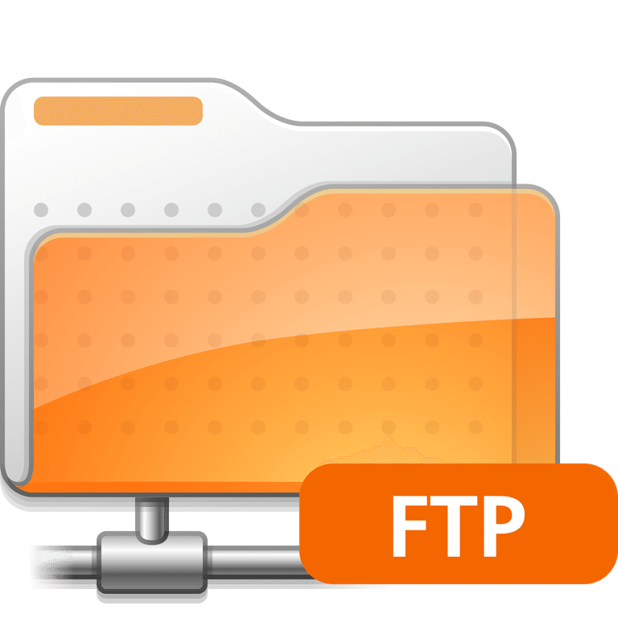
Master/Slave
Notes:
For the next tip, let’s try to solve following issue. You want your application to consume files from ftp. This means, read file, process it, delete it. Most probably, if you care about reliability, you have 2 instances of this application for failover. If there are two of them, they work in parallel and may read and process the same file at the same time. This is not what we want. What we want, to have only one processor active, another should be inactive in this case.
How to achieve this?
Your suggestions?

Slide 27
Master/Slave
Notes:
You can just disable the consuming functionality on one host with help of configuration property (so the whole ftp consuming is turned off)

Slide 28
Master/Slave
Notes:
But then, if the remaining host goes down, nobody is processing the ftp – so why we ever cared for two hosts and failover?

Slide 29
Master/Slave
Master
Slave -> Master
Notes:
Better solution would be to say that we have a kind of master/slave configuration. When the master goes down, slave detects this and becomes master

Slide 30

Master/Slave
Master
Zookeeper
Slave -> Master
Notes:
We can use zookeeper server for this scenario. Both master and slave register on zookeeper server. Who registered first is elected as master. Later if master goes down, slave is elected as new master

Slide 31
Master/Slave
The Master is dead.
Long live the Master!
Notes:
So how complex should be doing such a thing?
Your suggestions? One line, 10, 100?

Slide 32
Route Policy for failover
<bean id="zPolicy" class="org.apache.camel.component.zookeeper.policy.ZooKeeperRoutePolicy"
c:uri="zookeeper:localhost:2161/myApp"
c:enabledCount="1"/>
<route routePolicyRef="zPolicy">
<from uri=“ftp”/>
<to uri=“bean:myProcessor”/>
</route>
Notes:
The solution to this problem is pretty simple – you would need to declare zookeeper policy bean and refer to it in route you need.

Slide 33
Testing
Notes:
Let’s talk a bit about testing. When writing application for camel, we usually create different integrated parts – we create processors that consume the message at the end of route and do the logic, we write routes.
What from this parts would test?

Slide 34
Testing
Processors are just POJOs
So unit tests are enough
Notes:
Camel tries to be very lightweight framework and all parts that developer writes – mostly POJOs that could be easily tested with unit tests

Slide 35
Testing
Processors are just POJOs
So unit tests are enough
Route config requires testing too
Integration if possible
With embedded broker
Notes:
But developer writes routes as well, so it would be nice to test them too. And if routes involve broker, it would be nice to use it too to check correct integration

Slide 36
Testing: Embedded ActiveMQ
<bean id="activemq" class="ActiveMQComponent“
<property name="connectionFactory">
<bean class="ActiveMQConnectionFactory"
p:brokerURL="vm://myBroker?broker.persistent=false" />
</bean>
</property>
</bean>
Broker is auto-started on tests run
No need in any additional config
Queues creates on-the-fly
Messages DB created on-the-fly (stored in RAM)
Notes:
Fortunately ActiveMQ supports such working mode. On this slide we can see example of configuration that will automatically start broker in process of JVM. Also internal ActiveMQ database for message storing will reside in memory (so no need to clean file system after tests).
No additional configuration needed.

Slide 37
Testing: Mocks
Mocks can replace endpoints with mock-objects
<from uri=“direct:start”>
<to uri=“mock:result”>
Notes:
Also for testing routes Camel has own mocks that allow to specify a mock object as endpoint,

Slide 38
Testing: Mocks
…and make assertions
@EndpointInject(uri="mock:result")
MockEndpoint endpoint;
@Produce(uri="direct:start")
ProducerTemplate tpl;
@Test public void testSendMessage() {
String body = "<matched/>";
endpoint.expectedBodiesReceived(body);
tpl.sendBody(expectedBody);
endpoint.assertIsSatisfied();
}
Notes:
We can make some assertions on it and after message is processed, verify them.
Also Camel supports Spring and allows to use annotations for dependency injection in test classes
So I hope I intrigued you enough to give Camel a try if you never used it or uncovered some tips with it you didn’t know about.

Slide 39


Slide 40

THANK YOU!

