Slide 1

Microservices
On
Practice
VITALI KVIATKOUSKI

Slide 2
AGENDA
Intro
Team
Infrastructure
Microservices Design
Data
Interaction
Failures
When to use

Slide 3
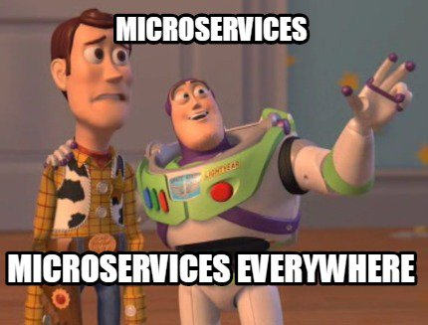

Slide 4




Architecture Type
Application as monolith
Application as microservices
Notes:
Most probably you’ve either heard about microservices or already using them. So we will only touch the definition here.
With traditional approach the whole system, whole implemented logic is packed as one big application. Such application is called monolithic because it is developed, released and deployed as a whole.
With microservices architecture, on the contrary, the system is represented as set of services that are loosely coupled together and thus can be developed and deployed separately.
This approach to application architecture has been formed and applied for many years in some forms, but was described in details more-less recently.
There is a good article in Martin Fowler blog that describes main principles of microservices architecture and team work.
This presentation describes what patterns and principles were most important for our team and worked well for us.

Slide 5
Business Capabilities
Separate services for different needs
reporting
payments
Separate teams
Production Support
Creating additional tools / applications
Notes:
First thing that is different – it is oriented
Separate services are created for different customer needs. They are created by separate teams, and each team is responsible for its own one. Including production support.
With traditional approach team split into those who works with database, business logic level, frontend level and so on.
With microservices approach, because service most often is pretty simple itself, developer has to work on all layers and understand the business of customer and this particular service.
Different issues raised on production, force team to create additional tools and applications to help to diagnose and maintain product. In our case, we created completely new additional application that was not even planned but helped us with support

Slide 6
Infrastructure
Separate envs (QA/DEV/DEMO)
Align environment config (chef)
Monitoring (Zabbix)
Automation is a must have
Notes:
Infrastructure for microservices, due to its distributed nature, plays important role.
It’s practical to have several separate environments – for development, testing, production. At the same time, infrastructure of those envs should be aligned and be similar if not the same. This means the same OS, java version, application server. This will help to avoid many different strange and hard to diagnose issues because of environment differences.
As there are many rather small services, chance one of them goes down is bigger than for one huge application. And when it happens, we’d like to know it so the monitoring is must have.
And environment set up and deploy should be automated as much as possible

Slide 7
Infrastructure Automation
Automated DB scripts (liquibase)
Automated data migration
Automated deployment (Jenkins)
Notes:
Automation is so important for microservices because of amount of services and their deployment complexity.
Our team uses following practices:
Database structures are created and changed evolutionary, according to demands of currently deployed application. Each time, during deploy, new portion of scripts (we are using such tool as liquibase) runs over database.
But already existing data in database should be migrated too. We need to transform them according to changed database tables – and we write either liquibase scripts to do data migration or separate run-and-throw-away java tool
The whole lifecycle is automated using CI server (Jenkins in our case).
Jenkins always checks application can compile and pass tests.
Helps to release application and place it in artifactory
Then, using chef scripts, deploy final application version on integration environment to check integration.
Last part installed application is verified using automated user acceptance testing
Each this step is triggered by hitting one button only

Slide 8
Automated Deployment
Workflow
Check (unit + integration tests)
Release (artifactory)
Deploy (chef)
Accept (selenium)
One-button deployment
Notes:
Automation is so important for microservices because of amount of services and their deployment complexity.
Our team uses following practices:
Database structures are created and changed evolutionary, according to demands of currently deployed application. Each time, during deploy, new portion of scripts (we are using such tool as liquibase) runs over database.
But already existing data in database should be migrated too. We need to transform them according to changed database tables – and we write either liquibase scripts to do data migration or separate run-and-throw-away java tool
The whole lifecycle is automated using CI server (Jenkins in our case).
Jenkins always checks application can compile and pass tests.
Helps to release application and place it in artifactory
Then, using chef scripts, deploy final application version on integration environment to check integration.
Last part installed application is verified using automated user acceptance testing
Each this step is triggered by hitting one button only

Slide 9
Microservices Design
Decentralized data
Services interaction
Interaction types
Failure design
Notes:
We took a look at how to organize teams and infrastructure.
Let’s take a look at something called decentralization of data

Slide 10
Decentralized Data
Separate storages
polyglot persistence
MongoDB/PostgreSQL
No direct access to storages of other services
Article Management
Orders
REST
MongoDB
PostgreSQL
Notes:
Each microservice can use its own storage and own kind of storage, the one that fits microservice needs better.
Also the thing called as Polyglot Persistence is welcomed. With polyglot persistence different parts of information is distributed between separate databases.
In our case, author articles (which are complex documents) are stored in object storage (MongoDB) and orders we store in transactional relational storage (PostgreSQL) which is better suited for transactions and reporting.
The most important concept, shown on this slide – client of microservice never gets access to database directly. Instead it uses API exposed by microservice (most often it is REST).

Slide 11
Microservices Design
Decentralized data
Services interaction
Interaction types
Failure design
Notes:
We briefly touched this on prev slide, but let’s take a close look at how microservices interact with each other

Slide 12
Interaction
Protocols
Documentation (must have)
Standardization (protocols / formats to use)
REST/JMS with JSON as format
Client Libs
Interaction type
sync
async
Notes:
Most popular protocols of interaction are:
Exposing REST API
Exchanging asynchronous messages (in case of java it will be jms)
The most important point is that interaction protocol should be well documented.
Also its better to agree among all services what protocols and formats to use.
Microservice can also provide client library to ease the access to it. Such library not only can ease the access, but it also server the documentation purpose and so on
Type of interactions (sync / async) should be chosen wisely depending on scenario
Be ready for failures – it’s such a huge topic that we will return to it.

Slide 13
Microservices Design
Decentralized data
Services interaction
Interaction types
Failure design
Notes:
So we took a look at data decentralization and now can ask the question “How do services interact with each other?”

Slide 14
Synchronous Interaction
As fast as possible
Everything what requires user attention
2-3 secs
Use cache
Guava in-process cache
sync
sync
async
Storing Order
Charge Money
Create License
Notes:
Synchronous interaction is usually used for read operation in because we need to show the results of right away to user
With sync interaction the request should be processed as fast as possible. If it spans more 2-3 seconds, it should become async one.
For example, in our system, ordering an item consists of 3 steps
Storing order in database
Charing money from credit card
Creating license in financial system
We can’t make first two steps async, because they require user attention. The last one (license creation) can well be made async, because it is rather heavyweight and if error happens, user anyway can’t fix it.
Also when retrieving data from microservice, it may make sense to use caching. If the amount and size of data is not big, in-process Guava cache can be used as lightweight and very fast solution.

Slide 15
Asynchronous Interaction
Client
Microservice
Request
Store
Return request ID
Microservice
DB
Save + ID
Client DB
Process
Update status
Message about completion
Request status
Notes:
With async interaction we use following scheme that simplifies support in case of issues.
First request of client accepted by microservice. It is also important to create unique request identifier and use it throughout all the services for easier identication of this particular request (really helps for tracing and logging)

Slide 16
Asynchronous Interaction
Client
Microservice
Request
Store
Return request ID
Microservice
DB
Save + ID
БД Клиента
Process
Update status
Message about completion
Request status
Notes:
Then the request descriptor is stored in DB…

Slide 17
Asynchronous Interaction
Client
Microservice
Request
Store
Return request ID
Microservice
DB
Save + ID
Client DB
Process
Update status
Message about completion
Request status
Notes:
…and id of accepted request is returned to the client

Slide 18
Asynchronous Interaction
Client
Microservice
Request
Store
Return request ID
Microservice
DB
Save + ID
Client DB
Process
Update status
Message about completion
Request status
Notes:
Client in its turn saves it’s own copy of descriptor in his database and can periodically (if does not support async messaging) check for request status to see if the async processing is completed

Slide 19
Asynchronous Interaction
Client
Microservice
Request
Store
Return request ID
Microservice
DB
Save + ID
Client DB
Process
Update status
Message about completion
Request status
Notes:
At the same time, microservice process the request asynchronously

Slide 20
Asynchronous Interaction
Client
Microservice
Request
Store
Return request ID
Microservice
DB
Save + ID
Client DB
Process
Update status
Message about completion
Request status
Notes:
… and when it’s complete, updates the status of request in DB…

Slide 21
Asynchronous Interaction
Client
Microservice
Request
Store
Return request ID
Microservice
DB
Save + ID
Client DB
Process
Update status
Message about completion
Request status
Notes:
... And send async message to th.e client that processing is complete.
With this scheme we have descriptors of request with processing statuses and so on on both sides. This can look like overhead, but this really help with digging into issues on the microservice side.

Slide 22
Microservices Design
Decentralized data
Services interaction
Interaction types
Failure design
Notes:
By distributed nature and due to amount of microservices they could be more fragile that a monolith

Slide 23
Failures
Be ready for failure
Be ready to recover
Find failure points
Define how to recover
Sync – client-side
responsible: user
Async – service-side
responsible: developer
Notes:
So first of all we should be ready for failure and design your application with expectation that if something can fail in this place, it will fail.
After it failed, you should be ready to recover. Recover data or system state. For example, if in previous example async processing failed, we need to prescribe support what it needs to do.
Also you need to find failure points. In previous example there are more than enough:
Microservice DB can be unavailable
Client DB can be unavailable
Async processing failed
Async message sending failed
We need to define how to recover:
Sync interaction – on the client side, show user error and ask to retry action once again
Async – on the service side processing failed, automatically try to execute it again
Responsible in this case is developer, who need to predict and have ways to mitigate the issue

Slide 24

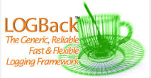

Design for failure
Find failure
Monitoring
Exhaustive logging
Quick fix
Automatic
Redelivery
High Availability
Manual
Checking emails
Notes:
When designing for failure, first we need to find failure. To check if all parts of application works correctly, we use exhaustive logging with help of logback and logs with warn and error level are tracked by centralized logging collector (splunk). Who sends emails to dev and support team with stacktrace included
After issue uncovered, it needs to be fixed and as fast as possible. Here we have 2 ways:
Automatic fix
Manual fix
Automatic fix helps to mitigate most of the failures.
So, automatic redelivery (when we just try once again to execute the same action) helps to fix errors related to temporary network lags or DB unavailability.
Also High Availability helps to hide server failure, assigning the request handling to another (alive) server.
Manual fix on the other side, requires human work and special attention to each found error, when automatic redelivery can’t help.

Slide 25
Redelivery and DLQ
Broker
ActiveMQ
read
Consumer
request
Queue1
Redelivery (X attempts)
move
DLQ
view
fix
Support team
Notes:
Automatic redelivery is indeed very powerful tool.
It is best suited for async messages. In this case on middleware storage called broker comes request from client that is placed into Queue1

Slide 26
Redelivery and DLQ
Broker
ActiveMQ
read
Consumer
request
Queue1
Redelivery (X attempts)
move
DLQ
view
fix
Support team
Notes:
Consumer read the message and tries to process it

Slide 27
Redelivery and DLQ
Broker
ActiveMQ
read
Consumer
request
Queue1
Redelivery (X attempts)
move
DLQ
view
fix
Support team
Notes:
If the processing was unsuccessful, action is executed again and again, up to X attempts

Slide 28
Redelivery and DLQ
Broker
ActiveMQ
read
Consumer
request
Queue1
Redelivery (X attempts)
move
DLQ
view
fix
Support team
Notes:
If all the attempts to redeliver failed, then message goes to special queue called DLQ

Slide 29
Redelivery and DLQ
Broker
ActiveMQ
read
Consumer
request
Queue1
Redelivery (X attempts)
move
DLQ
view
fix
Support team
Notes:
This queue is monitored by support team and who see the issue and tries to fix it

Slide 30
Redelivery and DLQ
Broker
ActiveMQ
read
Consumer
request
Queue1
Redelivery (X attempts)
move
DLQ
view
fix
Support team
Notes:
Support team changes the message or the state of system. And then sends the message back to Queue1 and the whole cycle starts once again

Slide 31



Failover
2
App Server
Amazon ELB
Schedule (Quartz)
clustering in DB
Routes (Camel)
zookeeper policy
Notes:
One more good point in ensuring reliability of a system is failover.
For failover we use number 2. Each application or storage exists on production in two instances. And this relates to everything!
In front of tomcat we have amazon balancer to distribute the load and exclude one tomcat instance if it fails, redirecting all user requests to second instance
Scheduled activities that we run at fixed time should happen only once at a given time and we can’t explicitly turn it off on one instance of application, because if the instance with enabled jobs fails, we loose the scheduled activities. But quartz clustering feature allows to do failover – if application instance crashes, second instance will start running those scheduled activities
Also there are cases when for example, we need to read file from ftp, process it and delete, but do this only once. And if we implement this consumer, it will run inside two application instances and start consuming the same file in parallel, what is not what we want. But if we implement consumer using Camel, it has a nice feature that allows an application to register in centralized service like zookeeper and enable routes that become active and consuming on one host only

Slide 32













What we use?
Core
Integration
DevOps
Notes:
On this slide you can see the tech stack we are using on a project.
Key note here is that though microservices support and encourage polyglot persistence, polyglot platform (use other langs that suit better), polyglot pretty everything, we strive to have core technologies unified. So we do not use anything except java, we have only one build tool – gradle, deploy on tomcat only etc. We use one deploy tool, one monitoring tool, one log collecting tool. This helps to ensure we do not have duplication of tools that would require doubled IT support. This helps to ensure we have expertise – maybe not wide covering several similar tools, but narrow – specializing in one tool.
Event for persistence and integration (in the middle column of slide), project feels free to choose type of storage that suits better (be it document storage, file storage or search engine), but within the type of storage, there is only one approved option.

Slide 33
What we have?
ROA File Processor
ROA Admin
Reprints
ROA REST 1
PRM
Promotions
ROA Payment
RLNK
ROA REST 2
ROA Pubportal
Payment
CRM Integ
Tax
Reporting
Notifications
Foreign Exchange
Notes:
16 applications / services

Slide 34
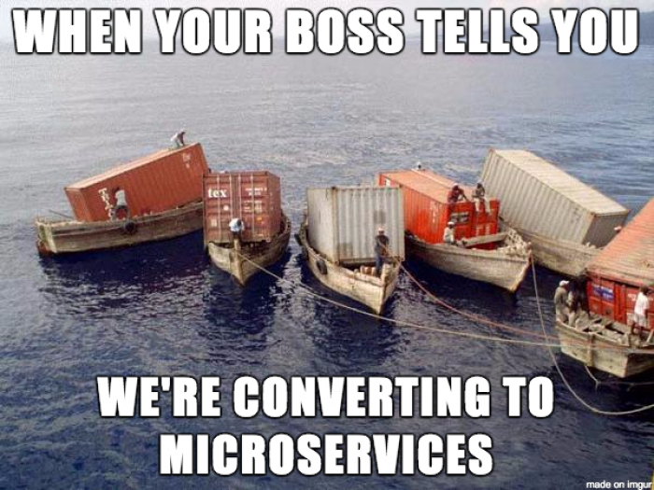
Notes:
As usually it’s not a silver bullet

Slide 35
When to use Microservices
System is too big
Team is too big
System is too complicated
System is too new
Notes:
System is too big
and it just does not fit on one server
Team is too big
And distributed
System is too complicated
Complicated to understand
Complicated to develop
Complicated to deploy
In this case splitting it into services won’t solve the complexity problem but allows to abstract away
System is too new
Allows to isolate legacy applications as more microservices
That’s how our product was born

Slide 36


Slide 37
THANK YOU!

