Slide 1


iTechArt
Group
2021
itechart.com

Slide 2
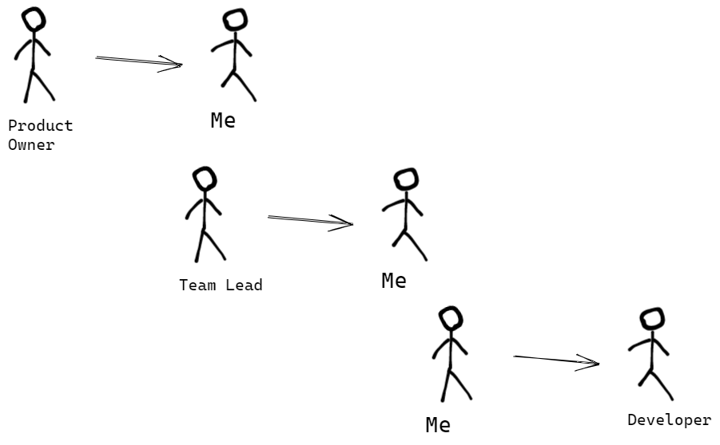

Slide 3
C4
Context
Container
Component
Class

Slide 4
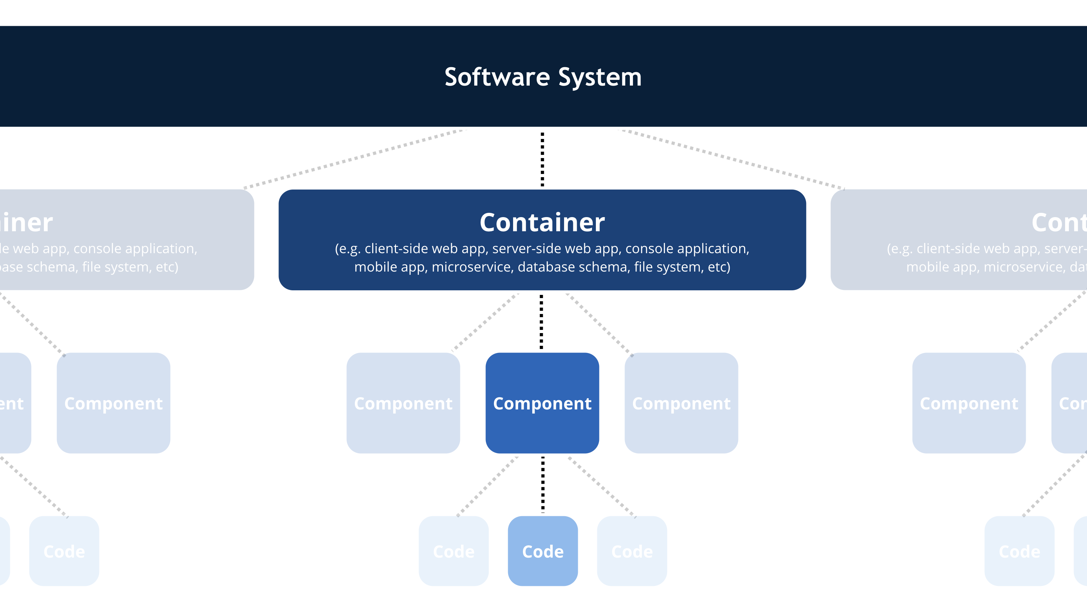
C4
Context
Container
Component
Class

Slide 5
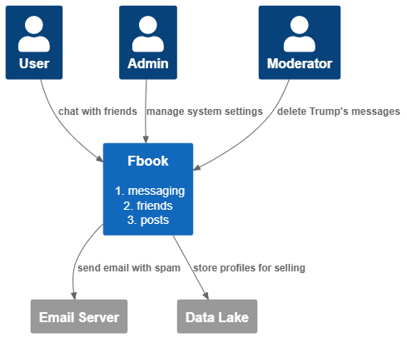
Context
Content, not format
Colors
Details matter

Slide 6
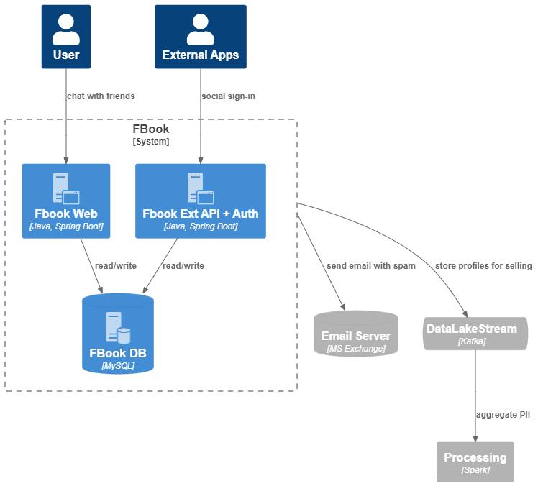
Container

Slide 7
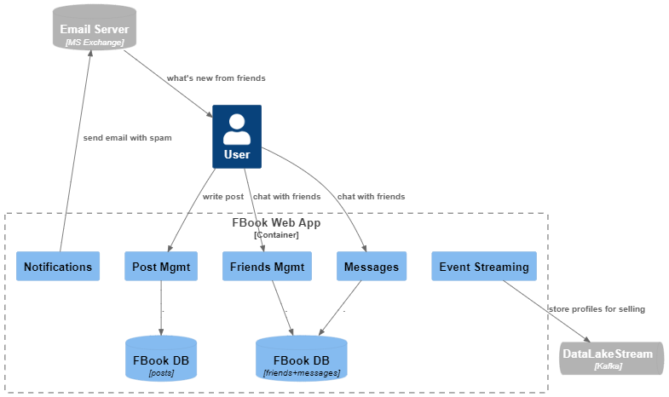
Component

Slide 8
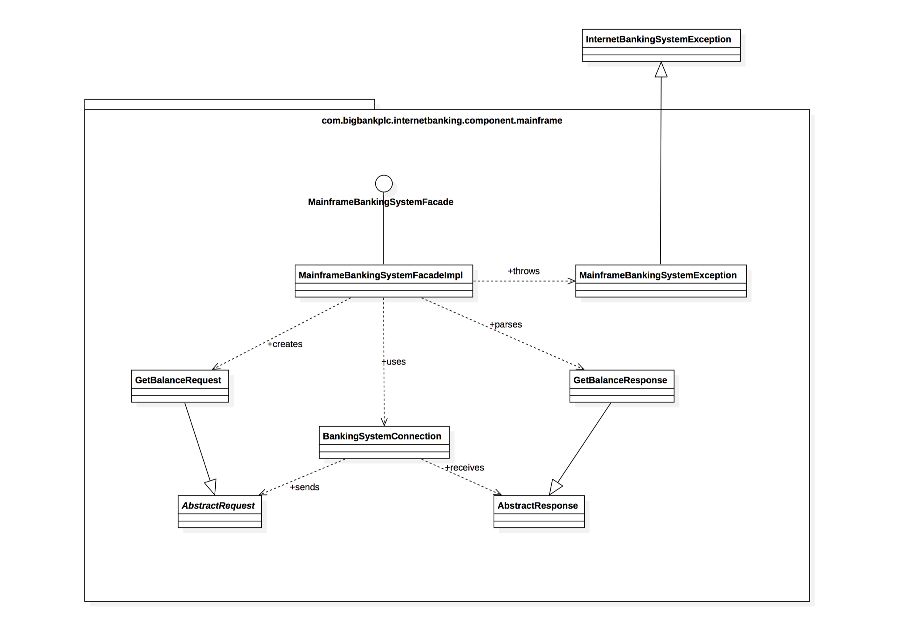

Class

Slide 9
Plantuml extension

Slide 10
c4model.com

