Slide 1
Building domain-specific languages with Groovy
Yaroslav Yermilov
Senior Software Engineer, EPAM Systems

Slide 2


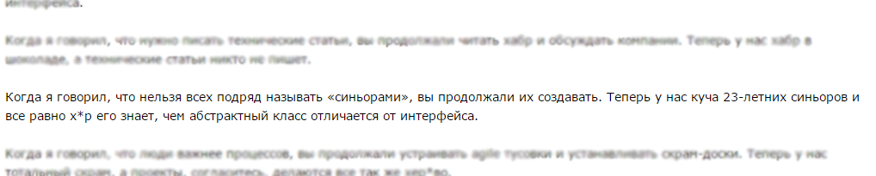
About me
Yaroslav Yermilov
Senior Software Engineer, student
https://ua.linkedin.com/pub/yaroslav-yermilov/58/682/506
https://www.facebook.com/yaroslav.yermilov
https://twitter.com/yermilov17
fond of Java, complete code, big data, data science, Groovy
http://megamozg.ru/post/7256/

Slide 3


DSL?
A domain-specific language (DSL)
is a computer language specialized to
a particular application domain. This
is in contrast to a general-purpose
language (GPL), which is broadly
applicable across domains, and
lacks specialized features for a particular domain.
A domain-specific language (DSL)
is a computer language specialized to
a particular application domain. This
is in contrast to a general-purpose
language (GPL), which is broadly
applicable across domains, and
lacks specialized features for a particular domain.
http://en.wikipedia.org/wiki/Domain-specific_language

Slide 4
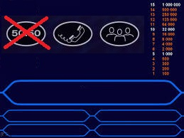
Quiz!
DSL or not a DSL?
DSL
NO
https://github.com/yermilov/groovy-dsl/tree/develop/examples/dsl-or-not-a-dsl

Slide 5
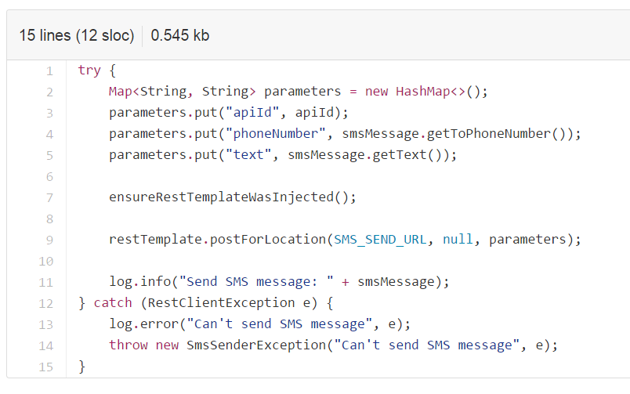
Quiz!
DSL or not a DSL?
DSL
NO
https://github.com/yermilov/groovy-dsl/tree/develop/examples/dsl-or-not-a-dsl

Slide 6
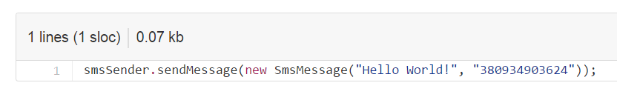
Quiz!
DSL or not a DSL?
DSL
NO
https://github.com/yermilov/groovy-dsl/tree/develop/examples/dsl-or-not-a-dsl

Slide 7
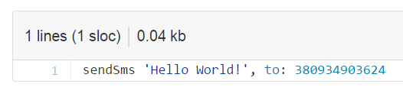
Quiz!
DSL or not a DSL?
DSL
NO
https://github.com/yermilov/groovy-dsl/tree/develop/examples/dsl-or-not-a-dsl

Slide 8
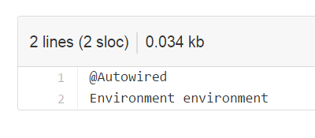
Quiz!
DSL or not a DSL?
DSL
NO
https://github.com/yermilov/groovy-dsl/tree/develop/examples/dsl-or-not-a-dsl

Slide 9
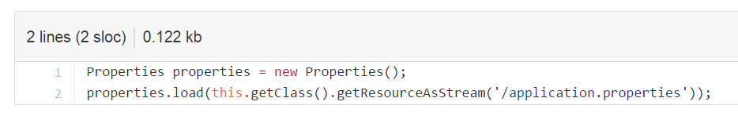
Quiz!
DSL or not a DSL?
DSL
NO
https://github.com/yermilov/groovy-dsl/tree/develop/examples/dsl-or-not-a-dsl

Slide 10
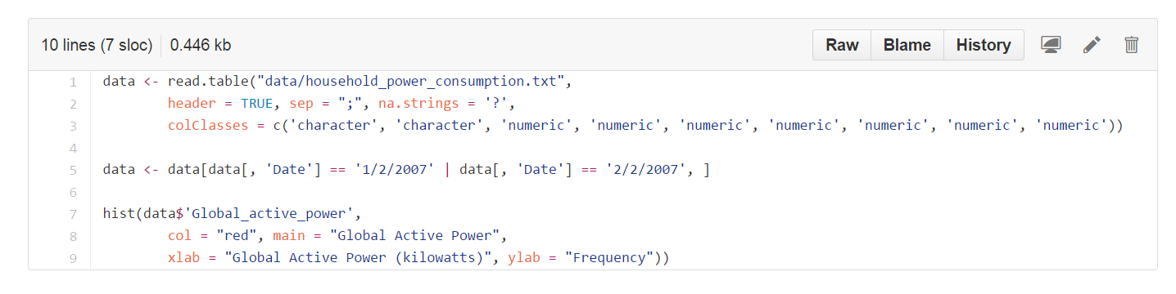
Quiz!
DSL or not a DSL?
DSL
NO
https://github.com/yermilov/groovy-dsl/tree/develop/examples/dsl-or-not-a-dsl

Slide 11
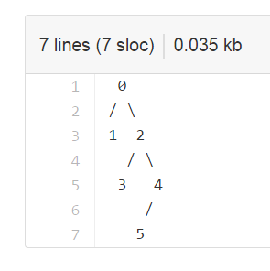
Quiz!
DSL or not a DSL?
DSL
NO
https://github.com/yermilov/groovy-dsl/tree/develop/examples/dsl-or-not-a-dsl

Slide 12
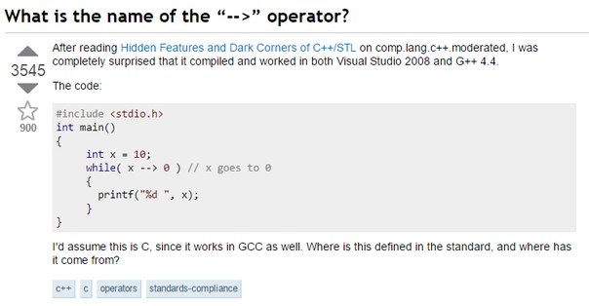
Quiz!
DSL or not a DSL?
DSL
NO
http://stackoverflow.com/questions/1642028/what-is-the-name-of-the-operator

Slide 13

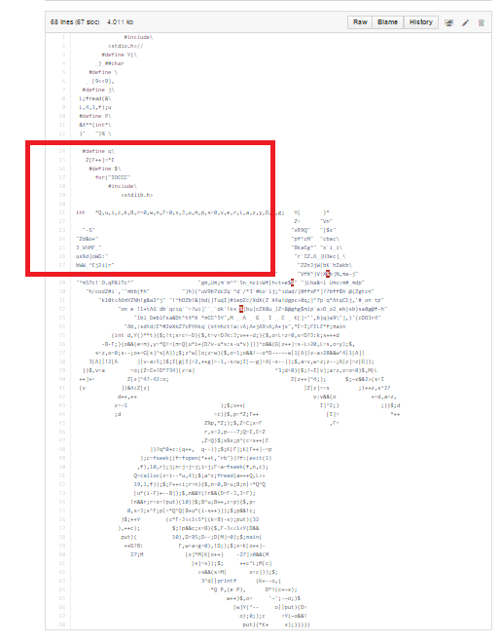
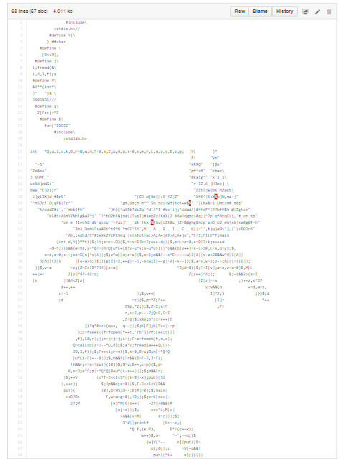
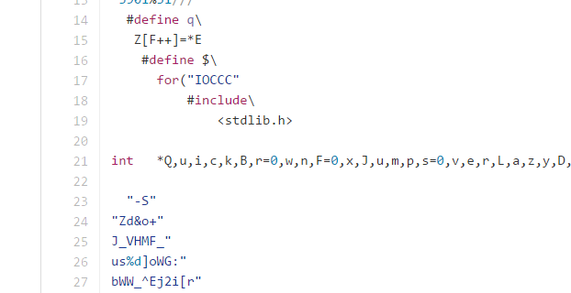
Quiz!
DSL or not a DSL?
DSL or not a DSL?
DSL
DSL
NO
NO
https://github.com/yermilov/groovy-dsl/tree/develop/examples/dsl-or-not-a-dsl

Slide 14



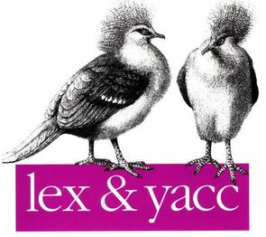

How to build DSL?

Slide 15


Groovy?
Groovy is a powerful, optionally typed and dynamic language, with static-typing and static compilation capabilities, for the Java platform aimed at multiplying developers’ productivity thanks to a concise, familiar and easy to learn syntax. It integrates smoothly with any Java program, and immediately delivers to your application powerful features, including scripting capabilities, Domain-Specific Language authoring, runtime and compile-time meta-programming and functional programming.
Groovy is a powerful, optionally typed and dynamic language, with static-typing and static compilation capabilities, for the Java platform aimed at multiplying developers’ productivity thanks to a concise, familiar and easy to learn syntax. It integrates smoothly with any Java program, and immediately delivers to your application powerful features, including scripting capabilities, Domain-Specific Language authoring, runtime and compile-time meta-programming and functional programming.
http://www.groovy-lang.org/
Groovy is a powerful, optionally typed and dynamic language, with static-typing and static compilation capabilities, for the Java platform aimed at multiplying developers’ productivity thanks to a concise, familiar and easy to learn syntax. It integrates smoothly with any Java program, and immediately delivers to your application powerful features, including scripting capabilities, Domain-Specific Language authoring, runtime and compile-time meta-programming and functional programming.
http://www.groovy-lang.org/
Groovy is a powerful, optionally typed and dynamic language, with static-typing and static compilation capabilities, for the Java platform aimed at multiplying developers’ productivity thanks to a concise, familiar and easy to learn syntax. It integrates smoothly with any Java program, and immediately delivers to your application powerful features, including scripting capabilities, Domain-Specific Language authoring, runtime and compile-time meta-programming and functional programming.

Slide 16
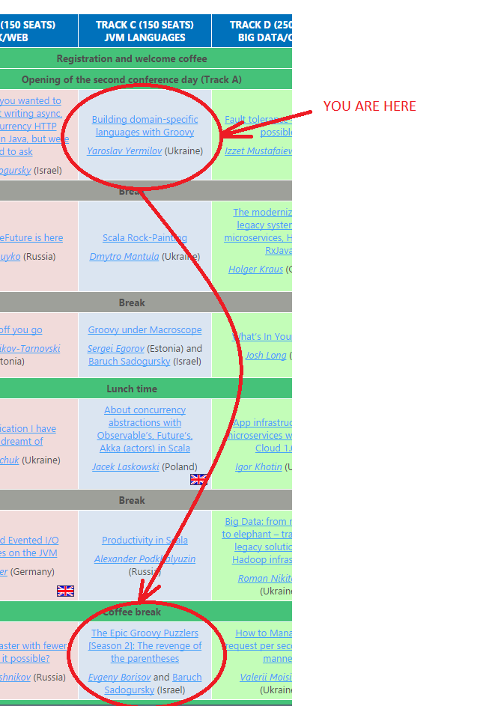


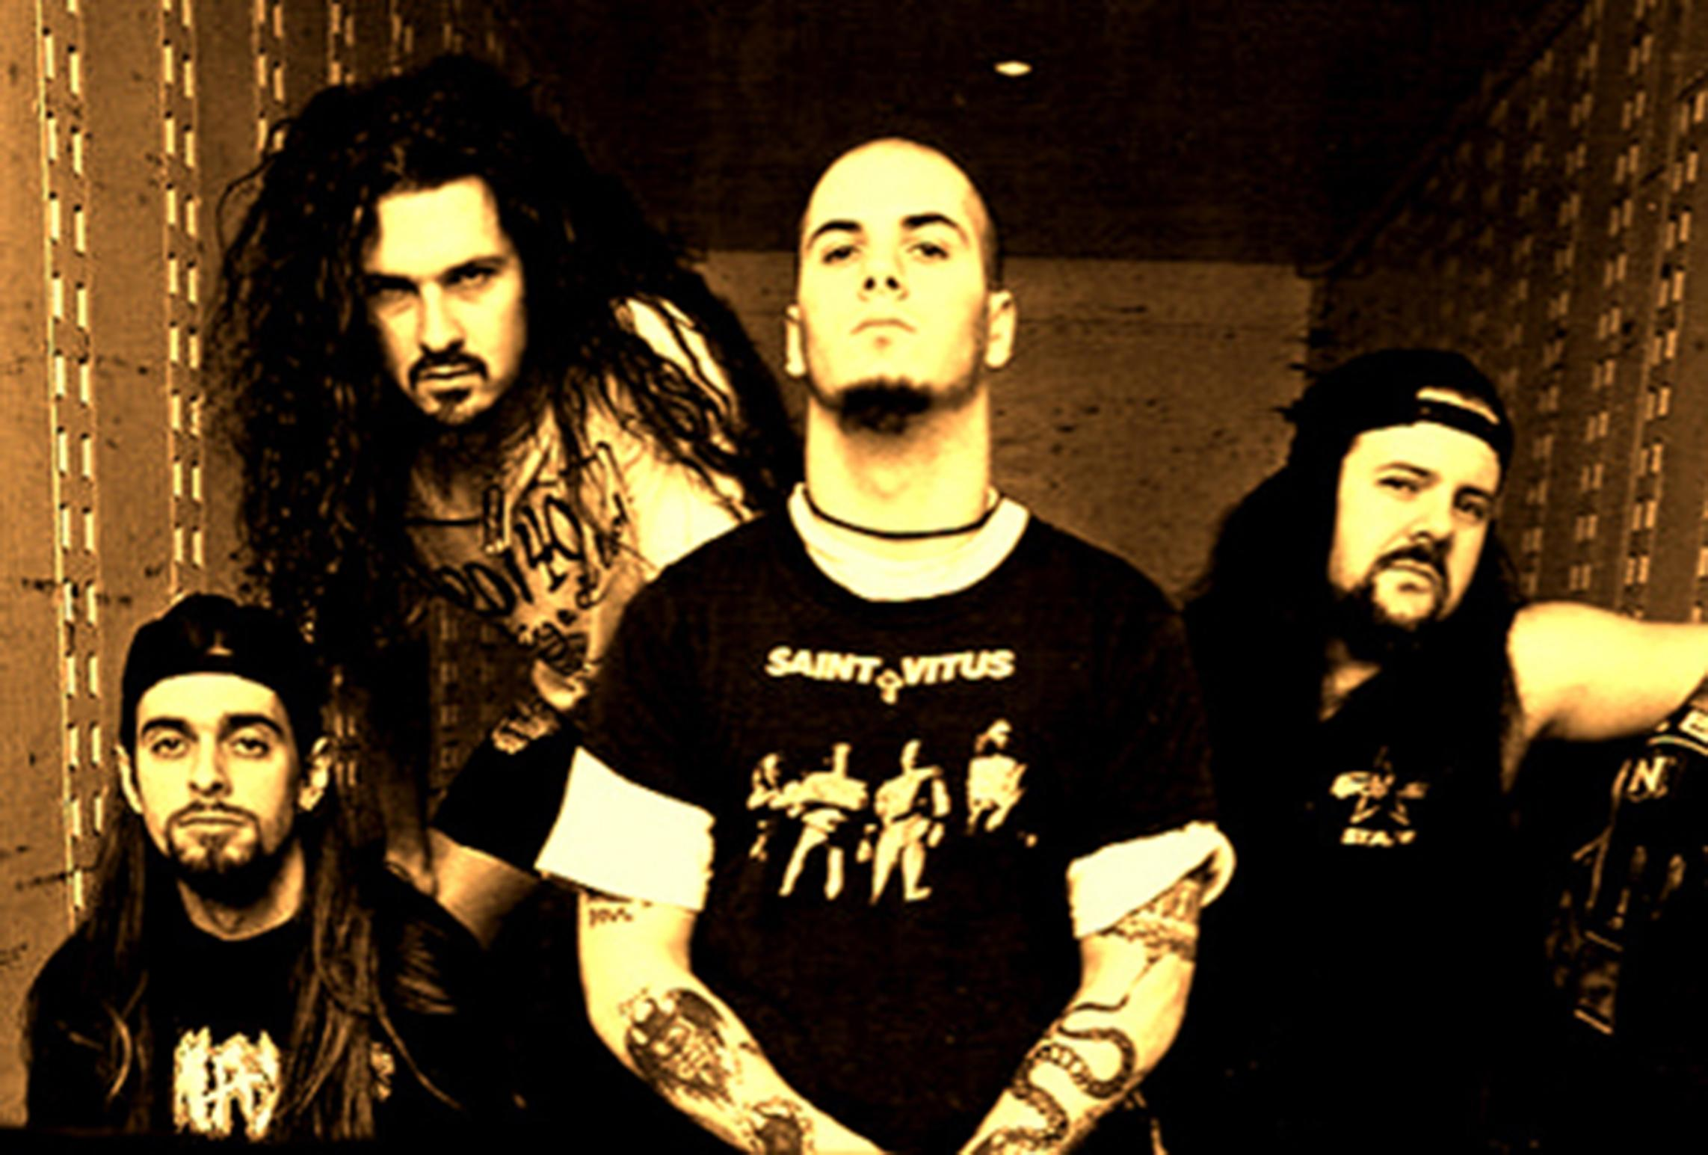
Groovy

Slide 17
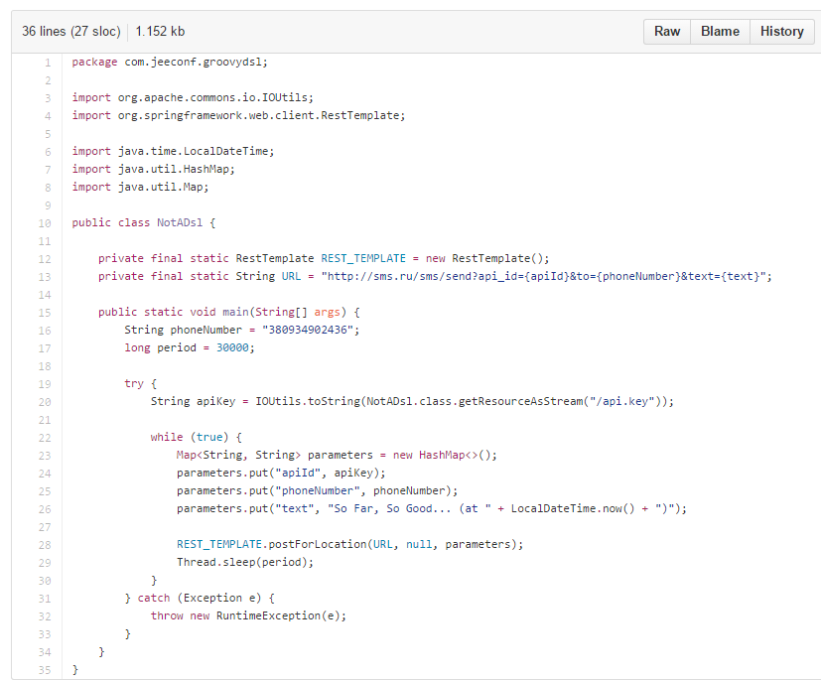
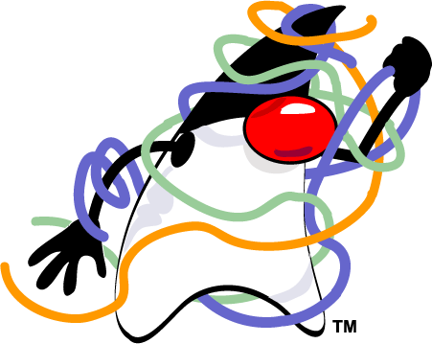
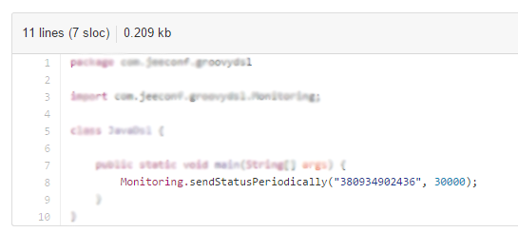
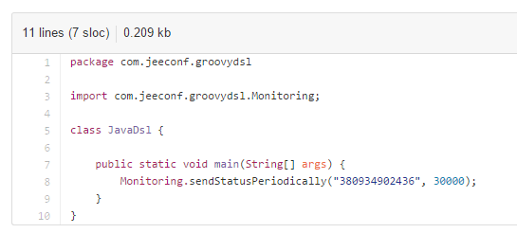
https://github.com/yermilov/groovy-dsl

Slide 18

Notes:
concentrate more on possibilities
concentrate less on technical details
something is unclear - ask
want to discuss - you are welcome after the talk

Slide 19
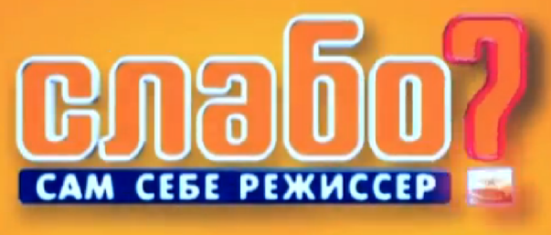
https://github.com/yermilov/groovy-dsl

Slide 20


https://github.com/yermilov/groovy-dsl

Slide 21
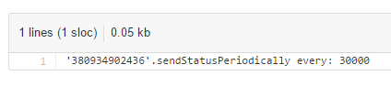

https://github.com/yermilov/groovy-dsl

Slide 22

https://github.com/yermilov/groovy-dsl

Slide 23

https://github.com/yermilov/groovy-dsl

Slide 24
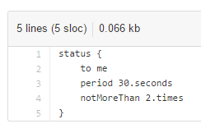

https://github.com/yermilov/groovy-dsl

Slide 25
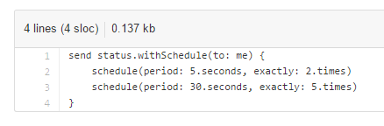
https://github.com/yermilov/groovy-dsl

Slide 26


https://github.com/yermilov/groovy-dsl

Slide 27
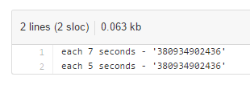
https://github.com/yermilov/groovy-dsl

Slide 28
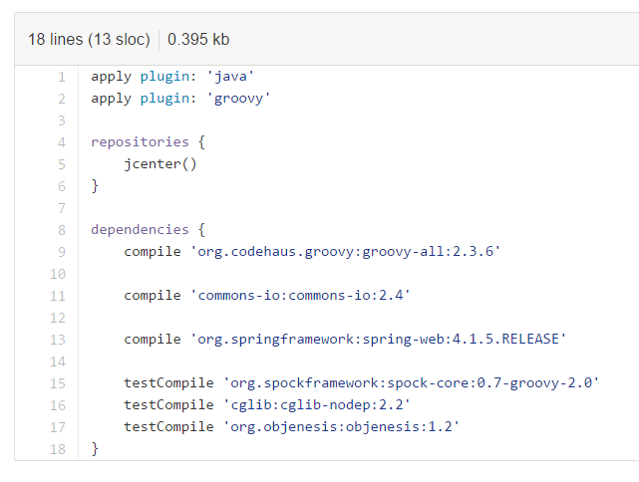
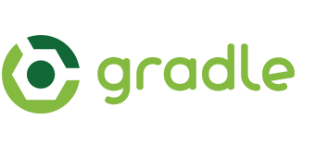
Groovy existing DSLs
https://github.com/yermilov/groovy-dsl

Slide 29
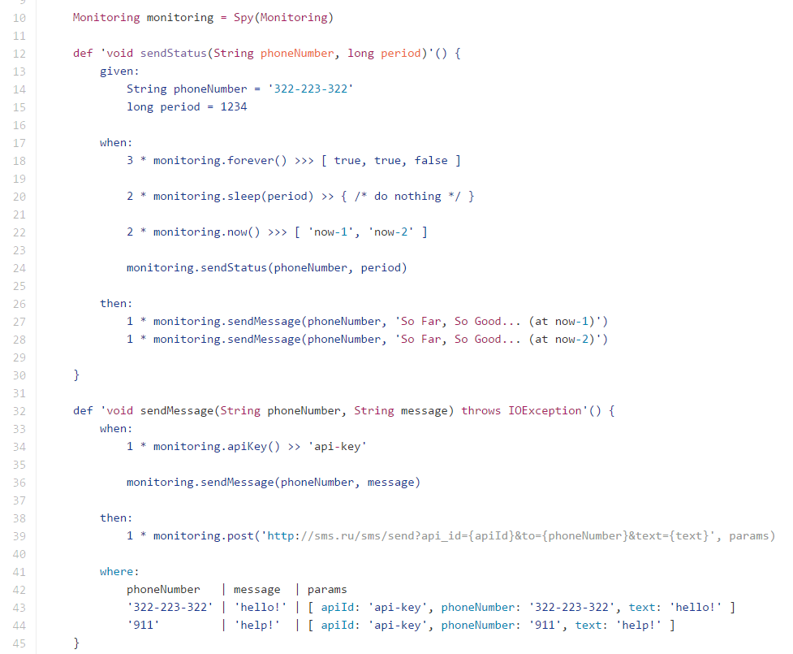

Groovy existing DSLs
https://github.com/yermilov/groovy-dsl

Slide 30
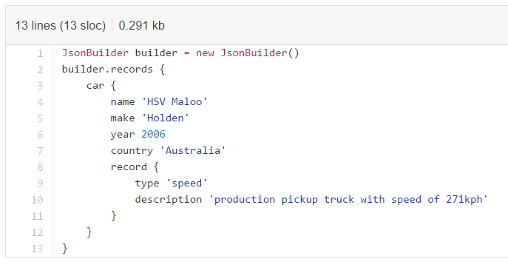
Groovy existing DSLs
https://github.com/yermilov/groovy-dsl/tree/develop/examples/existing-dsls

Slide 31
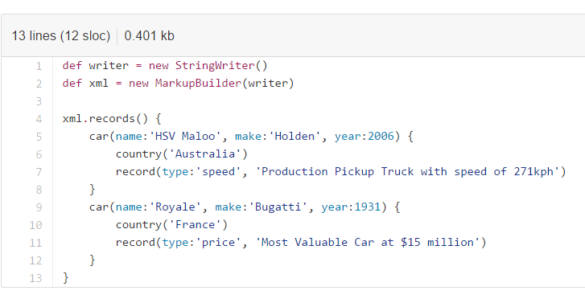
Groovy existing DSLs
https://github.com/yermilov/groovy-dsl/tree/develop/examples/existing-dsls

Slide 32
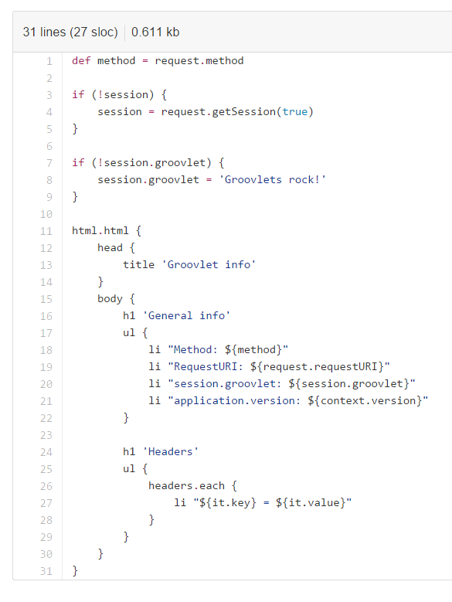
Groovy existing DSLs
https://github.com/yermilov/groovy-dsl/tree/develop/examples/existing-dsls

Slide 33
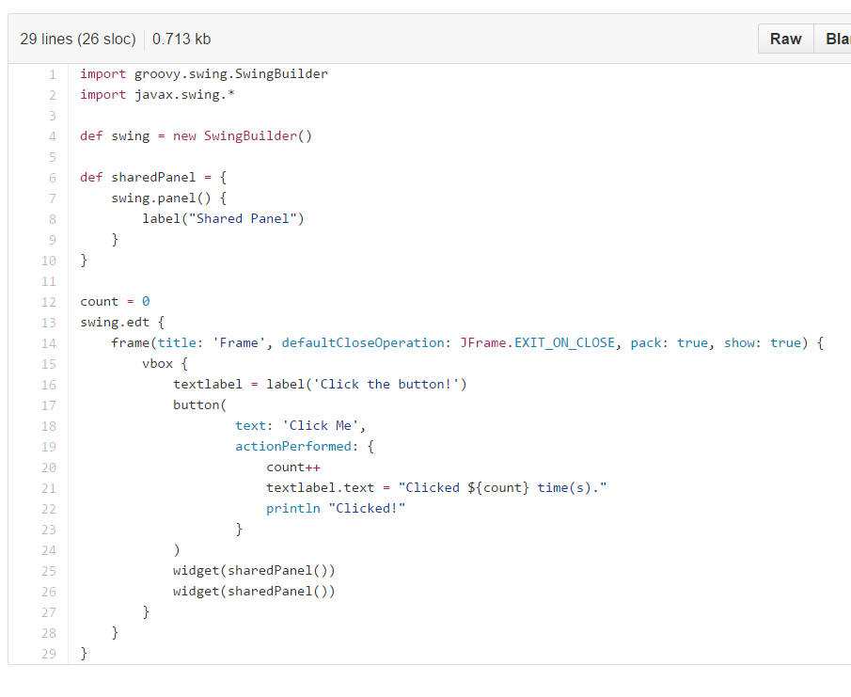
Groovy existing DSLs
https://github.com/yermilov/groovy-dsl/tree/develop/examples/existing-dsls

Slide 34
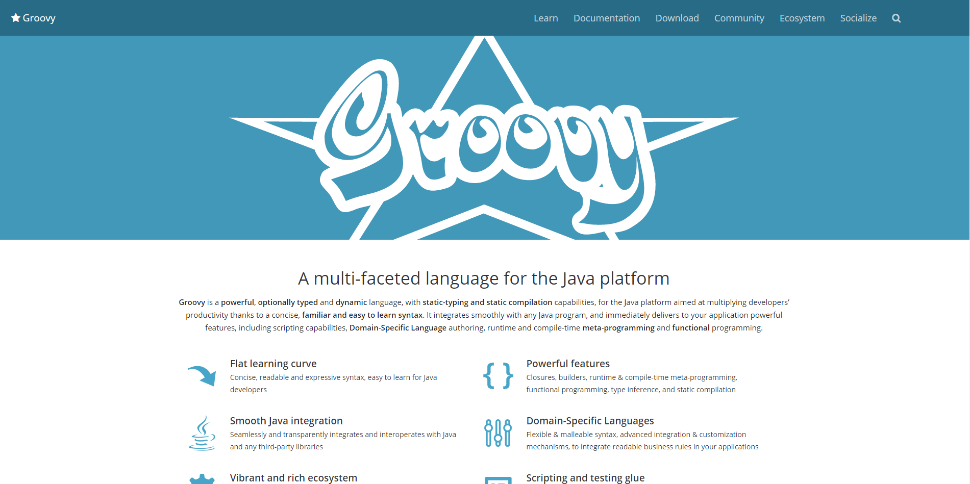
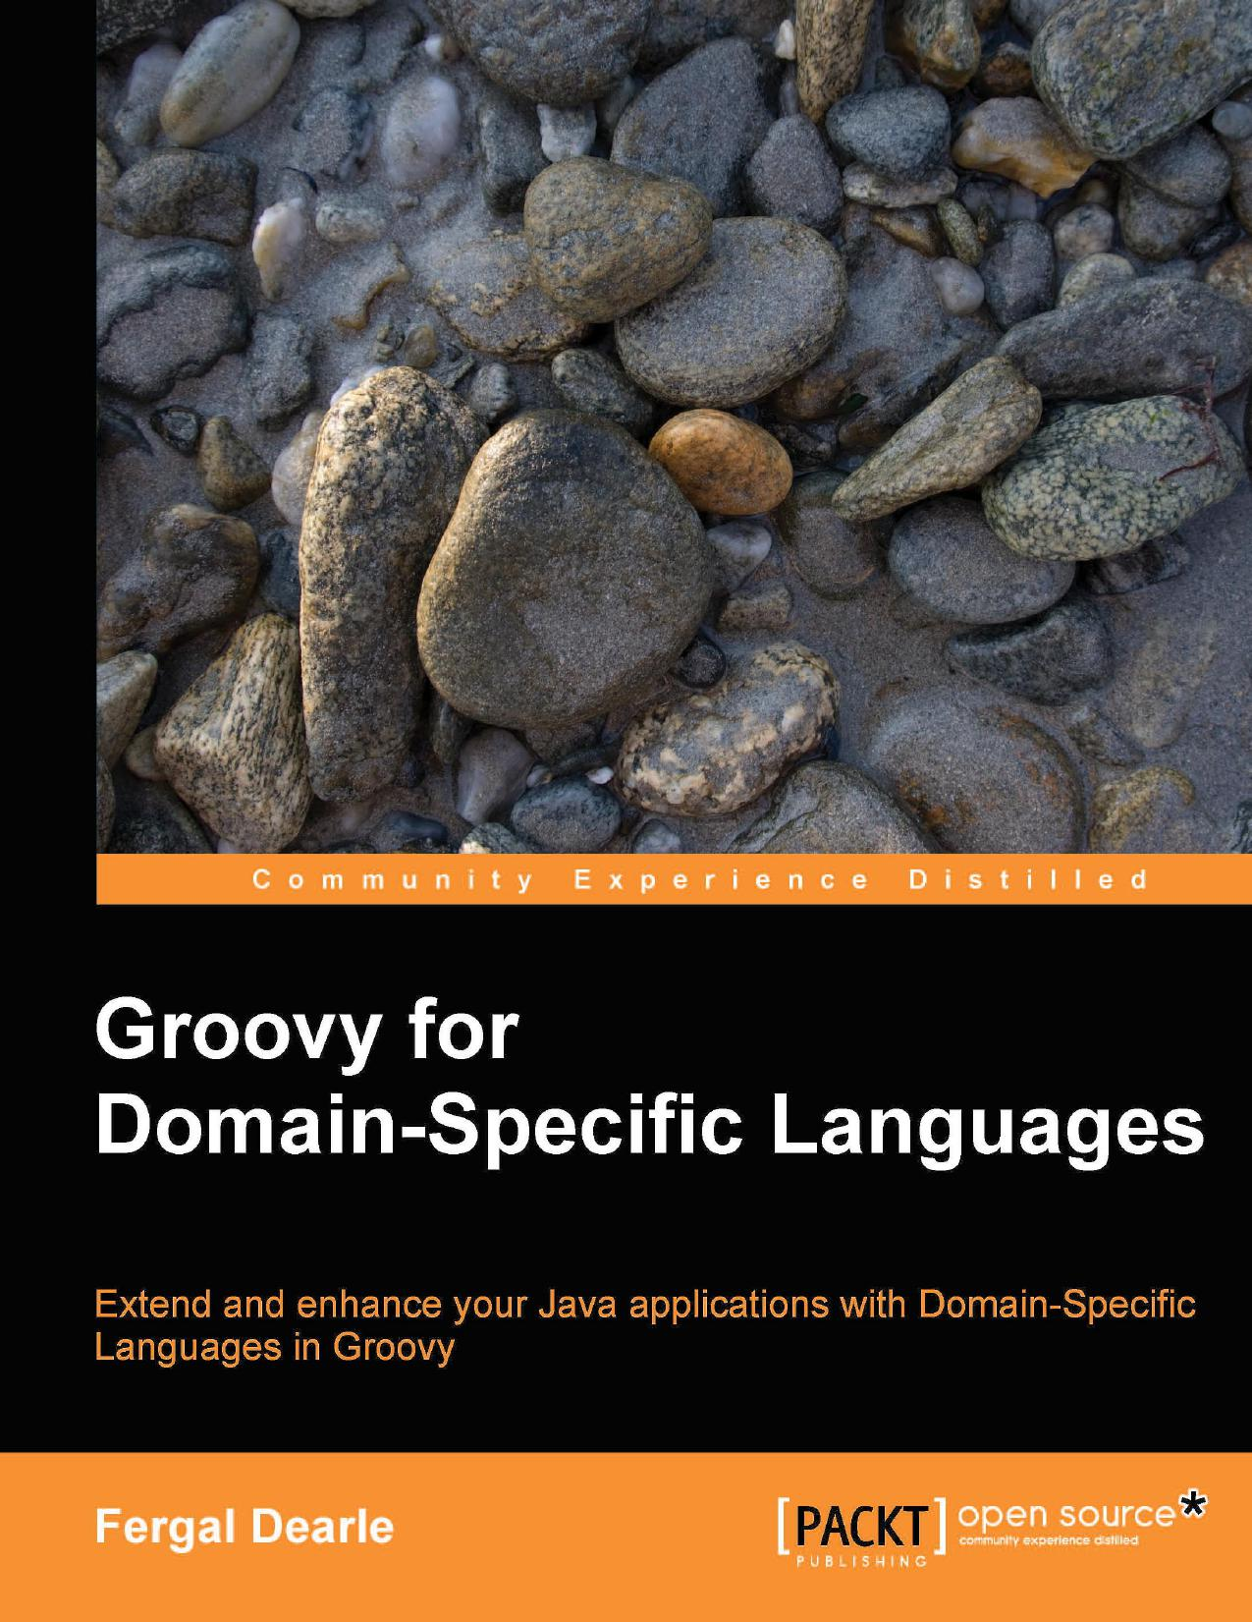
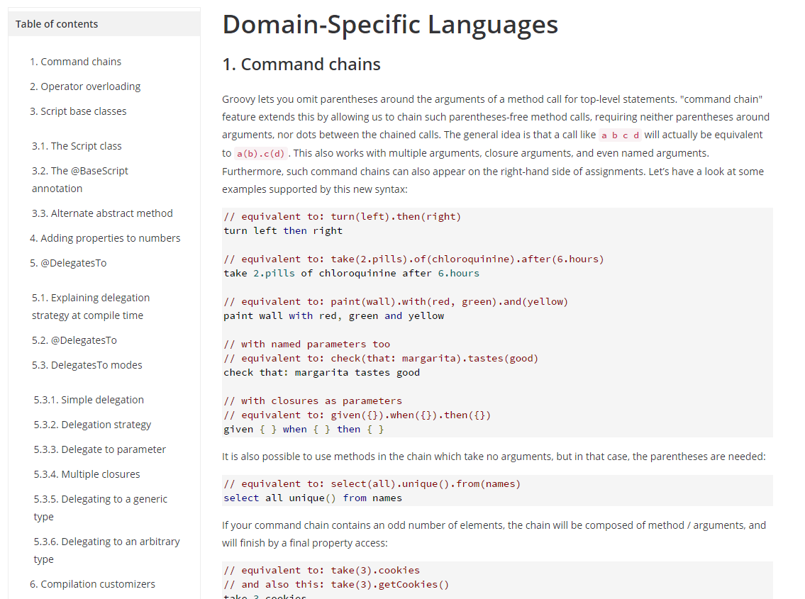
Looking further
http://www.groovy-lang.org/
http://www.groovy-lang.org/dsls.html

Slide 35
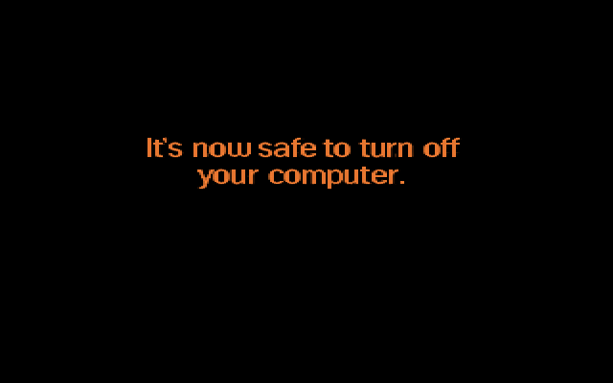
Thanks!

