Slide 1
Deep Q-Network Agent for Crafter Environment
Systematic Investigation of DQN Enhancements and Exploration Strategies
[Your Names Here]
November 2025
✓ 4.90 reward vs -0.90 random (5.4× better) • ✓ 10/22 achievements • ✓ Double DQN + Dueling = optimal

Slide 2
The Crafter Challenge
Environment Specifications:
  64×64×3 RGB observations
  17 discrete actions
  22 achievements
  1M step budget
  Procedurally generated maps
Key Challenges:
  Sparse Rewards
  Credit Assignment
  Exploration
  Long Episodes (150-200 steps)
Random Baseline:
  -0.90 ± 0.00 reward
  0/22 achievements
  0% Crafter Score

Slide 3
Method: Enhanced DQN Architecture
Base DQN Loss Function:
  L(θ) = E[(r + γ · max Q_target(s', a') - Q(s, a))²]
Enhancement 1: Double DQN
  L(θ) = E[(r + γ · Q_target(s', argmax Q(s', a')) - Q(s, a))²]
  Why? Decouples action selection from evaluation → reduces overestimation bias
Enhancement 2: Dueling Architecture
  Q(s, a) = V(s) + [A(s, a) - mean A(s, a')]
  Why? Separates state value from action advantage → better value estimates
Enhancement 3: N-Step Returns (n=1, 3, 5)
  R_t^(n) = Σ γ^i · r_{t+i} + γ^n · max Q(s_{t+n}, a)
  Why? Faster propagation of sparse rewards → better credit assignment
Hyperparameters: LR=1e-4, Buffer=100k, Batch=32, Target Update=2500 steps

Slide 4
Ablation Study: Which Enhancements Matter?
Configuration | Final Reward | Crafter Score | Achievements
Random Baseline | -0.90 ± 0.00 | 0.00% | 0.0 ± 0.0
Base DQN | 4.17 ± 0.10 | 30.65% | 8.3 ± 0.5
+ Double + Dueling ⭐ | 4.90 ± 0.16 | 32.91% | 8.0 ± 0.0
+ N-step (n=3) | 4.48 ± 0.16 | 30.23% | 8.7 ± 0.9
+ N-step (n=5) | 4.00 ± 0.19 | 26.82% | 8.7 ± 1.2
All Enhancements* | 2.37 ± 0.06 | 43.70% | 4.7 ± 0.5
Note: All results averaged over 3 seeds (0, 1, 2) at 1M steps. *Includes Munchausen-DQN (showed instability)

Slide 5
Exploration Experiment: Does Longer Help?
Hypothesis: Extended epsilon-greedy exploration will help agent discover more strategies
  Standard Schedule: Decay ε from 1.0 to 0.01 over 50,000 steps (5% of training)
  Extended Schedule: Decay ε from 1.0 to 0.05 over 200,000 steps (20% of training)
Configuration | Standard (50k ε) | Extended (200k ε) | Change
Base DQN | 4.17 ± 0.10 ⭐ | 3.53 ± 0.77 | -15% ❌
Enhanced DQN | 4.90 ± 0.16 ⭐ | 4.33 ± 0.16 | -12% ❌
Key Finding | Well-calibrated | Higher variance (7.7×) | Longer ≠ Better
Finding: Extended exploration DECREASED performance. Standard 50k decay is well-calibrated!

Slide 6
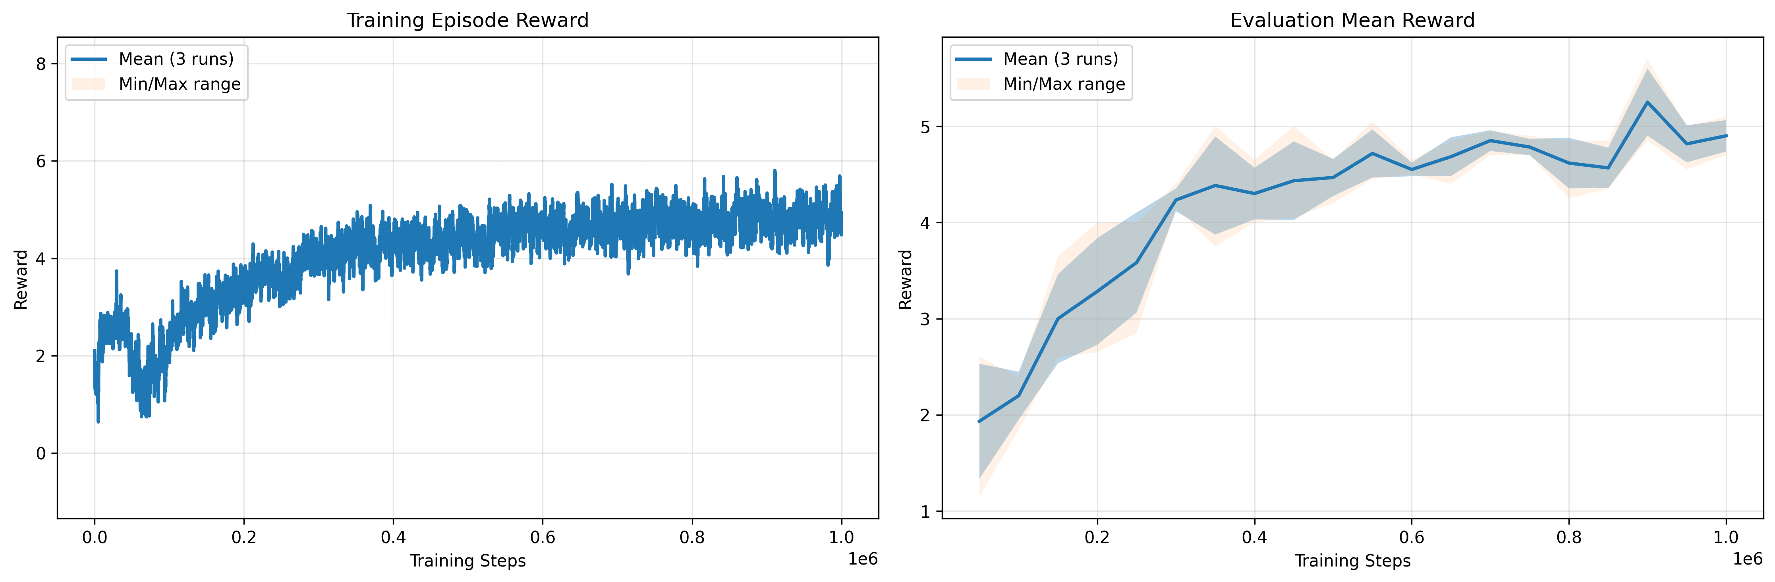
Training Dynamics: Best Agent Performance
Enhanced DQN: 4.90 ± 0.16 reward (avg over 3 seeds) | Random: -0.90
MANDATORY PLOT: Average episodic reward showing training & evaluation performance

Slide 7
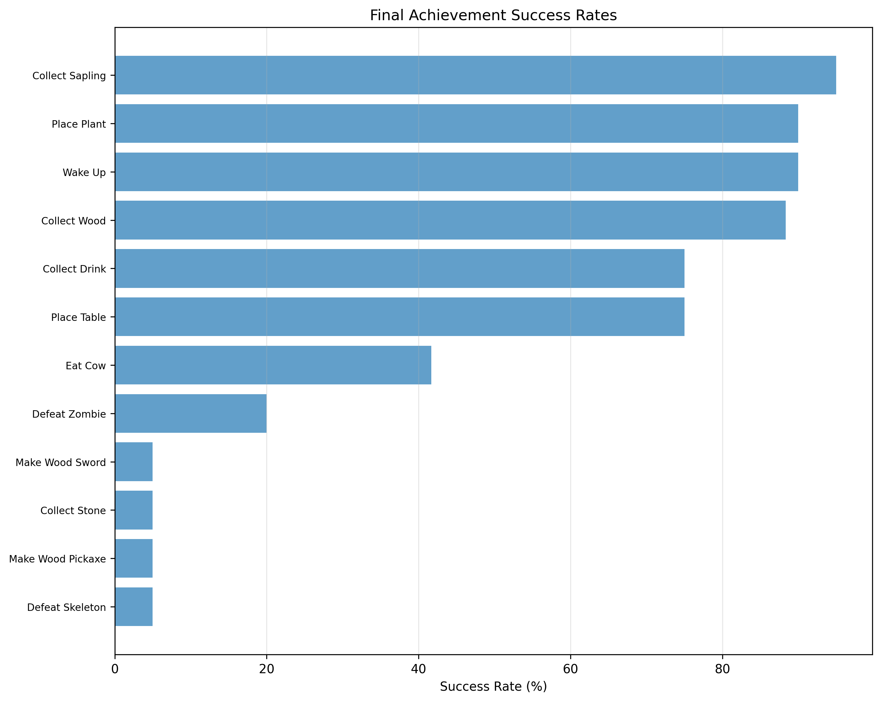
Achievement Spectrum Analysis (BONUS)
Summary: 10/22 achievements unlocked (45%) | Crafter Score: 32.91% | Gap to Human: 50% vs 33%

Slide 8
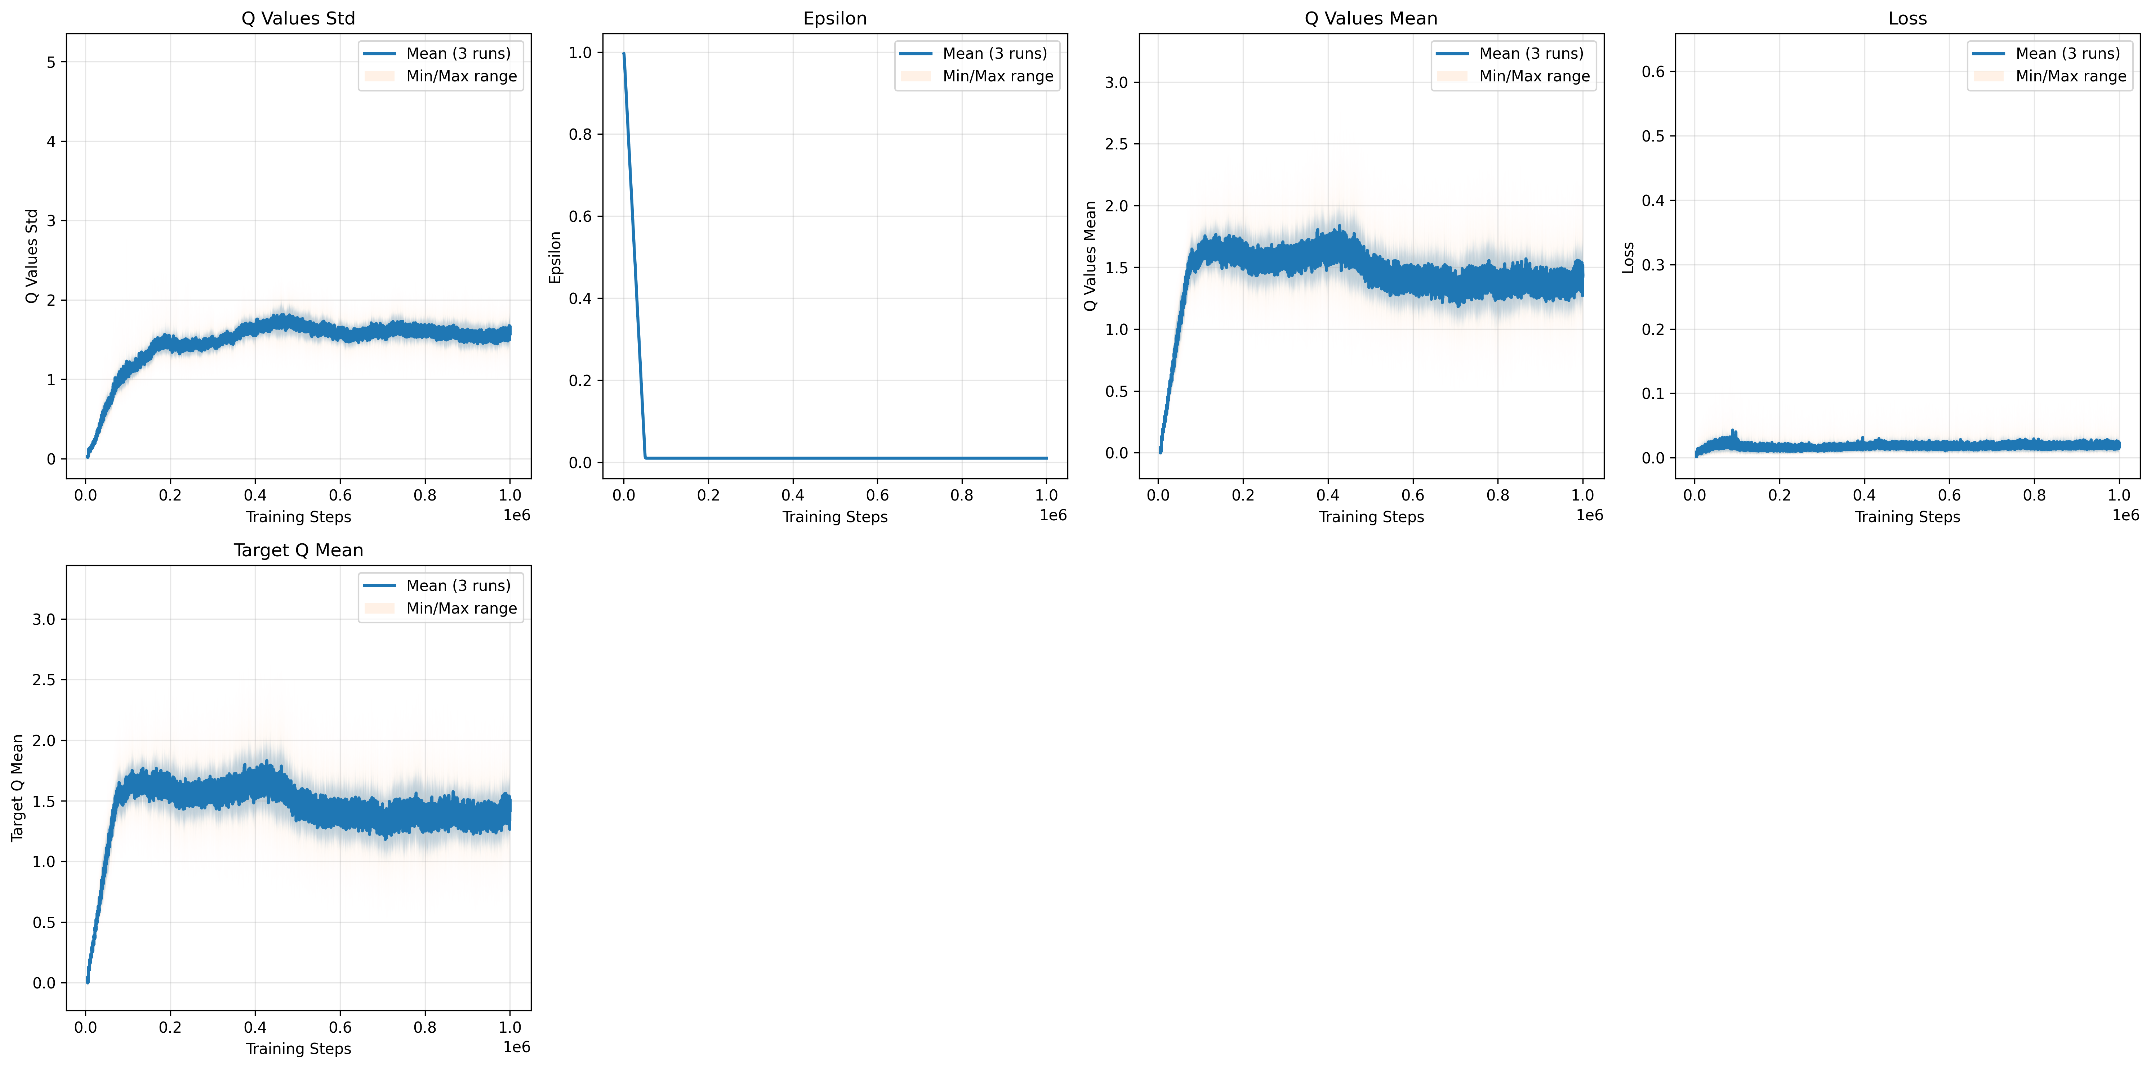
Training Metrics Deep Dive
Loss converges to ~0.014 | Q-values stabilize at 3-5 | Training shows stable dynamics

Slide 9
Emergent Behaviors & Observations
✅ Successful Strategies:
  Resource gathering prioritization
  Food management when low health
  Day/night adaptation (avoids zombies)
  Tool progression (wood tools)
  Infrastructure placement (tables)
🔍 Interesting Observations:
  Implicit recipe learning (no reward shaping)
  Risk avoidance (emerges from sparse penalty)
  Strategy diversity across seeds
❌ Failure Modes:
  Gets stuck in corners (~10%)
  Doesn't prioritize rare achievements
  Struggles with multi-step planning
  Stone/iron tools require 5+ steps
  Limited cave exploration

Slide 10
Conclusions & Future Work
✅ Key Achievements:
  Custom DQN from scratch
  4.90 vs -0.90 reward (5.4× better)
  10/22 achievements unlocked
  Double DQN + Dueling = optimal
  Stable across 3 seeds (±0.16)
💡 Key Insights:
  Exploration: 50k decay well-calibrated
  Longer exploration decreased performance
  Credit assignment = key challenge
  Simpler can be better
🚀 Future Directions:
  Better Exploration:
    Intrinsic motivation (RND, NGU)
    NOT longer epsilon-greedy
  Hierarchical RL:
    Reusable sub-policies
  Model-Based RL:
    World models (DreamerV2)
  Curriculum Learning:
    Progressive achievement targets

Slide 11
Questions & Discussion
Thank You!
Summary of Contributions:
  ✅ Custom DQN implementation (no frameworks)
  ✅ Systematic ablation study (6 configurations × 3 seeds)
  ✅ Novel exploration experiment (valuable negative result)
  ✅ Comprehensive evaluation (achievements + behaviors)
Key Takeaway: Systematic investigation beats guesswork
Contact: [Your Email] | Code: [GitHub URL]

