Slide 1

Best practice with Git

Slide 2


Зміст
2
Forks
Branches
PullRequest
Submodules

Slide 3

1.
Forks, Branches, PullRequest
Maksym Kheilyk

Slide 4


Forks

Slide 5

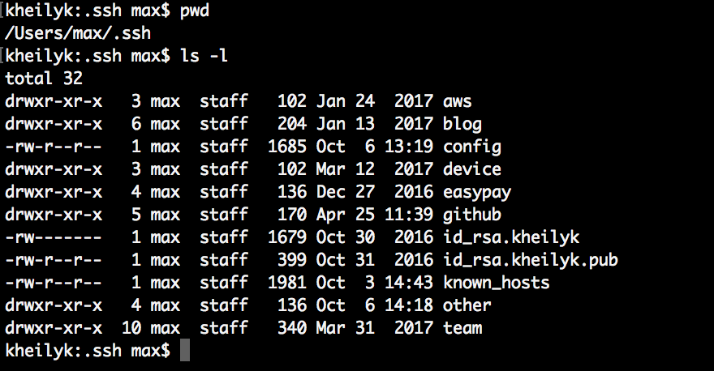
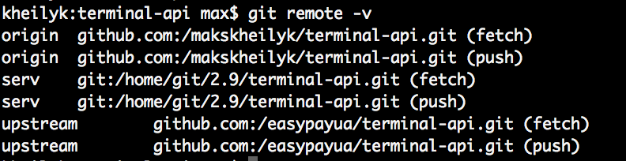
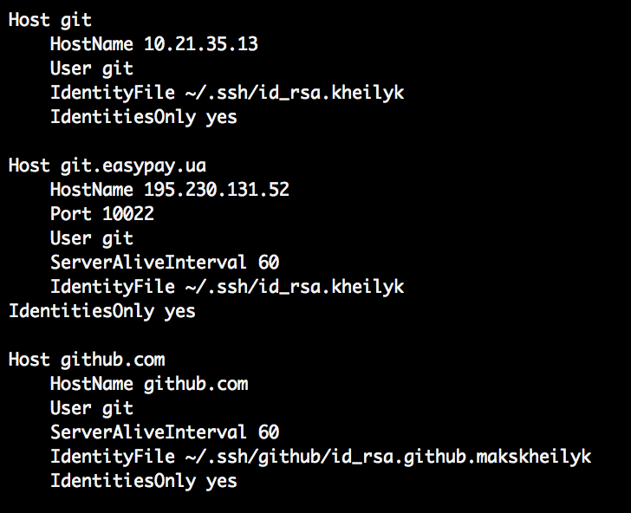
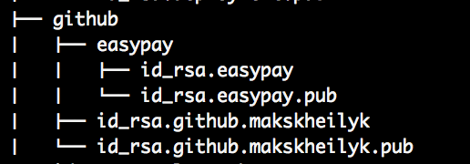
Работа с удалёнными репозиториями

Slide 6
Branches

Slide 7


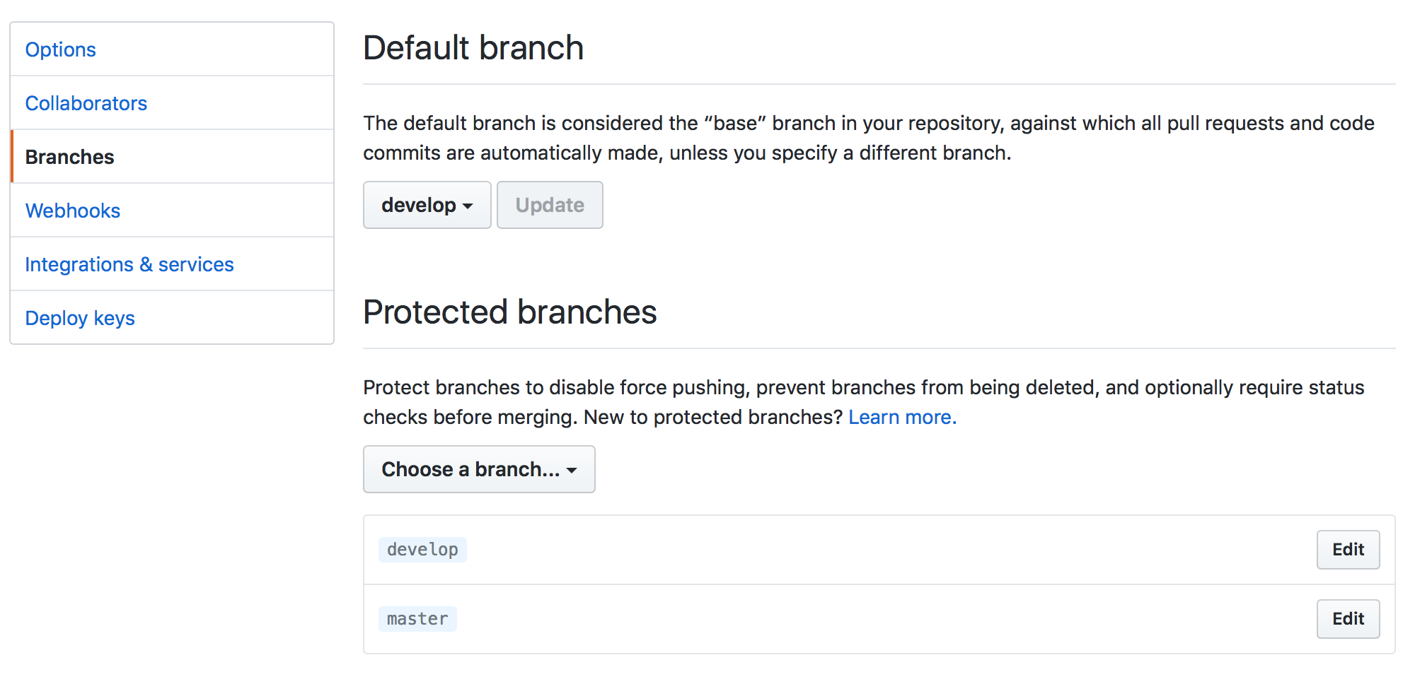
ЗАГОЛОВОК СЛАЙДУ

Slide 8
PullRequests

Slide 9

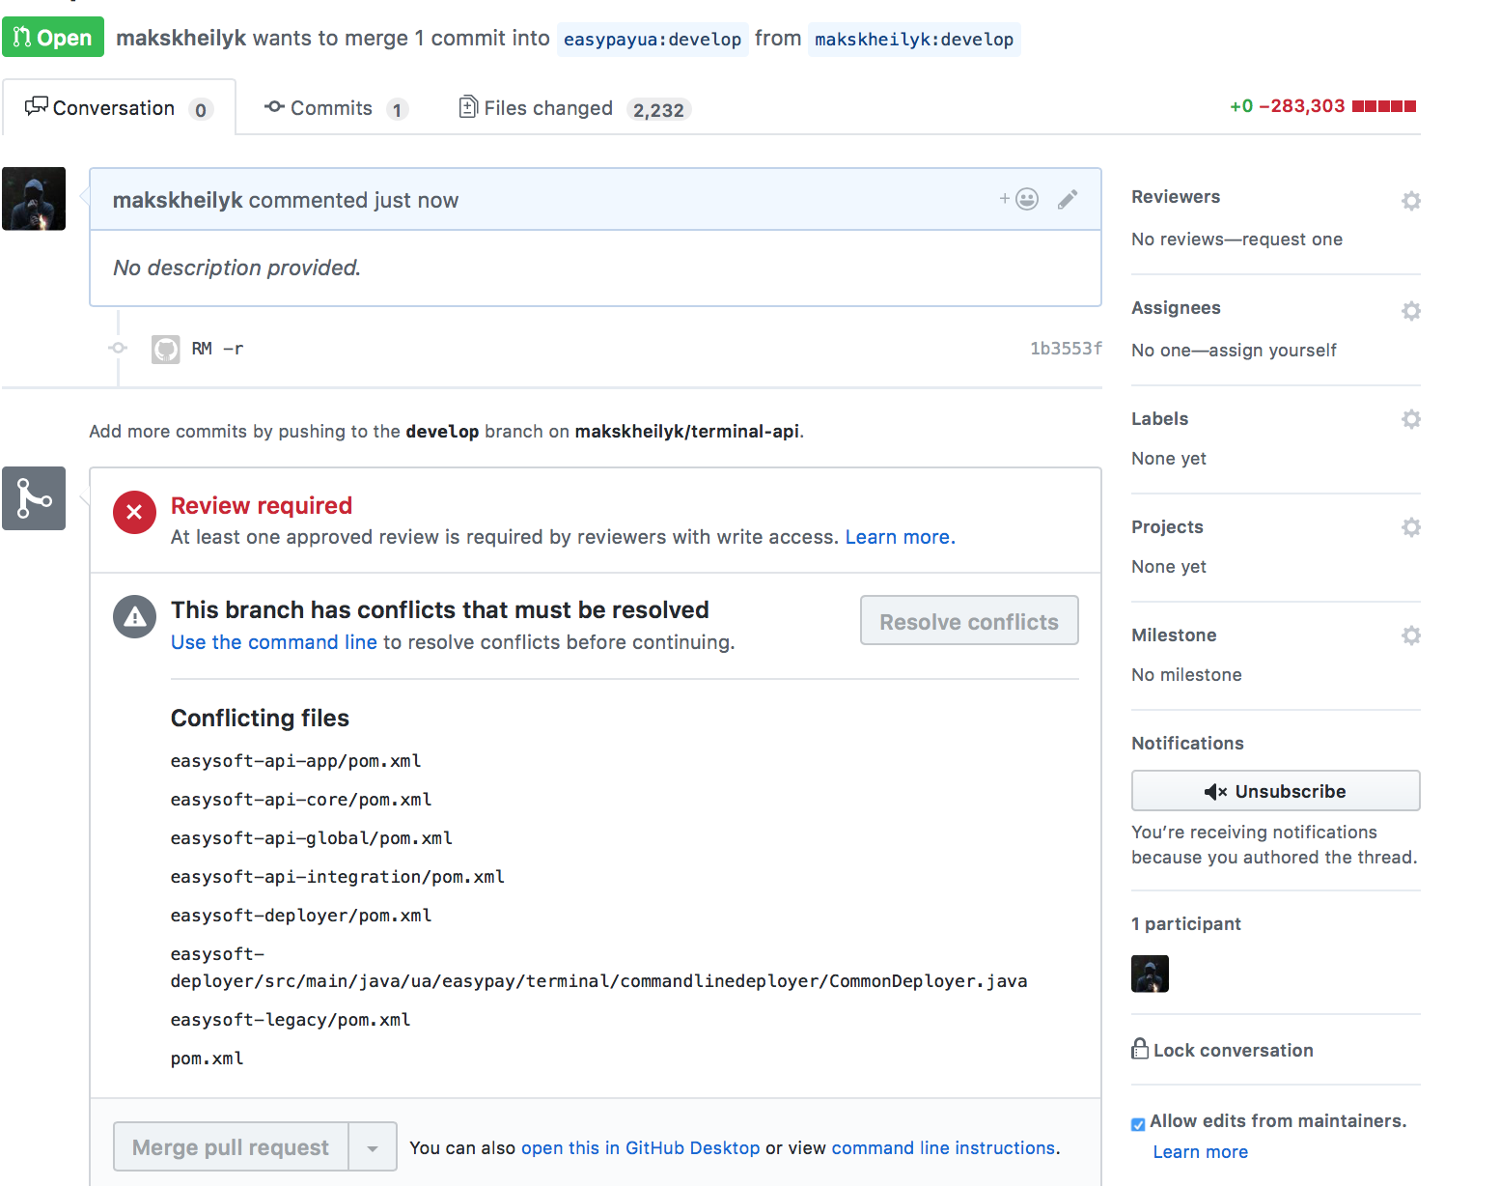
Pull request

Slide 10
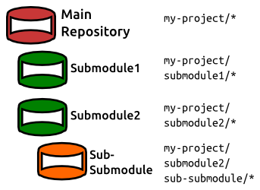
2.
Submodules
Vitalii Tolmachov

Slide 11
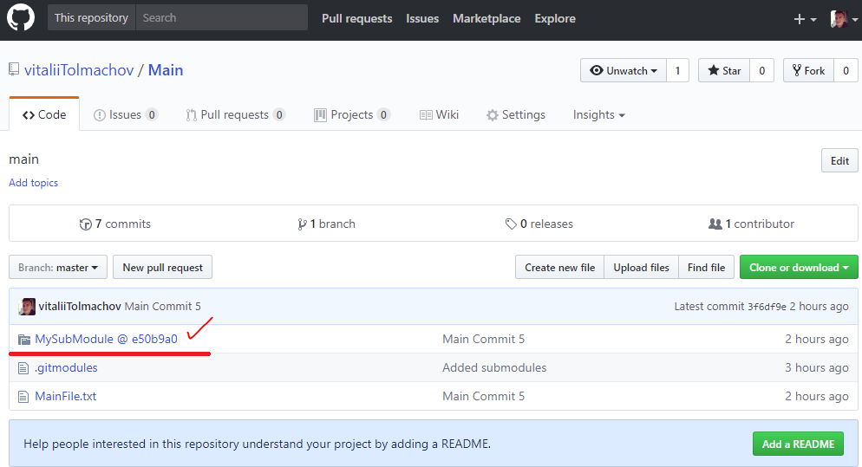
How 2 Add
In main project tap:
git submodule add git://github.com/submodulerepo/submodule.git SubModuleName //check .gitmodules file
git commit -am 'Added submodules'
git push -u origin

Slide 12
How 2 Use
How to Use Submodule
Make changes in main project:
git commit -am 'Main Commit’
git submodule foreach 'git add .’ //add changed files if need
git submodule foreach "git commit -am 'Submodule commit’” //commiting to submodule
git submodule foreach 'git push origin’ //pushing to submodule
git push --recurse-submodules=check //push main

Slide 13
How 2 get changes?
git clone git://github.com/schacon/myproject.git
Go to project folder
Git submodule init --recursive //Let Git know about submodules
git submodule update --recursive

Slide 14



Summary
is awesome, let’s migrate
Always use forks
Use setting for branches
PullRequest before merging with central repository
Use submodules for huge projects
is coming…

Slide 15


Q&A

