Slide 1
Capstone Presentation
Ireland Homelessness Analytics
An end-to-end capstone project using public datasets, SQL views and Power BI-ready reporting artifacts.
Core KPI
Highest rate
Prepared pages
23.2 per 10,000
Dublin
9 report pages
01

Slide 2
Business problem
Ireland Homelessness Analytics
The project turns fragmented public data into regional decision context
Question
-
Absolute counts alone can overstate large regions and understate smaller ones.
How do homelessness levels differ across Ireland, and what housing and economic context helps interpret those differences?
-
Datasets use different geography grains: county, homelessness region and NUTS2.
-
The report needs to support interpretation, not causal claims.
02

Slide 3
Datasets
Ireland Homelessness Analytics
Six prepared datasets form the analytical model
Dataset
Grain
Role
Homelessness
Region
Fact
Population
County
Dimension
Rent
County + half-year
Context
Housing
County + year
Context
Unemployment
NUTS2 + year
Context
Geography bridge
Region + county
Bridge
The bridge is the control point: it lets county-level data support region-level analysis without silently changing grain.
03

Slide 4
Methodology
Ireland Homelessness Analytics
The workflow separates raw data, clean data, SQL logic and reporting
01
02
03
04
05
Validate
Standardise
Model
Implement
Visualise
Arithmetic checks, missing values, duplicates and text consistency.
Lowercase snake_case columns and consistent geography fields.
Bridge county-based data to homelessness regions with documented assumptions.
Load clean files to SQLite and create analytical SQL views.
Use Power BI-ready extracts and page specs for dashboard build.
Method principle: define standards once, then apply them consistently across every dataset.
04

Slide 5
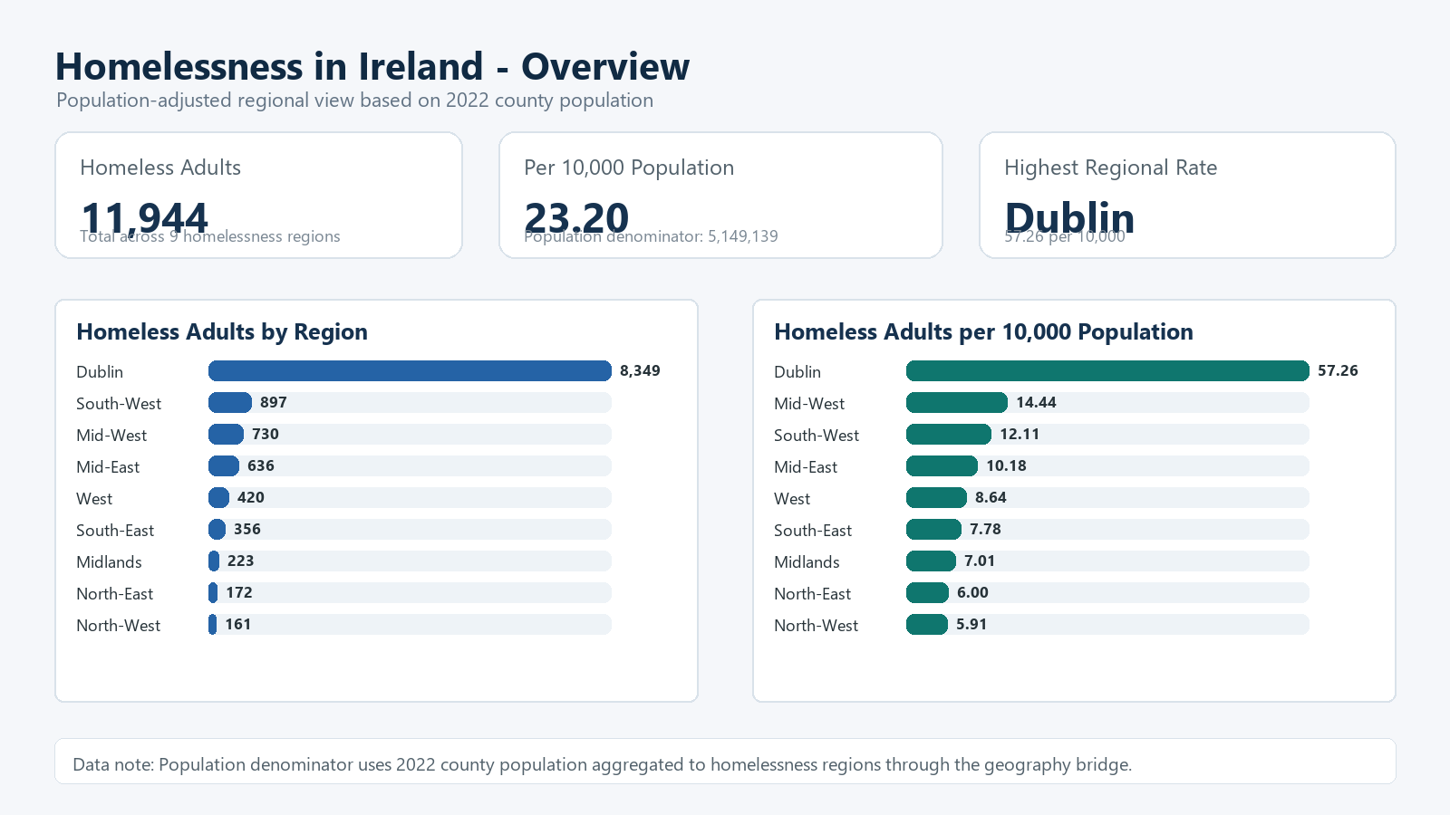
Overview
Ireland Homelessness Analytics
The headline rate is 23.2 homeless adults per 10,000 population
Homeless adults
11,944
Population
5,149,139
Highest rate
Dublin 57.26
Decision implication: the core comparison KPI should be population-adjusted, not absolute count alone.
05

Slide 6
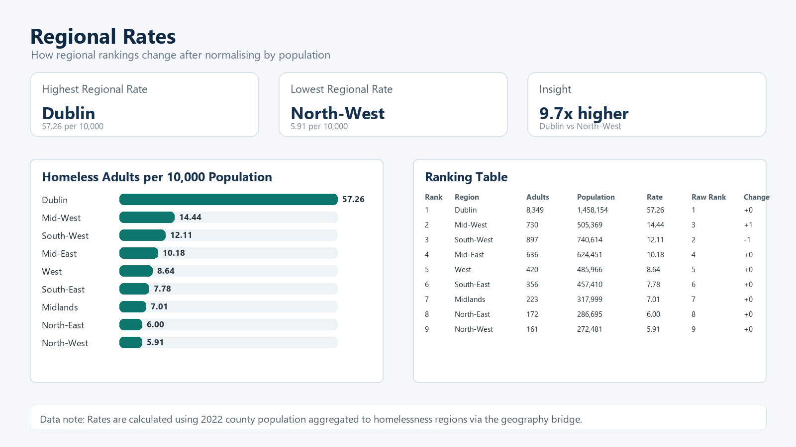
Regional findings
Ireland Homelessness Analytics
Normalisation changes the regional story
What matters
Dublin remains the highest-rate region after population adjustment.
Ranking by rate is more informative than comparing counts alone.
Regional comparisons should use the geography bridge assumptions explicitly.
06

Slide 7
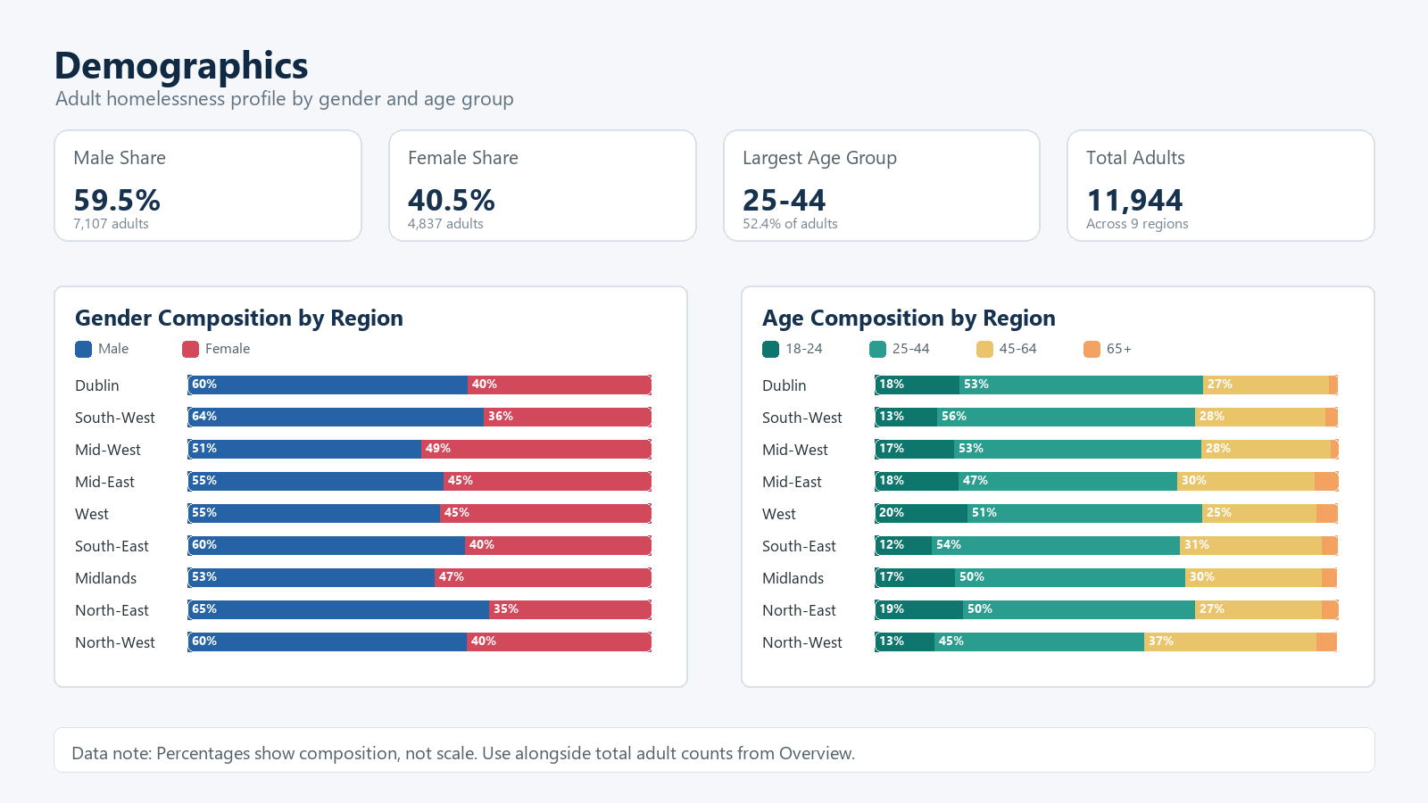
Demographics
Ireland Homelessness Analytics
The adult homeless population is concentrated in ages 25 to 44
Largest age group
25-44
Share
52.37%
Male share
59.5%
Implication: demographic composition should inform service planning, not only regional totals.
07

Slide 8
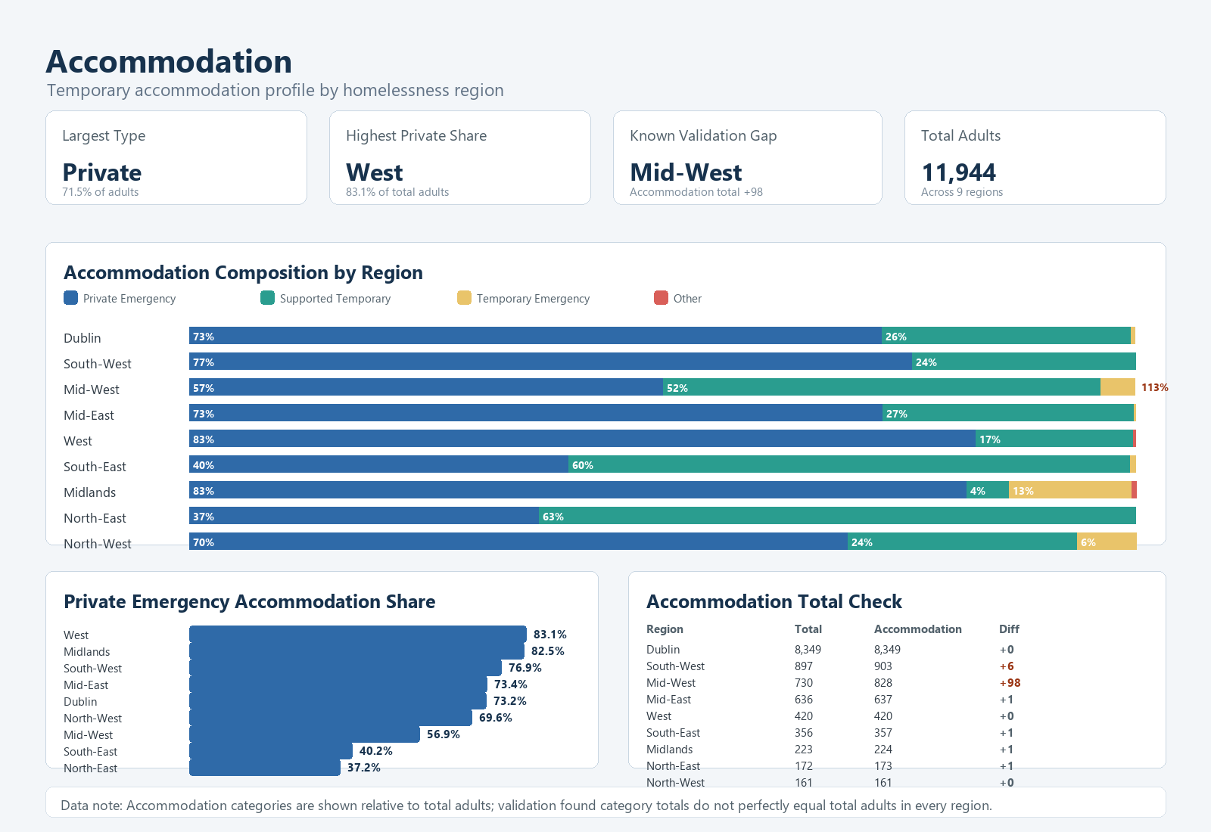
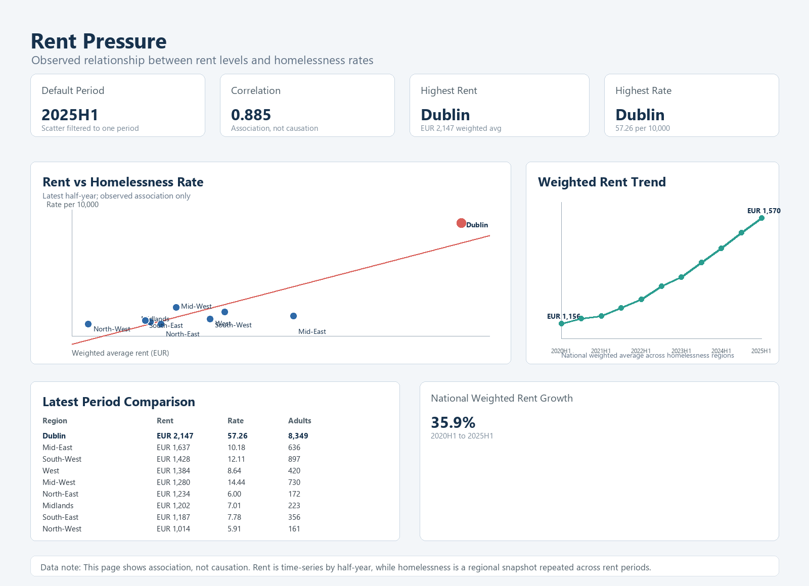
Housing context
Ireland Homelessness Analytics
Housing pressure indicators align with high homelessness rates
Evidence from SQL views
Rent pressure correlation with homelessness rate: 0.885.
Housing affordability correlation in 2023: 0.913.
Dublin is the highest region for both homelessness rate and affordability pressure.
These are contextual associations, not causal proof.
08

Slide 9
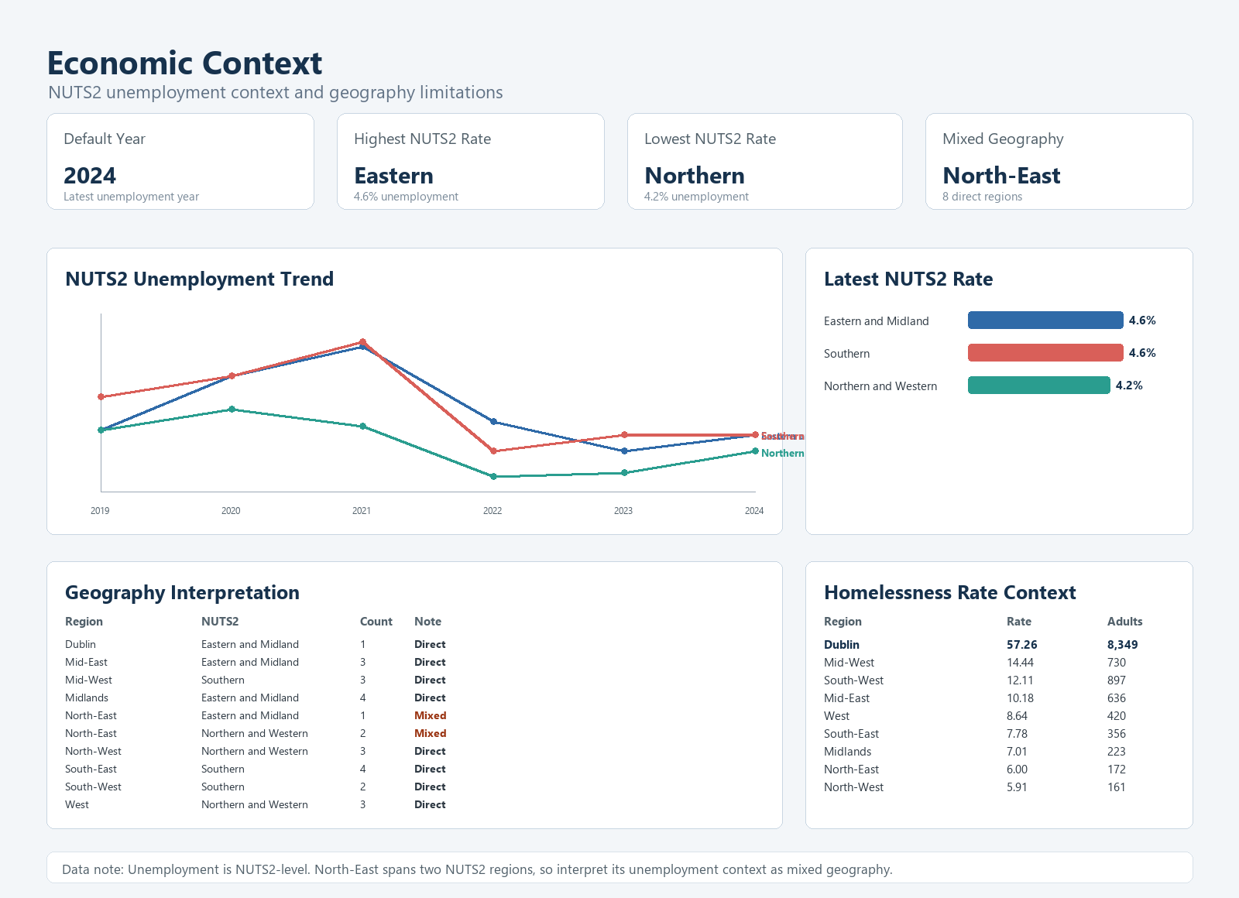
Economic context
Ireland Homelessness Analytics
Unemployment is useful context, but geography limits interpretation
-
Unemployment is available at NUTS2 level, not homelessness-region level.
-
North-East spans two NUTS2 regions, so it must remain a mixed-geography case.
-
The page supports context, not a local causal unemployment explanation.
09

Slide 10
Recommendations
Ireland Homelessness Analytics
The report supports four practical decisions
1
Use rate per 10,000 as the primary regional KPI
This avoids over-relying on absolute counts.
2
Monitor regions with combined housing and homelessness pressure
Use rent, affordability and homelessness rate together.
3
Publish geography caveats with regional comparisons
County, homelessness region and NUTS2 are different grains.
4
Expand housing-market indicators for future analysis
Richer housing supply and rent affordability data would improve interpretation.
10

Slide 11
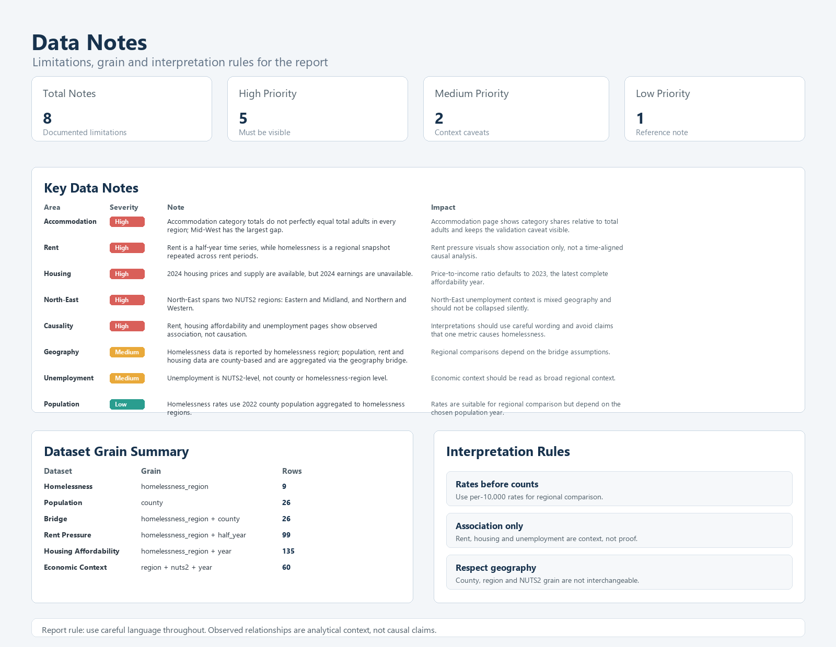
Limitations
Ireland Homelessness Analytics
The findings are strong enough for context, not causal attribution
Accommodation category totals do not perfectly equal total adults in every region.
Rent is time-series; homelessness is a regional snapshot.
2024 earnings are unavailable, so affordability ratio defaults to 2023.
Unemployment is NUTS2-level and North-East is mixed geography.
11

Slide 12
Final takeaway
Questions
The project demonstrates a full analytics lifecycle: problem framing, data validation, standardisation, bridge design, SQL views, Power BI-ready pages, interpretation and recommendations.
Use the report to compare regions carefully and to identify where deeper housing support analysis should be prioritised.
12

