Slide 1
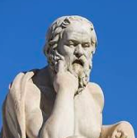

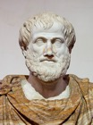
Socrates Questions Can Reduce LLM Hallucinations
LLM can reduce hallucinations via Socratic self-questioning using simple specific focused questions.
It gets expensive if using cloud-based services, because you end up submitting 10 questions instead of 1.
This is one more reason for running your models locally on your own hardware.
Socrates (470–399 BC)
Greece, Athens the founder of Western philosophy
Plato ( 428-348 BC) Greece, Athens
philosopher
Aristotle (384–322 BC)
Greece, Athens
philosopher

Slide 2
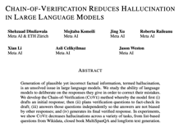
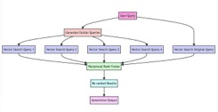
Reduce Hallucinations - Terms and Publications
CoT = Chain-of-Thought prompting
ToT = Tree-of-Thought prompting
Plan-and-Solve prompting
Techniques For LLMs to Verify Themselves And Reduce Mistakes https://twitter.com/bindureddy/status/1712989785500025002
Chain-Of-Verification (CoVe) Reduces Hallucination In LLMs https://arxiv.org/pdf/2309.11495.pdf (September 2023)
Large Language Models are Better Reasoners with Self-Verification https://export.arxiv.org/abs/2212.09561 (May 2023)
RAG-Fusion
https://github.com/Raudaschl/rag-fusion (October 2023)
https://towardsdatascience.com/forget-rag-the-future-is-rag-fusion-1147298d8ad1
Promptbreeder - mutation/selection of prompts video: https://www.youtube.com/watch?v=tkX0EfNl4Fc paper: https://arxiv.org/abs/2309.16797 (September 2023)

