Slide 1
AI Updates
November 03, 2023
Long Context Models
Diffusion Models
Diffusion Model for Code Generation
Ollama Updates
Talmudic Reasoning
Self-RAG
Typical Python modules used for model fine-tuning

Slide 2
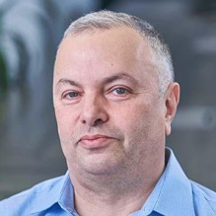

About the Speaker
Lev Selector, Ph.D.
40+ years of software engineering, data science, and building teams (hiring, training, and managing)
Ph.D. in mathematical modeling and computer simulations
Interests:
Generative AI, Using LLM with your data
Local AI for Local Private Data
Cloud architecture, fin-tech, application security
Find/connect: Linkedin, GitHub, YouTube, Google
https://eais.ai

Slide 3
HuggingFace LLM Leaderboard
https://huggingface.co/spaces/HuggingFaceH4/open_llm_leaderboard
https://huggingface.co/datasets/open-llm-leaderboard/results
https://huggingface.co/spaces/felixz/open_llm_leaderboard
https://huggingface.co/spaces/felixz/meta_open_llm_leaderboard
https://github.com/lselector/ai/blob/master/llm_leaderboard.py
Rank | Model | Aver | Precision | Nparam
0 | GPT-4 | 84.30 | 16bit | 1800
1 | ValiantLabs/ShiningValiant | 74.17 | 16bit | 70
2 | ICBU-NPU/FashionGPT-70B-V1.2 | 74.11 | 16bit | 70
41 | GPT-3.5 | 71.90 | 16bit | 175
57 | garage-bAInd/Camel-Platypus2-70B | 71.36 | 8bit | 70
62 | lloorree/jfdslijsijdgis | 70.99 | 4bit | 70
107 | tiiuae/falcon-180B | 68.74 | 16bit | 180
141 | Undi95/Mistral-11B-TestBench11 | 67.21 | 16bit | 11
147 | ehartford/dolphin-2.1-mistral-7b | 67.06 | 16bit | 7
155 | meta-llama/Llama-2-70b-chat-hf | 66.80 | 16bit | 70
165 | Weyaxi/SlimOpenOrca-Mistral-7B | 66.54 | 16bit | 7
177 | Aspik101/trurl-2-13b-pl-instruct_unload | 66.03 | 16bit | 13
183 | Open-Orca/Mistral-7B-OpenOrca | 65.84 | 16bit | 7
357 | Open-Orca/OpenOrca-Platypus2-13B | 63.19 | 4bit | 13
422 | mistralai/Mistral-7B-v0.1 | 62.40 | 16bit | 7
988 | joehuangx/spatial-vicuna-7b-v1.5-LoRA | 55.72 | 4bit | 7
1870 | baseline | 25.00 | nan | 0

Slide 4
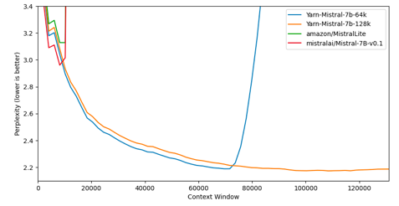
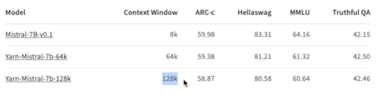
Yarn-Mistral-7b-128k
Nous-Yarn-Mistral-7b-128k is an extension of Mistral-7B-v0.1 and supports a 128k token context window. It is achieved by pre-training it on long context data for 1500 steps using the YaRN extension method.
https://huggingface.co/NousResearch/Yarn-Mistral-7b-128k (base model)
https://huggingface.co/NousResearch (28 team members)
https://huggingface.co/TheBloke/Yarn-Mistral-7B-128k-GGUF (4bit)
https://www.youtube.com/watch?v=MQD1n4FqZmU (video)
YaRN: Efficient Context Window Extension of LLMs (Nov 2023)
https://arxiv.org/abs/2309.00071 https://github.com/jquesnelle/yarn
The graph shows that 64k and 128k models have indeed low perplexity for long texts.
Perplexity is a common metric measuring how well a model predicts a sample of text. Lower perplexity indicates better generalization performance.
Perplexity is related to the entropy or uncertainty of the language model. A model with lower perplexity is able to assign higher probabilities to the test set words.
Lower perplexity indicates an LLM has learned better representations of language. But perplexity alone is not enough. The model needs to be evaluated on actual end applications for exposure bias, calibration, outlier tokens handling and varying test set size. Also coherence (if the output logical?) and repetition (is the output too generic and repetitive?)
Almost no degradation in accuracy

Slide 5
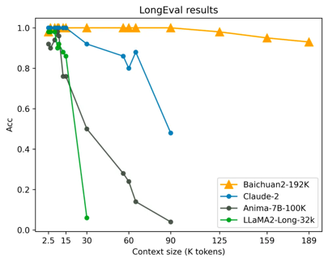
Baichuan2-192K
A Chinese company "Baichuan Intelligent Technology" has released the Baichuan2–192K large model with 192K context window, which is approx 300 pages of text - much longer than Claude2 (100K) or GPT-4 (8K - 32K).
Baichuan2–192K not only surpasses Claude2 in context window length, but also leads in terms of long window text generation quality, long context understanding, long text Q&A, and summary.
Available via API only (in Chinese & English)
https://www.maginative.com/article/baichuan-intelligent-unveils-baichuan2-192k-claiming-new-breakthrough-with-longest-context-model/
https://medium.com/@piyushlamsoge20/baichuan-intelligent-launches-large-model-baichuan2-192k-which-can-input-350-000-words-at-a-time-eed70c51d9f9
https://huggingface.co/baichuan-inc - some small models
Baichuan Intelligent has proposed an extrapolation scheme for RoPE and ALiBi dynamic position coding. This scheme can perform different degrees of Attention-mask dynamic interpolation on ALiBi position coding of different lengths, ensuring resolution while enhancing the model’s ability to model long sequence dependencies.

Slide 6
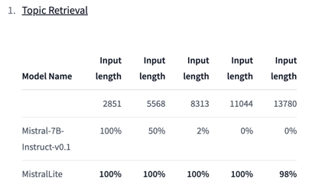
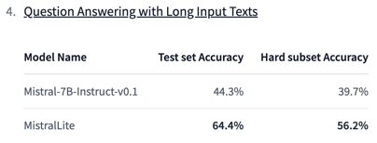
amazon / MistralLite
Amazon enters the open source LLM game
with a RoPE fine-tuned Mistral 7B with 32k tokens context length
and good accuracy!
https://huggingface.co/amazon/MistralLite

Slide 7
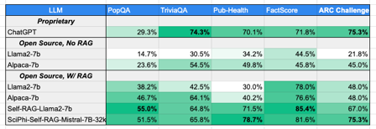

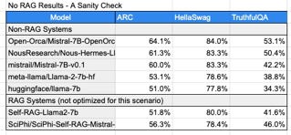
Mistral 7B for 32k context and RAG
SciPhi-Self-RAG-Mistral-7B-32k is a LLM fine-tuned from Mistral-7B-v0.1.
This model underwent the fine-tuning process described in the SciPhi-Mistral-7B-32k model card
It then underwent further fine-tuning on the recently released self-rag dataset - https://arxiv.org/abs//2310.11511
Other RAG-related instruct datasets were mixed in during this process in an effort to keep the tone of the current model
This model benchmarks well, but it needs further tuning to be an excellent conversationalist.
https://huggingface.co/SciPhi/SciPhi-Self-RAG-Mistral-7B-32k
https://huggingface.co/SciPhi/SciPhi-Mistral-7B-32k
https://sciphi.readthedocs.io/en/latest/setup/quickstart.html
https://huggingface.co/TheBloke/Mistral-7B-SciPhi-32k-GGUF
Owen Colegrove
https://www.linkedin.com/in/owencolegrove/
https://huggingface.co/emrgnt-cmplxty
https://github.com/SciPhi-AI/sciphi
https://sciphi.readthedocs.io/en/latest/
https://owencolegrove.substack.com/p/ai-can-write-near-human-level-college
https://www.sciphi.ai
https://twitter.com/owencolegrove
Owen Colegrove

Slide 8
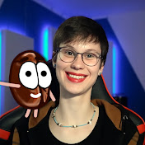
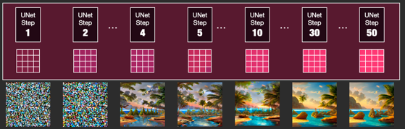
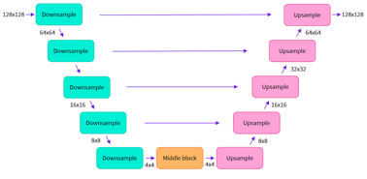
Stable Diffusion
How does Stable Diffusion work? – Latent Diffusion Models EXPLAINED https://www.youtube.com/watch?v=J87hffSMB60
https://jalammar.github.io/illustrated-stable-diffusion/
How diffusion model works:
It converts the text prompt into a embedding vector (using standard CLIP or BERT model)
This text vector is combined with random noise to form the initial latent input
The latent input then goes through the iterative diffusion process
At each step, noise is added - and the vector is fed into the U-Net (encoder/decoder)
The encoded text is injected into U-Net decoder step to guide the image generation
The U-Net predicts the noise and removes it to reverse the diffusion
The final output is a full spatial image, no separate decoding step is needed
youtube.com/@AICoffeeBreak
75 steps (typical)
U-Net

Slide 9
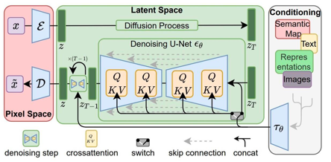
Stable Diffusion - continued
Training:
The model is trained on pairs (text + image)
The text is encoded into a text vector, this vector is combined with the image via concatenation or cross-attention.
The fused (text+image vector) is then used to train the diffusion model. By training on text and image together, the model learns associations between concepts in text and visual features
Inference:
The model starts with random latent vector and gradually modifies it through a diffusion process over multiple steps
In each step it uses U-Net which works essentially as an auto-encoder (encoder - decoder)
The noise is injected just before the U-Net of each step,
The encoded text is injected into the decoder in each step to guide the reconstruction of the image
Typical number of diffusion steps is 75
Typical size of the latent vector is 64x64x32, where 32 is the number of channels
How text embedding vector may be incorporated with the image:
Concatenate - channel-wise with the image feature maps
Project - into the same dim. space as the image features
Cross-Attention (between image and text vector)
U-Net conditional input at each U-Net decoder layer
https://stability.ai/blog/stable-diffusion-announcement (2022)
https://arxiv.org/abs/2112.10752 - original paper (2022)
https://huggingface.co/blog/annotated-diffusion - explanation
https://github.com/CompVis/stable-diffusion - code
https://en.wikipedia.org/wiki/Stable_Diffusion - Wikipedia

Slide 10
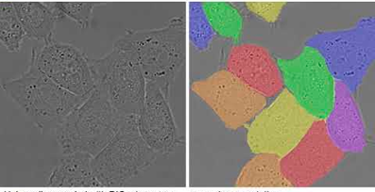
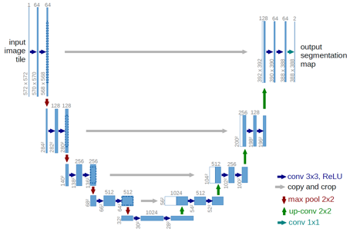
U-Net
U-Net: Convolutional Networks for Biomedical Image Segmentation https://arxiv.org/abs/1505.04597
U-Net consists of a contracting (left) and expanding (right) paths
The contracting path is a typical convolutional network that consists of repeated application of convolutions, activations, and max pooling operations to downsample the input image and extract features.
The expanding path consists of upsampling the features and concatenating them with high-resolution features from the contracting path. This allows the network to propagate context information to higher resolution layers.
There are skip connections between the left and right paths that concatenate feature maps of equal resolution allowing to retain fine-grained information from the left path.
The network has a large number of feature channels in the upsampling part, the last layer is a 1x1 convolution that maps each component feature vector to the desired number of classes (segmentation).
U-Net is trained end-to-end, pixel-to-pixel, by providing an input image and corresponding segmentation mask. The loss function (e.g. binary cross-entropy) is calculated by comparing the predicted and true segmentation masks.

Slide 11
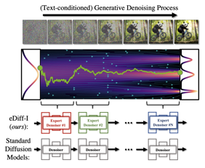
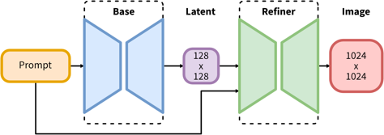
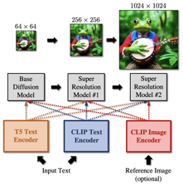
Stable Diffusion XL (SDXL-1.0 released July 2023)
https://huggingface.co/stabilityai/stable-diffusion-xl-base-1.0
https://arxiv.org/abs/2211.01324 - ensemble of experts
https://huggingface.co/stabilityai/stable-diffusion-xl-refiner-1.0
https://arxiv.org/abs/2108.01073 - SDEdit (guided image synthesis)
SDXL consists of an ensemble of experts pipeline for latent diffusion:
In a first step, the base model is used to generate (noisy) latents, which are then further processed with a refinement model for the final denoising steps
Alternatively, we can use a specialized high-resolution model on the 2nd step and apply a technique called SDEdit (img2img) to the latents generated in the first step, using the same prompt

Slide 12
VQGAN
Adding Noise
Some Stable Diffusion models can accept image as an input. They can use both VQGAN and U-Net.
VQGAN (Vector Quantized Variational Autoencoder GAN) is used to encode the input image into a discrete latent space.
The encoded latent vector is then passed to the U-Net decoder which up-samples it and generates the output image.
So in summary:
VQGAN compresses the image into a small latent vector
U-Net uses that vector to generate the output image
Adding Gaussian noise to images in Stable Diffusion:
create a tensor with the same dimension as the input image - and populate it by sampling from a Gaussian noise with mean=0 and standard deviation 1
scale the values by a noise magnitude hyperparameter
add noise tensor to input image tensor
At training time use noise scheduler to steadily reduce the noise magnitude over time - thus forcing the model to learn to generate clearer images in the presence of noise
At inference time, the noise magnitude can be controlled to trade-off between image quality and diversity. More noise leads to more diverse outputs.
Segmind Stable Diffusion (SSD-1B)
https://www.youtube.com/watch?v=30Z86i65UWg
SSD-1B is a distilled 50% smaller version of the Stable Diffusion XL (SDXL),
offering a 60% speedup while maintaining high-quality text-to-image generation capabilities
It has been trained on diverse datasets using knowledge distillation strategy, teaching several expert models in succession, including SDXL, ZavyChromaXL, and JuggernautXL, to combine their strengths and produce impressive visual outputs.
Model - https://huggingface.co/segmind/SSD-1B
Code - https://colab.research.google.com/drive/1MYz-hpaq7ywLa7Q7-tMy4hRcPB1-CQrN

Slide 13
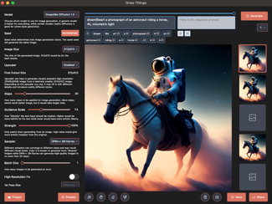
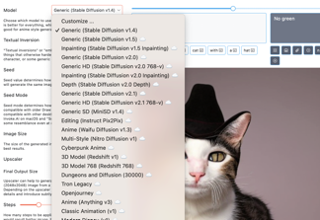
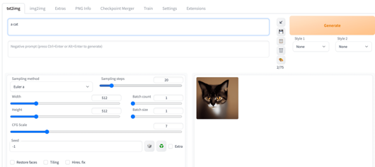
Install & run Stable Diffusion
https://stable-diffusion-art.com/sdxl-model/ - Windows, (app, 3.5B params base model + 6.6B refiner model), requires 16GB RAM, 8GB VRAM
https://stable-diffusion-art.com/install-windows/ -
https://stable-diffusion-art.com/install-mac/
Draw Things - a Mac app https://apps.apple.com/us/app/draw-things-ai-generation/id6444050820
Diffusers - a Mac app by HuggingFace https://apps.apple.com/us/app/diffusers/id1666309574
DiffusionBee - a Mac app https://diffusionbee.com/download
AUTOMATIC1111 - python, rust, browser:
brew install cmake protobuf rust python@3.10 git wget
git clone https://github.com/AUTOMATIC1111/stable-diffusion-webui.
follow install instructions
use UI at http://127.0.0.1:7860/

Slide 14
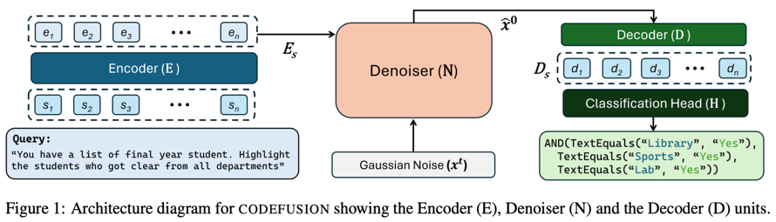
CodeFusion: A Pre-trained Diffusion Model for Code Generation
https://arxiv.org/abs/2310.17680
Imagine a developer who can only change their last line of code? Auto-regressive LLM models have a similar limitation
We introduce CodeFusion, a pre-trained diffusion code generation model that addresses this limitation by iteratively denoising a complete program conditioned on the encoded natural language
CodeFusion was evaluating for Bash, Python, and Microsoft Excel conditional formatting (CF) rules
Experiments show that CodeFusion (75M parameters) performs on par with state-of-the-art auto-regressive systems (350M-175B parameters) in top-1 accuracy; and outperforms them in top-3 and top-5 accuracy due to its better balance in diversity versus quality.

Slide 15


Ollama Updates
Dolphin 2.1 Mistral is an instruct-tuned model based on Mistral by Eric Hartford that is uncensored and licensed for both commercial and non-commercial use.
OpenHermes 2 Mistral is a new fine-tuned model based on Mistral, trained on open datasets totalling over 900,000 instructions. This model has strong multi-turn chat skills, surpassing previous Hermes 13B models and even matching 70B models on some benchmarks.
Zephyr is a fine-tuned 7B version of mistral that was trained on a mix of publicly available, synthetic datasets and performs as well as Llama 2 70B in many benchmarks.
Mistral OpenOrca is a 7 billion parameter model fine-tuned on top of the Mistral 7B model using the OpenOrca dataset.

Slide 16
Misc
Transcribe 5 hours of audio in 10 minutes with OpenAI’s Whisper Large v2
https://huggingface.co/openai/whisper-large-v2
https://github.com/Vaibhavs10/insanely-fast-whisper
Optimists have a life span 11-15% longer than pessimists
PocketLLM - local app for RAG semantic search
https://www.thirdai.com/pocketllm/
President Biden has issued a first US government regulation on AI, specifically on AI safety
Developers of higher-risk AI must share the results of safety testing and risk assessments with the government before public release
Federal agencies must create standards for responsible AI development, including labeling AI-generated content
Specific anti-discrimination measures in areas like housing and benefits programs potentially using biased algorithms
Criticism: no strong enforcement mechanisms, no tools to address immediate disinformation threats
How many LLM startups have you founded this week so far?
Google agreed to invest up to $2 Bln in Anthropic
($500 Mln upfront). Anthropic, the creator of the Claude 2 chatbot, was valued earlier this year at $4.1 Bln
Practical RAG Application Design
https://pub.towardsai.net/practical-considerations-in-rag-application-design-b5d5f0b2d19b#04a3
Microsoft - Enterprise Co-pilot for Office 365 (300+ users at $30/mo per user) - dedicated AI servers in Azure cloud
https://www.cnet.com/tech/services-and-software/microsoft-365-copilot-ai-tool-will-cost-30-per-month-launching-nov-1/

Slide 17


Improving AI Accuracy - The Talmudic Reasoning
Word "Talmud" = "Study", "Instruction", "Learning"
The Talmud is a compendium of Jewish law, stories, ethics, and debates
The Talmudic way of learning is asking questions
The method of study reflects a deep emphasis on analytical thinking, critical questioning, and dialogue
Layered Questions - diving deeper into nuances
Challenging Assumptions (ask "why ?")
Dialogical Approach ("chevruta" = partnership), students debate
Using Hypothetical scenarios (ask "what if ?") to explore different angles of a topic
Comparing Cases: "How is this case different from that one?" or "If in this situation we rule this way, then what about in that situation?"
Seeking Sources ("What is the source for this?" or "Where do we learn this from?" )
Practical Implications ("How does this apply in practice?" or "What should one do in such a situation?")
Clarifying Terminology (clarify definitions or the meaning of specific words)
Analyzing Logic and Reasoning - ask about the logical progression or reasoning behind a particular statement or ruling, delving into the underpinnings of a given argument.
Emphasizing Context - understanding the broader context, probe the broader setting or background
Idea - use Talmud texts as training data for an LLM. For example, fine-tune Mistral model

Slide 18
weekly ML terms
Bandit frameworks - named after casino slot machines called "one-armed bandits". Pulling an arm of the machine may give a reward. The learner repeatedly selects from a set of options (arms of a bandit) to learn the probabilities (distributions). The learner must balance exploiting options with higher observed rewards so far vs. exploring less tested options to get better estimates (exploration-exploitation tradeoff in sequential decision making).
Multi-armed bandits - having unknown reward distributions
Contextual bandits - receive extra context info).
Bayesian bandits - treat unknown reward distributions as priors and update beliefs about them as rewards are observed
Adversarial bandits - environment provides rewards in an adversarial manner rather than stochastic. Exploitation is risky so more exploration is needed.
Algorithms:
epsilon-greedy (epsilon is the probability of choosing exploration, it decreases with time)
UCB1 (Upper Confidence Bound 1) - simple algorithm for balancing exploration and exploitation
Thompson sampling - handles exploration/exploitation trade-off automatically through random sampling
Active learning - the algorithm asks for user labeling.
First, the algorithm is trained on a small labeled dataset.
Then algorithm tries to automatically label a bigger dataset calculating a confidence score for each row. The human is then manually labels the rows with low scores. Then the algorithm is re-trained, re-calculates scores, etc.
Active learning aims to minimize the number of labels needed to achieve high accuracy.
Use cases: classification (text, image), information retrieval, stream-based selective sampling (selecting which example to label from an incoming unlabeled dataset)
Causal inference - drawing conclusions about cause-effect relationships (not just association or correlation). It is done by developing and analyzing a causal model. The model is then tested via randomized controlled trials. Important to control for confounding factors that could influence the relationship between variables. Methods include matching, propensity score analysis, and instrumental variables.
Use cases - medicine, social sciences, economics, public policy. Challenges involve unmeasured confounding factors and the complexity of causal mechanisms in the real world.

Slide 19
Self-RAG
Self-RAG: Learning to Retrieve, Generate, and Critique through Self-Reflection
https://arxiv.org/abs//2310.11511
https://arxiv.org/pdf/2310.11511.pdf
(Univ. of Washington & IBM)
Despite their remarkable capabilities, large language models (LLMs) often produce responses containing factual inaccuracies due to their sole reliance on the parametric knowledge they encapsulate.
Retrieval-Augmented Generation (RAG), an ad hoc approach that augments LMs with retrieval of relevant knowledge, decreases such issues.
However, indiscriminately retrieving and incorporating a fixed number of retrieved passages, regardless of whether retrieval is necessary, or passages are relevant, diminishes LM versatility or can lead to unhelpful response generation.
We introduce a new framework called Self-Reflective Retrieval-Augmented Generation (Self-RAG) that enhances an LM's quality and factuality through retrieval and self-reflection.
Our framework trains a single arbitrary LM that adaptively retrieves passages on-demand, and generates and reflects on retrieved passages and its own generations using special tokens, called reflection tokens.
Generating reflection tokens makes the LM controllable during the inference phase, enabling it to tailor its behavior to diverse task requirements.
Experiments show that Self-RAG (7B and 13B parameters) significantly outperforms state-of-the-art LLMs and retrieval-augmented models on a diverse set of tasks.
Specifically, Self-RAG outperforms ChatGPT and retrieval-augmented Llama2-chat on Open-domain QA, reasoning and fact verification tasks, and it shows significant gains in improving factuality and citation accuracy for long-form generations relative to these models.

Slide 20
Typical modules used for model fine-tuning
# Typical requirements for fine-tuning
!pip install -q -U bitsandbytes
!pip install -q -U git+https://github.com/huggingface/transformers.git
!pip install -q -U git+https://github.com/huggingface/peft.git
!pip install -q -U git+https://github.com/huggingface/accelerate.git
!pip install -q datasets
bitsandbytes - a lightweight wrapper around CUDA custom functions, in particular 8-bit optimizers, matrix multiplication (LLM.int8()), and quantization functions
https://github.com/facebookresearch/bitsandbytes - moved to:
https://github.com/TimDettmers/bitsandbytes
https://pypi.org/project/bitsandbytes/
HuggingFace modules:
transformers - https://github.com/huggingface/transformers
peft - https://github.com/huggingface/peft - Parameter-Efficient Fine-Tuning (PEFT) methods
accelerate - https://github.com/huggingface/accelerate - run PyTorch training on different GPUs, TPU, fp16
datasets - https://github.com/huggingface/datasets - data loading and pre-processing (from HuggingFace and local)

Slide 21
Thank You!

