Slide 1

ChatGPT and How You Can Make Money With It
Rachael Phillips

Slide 2

Rachael Phillips – Senior Consultant at Microsoft
Rachael.aphillips@outlook.com
rphillips@microsoft.com
www.rachaelphillipsdataexpert.com

Slide 3
AGENDA
LLMs = Large Language Models
What is ChatGPT and What Can It Do?
Creation of ChatGPT
3 Great Ways To Make Money with ChatGPT
How to use ChatGPT to make money making browser extension
How to use ChatGPT to make money by creating a web tool
How to use ChatGPT to write a children’s book
The End

Slide 4
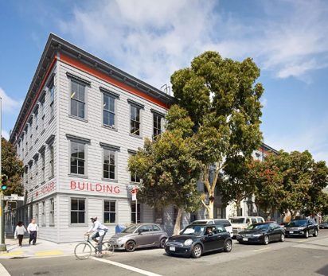
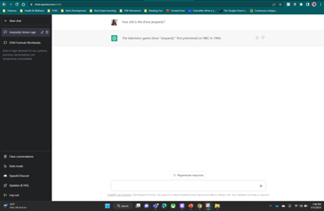
What is. ChatGPT and what can it do?
ChatGPT is a natural language processing tool by OpenAI where you can have human like conversations with an AI chatbot.
ChatGPT is open-source (for the time being) and all you need to do is create a free account.
There are several tasks it can be used for, such as:
Answering simple, Google-style questions
Generating code
Writing creative stories
Writing blogs
Suggesting YouTube Videos
It can assist with lyrics, chord progressions, and song structure but cannot create or write music
Can write romantic poems and short stories
Can write summaries of books
Can help with homework solutions
OpenAI headquarters is in San Francisco, CA

Slide 5



Creation of ChatGPT
ChatGPT is an extension of the GPT (Generative Pre-trained Transformer) language model that was developed by OpenAI, a private artificial intelligence research laboratory consisting of the for-profit OpenAI LP and its parent company, the non-profit OpenAI Inc.
The development of GPT-3 was led by the OpenAI team, with the primary contributors being:
Ilya Sutskever, who is one of the co-founders of OpenAI and is also the company's Chief Scientist.
Alec Radford, who is a Research Engineer at OpenAI.
Jeff Wu, who is a Research Engineer at OpenAI.
Narinder Singh, who is an AI researcher at OpenAI
ChatGPT is based off GPT-3, which has 175 billion parameters. It is one of the largest language models that has been trained to date, making it capable of a wide range of language tasks. – Includes natural language understanding, language translation, text summarization, text completion, and text generation.
It's also important to highlight that GPT-3 was trained on a dataset of internet text, So it's a collective effort of many contributors to the internet and the OpenAI team to developed this model.
Ilya Sutskever
Alec Radford
Jeff Wu

Slide 6
3 great ways to make money with ChatGPT
Money Making Browser Extension
Money Making Web Tool
Write a Book

Slide 7
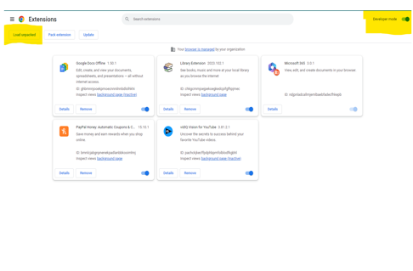
How to use chatgpt to make money making browser extension
Step 1:
Think of a good google chrome extension idea, it must be a simple idea (example: change any recipe online wording from “milk” to “vegan milk” and name the extension veganize)
Step 2:
Ask chatgpt to create a google chrome extension that can change the word “milk” to “vegan milk” when there is a vegan recipe on a webpage and call it veganize
Step 3:
Follow the instructions from chatgpt and copy the code output from chatgpt
Step 4:
Go to google chrome extensions page and click developer tools
Step 5:
Load the folder that contains the code that the chatgpt instructions wrote for you

Slide 8
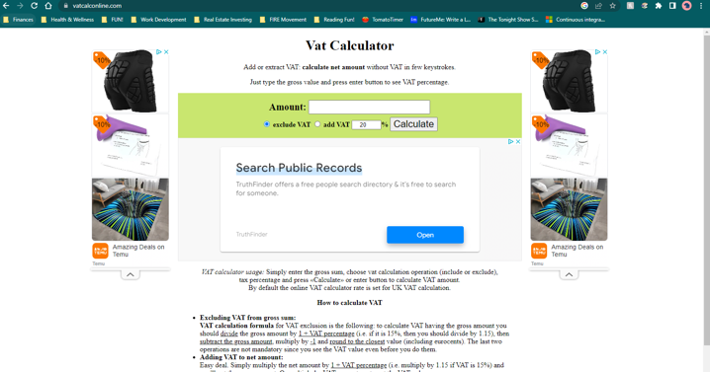
How to use chatgpt to make money by creating a web tool
Step 1:
Think of a tool that you think would be a good web tool (Example: VAT Calculator)
Step 2:
Ask ChatGPT to create a html for a VAT calculator that allows users to input a value and click a button that adds the VAT amount to that amount. It also has a button to remove the amount afterwards.
Step 3:
Paste the output code into a website developer tool
Step 4:
Create a website and use the code after maybe adding something better visually.

Slide 9
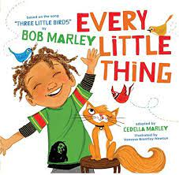
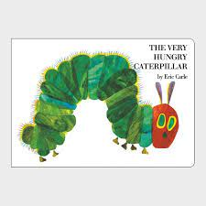
How to use ChatGPT to write a children’s book
Step 1:
Have ChatGPT write a story for you with a specific character and a scenario that they overcame. (Example: Timmy the shy bear fears school)
Step 2:
Have ChatGPT describe what the character looks like (Example: Timmy the shy bear)
Step 3:
Paste that description into the website discord page on midjourney with /imagine and pasting the description into the prompt
Step 4:
Create your book with visuals from midjourney of what your character is doing in the short story that ChatGPT wrote for you.
Step 5:
Once you have the book is finalized, use a tool such as book bolt studio to create the entire book and download as a pdf.
Step 6:
Go to Amazon’s kdp and upload your pdf.

Slide 10
References
Who created ChatGPT? Origins of ChatGPT and GPT Model (learnchatgpt.com) .. https://learnchatgpt.com/who-created-chatgpt/
ChatGPT – Wikipedia .. https://en.wikipedia.org/wiki/ChatGPT
4 GENIUS Ways To Make Money with ChatGPT (Must See) 🤯 – YouTube .. https://www.youtube.com/watch?v=5_tBWIZ8S_A
Who owns OpenAI ChatGPT and when did it launch? (hitc.com) .. https://www.hitc.com/en-gb/2022/12/07/who-owns-openai-chatgpt-and-when-did-it-launch/
How To Earn Money Using ChatGPT and Amazon #openai #chatgpt #makemoneyonline – YouTube .. https://www.youtube.com/watch?v=ZmuHnoBNa-8
https://chat.openai.com/
https://midjourney.com/home/?callbackUrl=%2Fapp%2F
https://bookbolt.io/

Slide 11
THANK YOU

