Slide 1
Today's topic:
How do we evaluate the quality
of a binary classifier or a medical test ?
Precision, Recall, ROC, AUC,
F1, Sensitivity, Specificity, etc.
Lev Selector
January 22, 2021

Slide 2
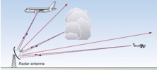
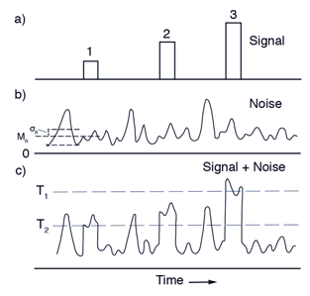
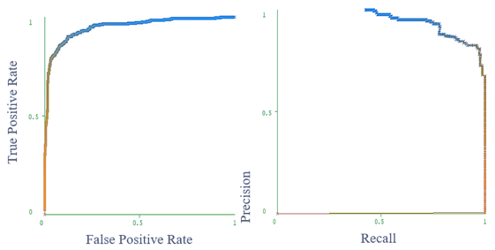

ROC Curve & Precision-Recall Curve
Receiver Operating Characteristic (ROC) curves for a binary classifier:
True Positive Rate (TPR) vs False Positive Rate (FPR)
at various threshold settings.
ROC curve was first developed by radar engineers during World War II
for detecting enemy objects.
TPR = REC = Recall or Sensitivity = TP/P = TP / (TP + FN)
( planes classified as planes / all planes' events)
FPR = False Positive Rate = fall-out = FP / N = FP / (FP + TN)
( noise classified as planes / all noise events )
PRE = Precision = TP/(TP+FP)
( planes classified as planes / all events classified as planes)
TNR = SPC = Specificity = TN/N = TN/(FP+TN)
(True Negative Rate)
--------------------------------------------------------------------------------
AUC = Area Under the Curve
Simply the area under the ROC curve (1 = very good, 0.5 = bad)
--------------------------------------------------------------------------------
F1 Score - a single number evaluation metric, harmonic average
of the precision and recall :
Radar detects planes.
It need to separate
"plane" signals from noise.
Planes
Noise
High Precision, Low Recall
Selecting Threshold
Low Precision, High Recall
Recall
Low Threshold
ROC
Curve
Precision-Recall
Curve
High Threshold
FPR

Slide 3


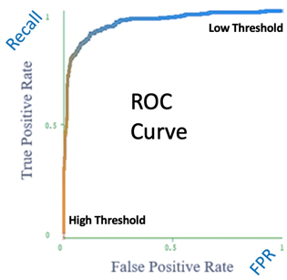
Noise
Planes
Noise
Planes
Precision – 100%
Recall – 15%
Good Precision = Sniper
Noise
Planes
Precision – 50%
Recall – 100%
Good Recall = Cover All
Good
Noise
Planes
Ideal:
Precision – 100%
Recall – 100%
+
Noise
Planes
Good:
Precision – 90%
Recall – 90%

Slide 4
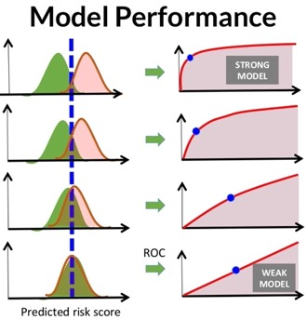
For measuring the performance of retrieval systems, several measures are used that depends on the following four major parameters:
True Positive (TP): True is identified True (correct identification)
True Negative (TN): False is identified False (correct identification)
False Positive (FP): True is identified False (wrong identification)
False Negative (FN): False is identified True (wrong identification)
P = TP + FN (number of correct identification cases)
N = FP + TN (number of wrong identification case) 25
Sensitivity = Recall = True Positive Rate (TPR) : TPR = (TP / P) = TP / (TP + FN)
Specificity (SPC) or True Negative Rate (TNR) : SPC = (TN / N) = TN / (FP + TN)
Precision or Positive Predictive Value (PPV) : PPV = TP / (TP + FP)
Negative Predictive Value (NPV) : NPV = TN / (TN + FN)
Fall-Out or False Positive Rate (FPR) : FPR = (FP / N) = FP / (FP + TN) = 1 – SPC
False Discovery Rate (FDR) : FDR = FP / (FP + TP) = 1 – PPV
Miss Rate or False Negative Rate (FNR) : FNR = FN / (FN + TP)
Accuracy (ACC) : ACC = (TP+TN) / (P+N)
F1 Score : F1 = 2*TP/(2*TP+FP+FN)
Mathews Correlation Coefficient (MCC):
MCC=(TP*TN-FP*FN)/sqrt((TP+FP)*(TP+FN)*(TN+FP) *(TN+FN))
Informedness = Sensitivity + Specificity -1
Markedness = Precision + NPV -1
From:
https://www.researchgate.net/post/How_do_I_calculate_the_false_alarm_rate_for_face_detection
From:
https://www.slideshare.net/KristenHunter/civitas-learning-understanding-roc-curves

Slide 5
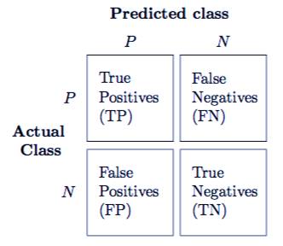
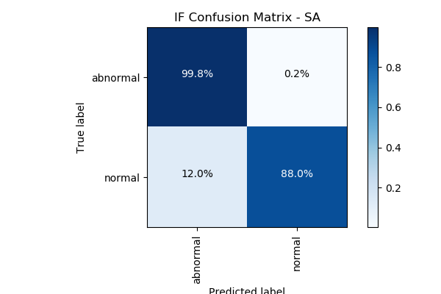
Confusion Matrix
For a simple binary classifier we are predicting one of two possibilities (Yes/No, Positive/Negative, Plane/No-Plane, Normal/Abnormal, etc.).
So we construct a 2x2 matrix to visualize True & False Positives and Negatives.
from sklearn import metrics
expected = target
predicted = model.predict(data)
metrics.precision_score(expected, predicted)
metrics.recall_score(expected, predicted)
metrics.roc_curve(expected, predicted)
metrics.roc_auc_score(expected, predicted)
metrics.confusion_matrix(expected, predicted)
[[194156 4864]
[ 23 321]]
Accuracy = sum(Diagonal) / sum(ALL) = sum(Correct) / sum(ALL)
Precision = TP / (TP+FP)
Recall = TP / (TP+FN) = TP / All_Actual_Positives

Slide 6

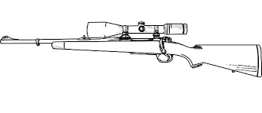

Accuracy = sum(Diagonal) / sum(ALL)
Precision = TP / (TP+FP) = TP / Predicted_Positives
Sniper
- high precision (zero FP)
- low recall (can't get everything)
Recall = TP / (TP+FN) = TP / Actual_Positives
Nuclear Bomb
- low precision (many FP)
- high recall (get everything)

Slide 7
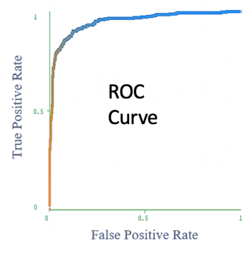
Good ROC curve is above diagonal
Optimal threshold – cut off most of noise, but catches most of planes
TP/P
Low Threshold – detect all events and all noise
Very high threshold.
Cut off all noise – and
most of "planes"
FP/N
ROC curve axes:
vertical = True Positives / All Actual Positives
horizontal = False Positives / All Actual Negatives

Slide 8
Medical Test Paradox – Predictive Power of Positive or Negative Test Result
from https://www.youtube.com/watch?v=lG4VkPoG3ko
Healthy
Sick
We have 1,000 people.
1% of them have a disease:
N_sick = 10
N_healthy = 990
We use a test with sensitivity SE = 90% and specificity SP = 91%.
This means that test shows results as following:
TP = True Positive = N_sick * SE/100 = 9 out of 10
TN = True Negative = N_healthy * SP/100 = 901 out of 990
FN = False Negative = 1 out of 10
FP = False Positive = 89 out of 990
What is the predictive power of this test?
Positive result : TP/(TP+FP) = 9/(9+89) = 0.092 (1 in 11 chance)
Negative result : TN/(TN+FN) = 901/(901+1) = 0.999 (very good)
Test Results:
Red = Positive
White = Negative
Specificity
Sensitivity
 | Positive | Negative
Disease | 9 | 1
Healthy | 89 | 901
Sensitivity = Recall = True Positive Rate (TPR) : TPR = (TP / P) = TP / (TP + FN)
Specificity (SPC) = True Negative Rate (TNR) : SPC = (TN / N) = TN / (FP + TN)

Slide 9
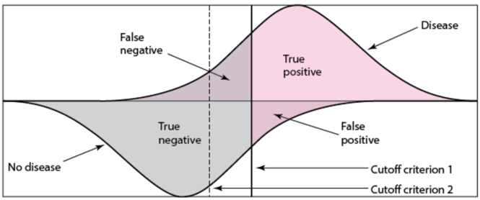
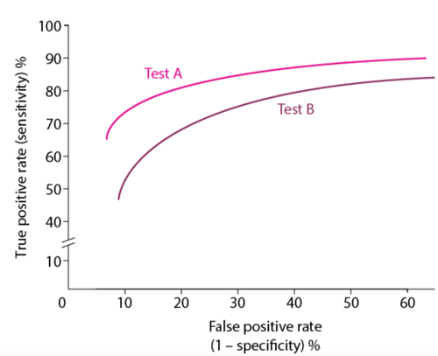
Medical Tests
Merck Manuals:
https://www.merckmanuals.com/professional/special-subjects/clinical-decision-making/understanding-medical-tests-and-test-results
Healthy
Sick
Typical ROC Curves

