Slide 1
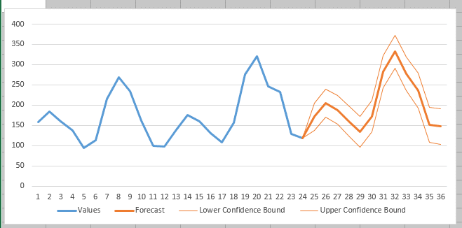
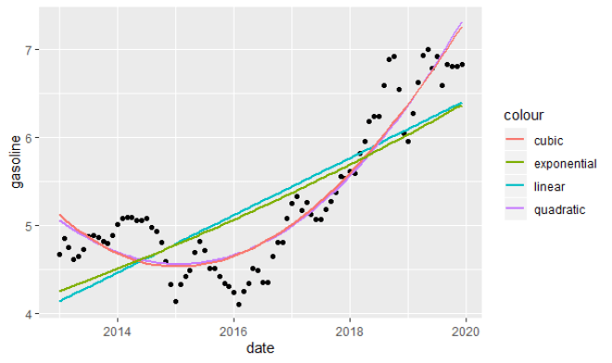
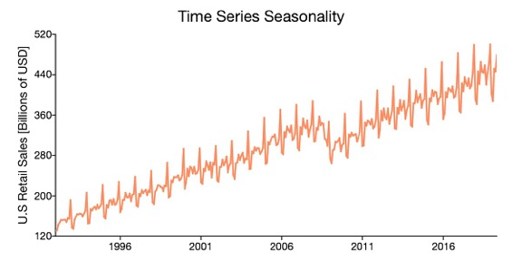
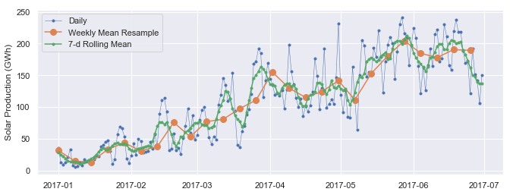
Lev Selector
February 5, 2021
Time Series Forecasting

Slide 2
Forecasting methods
Qualitative, Naive (forecast = last value, or an average of last period)
Trend, Linear Regression
Multivariate Linear Regression
Exponential Smoothing (weighted moving average)
Holt-Winters = Triple Exponential Smoothing (smooth, trend, seasonality)
Seasonality in the model using Fourier decomposition (over 4+ years)
ARMA (Auto-Regressive Moving Average), ARIMA (Auto-Regressive Integrated Moving Average) SARIMA (S=Seasonality), SARIMAX (X - eXogenous regressors)
Auto-correlations, bivariate cross-correlation, multivariate time series analysis
Causal (cause-effect) - modeling specific causes/drivers that can influence the target value (drivers – number of resources, spending on advertising, promotion, legal change, website redesign, sport event, new law, election, etc.). Some drivers cause permanent shift, others – temporary response.
Random Walk Simulation (Monte-Carlo) – when having causal model
Classification (Random Forest, Boosting, etc.) - "this type of ... historically was causing ..."
Neural Networks - LSTM (Long Short Term Memory), multivariate LSTM, GRU (Gated Recurrent Unit)
Facebook Prohpet -
Azure AutoML -
etc.

Slide 3
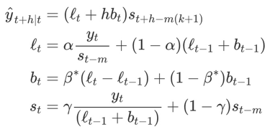
Forecasting in Power BI
Holt-Winters’ multiplicative method (~ 1960)
Power BI uses exponential smoothing and backtesting (hindcasting).
There are two algorithms:
.... a variation of the Holt-Winters algorithm for the seasonal data with a few changes to deal with noisy data
.... a simpler model for non-seasonal data which has a term for additive trend and additive error
For the seasonal forecasting, PBI modify the Holt-Winters algorithm by computing the sum of squares of prediction errors for what is called a validation window, instead of using the one-step ahead.
Another modification they make is when they detect large variations, they adjust the trend of the time window to a more recent to capture the overall trend of the time series.
... https://otexts.com/fpp2/holt-winters.html -
... https://powerbi.microsoft.com/es-es/blog/describing-the-forecasting-models-in-power-view/#ETSAAA -
... https://powerbi.microsoft.com/en-us/blog/introducing-new-forecasting-capabilities-in-power-view-for-office-365/#:~:text=The%20Power%20BI%20Team&text=Forecasting%20in%20Power%20View%20utilizes,from%20a%20series%20of%20data -
... https://stoneridgesoftware.com/take-advantage-of-forecasting-in-power-bi-with-the-analytics-pane/ -
... https://pawarbi.github.io/blog/forecasting/python/powerbi/forecasting_in_powerbi/2020/04/24/timeseries-powerbi.html -
... https://pawarbi.github.io/blog/forecasting/python/powerbi/forecasting_in_powerbi/2020/04/24/timeseries-powerbi.html#ETS(AAN) -

Slide 4
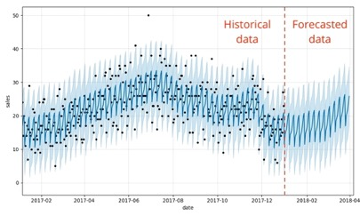
Forecasting using Facebook Prophet
.. https://github.com/facebook/prophet -
.. https://youtu.be/pOYAXv15r3A - (video)
.. https://facebook.github.io/prophet/docs/quick_start.html -
.. https://databricks.com/blog/2020/01/27/time-series-forecasting-prophet-spark.html -
.. Forecasting time series data based on an additive model where non-linear trends are fit with yearly, weekly, and daily seasonality, plus holiday effects.
.. It works best with time series that have strong seasonal effects and several seasons of historical data.
.. Prophet is robust to missing data and shifts in the trend, and typically handles outliers well.
Neural Prophet
.. https://towardsdatascience.com/neural-prophet-a-time-series-modeling-library-based-on-neural-networks-dd02dc8d868d -
.. https://github.com/ourownstory/neural_prophet -
.. Much faster than Prophet, uses PyTorch - https://pytorch.org/ , uses AR-Net for modeling time-series autocorrelation .. https://ai.facebook.com/blog/ar-net-a-simple-autoregressive-neural-network-for-time-series/ -
.. Custom losses and metrics, configurable non-linear layers of feed-forward neural networks, etc.
black dots - actuals
dark blue - predictions
light blue - 95% uncertainty intervals
The input to Prophet is always a dataframe with two columns: ds and y.
The ds (datestamp) column should be of a format expected by Pandas, ideally YYYY-MM-DD for a date or YYYY-MM-DD HH:MM:SS for a timestamp.
The y column must be numeric, and represents the measurement we wish to forecast.

Slide 5
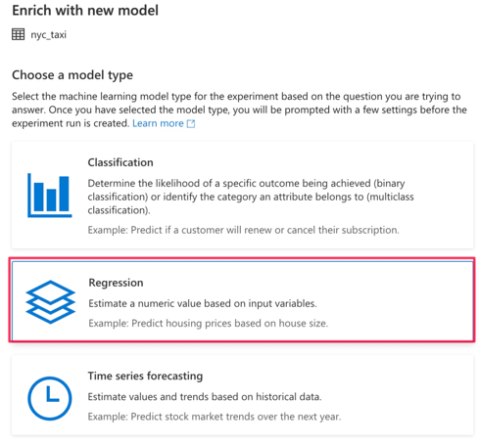
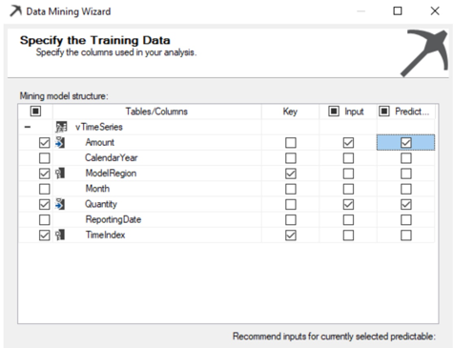
Forecasting Using Azure AutoML
or MSFT Time Series in SQL Server
AutoML Wizard - https://docs.microsoft.com/en-us/azure/synapse-analytics/machine-learning/tutorial-automl
Microsoft Time Series in SQL Server
- https://www.sqlshack.com/microsoft-time-series-in-sql-server/

Slide 6
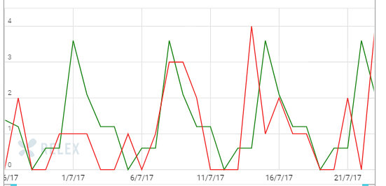
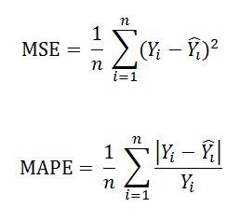
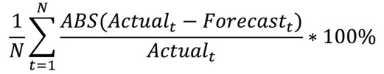
Model Quality Evaluation
How to Calculate Forecast Accuracy: https://www.callcentrehelper.com/calculate-forecast-accuracy-113808.htm
Mean Squared Error
Mean Absolute Percentage Error
MAPE =

Slide 7
More Details about different forecasting models

Slide 8
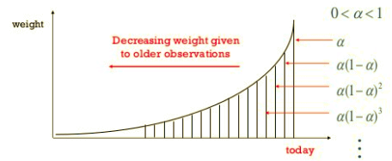
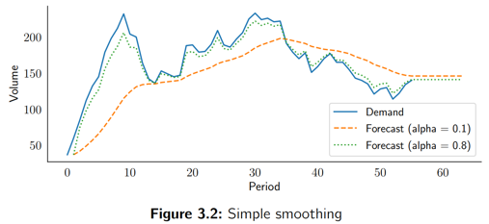
Exponential Smoothing
Exponential Smoothing - a weighted moving average,
where weights decline exponentially for older events.
If x(t) is real time series, then we construct forecast f(t)
step by step using formula:
f_{t+1} = a*x_{t} + (1-a)*f_{t}
We initiate f₀ as an average of first several points.
For future points (once we out of historical period) we simply extrapolate last value into the future.
Limitations of simple exponential smoothing model:
it does not project trends
it does not recognize seasonal patterns
it cannot use any external information
Good simple explanations by Nicolas Vandeput:
.. https://towardsdatascience.com/simple-exponential-smoothing-749fc5631bed
Python code:
.. https://towardsdatascience.com/diy-simple-exponential-smoothing-with-python-dbb570d30fb5

Slide 9
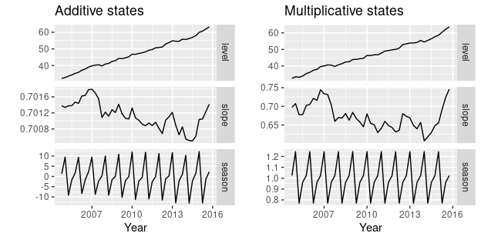
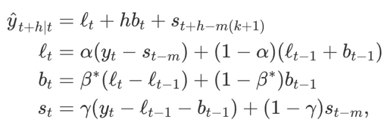
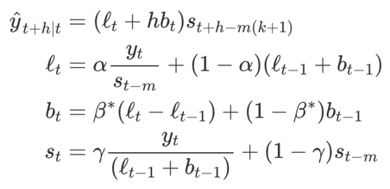
Holt-Winters = Triple Exponential Smoothing
Holt-Winters = Triple Exponential Smoothing
1st smoothing (level) -exponential smoothing for value
2nd smoothing (trend) - exponential smoothing for slope
3rd smoothing - exponential smoothing comparing to previous cycle
.. https://towardsdatascience.com/holt-winters-exponential-smoothing-d703072c0572 -
.. https://orangematter.solarwinds.com/2019/12/15/holt-winters-forecasting-simplified/ -
additive method
The additive method is preferred when the seasonal variations are roughly constant through the series, while the multiplicative method is preferred when the seasonal variations are changing proportional to the level of the series.
With the additive method, the seasonal component is expressed in absolute terms in the scale of the observed series, and in the level equation the series is seasonally adjusted by subtracting the seasonal component.
Within each year, the seasonal component will add up to approximately zero.
With the multiplicative method, the seasonal component is expressed in relative terms (percentages), and the series is seasonally adjusted by dividing through by the seasonal component. Within each year, the seasonal component will sum up to approximately m .
multiplicative method

Slide 10
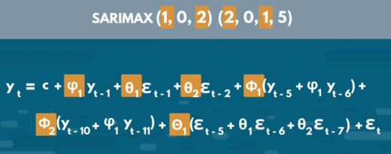
ARMA, ARIMA, SARIMAX
Auto-Regressive Moving Average model
Auto-Regressive Integrated Moving Average model
Seasonal Autoregressive Integrated Moving Average Exogenous model
ARIMA(p,d,q) (Auto-Regressive Integrated Moving Average)
p - number of autoregressive terms,
d - number of nonseasonal differences needed for stationarity
q - number of lagged forecast errors
ARIMA(1,0,0) - 1st order autoregressive model
ARIMA(2,0,0)) - oscillations
ARIMA(0,1,0) - random walk
ARIMA(1,1,0) - differenced first-order autoregressive model
ARIMA(0,1,1) - simple exponential smoothing:
ARIMA(0,1,1) - simple exponential smoothing with growth
ARIMA(1,1,1) - ...
ARIMA(0,2,1) - linear exponential smoothing
ARIMA(0,2,2) - linear exponential smoothing
- https://en.wikipedia.org/wiki/Autoregressive%E2%80%93moving-average_model
- https://en.wikipedia.org/wiki/Autoregressive_integrated_moving_average
- https://www.statsmodels.org/dev/examples/notebooks/generated/statespace_sarimax_stata.html
- https://365datascience.com/tutorials/python-tutorials/sarimax/
Autoregressive Model: - https://www.youtube.com/watch?v=5-2C4eO4cPQ -
Autocorrelation and Partial Autocorrelation - https://www.youtube.com/watch?v=DeORzP0go5I -
ACF and PACF:
- https://towardsdatascience.com/significance-of-acf-and-pacf-plots-in-time-series-analysis-2fa11a5d10a8 -
ARMA (Auto-Regressive Moving Average) - tries to describe a process as a sum of two processes - signal (AR) and noise (MA) - and then extrapolate signal into the future. .. https://people.duke.edu/~rnau/411arim.htm
ARMA(t) = AR(t) + MA(t), where AR is a weighted sum of "P" previous values,
and MA is weighted average of "Q" previous (white noise) errors:
AR : Y(t) = a0 + a1*Y(t-1) + ... + aP*Y(t-P) +
Z(t) -b1*Z(t-1) - ... -bQ*Z(t-Q)
SARIMAX

Slide 11
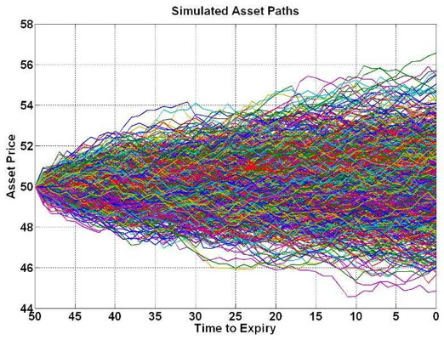
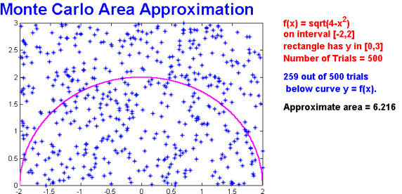
Monte Carlo Examples:
In the example above relative error is ~1/sqrt(N)
= 1/sqrt(259.0) = 0.062 (or ~6%)
MCMC – Markov Chain Monte Carlo (random walk)

Slide 12
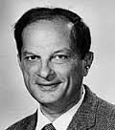
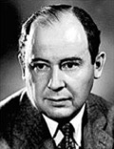
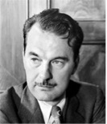

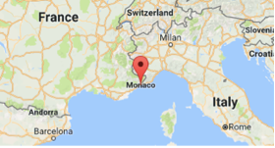

What is “Monte Carlo” ?
Monte Carlo method - use random sampling to obtain numerical results. It was invented in the late 1940s by Stanislaw Ulam, while he was working on nuclear weapons projects at the Los Alamos National Laboratory.
Nicholas Metropolis has suggested using the name Monte Carlo, which refers to the Monte Carlo Casino in Monaco.
Monte Carlo officially refers to an administrative area of the Principality of Monaco, specifically the ward of Monte Carlo/Spélugues, where the Monte Carlo Casino is located.
Casino’s name “Monte Carlo” means literally "Mount Charles”. It was chosen in 1863 in honor of Charles III, Prince of Monaco.
Stanislaw Ulam
John von Neuman
Nicholas Metropolis

Slide 13
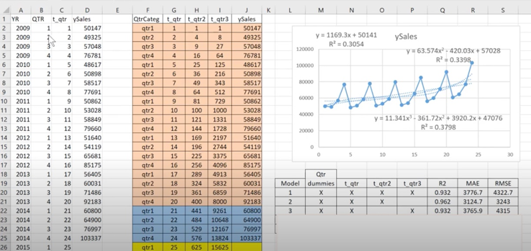
Time series forecasting with Multiple Linear Regression
Use multi-dimensional linear regression to get coefficients of the model.
.. Take quarterly values (or monthly values) – and put them into separate columns.
This way we have multiple time serieses
.. Model trend as a polynomial function – need to tune coefficients.
We use regular linear regression model to find best fit and find coefficients.
Here is a nice description with Python code:
- https://www.youtube.com/watch?v=td9QLuijh9c

Slide 14
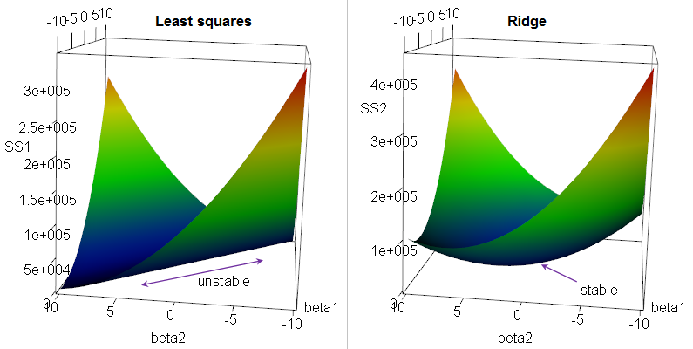

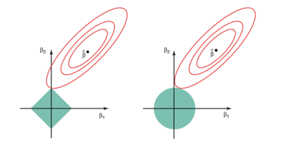
Regression: Ridge, LASSO, Elastic Net
Multivariate (multiple) Linear Regression Regularization.
Suppose we have a OLS (Ordinary Linear Squared) regression where two parameters x1 & x2
are not orthogonal, but in fact highly correlated.
Then there may be is infinite number of coefficients which will fit the model.
For example, (x1 - x2), (10*x1 - 10*x2), (100*x1 - 100*x2), etc.
If we are trying to minimize the cost function in the multidimensional
space of coefficients, we will get an infinite diagonal groove (ridge) for x1=x2.
Any place at the bottom of this ridge is equally good for us.
So we will get a big variability in possible values of coefficients for x1 & x2.
The solution will be unstable.
We can reduce this variability by adding additional regularization factor like this:
Why Ridge Regression is called Ridge ...
When we minimizing this expression, bigger "lambda" value will cause smaller "beta" values, thus keeping the coefficients "beta" from becoming too large.
This is called "Ridge Regression". It changes the infinitely long ridge into a local minimum.
In Ridge Regression we add a "regularization" term as sum of squares (L2 norm).
If instead we use L1 norm (sum of abs values) - it is called "LASSO Regression",
where LASSO = Least Absolute Shrinkage and Selection Operator.
LASSO favors solutions on the tips of the bounding surface for coefficients, where some of coefficients are zero. Thus it favors "sparse" solutions.
A combination of Ridge Regression and LASSO Regression is called "Elastic Net"
Why LASSO favors sparse solutions

Slide 15
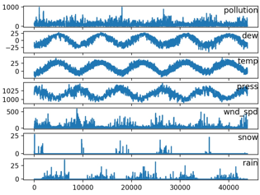
Multivariate Forecasting Using LSTM
Multivariate Time Series Forecasting with LSTMs in Keras (2020) - by Jason Brownlee
- https://machinelearningmastery.com/multivariate-time-series-forecasting-lstms-keras/
Time Series Prediction With Deep Learning in Keras (2020) - by Jason Brownlee
- https://machinelearningmastery.com/time-series-prediction-with-deep-learning-in-python-with-keras/
Neural networks for algorithmic trading. Multivariate time series (2017)
- https://medium.com/machine-learning-world/neural-networks-for-algorithmic-trading-2-1-multivariate-time-series-ab016ce70f57
Energy Demand Time Series Forecasting (2017)
- https://github.com/Azure/MachineLearningSamples-EnergyDemandTimeSeriesForecasting

Slide 16
XGBoost for Time Series Forecasting
"""
XGBoost can be used for time series forecasting, although it requires that the time series dataset be transformed into a supervised learning problem first.
It also requires the use of a specialized technique for evaluating the model called walk-forward validation, as evaluating the model using k-fold cross validation would result in optimistically biased results.
"""
- Jason Brownlee
https://machinelearningmastery.com/
Here are some links with python code:
- https://machinelearningmastery.com/xgboost-for-time-series-forecasting/ -
- https://www.kaggle.com/getting-started/48536 -
- https://towardsdatascience.com/using-gradient-boosting-for-time-series-prediction-tasks-600fac66a5fc
# finalize model and make a prediction for monthly births with xgboost
from numpy import asarray
from pandas import read_csv
from pandas import DataFrame
from pandas import concat
from xgboost import XGBRegressor
# transform a time series dataset into a supervised learning dataset
def series_to_supervised(data, n_in=1, n_out=1, dropnan=True):
n_vars = 1 if type(data) is list else data.shape[1]
df = DataFrame(data)
cols = list()
# input sequence (t-n, ... t-1)
for i in range(n_in, 0, -1):
cols.append(df.shift(i))
# forecast sequence (t, t+1, ... t+n)
for i in range(0, n_out):
cols.append(df.shift(-i))
# put it all together
agg = concat(cols, axis=1)
# drop rows with NaN values
if dropnan:
agg.dropna(inplace=True)
return agg.values
# load the dataset
series = read_csv('daily-total-female-births.csv', header=0, index_col=0)
values = series.values
# transform the time series data into supervised learning
train = series_to_supervised(values, n_in=6)
# split into input and output columns
trainX, trainy = train[:, :-1], train[:, -1]
# fit model
model = XGBRegressor(objective='reg:squarederror', n_estimators=1000)
model.fit(trainX, trainy)
# construct an input for a new preduction
row = values[-6:].flatten()
# make a one-step prediction
yhat = model.predict(asarray([row]))
print('Input: %s, Predicted: %.3f' % (row, yhat[0]))

