Slide 1
Data Science
Machine Learning
Today's Topic – Ensemble Models
Classifiers
Random Forest and Boosting
In this file:
Bagging (averaging, voting) vs Boosting (incremental correction)
Ensemble Learning, Trees, Random Forest vs Boosing
Binary Classification - Islands - when linear separation doesn't work
Decision Tree - and how to build it
Building Tree - Gini Impurity
Building Tree - Smallest Entropy
Building Tree – CHAID
Random Forest – authors
Bagging – Boosting – Stacking
Random Forest diagram
Bootstrap Sampling
Boosting Authors
Gradient Descent, Gradient Boosting, Validation
Ada Boost diagram
Misc. links
Lev Selector
February 19, 2021

Slide 2
Idea:
make a reliable system from unreliable blocks using single-shot democratic voting
Idea:
get to correct answer by making multiple corrective steps
Power of the majority
committee, senate, congress, council, board of directors, ...
1st approximation
Power of validation
science, open source community, ...
Computer 1
correction
Data
Computer 2
Majority voting
system
Weighted
voting
system
correction
Computer 3
...
correction
Bagging
Wrong bias is not removed,
it is simply averaged
Wrong bias is removed
using correction and validation
Boosting

Slide 3
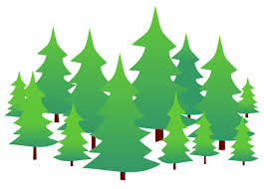
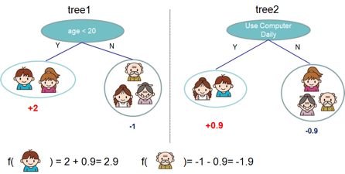
Ensemble Learning
Idea - train several models to do predictions.
Then combine predictions of these models to get a better predictor.
It is possible to combine any types of models into one predictor.
But commonly people combine variations of similar models, like decision trees models.
Two most famous approaches are:
- "Random Forest"
- "Gradient Boosted Trees"
Under the hood these models combine 100 ... 200+ similar trees.
The differences between algorithms:
how you select the data to train those trees
how you combine the predictions of these trees

Slide 4
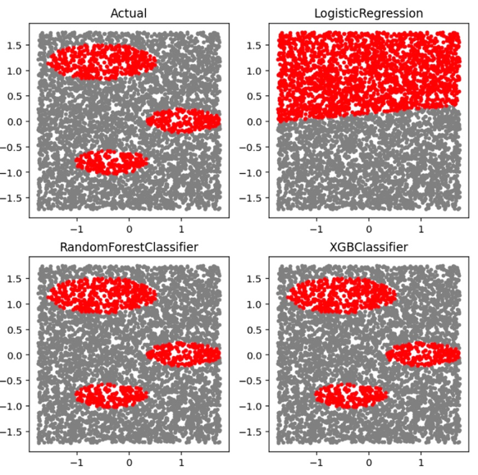
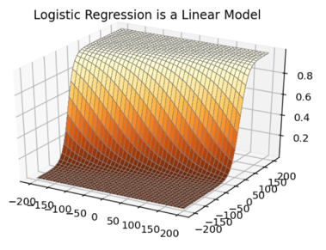
Binary Classification Problem
Example – two classes: red and grey.
Ensemble Tree Classifiers succeed
where Linear Classifiers fail
Ensemble tree classifiers
( Random Forest , XGBoost )
can solve complicated problems

Slide 5
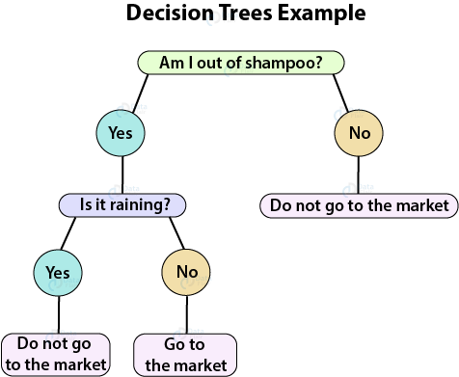
Decision Tree (DT)
DT goes from observations about an item (represented in the branches) to conclusions about the item's target value (represented in the leaves).
DT can do classification or regression.
DTs are intuitive and easily interpretable.
Algorithms for constructing DTs usually work top-down, by choosing a variable at each step that best splits the set of items.
We test all possible splits (or some subset) to decide how to split.
Simplicity is best, so we want to keep our tree small.
To do so, at each step we should choose the split that results in the purest daughter nodes.
Decision Tree Building Algorithms
ID3 (Iterative Dichotomiser 3) – uses smallest entropy metrics
C4.5 – successor of ID3
CART (Classification And Regression Tree) – uses Gini metrics
CHAID (CHi-squared Automatic Interaction Detector). Performs multi-level splits when computing classification trees.
MARS: extends decision trees to handle numerical data better.
Conditional Inference Trees. Statistics-based approach that uses non-parametric tests as splitting criteria, corrected for multiple testing to avoid overfitting. This approach results in unbiased predictor selection and does not require pruning.

Slide 6

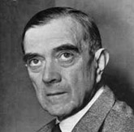
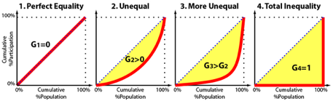
Gini Impurity
If you look at the documentation for the DecisionTreeClassifier class in scikit-learn, you’ll see something like this for the criterion parameter:
Gini Impurity (I_{G}) - metrics used by CART method for making splitting decisions on categorical features.
Gini impurity is a measure of how often a randomly chosen element from the set would be incorrectly labeled if it was randomly labeled according to the distribution of labels in the subset.
Gini max value is 0.5, and min value is 0 (when all cases in the node fall into a single target category).
If we have a set of items with J classes {1,2,..,J},
and p_{i} is the fraction of items of i-th class, then it can be shown that :
I_{G} = 1 – sum(p_{i}²)
When training a decision tree, the best split is chosen by maximizing the Gini Gain, which is calculated by subtracting the weighted impurities of the branches from the original impurity - https://victorzhou.com/blog/gini-impurity/
Name "Gini" comes from economics.
Corrado Gini - Italian statistician and sociologist.
He has published his paper Variability and Mutability in 1912.
He has introduced a Gini coefficient, sometimes called the Gini index or Gini ratio.
It is a measure of statistical dispersion intended to represent the income inequality or wealth inequality within a nation or any other group of people.
The coefficient ranges from 0 (or 0%) to 1 (or 100%), with 0 representing perfect equality and 1 representing perfect inequality.
Corrado Gini
1884-1965
fraction of incorrectly labeled

Slide 7
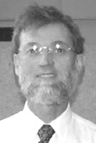


Smallest Entropy (Largest Information Gain)
ID3 (ID.3 = Iterative Dichotomiser 3)
an algorithm invented by Ross Quinlan (1986)
used to generate a decision tree from a dataset
splits data by an attribute that has smallest average entropy of the split (or largest information gain)
C4.5 is an extension of ID3, used for classification, has following advantages:
handles both continuous and discrete attributes (creates a threshold and then splits the list)
handles missing attributes data (simply not using them in entropy calculations).
handles attributes with differing costs
pruning trees after creation (attempts to remove inefective branches or replace them with leaf nodes).
C5.0 algorithm - improved C4.5:
- https://www.rulequest.com/see5-info.html - https://www.rulequest.com/download.html
much-much faster
less memory usage
builds smaller decision trees
support for boosting
support for weighting
automating winnowing (removing not effective attributes)
John Ross Quinlan
Inventor of canonical C4.5 and ID3 algorithms. Currently running his company RuleQuest Research.
- https://www.rulequest.com/Personal/
- https://www.rulequest.com/
Pure node : entropy = 0
Information Gain = 1 - Entropy

Slide 8
CHAID – Chi-Squared Automatic Interaction Detection
Decision Tree
Building Algorithm
CHAID - Chi-Squared Automatic Interaction Detection.
It was originally proposed by Gordon V. Kass in 1980
- https://en.wikipedia.org/wiki/Chi-square_automatic_interaction_detection
This algorithm used only for categorical variables.
In practice, CHAID is often used in the context of direct marketing to select groups of consumers and predict how their responses to some variables affect other variables.
Good explanation of CHAID vs CART:
https://towardsdatascience.com/clearly-explained-top-2-types-of-decision-trees-chaid-cart-8695e441e73e

Slide 9
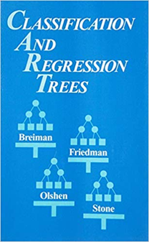
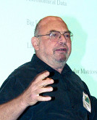
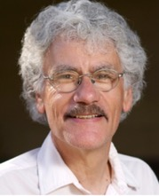

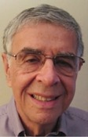


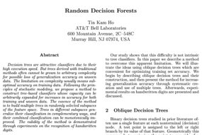
FORTRAN
Random Forest
2002-2003
Richard A. Olshen
Biostatistics
UC Berkeley,
Stanford
1942-
Charles J. Stone
Math, Probability
UCLA,
UC Berkeley
1936-2019
Leo Breiman
UC Berkeley
Statistics
1928-2005
Jerome H. Friedman
Statistics
UC Berkeley,
Stanford
1939-
Classification and
Regression Trees
(1984) by BFOS (BFOS = Breiman, Friedman, Olshen, Stone)
Random Decision Forests
(1995) by Tin Kam Ho
Adele Cutler
UC Berkeley, then Utah State University.
Wrote original Random Forest in Fortran with Leo Breiman in 2002-2003
https://www.stat.berkeley.edu/~breiman/RandomForests/cc_software.htm
Tin Kam Ho
at Bell Labs in NJ.
then AI at IBM (since 2014)

Slide 10
Ensemble Learning Methods with Decision Trees
A group of “weak learners” come together to form a “strong learner”
Bagging
reduces variance (averages)
does NOT reduce bias error
Boosting
reduces bias error
by sequential corrective learning
Stacking
improves predictive force (combines "skills" of different models)
Random Forest – parallel independent learners, democratic equal-weight voting.
Note - Random Forest is a specific case of Bagging = Bootstrap Aggregating
Bootstrap = data sampling with replacement
Aggregating = voting
Each learner gets a random subset of data (rows) and a random subset of features (columns).
Each tree is trained independently.
Each tree then can make its prediction.
Then overall decision is made by averaging decisions of individual trees.
Boosted Trees – trees trained sequentially.
Train 1st tree
Train 2nd tree concentrating on fixing errors left after 1st tree, combine trees (weighted voting)
Train 3rd tree concentrating on fixing errors left after 1st and 2nd trees, etc.
Continue boosting accuracy by adding trees.
Stacking (Meta-learner) - train several different models, and then train model on top of their outputs
- https://www.kdnuggets.com/2017/02/stacking-models-imropved-predictions.html

Slide 11


Slide 12
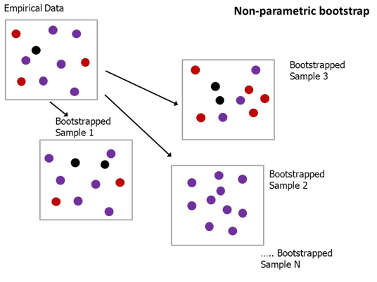
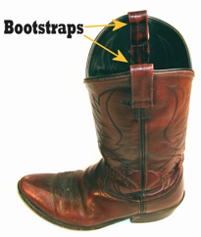
Bootstrap Sampling
method of preparing a set of data samples
by sampling them (with replacement) from original data set
Another meaning of the word bootstrap:
"pull oneself over a fence by one's bootstraps"

Slide 13



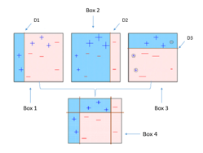
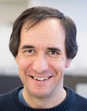
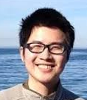


Boosting Algorithms
Strength of Weak Learners
AdaBoost (1995) Yoav Freund & Robert Schapire
(2003 Gödel Prize).
Leo Breiman
UC Berkeley
Jerome H. Friedman
UC Berkeley,
Stanford
From Wikipedia, etc:
The idea of gradient boosting originated in the observation by Leo Breiman that boosting can be interpreted as an optimization algorithm on a suitable cost function (1997, Berkeley).
Explicit regression gradient boosting algorithms were subsequently developed by Jerome H. Friedman (1999, Berkeley).
... simultaneously with the more general functional gradient boosting perspective of Llew Mason, Jonathan Baxter, Peter Bartlett and Marcus Frean (1999).
Stochastic gradient boosting - by Jerome H.Friedman, 2002 – adding random sampling to gradient boosting algorithm improves speed and accuracy.
XGBoost (2014)
more flexible and optimized
Tianqi Chen (was a Ph.D. student)
Light GBM (2016, Microsoft) fast-performing, distributed
(GBM = Gradient Boosting Machine)
CatBoost (2017, Yandex)
big data, categorical data, multiple GPUs.

Slide 14
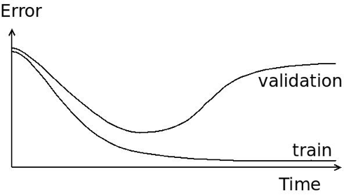
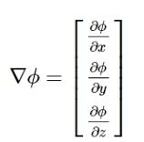
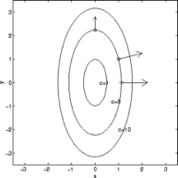
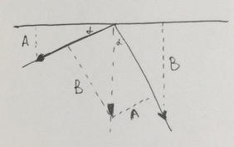
"validation data set" – used in boosting to figure out when to stop iterations to avoid overfitting
Gradient Boosting
is named so because on each steep
it is improving (boosting) the decision
by decreasing the error (Gradient Descent)
Gradient Descent
Gradient vector is perpendicular to level curves
Understand gradient vector

Slide 15

AdaBoost
First Boosting Algorithm
(1995) by Freund and Schapire

Slide 16
Gradient boosting trees model is originally proposed by Friedman et al.
He has coined the term GBM = Gradient Boosting Machine
“Gradient Boosting” - Greedy Function Approximation: A Gradient Boosting Machine, by Friedman (1999)
- https://statweb.stanford.edu/~jhf/ftp/trebst.pdf
XGBoost was created by Tianqi Chen. It is a library implementing GBM – and optimized for trees.
"XG" in XGBoost = “Extreme Gradient Boosting”.
Tianqi Chen - Introduction to Boosted Trees (2016)
- http://homes.cs.washington.edu/~tqchen/pdf/BoostedTree.pdf
- https://xgboost.readthedocs.io/en/latest/model.html
XGBoost
- uses "Regularized Gradient Boosting" model which prevents overfitting and gives better performance
- uses sparse matrices with sparsity aware algorithms to reduce memory and increase performance
- better support for multicore parallel processing - reduces training time
2015 - DART: Dropouts meet Multiple Additive Regression Trees
- https://arxiv.org/abs/1505.01866
- http://zhanpengfang.github.io/418home.html
- https://www.analyticsvidhya.com/blog/2016/03/complete-guide-parameter-tuning-xgboost-with-codes-python/
- https://www.quora.com/What-is-the-difference-between-the-R-gbm-gradient-boosting-machine-and-xgboost-extreme-gradient-boosting
- https://en.wikipedia.org/wiki/Gradient_boosting
- https://en.wikipedia.org/wiki/Xgboost
=============================================
Leo Breiman, Jerome Friedman, CART, BFOS on youtube:
- https://www.youtube.com/watch?v=t8ooi_tJHSE – 2 min, Working with Leo Breiman on Random Forests, Adele Cutler
- https://www.youtube.com/watch?v=JIXeMj1zwVU – 5min, CART
- https://www.youtube.com/watch?v=-Ju0Czc9GmA – 4min, The Birth of BFOS: Breiman, Freidman, Olshen and Stone
- https://www.youtube.com/watch?v=XaeQo1KSmjA – 4min, CART and Cross-Validation, Data Mining
- https://www.youtube.com/watch?v=8hupHmBVvb0 – 4min, Jerome Friedman, Data Mining Software Founding Father

