Slide 1
Feature Engineering for Text Data
By Alex Ni
March 13, 2021

Slide 2
Agenda
Quick recap on feature engineering
Why do we need feature engineering for text data
What can we do to perform feature engineering for text data
Common libraries for processing text data

Slide 3
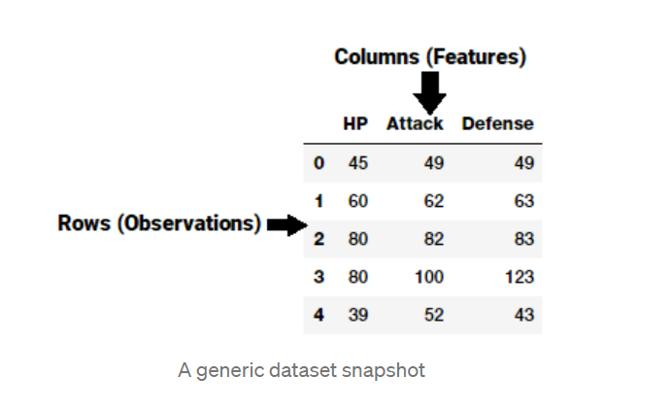

What is Feature Engineering?
A feature is typically a specific representation on top of raw data, which is an individual, measurable attribute, typically depicted by a column in a dataset
“Feature engineering is the process of transforming raw data into features that better represent the underlying problem to the predictive models, resulting in improved model accuracy on unseen data.”
— Dr. Jason Brownlee
Notes:
Continuous Numeric Data. Strategies for working with continuous… | by Dipanjan (DJ) Sarkar | Towards Data Science

Slide 4
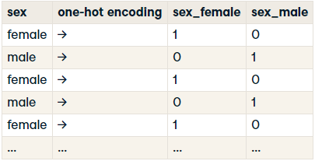
Feature Engineering for Structured Data
For Numerical Data:
Selection
Imputation
Aggregation
Binning
Scaling
Mathematical Transformation
For Categorical Data:
Label encoding
One-hot encoding

Slide 5
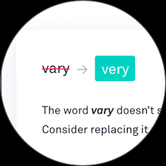
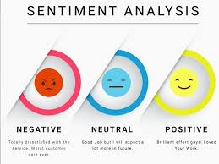
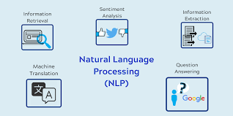
What if the feature is text-based only
Text-based data such as:
Emails
Movies/Product reviews
News articles
Social media
Support ticket
Translation
....

Slide 6
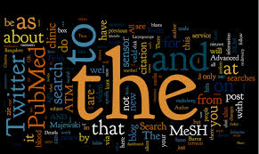
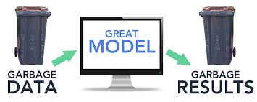
Why do we need feature engineering for text?
Text data is unstructured and free flowing that cannot be utilized by any machine learning algorithm.
Text data could be noisy which makes it harder for machine learning algorithms to directly work on raw data.

Slide 7
What can we do to make text machine friendly?

Slide 8
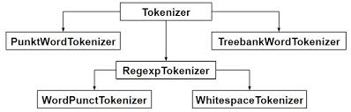
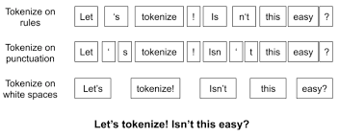
Tokenization
Splitting a piece of text into smaller units called tokens
Tokenization can occur at different level:
Text into sentences
Sentences into words
Tokens are the building blocks of natural language

Slide 9
Stemming and lemmatization
Convert word into its base form
Watch ← Watches, Watching, Watched
Stemming vs Lemmatization
Stemming is a somewhat crude method for cataloging related words; it essentially chops off letters from the end until the stem is reached
Lemmatization looks beyond word reduction and considers a language’s full vocabulary to apply a morphological analysis to words
E.g. “was” → “be”, “mice” → “mouse”
Notes:
Stemming vs Lemmatization. Truncate a word to its root or base… | by Aditya Beri | Towards Data Science

Slide 10
Text cleaning techniques
Converting words into lowercase
Removing leading and trailing whitespaces
Removing punctuation
Removing stopwords (a, an, the, ...)
Expanding contractions (don’t -> do not)
Removing special characters (numbers, emojis, etc)

Slide 11
Other text preprocessing techniques
Removing HTML/XML tags
Replacing accented characters (such as é)
Correcting spelling errors

Slide 12
Part-of-speech(POS) tagging
Assigning every word, its corresponding part of speech
Single word has a different POS tag in different sentences based on different contexts.
The bear is a majestic animal -- noun
Please bear with me -- verb
Word Sense Disambiguation
Sentiment analysis
Question answering, chatbot
Notes:
An introduction to part-of-speech tagging and the Hidden Markov Model (freecodecamp.org)

Slide 13
Name entity recognition
Identifying and classifying named entities into predefined categories
Categories include as names of persons, organizations, locations, expression of times, quantities, monetary values, percentages, etc.
Application:
Efficient search algorithms
Question answering
News article classification
Customer service
Notes:
Named Entity Recognition with NLTK and SpaCy | by Susan Li | Towards Data Science

Slide 14
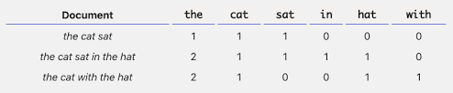
Text Vectorization: Bag of Words(BoW)
Extract word tokens and perform pre-processing
Compute frequency if word tokens
Construct a word vector out of these frequencies and vocabulary of corpus
A corpus is typically a collection of text documents usually belonging to one or more subjects

Slide 15
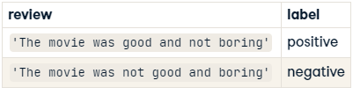
BoW shortcomings
Exactly the same BoW representation
But context of the words is lost
Sentiment dependent on the position of ‘not’

Slide 16
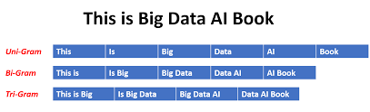
Text Vectorization: N-grams model
Contiguous sequence of N word tokens in a given document
BoW is basically a unigram model (N=1)

Slide 17
Shortcomings of N-gram modeling
Curse of dimensionality
Dimension of a dataset corresponds to the number of features that exist in a data set
Difficulties related to training machine learning models due to high dimensional data
Risk of massively overfitting
Causing observation to appear equidistant from all the others
Sparsity problem
Higher order n-grams are rare
Keep n small, typically less than or equal to
Storage problem
Context may be still lost
Notes:
What are the drawbacks of an n-gram language model ? | Cracking the ML Interview! (machinelearningaptitude.com)

Slide 18

TF-IDF model
Stands for Term Frequency-Inverse Document Frequency
Term Frequency: how many times a word appears in a document
Document Frequency: how many times a document containing that word appear across a set of documents
A statistical measure that evaluates how relevant a word is to a document in a collection of documents

Slide 19
Why do we prefer TF-IDF model?
In BoW model, weight of dimension dependents on the frequency of the word
Document contains the word ‘human’ in five places, therefore dimension corresponding to ‘human’ has weight 5
However, some words occur very commonly across all documents
One document has ‘Jupiter’ and ‘universe’ occurring 20 times each
‘Jupiter’ rarely occurs in the other documents. ‘Universe’ is quite common
Give more weight to ‘Jupiter’ on account of exclusivity

Slide 20
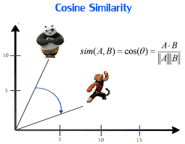
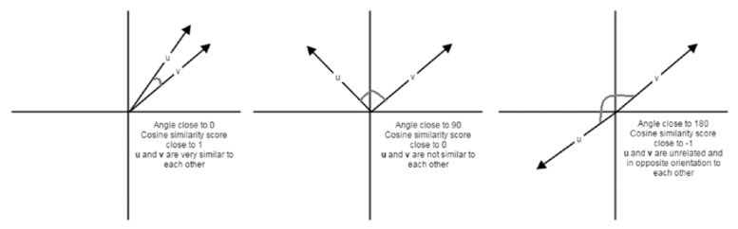
Cosine similarity
Identify how similar a text document is with any other documents
Built on top of BoW or TF-IDF based features
Mathematically, Cosine similarity is the ratio of the dot product of vectors and the product of the magnitude of vectors
Visually, smaller the angle, the higher the similarity

Slide 21
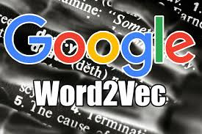


Word embeddings
Mapping words into an n-dimensional vector space
Produced using deep learning and huge amounts of data
Discern how similar two words are to each other
Used to detect synonyms and antonyms
Captures complex relationships
King-Queen → Man-Woman
France-Paris → Russia-Moscow
Some famous pre-trained methods:
Word2Vec by Google
Fasttext by Facebook
Glove by Standford
Notes:
Understanding NLP Word Embeddings — Text Vectorization | by Prabhu | Towards Data Science

Slide 22





Common libraries
Sci-kit learn
NLTK
spaCy
Gensim
Textblob
Standford CoreNLP
Notes:
Comparison of Top 6 Python NLP Libraries - KDnuggets

Slide 23
Resource
Continuous Numeric Data. Strategies for working with continuous… | by Dipanjan (DJ) Sarkar | Towards Data Science
Traditional Methods for Text Data | by Dipanjan (DJ) Sarkar | Towards Data Science
Text Vectorization: Bag of Words (BoW) | by Vaibhav Jayaswal | Towards Data Science
Understanding NLP Word Embeddings — Text Vectorization | by Prabhu | Towards Data Science
The Curse of Dimensionality. Why High Dimensional Data Can Be So… | by Tony Yiu | Towards Data Science
5 Heroic Python NLP Libraries (elitedatascience.com)

Slide 24
Thank you!

