Slide 1
A/B Testing
Tami Tang
March 27, 2021

Slide 2
Agenda
• Online Testing: What is A/B testing? What to test?
• Testing step-by-step Process
– Define Success
– Identify Bottlenecks
– Construct a Hypothesis
– Design, Run and Analyze

Slide 3
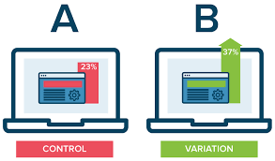
What is AB Testing
Notes:
AB testing is a statistical way of comparing two or more versions, such as version A and version B. To determine not only which version performs better but also to understand if the difference between the two versions is statistically significant.

Slide 4

Online Testing: Business Cases

Slide 5

Obama Campaign: Getting Sign-ups

Slide 6



Obama Campaign: Getting Sign-ups

Slide 7
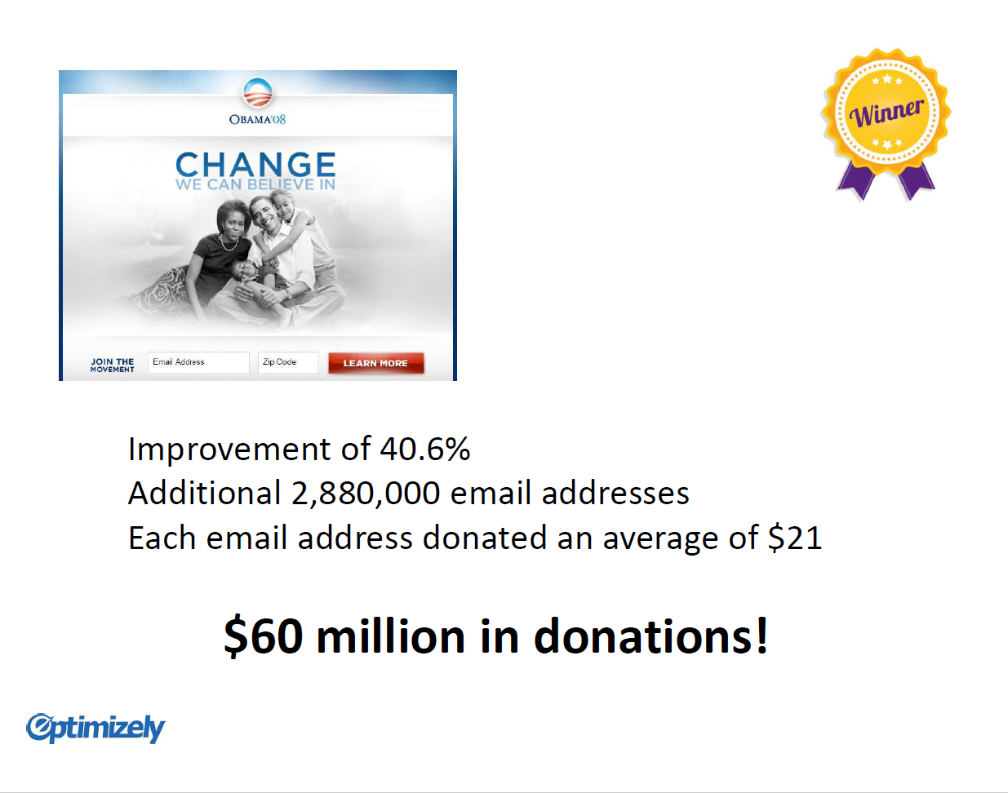
Obama Campaign: Getting Sign-ups

Slide 8

Testing “Add to Cart”

Slide 9
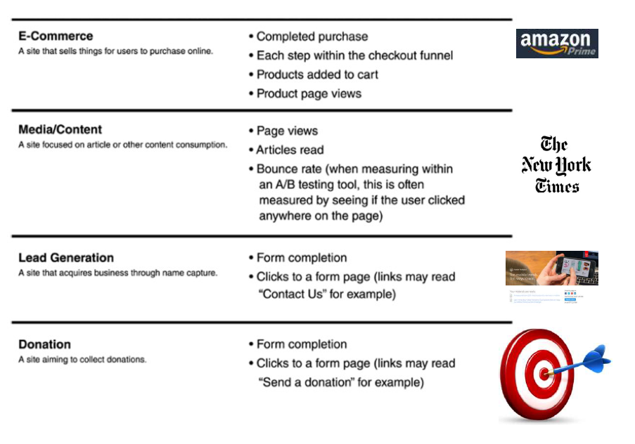
Define Success

Slide 10
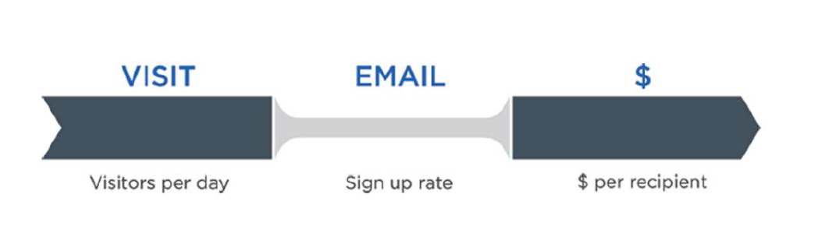
Identify Bottlenecks

Slide 11
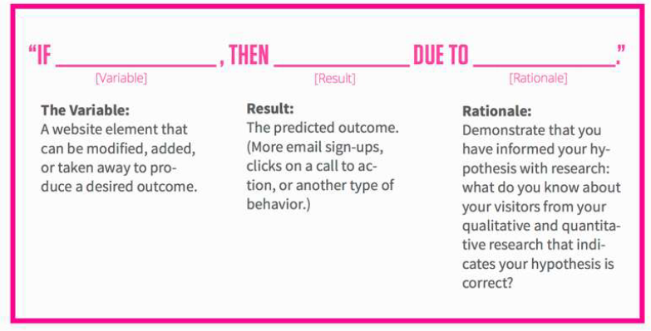
Construct A Hypothesis
“If the “Checkout” is changed to
“Complete My Order,” the conversion
rates in the checkout will increase,
because the copy is more specific and
personalized.”

Slide 12

Design>Run>Test

Slide 13

Terminology
• Response (or Dependent Variable, Outcome, Performance metric) - a quantitative measure of the experiment’s objective
• Factor (or Variable) - controllable variable that is thought to influence response.
– Factors are assigned Values (or Levels, Versions).
• Treatment (or Variant, Version) - a user experience being tested by assigning levels to the factors.
Notes:
Add visuals

Slide 14

Terminology
Response-- What would you measure?
What are the Treatments?
What are the Factors? Levels?
Notes:
Response: clicks on “Buy now”
Treatment: 4
Factor: 3
Level:

Slide 15
Common Testing Types
A/B (split) Testing
Multivariate testing (MVT)—Full and Functional Factorial Design

Slide 16

A/B testing
A/B testing is a way to compare two versions of a
single variable typically by testing a subject’s
response to variable A against variable B, and
determining which of the two variables is more
effective.

Slide 17
A/B Testing
• Pros:
– Easy to set up and interpret results
– Plenty of free tools - cheap way to start testing
– Lower traffic demands
• Cons:
– All-or-nothing approach (individual effects hard to
assess if changing several things at a time)

Slide 18
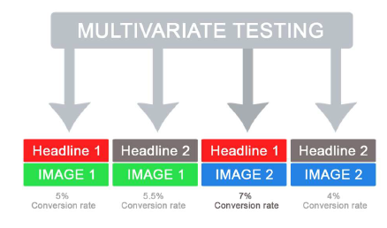
Multivariate Testing (MVT)
• Multivariate testing is a technique for testing a
hypothesis in which multiple variables are
modified.
• The goal of multivariate testing is to
determine which combination of variations
performs the best out of all of the possible
Combinations

Slide 19
Multivariate Testing (MVT)
• Pros:
– Generates insights on interaction between
multiple elements
– Can substitute for A/B testing
• Cons:
– More involved to set up compared to A/B testing
– Amount of visitor traffic required

Slide 20

Designing A/B Test
How long to run an A/B test?
Determine the sample size
( δ: difference between treatment and control)
--Power of the test (e.g., 80%)
--Significance Level (e.g. 95%)
--Minimum detectable effect (e.g. 2%)
Notes:
Need more samples if sample variance is larger; less samples if δ(delta) is larger
Two

Slide 21



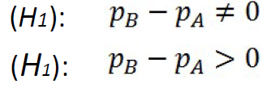
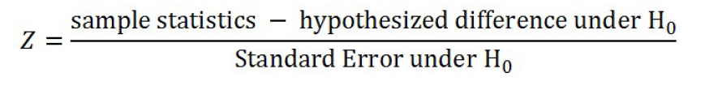
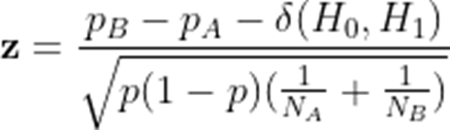

Hypotheses Testing
Population proportion:
Null Hypothesis(H0):
Alternative Hypotheses:
Test Statistic:
(Use Z-test when sample is large (n>50); Otherwise, T-test)

Slide 22

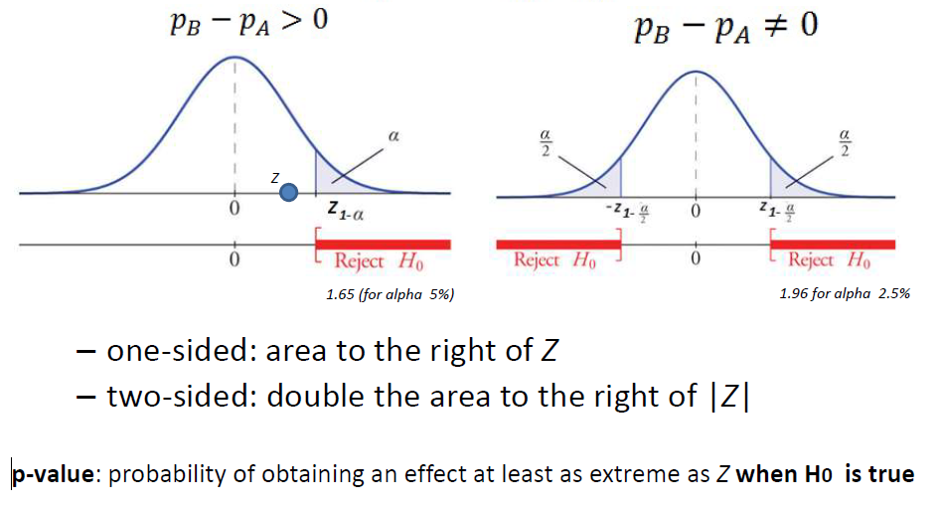
Hypotheses Testing
Test Statistic:

Slide 23
Thank You!

