Slide 1
Feature Engineering & Feature Reduction
Presented by Tyler Williams
April 2, 2021

Slide 2
What is it?
Data preparation!
Reduce the number of features by which data is to be analyzed, by grouping, simplifying, or eliminating features
Fewer features means there are fewer variables, which can make analysis of the dataset faster and easier

Slide 3


Sales leads at a car dealership
Buyer Age
Trade In Vehicle
Eye Color
Income
Buyer Height
Home Address
Walk-in
Weekend
Dealership
Inquiry Date
Day of Week
Car MSRP
Vehicle Type

Slide 4
Does More Features = Greater Value When analyzing sales leads?

Slide 5




Feature Importance
Elimination of irrelevant features
Eye Color
Buyer Height
Age
Feature Selection
Inquiry Date
Day of week
Weekend

Slide 6
Sparse Data
Different from empty or NULL data
Large number of zero values
Be aware of sparse features in your data, and consider converting them before running packages in sklearn or pandas
 | Trade-In? | Luxury Brand Owner?
Buyer 1 | 0 | 0
Buyer 2 | 0 | 0
Buyer 3 | 1 | 0
Buyer 4 | 0 | 1
Buyer 5 | 1 | 0
Buyer 6 | 0 | 0

Slide 7
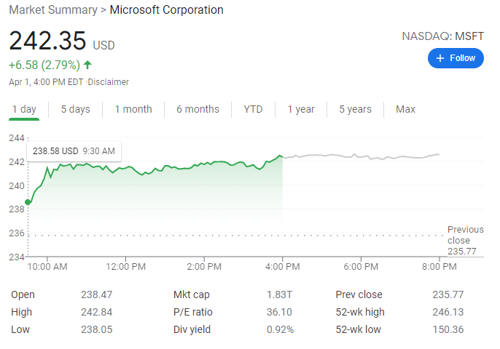

Feature Grouping
Analyze big stocks individually
Group penny stocks to analyze on the aggregate

Slide 8
Why reduce features?
Reduce collinearity, where two or more variables are highly correlated
Improve speed – fewer variables means fewer resources needed
Improve generalizability – Too many features 🡪 risk of overfitting
Easier to visualize for humans – easy to graph 2 or 3 dimensions; more is harder to visualize
High dimensionality can produce sparse data; reduction can make data less sparse

Slide 9


What about information loss?
3D Movies (or real life in 3D)
vs.
2D “standard” movies
You can still make sense of what’s happening, with minimal loss of information

Slide 10

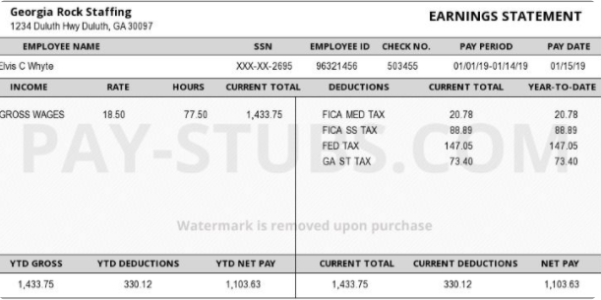
Feature engineering
????
Using domain knowledge to extract features from raw data
🡺 Income/Price ratio!

Slide 11

H2O.ai – Automatic Feature Engineering

Slide 12
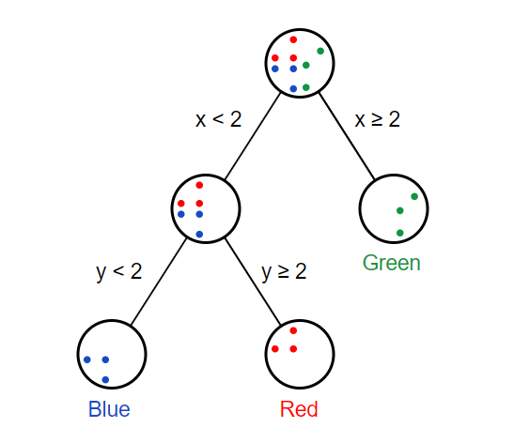
More feature importance
Random Forest is essentially a bunch of decision trees bundled together
Train multiple decision trees with samples from your dataset
Take majority vote if trees produce class labels
Take average if trees produce numerical values
When training a model, determine feature importance with Random Forest
https://victorzhou.com/blog/intro-to-random-forests/

Slide 13
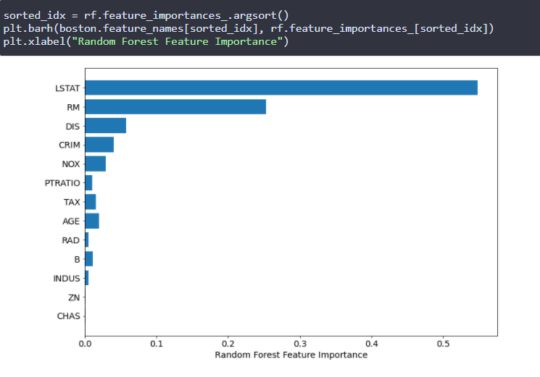
Running Random forest in python
Running RandomForestRegressor or RandomForestClassifier from the scikit-learn package returns a feature_importances_ attribute.
Backward Elimination - Select the most important features and rerun the random forest

Slide 14
Mathematical Feature Reduction
Principal Component Analysis (PCA)
Combining multiple, correlated variables into a single component
Factor Analysis
Finding the underlying common factor that gives rise to multiple indicators

Slide 15
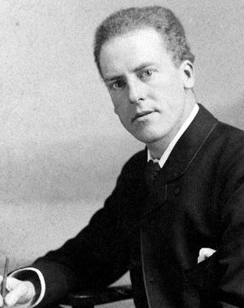
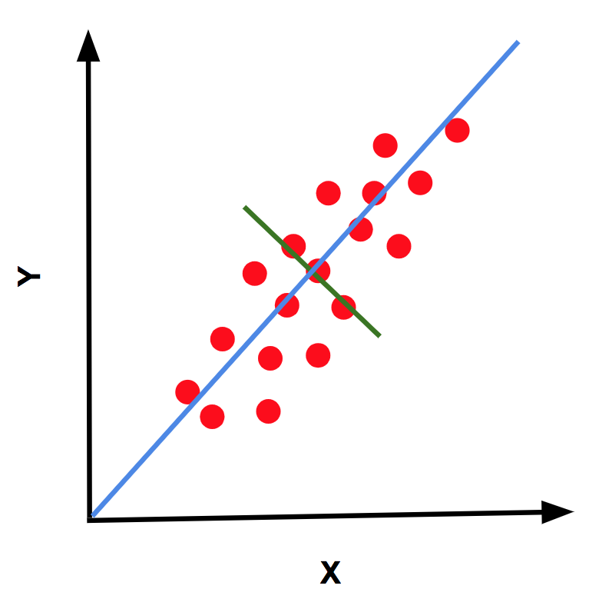
Principal Component Analysis (PCA)
A method introduced by Karl Pearson
Plot attributes in two dimensions
Find the line that maximizes the spread of the points along its axis
The perpendicular line should minimize the same spread

Slide 16
Steps For Calculating PCA
Standardize the data
Compute the covariance matrix for the data variables
Computing the eigenvectors and eigenvalues and order them in descending order
Then, calculate the Principal Components
Perform ‘dimensionality reduction’ of the data set
Principal Component Analysis (PCA)| What is PCA? (intellipaat.com)

Slide 17
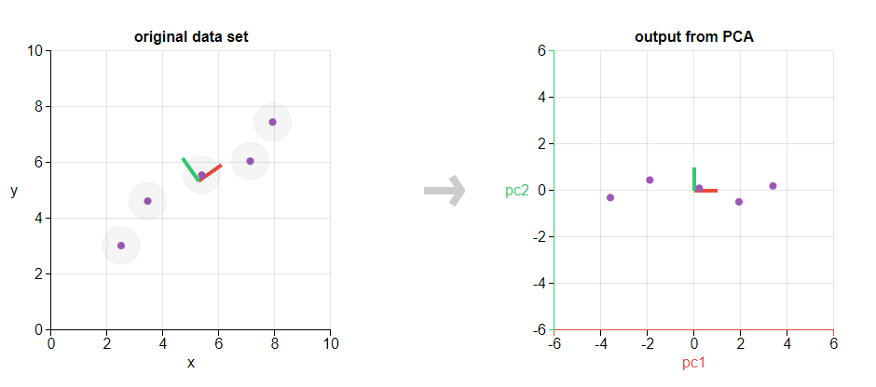
2D Example of PCA
With the vertical axis minimized, you have effectively reduced the two dimensions to one
Principal Component Analysis explained visually (setosa.io)

Slide 18
Note on PCA
Only works for numeric features
Categorical or text features must be converted to numeric
NLP Tokenizer
Assign weights/scores to discrete, fixed categories

