Slide 1
String similarity Metrics
By Rachael Phillips
April 30, 2021

Slide 2
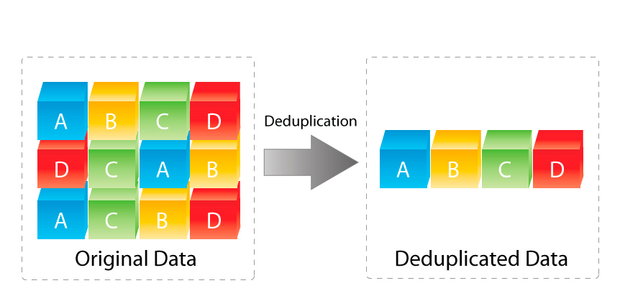


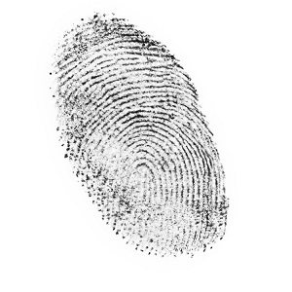


Use cases for string similarity metrics
DNA Analysis
Fraud Detection
Data deduplication
Fingerprint Analysis
Data Integration
Plagiarism Detection

Slide 3
Different String Similarity Metrics
1
Levenshtein
2
Jaro
3
Jaro-Winkler

Slide 4
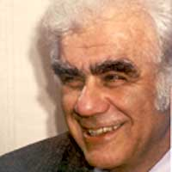
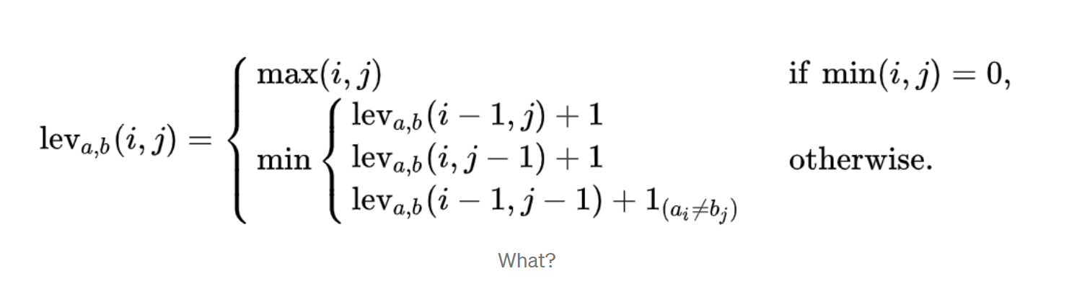
Levenshtein Distance
Created by Vladimir Levenshtein in 1965 – Russian scientist who did research in information theory, error-correcting codes, and combinatorial design
He graduated from the Department of Mathematics and Mechanics of Moscow State University in 1958 and worked at the Keldysh Institute of Applied Mathematics in Moscow ever since. He was a fellow of the IEEE Information Theory Society.
a = string 1, b = string 2, i and j are the terminal character of string 1 and 2, respectively
1

Slide 5
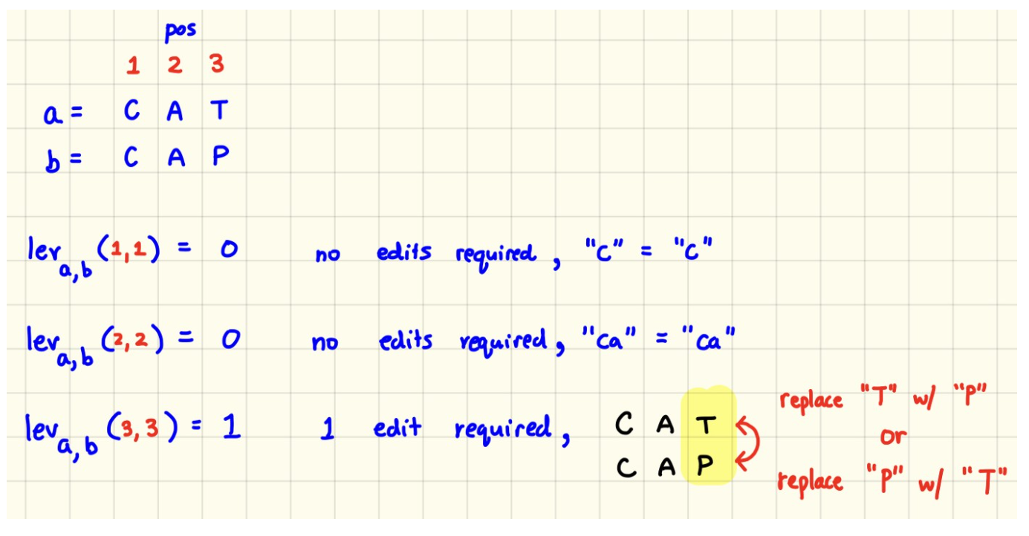
Levenshtein Distance – Simple Example
0 | 1-c | 2-a | 3-t
1-c | 0 | 1 | 2
2-a | 1 | 0 | 1
3-p | 2 | 1 | 1
1

Slide 6
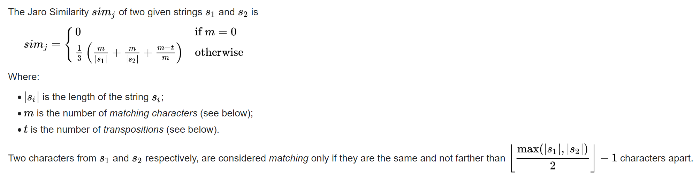
Jaro Similarity – Matthew a jaro
It is the minimum number of single-character transpositions required to change one word into another.
Example – ‘martha’ and ‘marhta’; m=6, t=2/2=1,|s1|=6 and |s2|=6
dj = (1/3)*(6/6 + 6/6 + (6-1)/6)=(1/3)*(17/6)=.944 = 94.4%
2

Slide 7
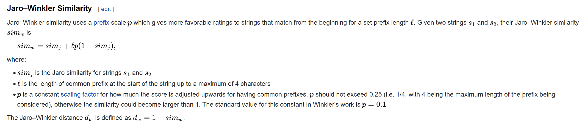
Jaro-Winkler Similarity – William e winkler
From the previous example, ‘martha’ and ‘marhta’
dw = 0.944 + ( (0.1*3)(1-0.944) ) = 0.944 +0.3*0.056 = 0.961 = 96.1%
Where p is a constant scaling factor, we use 0.1 here, which is the standard value and l is the length of common prefix at the start of the string (up to a max of 4 characters). So, l = 3.
3

