Slide 1
Lead Scoring with Deciles
Ranking quality leads
Presented by Tyler Williams
May 21, 2021

Slide 2
Scenario
Collection of sales leads with tracked attributes
Machine Learning model used to predict likelihood of lead making a purchase
Use SQL to rank the leads and group them into deciles

Slide 3
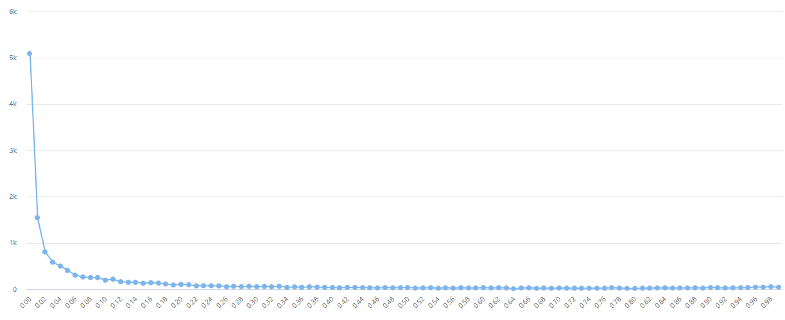
Old ML Model – Scores

Slide 4
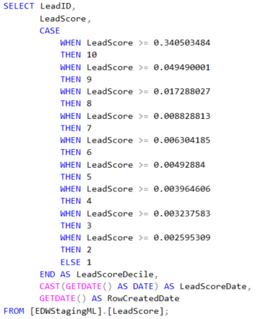
Static Decile Calculation
Unknown basis for cutoff values
Calculated once at some time far in the past?

Slide 5
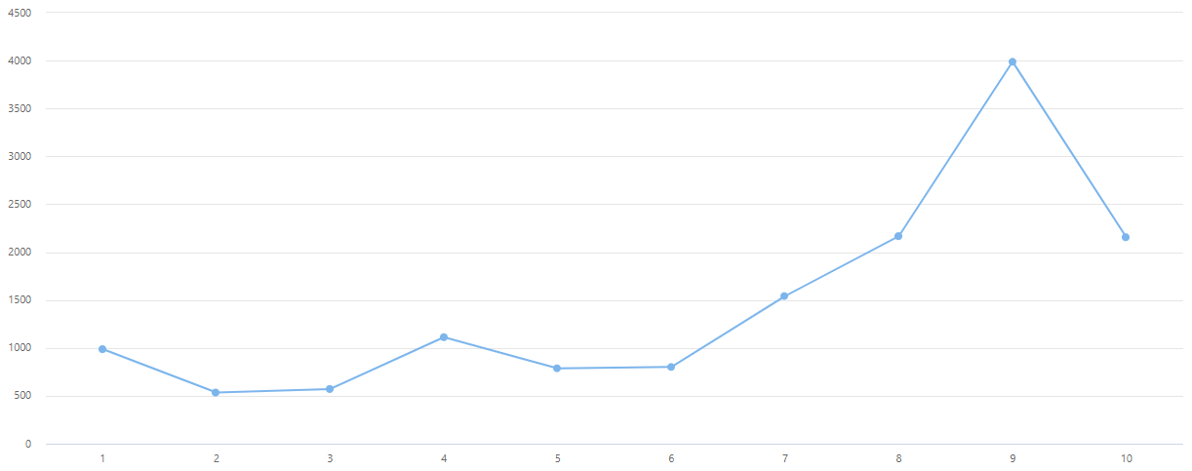
Old Model – Static Decile Distribution

Slide 6
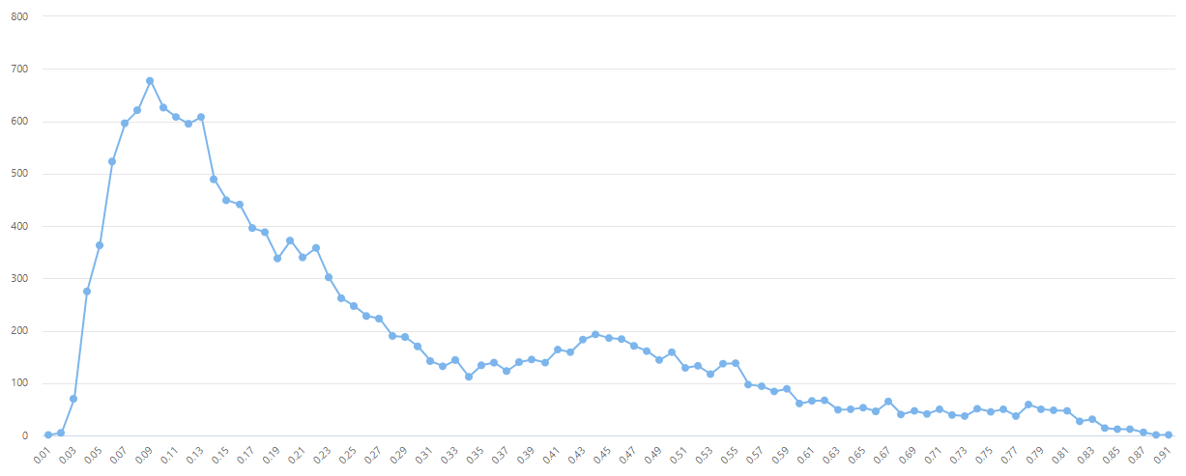
New ML Model - Scores

Slide 7
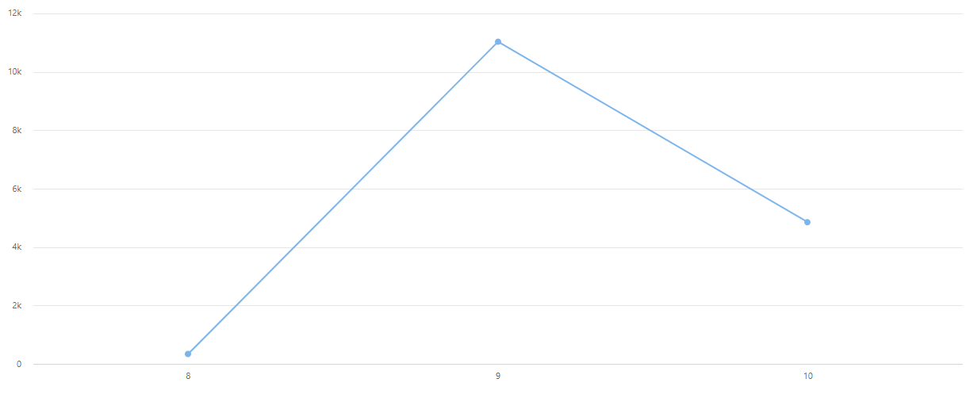
New Model – Static Decile Distribution

Slide 8

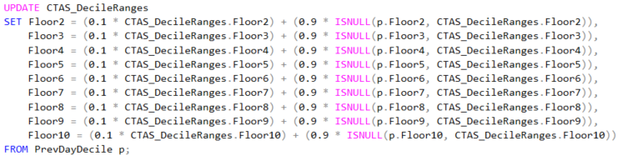
Dynamic Decile Calculation with Logarithmic Smoothing

Slide 9
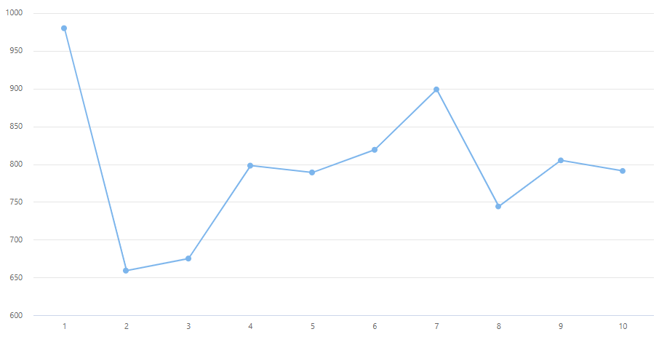
New Model – Dynamic Decile Distribution

