Slide 1
Encoding categorical features
Beyond One-hot Encoding
by Alex Ni
June 11, 2021
Notes:
https://towardsdatascience.com/beyond-one-hot-17-ways-of-transforming-categorical-features-into-numeric-features-57f54f199ea4

Slide 2
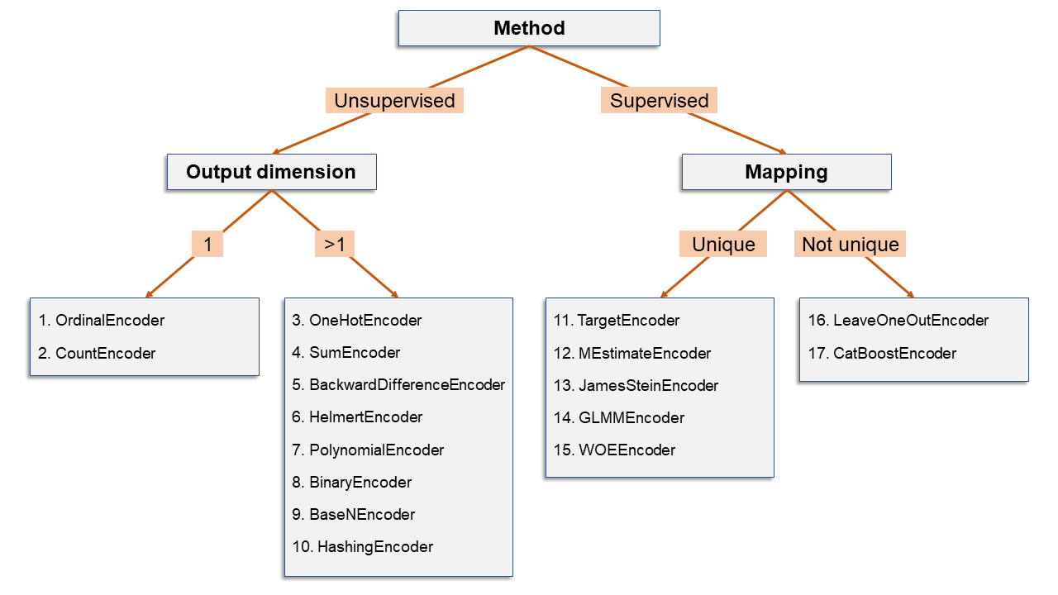
17 ways of encoding categorical variables
OrdinalEncoder
CountEncoder
OnehotEncoder
SumEncoder
BackwardDifferenceEncoder
HelmertEncoder
PolynomialEncoder
BinaryEncoder
BaseNEconder
HashingEncoder
TargetEconder
MEstimateEncoder
JamesSteinEncoder
GLMMEncoder
WOEEncoder
LeaveOneOutEncoder
CatBosstEncoder
Method
Unsupervised: the encoding is based solely on the categorical column
Supervised: the encoding is based on some function of original column and a second (numeric) column
Output dimension
The encoding of a categorical column may produce one numeric column (output dimension = 1) or many numeric columns (output dimension > 1)
Mapping
Whether each level is mapping to a unique output

Slide 3
Python libraries: category_encoders
A set of scikit-learn-style transformers for encoding categorical variables into numeric by means of different techniques.
Github link: https://github.com/scikit-learn-contrib/category_encoders
How to use:
!pip install category_encoders
import category_encoders as ce
ce.OrdinalEncoder().fit_transform(x)

Slide 4
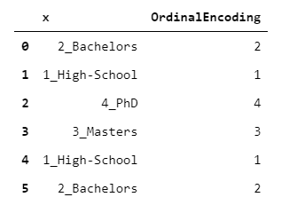
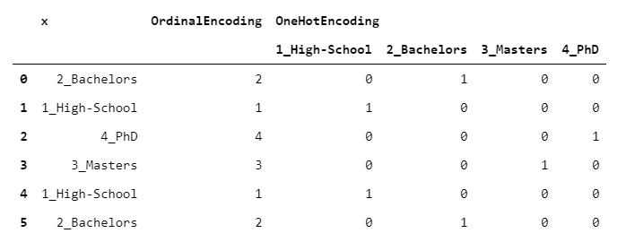
Unsupervised encoding
Output dimension = 1
When the encoding is based solely on the categorical column
Encoders include:
OrdinalEncoder
CountEncoder
OnehotEncoder
SumEncoder
BackwardDifferenceEncoder
HelmertEncoder
PolynomialEncoder
BinaryEncoder
BaseNEconder
HashingEncoder
Output dimension > 1

Slide 5
OrdinalEncoder(LabelEncoder)
Each level is mapped to an integer, from 1 to L (where L is the number of levels)
Risk of imposing ordinality, especially if the levels have no intrinsic order

Slide 6
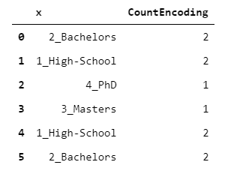
2. CountEncoder
Each level is mapped to the number of observations carrying that level
Could be useful to reflect the “credibility” of each level

Slide 7
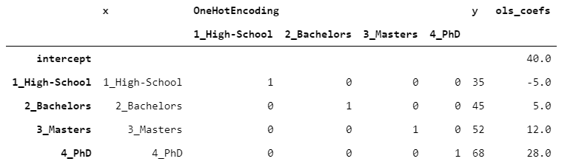
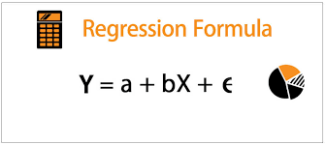
3. OneHotEncoder
Each level is mapped to a dummy column, indicating whether that level is carried by that row
Compares the mean of dependent variables for a given level to a base reference level(i.e. the value of the intercept)
Risk: feature space can blow up quickly leading to curse of dimensionality
If we fit a linear regression on the data, coefficients are added to the intercept to obtain the estimate
Example: 40+(-5)*1+(5)*0+(12)*0+(28)*0=35

Slide 8
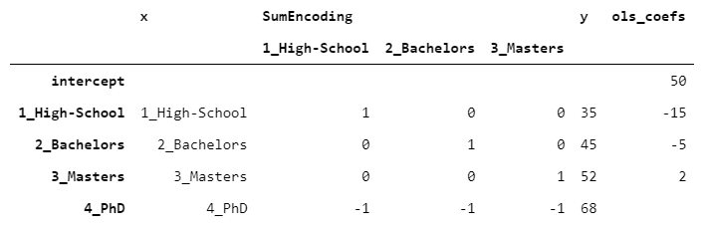
4. SumEncoder (Deviation coding)
Belongs to a class called “contrast encodings”
Reference: https://www.statsmodels.org/devel/contrasts.html
Compares the mean of the dependent variable for a given level to the mean of the dependent variable over all the levels
It is used when you want the regression coefficients to have zero-sum
The intercept(50) equals to the mean of y
By taking y of the last level and subtracting it from the intercept (68-50) we get 18, which is exactly the opposite of the sum of the remaining coefficients (-15-5+2=-18)

Slide 9
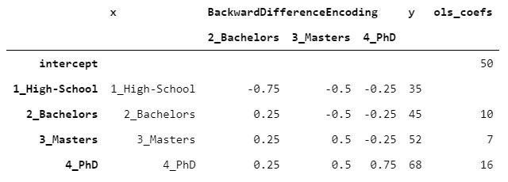
5. BackwardDifferenceEncoder (Another contrast encoding)
Designed for comparing each couple of consecutive levels (e.g. bachelors vs. masters) with respect to the target variable (e.g. income)
Compares the mean of the dependent variable for a given level to the mean of the dependent variable for the prior level
Example: the coefficient of Bachelors is 10, because y of Bachelors is 10 higher than High-School, Masters’ coefficient equals 7 because y of Masters is 7 higher than Bachelor's and so on.

Slide 10
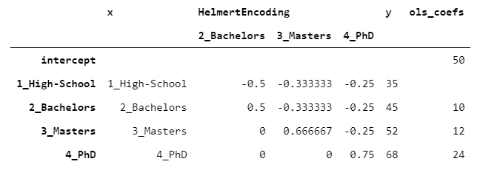
6. HelmertEncoder (Another contrast encoding))
Compares the mean of the dependent variable for a given level to the mean of the dependent variable for the ALL prior level
Example: PhD’s coefficient is 24, because PhD is 24 higher than the mean of the previous levels 68-((35+45+52)/3)=24.

Slide 11
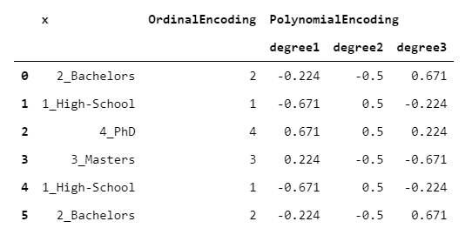
7. Orthogonal Polynomial Coding
Designed to quantify linear, quadratic and cubic behaviors of the target variable with respect to the categorical variable
Assume that the underlying categorical variable has levels that are not only ordinable, but also equally spaced

Slide 12
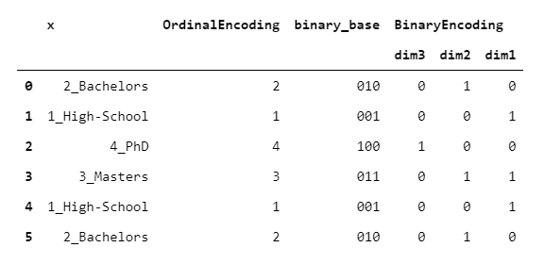
8. BinaryEncoder
Basically the same of OrdinalEncoder, the only difference is that the integers are converted to binary numbers, then every positional digit is one-hot encoded.

Slide 13
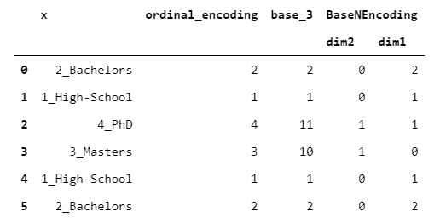
9. BaseNEncoder
A generalization of the BinaryEncoder. In fact, in BinaryEncoder, the numbers are in base 2, whereas in BaseNEncoder, numbers are in base n, with n greater than 1.

Slide 14
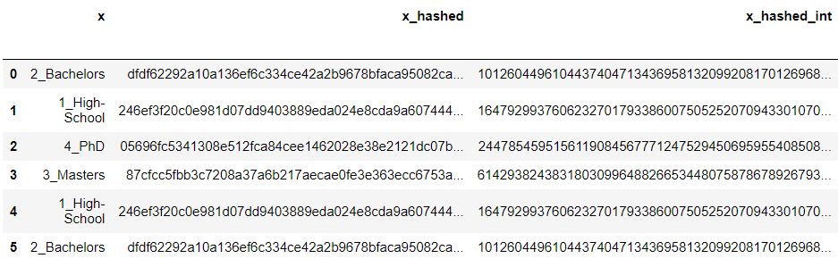
10. HashingEncoder
Each original level is hashed, using some hashing algorithm, such as SHA-256. Then, the outcome is converted to integer and the module of that integer with respect to some (big) divisor is taken.

Slide 15
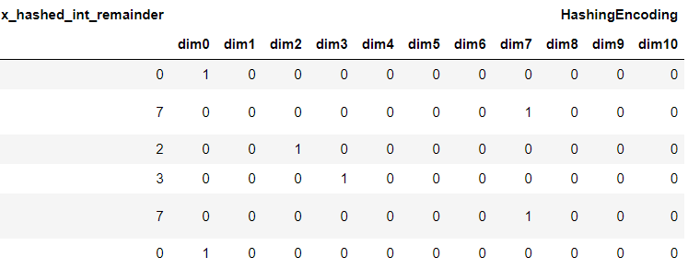
10. HashingEncoder
Then, the outcome is converted to integer and the module of that integer with respect to some (big) divisor is taken. By doing so, we have mapped each original string to an integer between 1 and divisor-1.
Lastly, the integer that has been obtained by this procedure is one-hot encoded.

Slide 16

Supervised encodings
Let’s say you want to employ the information carried by y, an idea is to take the mean of y for each level of x
Problem: some groups may be too small or too variable to be reliable.
Solution: choose a middle way between the group mean and the global mean of y:

Slide 17
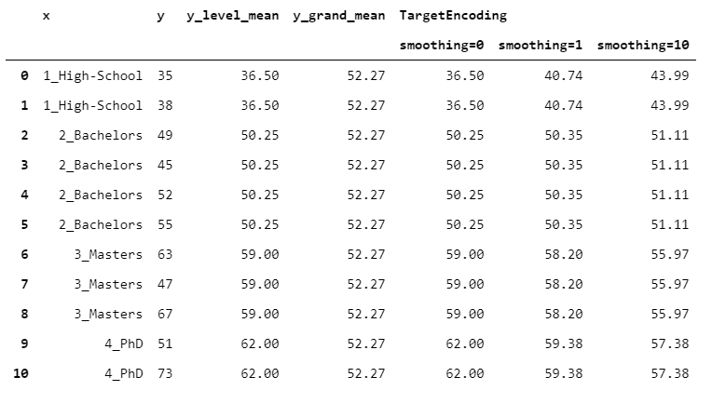
11. TargetEncoder
w_i= 1 / (1 + np.exp(-(count_encoding - 1) / smoothing))
The weight depends on a parameter called “smoothing”.
When smoothing is 0, we rely solely on group means. Then, as smoothing increases, the global mean weights more and more, leading to a stronger regularization.

Slide 18
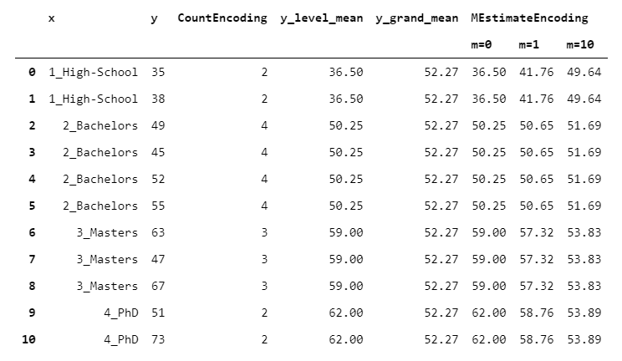
12. MEstimateEncoder
w_i= count_encoding / (count_encoding + m)
Similar to TargetEncoder, but w_i depends on a parameter called “m”, which sets how much the global mean should weight in absolute terms

Slide 19
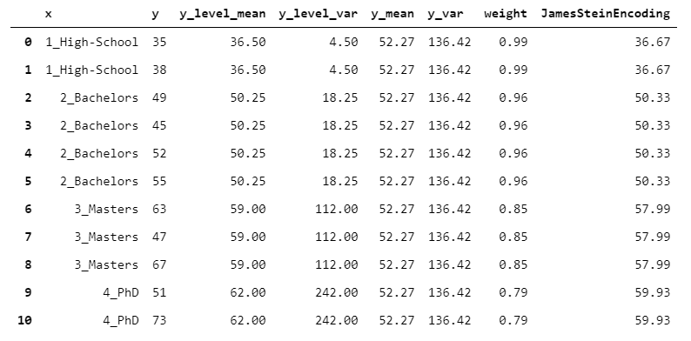
13. JamesSteinEncoder
Unlike TargetEncoder and MEstimatedEncoder, it find an optimal weight that does not depend on a manually set parameters (e.g. smoothing for TargetEncoder and m for MEstimateEncoder)
The intuition is that the mean of a group with high variance should be trusted less. Therefore, the higher the group variance, the lower the weight
Notes:
https://chris-said.io/2017/05/03/empirical-bayes-for-multiple-sample-sizes/

Slide 20
More encoders...
GLMMEncoder
WOEEncoder
LeaveOneOutEncoder
CatBoostEncoder

Slide 21
Reference
https://towardsdatascience.com/beyond-one-hot-17-ways-of-transforming-categorical-features-into-numeric-features-57f54f199ea4
https://github.com/smazzanti/beyond_one_hot/blob/main/beyond_one_hot.ipynb
https://www.statsmodels.org/devel/contrasts.html#backward-difference-coding

