Slide 1
Ten Mistakes to Avoid In the Machine Learning Life Cycle
By Fern Halper
https://go.tdwi.org/rs/626-EMC-557/images/TDWI_10Mistakes_Machine_Learning_Life_Cycle_web.pdf
Solutions to Failures
Identify The Right Use Cases For ML, work with business
Consider The Data Infrastructure And Architecture, make it flexible
Consider The Need For Data Engineers And Tooling. Data Is The King
Think About Data Preparation & Feature Engineering
Consider The Need For MLOps
Register and Manage/Monitor Models
Consider Data Issues In Production
Govern Data And Models
Take Interpretability And Explainability Into Account
Build Analytics Culture & Processes. Communicate the value before, during, and after.

Slide 2
Top 18 Low-Code and No-Code ML Platforms
https://serokell.io/blog/top-no-code-platforms
PyCaret - open-source ML library in Python, a wrapper that can replace hundreds of lines of code with just a few words. Uses scikit-learn, XGBoost, Microsoft LightGBM, spaCy, etc.
Auto-ViML - automatically cleans, transforms, and normalizes data (numeric, text, visual), then renders your data through different machine learning models.
H2O AutoML - open-source ML and AutoML platform.
Google Cloud Auto ML
Google ML Kit (for Android and iOS)
Teachable Machine (Google) - use ML for apps and websites to recognize and classify photos and sounds.
Runway AI - video and photo editing (green screen, filtering, etc.)
Lobe - ML project templates.
Obviously AI - forecasting and optimization for marketing and business.
CreateML - user-friendly drag-and-drop platform by Apple for Mac and IOS.
MakeML - for iOS, object segmentation and object detection, photos and videos.
Fritz AI - for iOS and Android apps, snapchat, etc.
SuperAnnotate - automates annotations to videos and texts.
RapidMiner - obtaining and processing data from different sources.
What-If Tool - assess the performance of the models without coding.
DataRobot - platform for business predictive analytics.
Nanonets AI - captures data from documents - unseen, semi-structured docs.
MonkeyLearn Studio - automating tagging emails, tickets, and other texts.

Slide 3
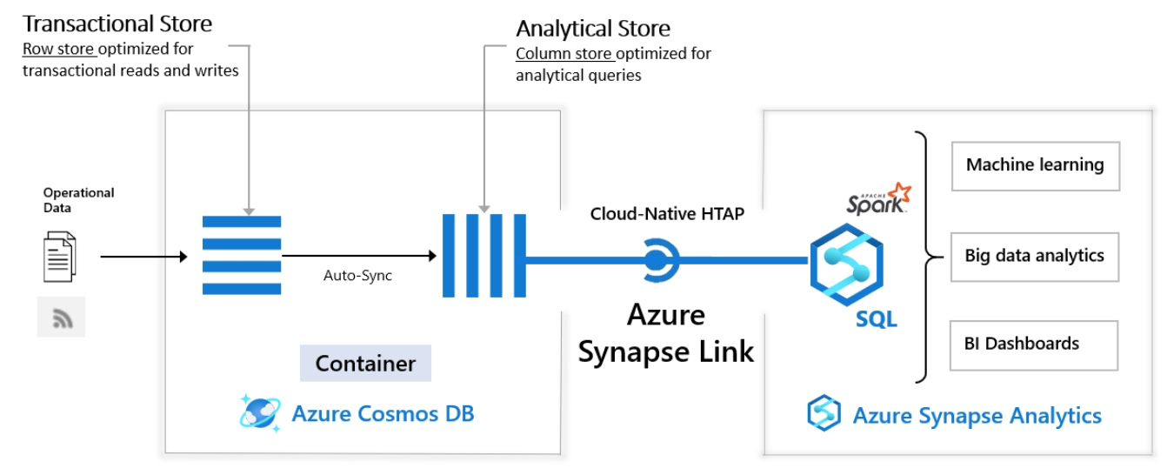
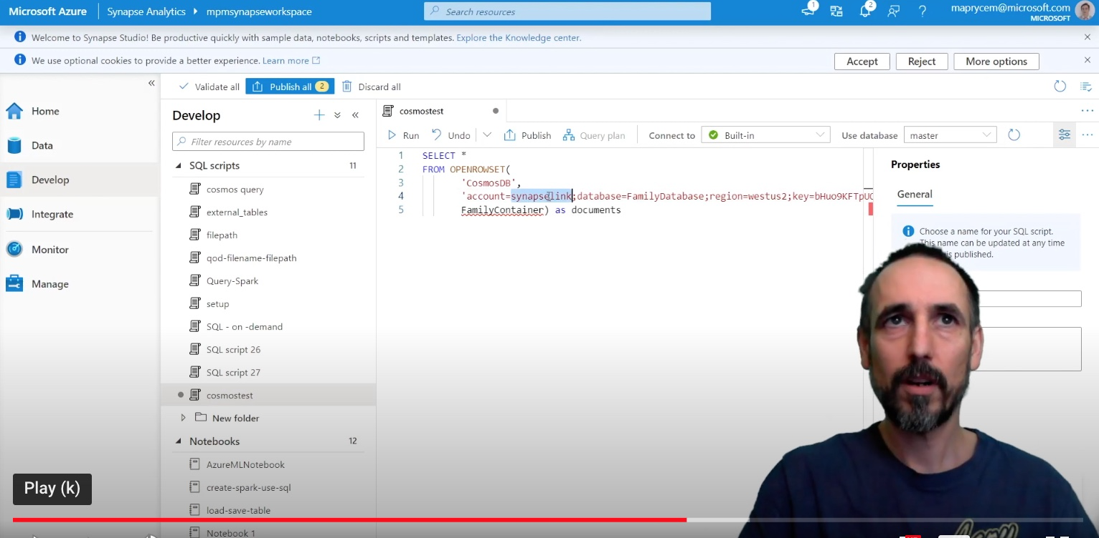
Link for Cosmos DB
Very good short video
https://www.youtube.com/watch?v=UcYMgKpbdPk
Looks like all the "Link" is is simply enabling "Analytical Store" inside Cosmos DB, thus enabling replication from transactional to analytical parts of Cosmos DB.
Then you can simply query the Analytical part using SQL from Synapse.
https://docs.microsoft.com/en-us/azure/cosmos-db/synapse-link
https://docs.microsoft.com/en-us/azure/cosmos-db/configure-synapse-link

Slide 4





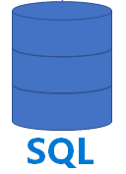






Cosmos DB
Link for Cosmos DB
Azure Synapse Analytics
Operational Data
Cosmos DB
Link for Cosmos DB
Auto-Sync
SQL Query
Power BI
Transactional Store,
massive inserts,
key-value (JSON doc)
Analytical Columnar Store
Configuring Synapse Link for Cosmos DB means enabling Analytical Store in Cosmos DB and enabling automatic sync of data into it. So you can use SQL to query data from Analytical Store without slowing down the Transactional Store.
ML Studio
Azure Data Lake Storage (Files)

Slide 5
Link for Cosmos DB – how it works
Very interesting article about Cosmos DB and different architectures. - https://www.linkedin.com/pulse/how-select-proper-data-backend-technology-azure-andrei-zaichikov/ Good people to connect:
Andrei Zaichikov (Luxembourg, Europe) - https://www.linkedin.com/in/zaychikov/
Aleksey Savateyev - https://www.linkedin.com/in/aleksey-s-7b0918/ - https://www.youtube.com/watch?v=8RiHSDf7xBs - https://azure.microsoft.com/en-us/blog/gain-insight-into-your-azure-cosmos-db-data-with-qlik-view-and-qlik-sense/
Kirill Gavrylyuk - director of Cosmos DB development:
- https://www.linkedin.com/in/kirillgavrylyuk/ - https://www.youtube.com/watch?v=27SN1eyVn5k - https://www.youtube.com/watch?v=2gydxodDS_I - https://www.youtube.com/watch?v=rIjH24x19pQ
Question:
How Link manages to do real-time replication?
It is interesting because inserts into analytical DBs are usually very slow.
Answer: (from a Microsoft architect):
In a nutshell this is achieved using the combination of micro-batch jobs and mass parallel ingestion. As you know, Synapse doesn't perform well under transactional load due to variety of factors, but using Polybase removes these limitations.
Think about repointing Polybase to some other source (other than ADLS for example). Some ideas around the actual implementation you can figure out using the POLARIS public paper:
- http://www.vldb.org/pvldb/vol13/p3204-saborit.pdf
Here is the video walking through this POLARIS paper explaining how the Azure Synapse SQL engine works. Especially the Serverless SQL:
- https://www.youtube.com/watch?v=IqjVZexHCcE
Here is a video showing how to configure Link in Azure interface:
- https://www.youtube.com/watch?v=UcYMgKpbdPk
Configuring the "Link" is is simply enabling "Analytical Store" inside Cosmos DB, thus enabling replication from transactional to analytical parts of Cosmos DB.
Then you can simply query the Analytical part using SQL from Synapse.
Official docs:
- https://docs.microsoft.com/en-us/azure/cosmos-db/analytical-store-introduction
- https://docs.microsoft.com/en-us/azure/cosmos-db/synapse-link
- https://docs.microsoft.com/en-us/azure/cosmos-db/configure-synapse-link

Slide 6
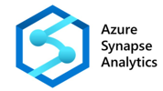


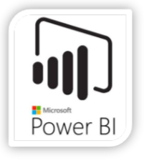
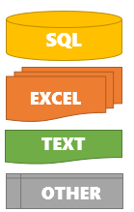





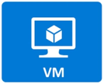

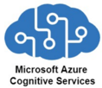

Azure Synapse
Azure Data Lake Storage Gen2
Synapse
Integrate
Data Pipelines
Machine Learning
Web End-Points

Slide 7


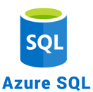

XYZ Electric Co Data Architecture
Stream Analytics
Hourly Electric Meter Data (residential)
Azure Data Lake Storage Gen2
Synapse
Integrate
Streaming Data
Data Pipelines
Data Concentrator
Pre-aggregated Data
Machine Learning
Web End-Points

