Slide 1
Encoding categorical features
Beyond One-hot Encoding, Part II
by Alex Ni
June 11, 2021

Slide 2
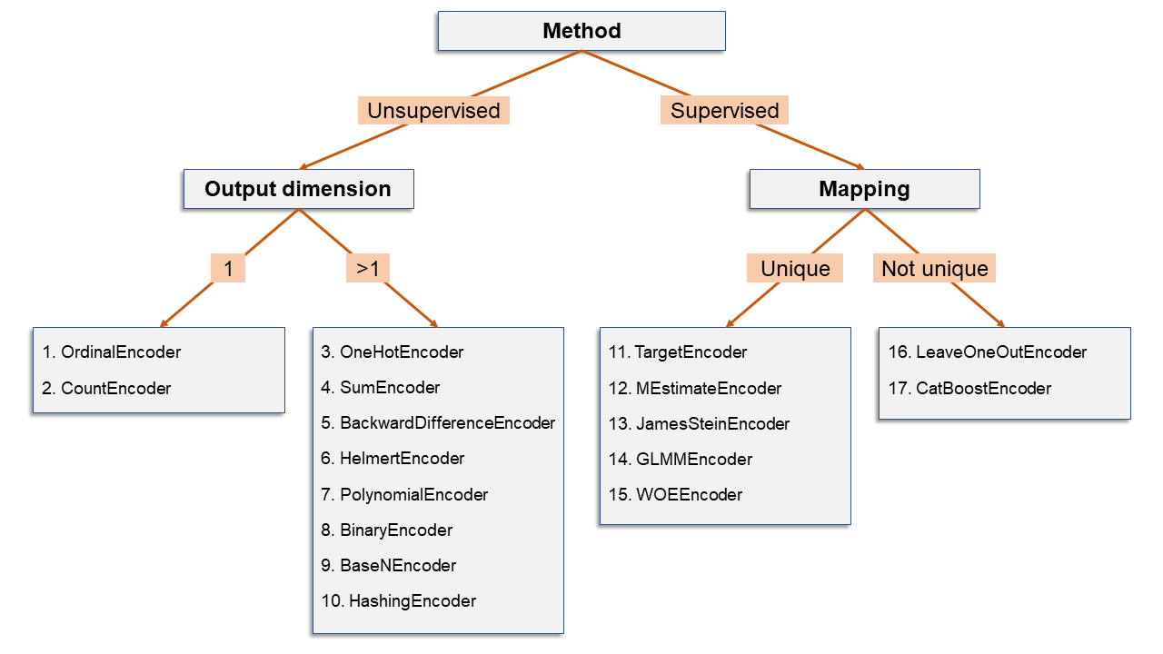
Recap: 17 ways of encoding categorical variables
OrdinalEncoder
CountEncoder
OnehotEncoder
SumEncoder
BackwardDifferenceEncoder
HelmertEncoder
PolynomialEncoder
BinaryEncoder
BaseNEconder
HashingEncoder
TargetEconder
MEstimateEncoder
JamesSteinEncoder
GLMMEncoder
WOEEncoder
LeaveOneOutEncoder
CatBosstEncoder
Method
Unsupervised: the encoding is based solely on the categorical column
Supervised: the encoding is based on some function of original column and a second (numeric) column
Output dimension
The encoding of a categorical column may produce one numeric column (output dimension = 1) or many numeric columns (output dimension > 1)
Mapping
Whether each level is mapping to a unique output

Slide 3
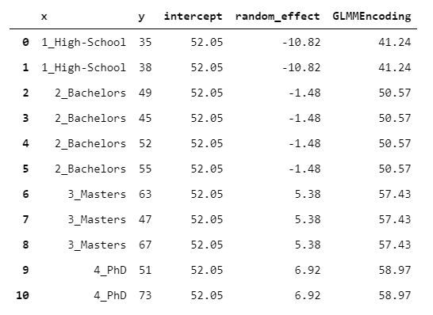
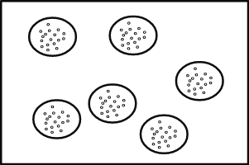
14. GLMMEncoder
Fit a General Linear Mixed Models(GLMM) with no regressors (only the intercept) and use the levels as groups
Exploits the fact that Linear Mixed Effect Models are designed precisely for handling homogeneous groups of observations
Homogeneous groups
Students sampled from within same classrooms
Patients seen by the same doctor

Slide 4

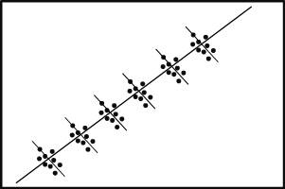
General Linear Mixed Model
An extension of simple linear model that incorporates fixed and random effects
Particularly useful when there is non-independence in the data
Fixed effect:
Variables that are constant or change at a constant rate over time across individuals
Example: Age, sex, ethnicity, etc.
Random effect:
Unpredictable variables
Example: price of a new car depending on make, year, location
A good explanation from here:
https://stats.idre.ucla.edu/other/mult-pkg/introduction-to-linear-mixed-models/
Fixed effect
Random effect
Notes:
https://stats.idre.ucla.edu/other/mult-pkg/introduction-to-generalized-linear-mixed-models/

Slide 5
15. WOEEncoder
Weight of Evidence(WOE)
Only works for binary target variable (predict 0 or 1)
Consider
distribution of 1s (# of 1s in each group / # of 1s in all y)
distributions of 0s (# of 0s in each group / # of 0s in all y)
Core of algorithm:
Divide the distribution of 1s by the distribution of 0s for each group
Then take the logarithm of that value

Slide 6
Issues with TargetEncoder and GLMMEncoder
Target Encoding introduces a parameter called “smoothing”, which depends on how “credible” is the group mean.
GLMMEncoder needs to fit a general linear mixed model before the encoding.
We may have issues of row-wise leakage
improper sharing of information between rows of data

Slide 7
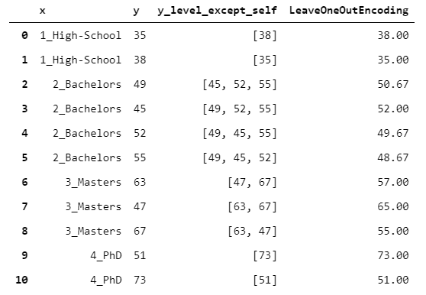
16. LeaveOneOutEncoder
Non-unique mapping
A vanilla target encoding
For each row, it does not consider the value of y observed for that row.
Then take the mean of the y

Slide 8
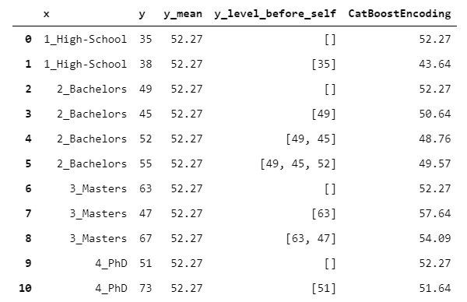
17. CatBoostEncoder
Non-unique mapping
A gradient boosting based encoding algorithm, works like LeaveOneOutEncoder but following an on-line approach
Assume the rows above the current row have been observed previously in time, while the rows below have yet to be observed (i.e. will be observed in the future). Then, the algorithm does a leave-one-out encoding, but based only on the rows already observe

Slide 9
Reference
Beyond-one-hot-17-ways-of-transforming-categorical-features-into-numeric-features
https://towardsdatascience.com/beyond-one-hot-17-ways-of-transforming-categorical-features-into-numeric-features-57f54f199ea4
An introduction to general linear mixed model
https://stats.idre.ucla.edu/other/mult-pkg/introduction-to-linear-mixed-models/
Catboost
https://catboost.ai/docs/concepts/algorithm-main-stages_cat-to-numberic.html

