Slide 1
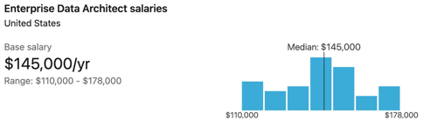

Become a Data Architect – session 1
Data Architect Base Salary:
135K+ for 4+ years of experience
150K (range 110K-180K)
There is a huge demand for data specialists:
Data Engineer
Data Analyst
Data Architect
Data Scientist
Machine Learning Engineer
Researcher (Data Science or Machine Learning)
Managers and PMs
The biggest demand is for data architects.
Adding the word "Architect" to any technical profession
increases salary by ~20%. Especially if you also add words "Senior" or "Enterprise":
Senior Data Architect
Enterprise Data Architect
With job market being so "hungry", the education and experience becomes optional:
Optional: several years of relevant experience
Optional: BS Degree
Data Architect Salary at Microsoft:
200K Microsoft (143K-232K)
Total compensation up to $318K

Slide 2


Two Ways to Grow
Learn new skills at work
while doing something else.
Reach 80% of readiness.
Become "entitled".
Get promoted.
Slow progress
Learn 5-10% of new skills.
Convince a manger to give you the new project/job
based solely on your enthusiasm and desire
(I can do this job, trust me ... )
Learn the skill while doing the job.
Fast progress
We do this

Slide 3
What Does a Data Architect Do ?
Data Architect (DA):
Interviews business stakeholders to understand requirements and constraints
Proposes a solution diagram (usually constructs from templates)
How data is loaded, stored, maintained, queried, and consumed
How to do analytics (self-service), Machine Learning Modeling, reporting
Select tools/technology, considering costs, compliance, privacy, security
Automation, data lineage, data governance
DA designs all stages and plans for execution: Design, Create, Deploy, Manage
DA establishes datamodels, policies, rules, standards that govern data collection, processing, storage, and usage
DA advises and educates managers, engineers, analysts
Most Essential Technical Skills:
Strong data modeling skills
Database architecture and DW (Data Warehousing)
ETL Tools
Template Data Architectures in all three major Clouds
Data governance know-how
SQL, Python or R
Analytics dashboarding (Power BI, Tableau, ...)
Business skills:
Excellent communication skills.
Listen to managers carefully to understand requirements
Convert data challenges into automated processes
Max results for min resources
Excellent presentation skills
Explain complex concepts to non-technical audience
Advise data modelers, data engineers, database administrators, and junior architects
Industry Knowledge, how data is collected, analyzed and utilized
Maintaining flexibility in the face of big data developments.

Slide 4
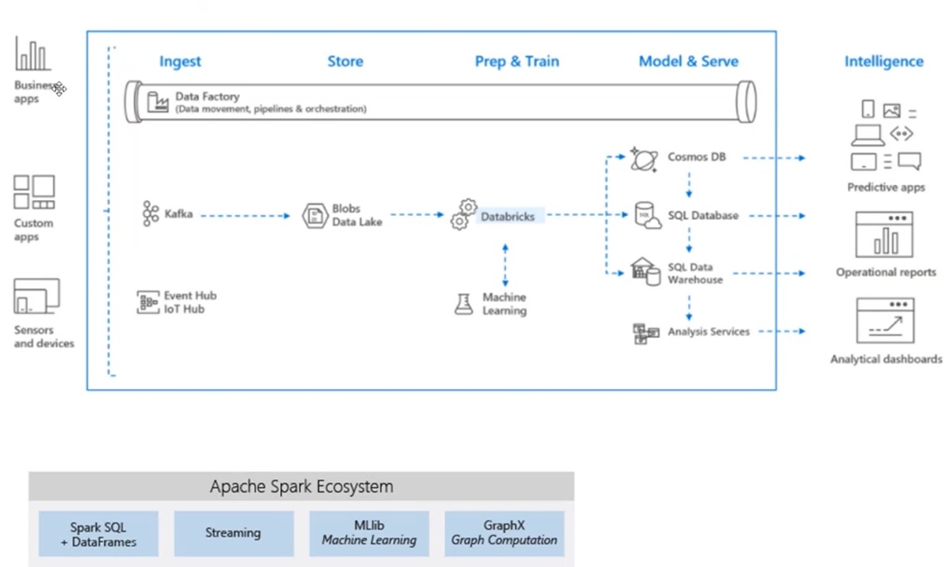
Generic Data Diagram

Slide 5
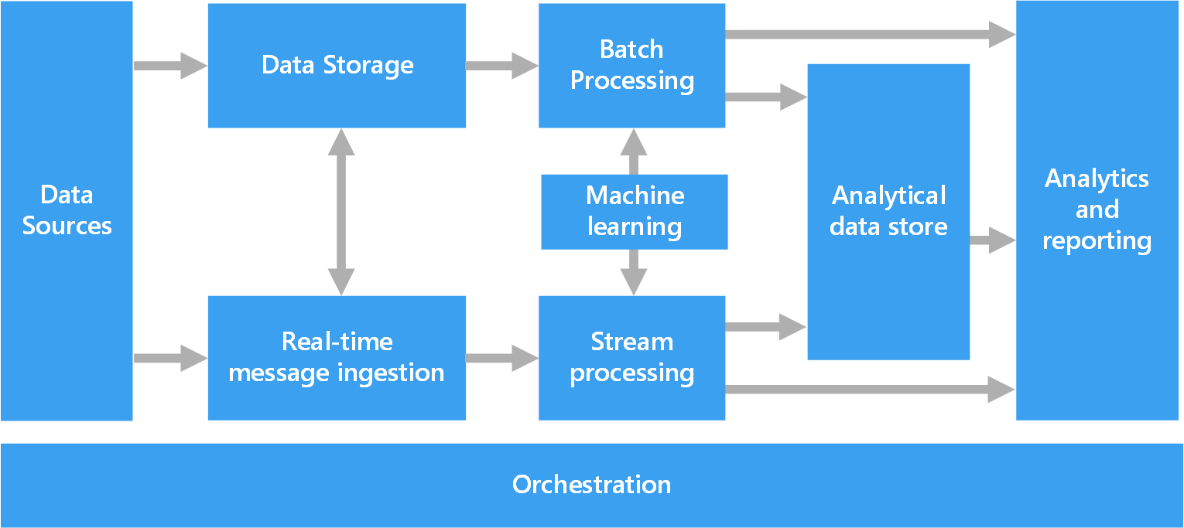
Components of a big data architecture
from https://docs.microsoft.com/en-us/azure/architecture/data-guide/big-data/

Slide 6
Data Architect Responsibilities
Design data-flow and data-storage strategy/architecture
Build an inventory of data (available, needed, where to get)
Work with IT, Data Scientists, and Management
Identify and evaluate current data management technologies
Create a fluid, end-to-end vision for how data will flow through an organization
Develop data models for database structures
Design, document, construct and deploy database architectures and apps
Provide for scale, security, performance, data recovery, reliability, etc.
Ensure data accuracy and accessibility
Create frameworks / templates for solutions
Constantly monitor, refine and report on the performance of data management systems
Meld new systems with existing DW
Produce and enforce database development standards
Maintain a corporate repository of all data architecture artifacts and procedures
Make presentations to upper management

Slide 7
DA Technical Skills
Good foundation in Computer Science, Software Architectures, Engineering
Data structures, algorithms,
System Design, Distributed System Design
3-tier architecture = MVC (Model, View, Controller)
3-tier using clusters (a.k.a. Shared Architecture), consistent hashing
Lambda Architecture - events
Streaming Architecture (Kafka): no central DB, just a message bus
Databases types (SQL, noSQ (Key-value), Graph, etc.),
OLTP vs OLAP, columnar storage (VertiPaq), denormalise for speed
MPP (Massive Parallel Processing) DW, Clusters, Polaris Engine
SQL mastery (DML , DDL, DCL, TCL)
DBs: Mainframe DB2, Sybase, MS SQL Server, MySQL,
Oracle, PostgreSQL, MongoDB, DynamoDB, CosmosDB, BigQuery,
Apache Cassandra, SnowFlake.net, Pig, etc.
Data Warehouse (Kimball Star Schema, Facts, Dimensions, Snowflake schema)
ETL tools (bcp, Oracle Data Loader, Informatica, Ab Initio, StreamSets,
ADF (Azure Data Factory), Azure Synapse Integrate, etc.)
Data Analytics (Power BI, Tableau, visualizations, Reporting, self-service)
Data modeling tools (ERWin, Enterprise Architect, Visio, etc.), UML
Data schema, entities, relations, data flows, hierarchies
CAP Theorem (Consistency, Availability, Partition Tolerance)
Geographical redundancy,
ACID transactions, dirty reads
Replication, transaction log
Distributed transactions, two-phase commit
Backup/archival software
receiving/sending data in different formats (XML, SOAP, JSON, REST, protocol buffers)
Working with APIs
File formats: CSV, parquet, JSON, Apache Arrow
Handling nulls, missing data, data quality and integrity
Hadoop/Spark data processing, loading, map-reduce, Google Big Table, HDFS, GDFS
Streaming, Kafka, Event Hub, IoT ingesting
Design patterns
Big data handling
Data mining
Data security, access, data privacy, GDPR, differential privacy
Risk assessment
Data governance (measure and manage data quality, ownership, compliance, security, cleaning, standards, categories, encryption, etc.)
Data lineage
Agile methodologies and ERP implementation, GitHub, GitLab
App Servers
Machine Learning, predictive modeling, NLP and text analytics
Python, C/C++, Java, Perl
Unix/Linux and MS Windows
Some Math and Statistics
IaaS, PaaS, SaaS (infrastructure, Platform, Software as a Service)
Reference architectures and specific tools for all 3 major Clouds
for ETL, SQL DW, Analytics, Machine Learning, Visualization, Reporting, etc.

Slide 8
Amazon – AWS (Amazon Web Services)
S3 (Simple Storage Service)
EC2 (Elastic Compute Cloud)
Lambda functions (serverless)
Databases: Redshift, Snowflake, Athena (serverless), Aurora (MySQL & PostreSQL compatible DB), MariaDB, MySQL, PostreSQL, Microsoft SQL Server, DynamoDB, Apache PrestoDB, Neptune Graph Database
Amazon Glue: managed ETL service
Amazon Data Pipeline
AppFlow, Kinesis Firehose, AWS Datasync, AWS Data Migration Service
Amazon EMR (Elastic MapReduce) - Hadoop, Spark
Amazon Machine Learning: SageMaker (python, jupyter notebooks, deployment, ...)
Amazon AI Services:
Amazon Comprehend (extract from text)
Amazon CodeGuru (auto code review)
Amazon Lex (Chatbots)
Amazon Forecast
Amazon Textract (extract tet and data from millions of docs)
Amazon Kendra (Natural Language Search)
Amazon Fraud Detector
Amazon Rekognition - image/video analysis,
Amazon Personalize - recommendation engine,
Amazon Translate - real time translation
Amazon Polly - text-to-speech
Amazon Transcribe - speech to text
Amazon QuickSight - Analytics dashboards, ...

Slide 9



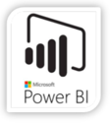
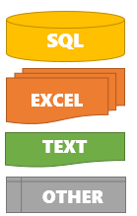





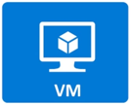

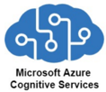

Azure
ADLS (Azure Data Lake Storage Gen2) blobs and files
ADF (Azure Data Factory)
Microsoft SQL Server, SQL Data Warehouse
Azure Functions
Synapse
Integrate
SQL pools (serverless & dedicated),
PySpark
ADLS
Databricks
Machine Learning Studio
CosmosDB, Link for Cosmos DB
Power BI
Cognitive Services
Azure Purview (data lineage, governance)
Azure DevOps (agile planning, CI/CD tools, code repos, etc.)
Azure Data Lake Storage Gen2
Synapse
Integrate
Data Pipelines
Machine Learning
Web End-Points

Slide 10
Google Cloud Platform
Cloud Storage
Storage Transfer Service
Cloud Functions
Databases:
Cloud SQL: managed MySQL, PostgreSQL, and SQL Server
Cloud BigQuery: Serverless DW, globally scalable, cost-effective
Cloud Spanner: 99.999% availability, gaming, global fin. ledger, inventory
Cloud Bigtable: NoSQL wide-column (similar to HBase & Apache Cassandra)
Firestore: NoSQL for Mobile, IoT, ...
Firebase Realtime DB: mobile, personalized ads, in-app chats, ...
Memorystore: Redis or Memcached
MongoDB Atlas
Neo4j Auro (Graph DB)
Datastax (NoSQL built on Apache Cassandra)
Datalab, DataPrep, DataFlow
Machine Learning: DataLab, ML Engine, AutoML
BI Dashboards: Google Data Studio
Colaboratory (Colab) - free jupyter notebooks with GPU - https://colab.research.google.com/
Kaggle - ML competitions, code, notebooks (kernels), ... - https://www.kaggle.com/
Oracle Cloud
Oracle Infrastructure, DB, Java, ERP apps, NetSuite, HR, CRM, ...

Slide 11
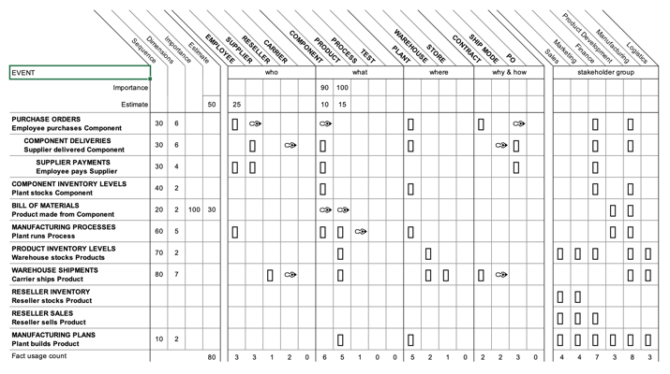
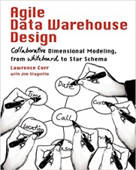
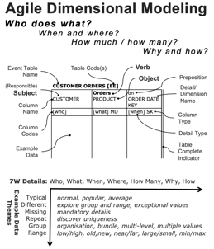
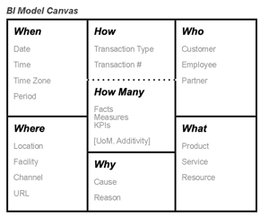
BEAM - Business Event Analysis & Modeling
Interview business stakeholders, and document the data and process:
Create Event Matrix (Excel) documenting facts and dimensions. Use "starter" templates for the interview and documentation.
https://agilebi.guru/project/business-event-analysis-and-modeling-beam-templates/
https://medium.com/hitachisolutions-braintrust/agile-data-modeling-e09c703205c1
http://www.decisionone.co.uk/training/
https://www.linkedin.com/in/lawrencecorr/

Slide 12
DA Resources
AWS to Azure services comparison
- https://docs.microsoft.com/en-us/azure/architecture/aws-professional/services
Browse Azure Architecture
- https://docs.microsoft.com/en-us/azure/architecture/browse/
Big data architectures
- https://docs.microsoft.com/en-us/azure/architecture/data-guide/big-data/
BEAM
https://agilebi.guru/project/business-event-analysis-and-modeling-beam-templates/
https://medium.com/hitachisolutions-braintrust/agile-data-modeling-e09c703205c1
http://www.decisionone.co.uk/training/
https://www.linkedin.com/in/lawrencecorr/

