Slide 1
Become a Data Architect – session 2
Data Structures & Algorithms
There are many sites with questions and answers, books, youtube videos, etc.
Books:
Introduction to Algorithms, 3rd Edition (The MIT Press)
Cracking the Coding Interview: 189 Programming Questions and Solutions 6th Edition - by Gayle Laakmann McDowell
Computer Algorithms - by Horowitz, Sahni, Rajsekaran
Data Structures and Algorithms - by Aho, Ullman, Hopcroft
Algorithm Design: Foundations, Analysis, and Internet Examples by Goodrich, Tamassia
Designing Data-Intensive Applications - by Martin Kleppmann
Training websites:
- https://leetcode.com/
- https://www.hackerrank.com/
- https://www.educative.io/
- https://www.interviewcake.com/
Youtube - multiple channels, for example: Gaurav Sen
- https://www.youtube.com/watch?v=_5vrfuwhvlQ
- https://www.youtube.com/watch?v=zaRkONvyGr8
etc.

Slide 2
=======================================
array - arr[i] - elements have same type
=======================================
list - lst[i] - like array but:
- elements may have different size and type
- elements may be complext structures (lists, dicts, etc.)
[1,2,3]
[1,"dog",[2,3]]
=======================================
tuple - like a list, but immutable (can not be changed)
(1,2,3)
((1,2),(3,4))
=======================================
string - "abcde fghij" - ordered set of characters
=======================================
sequence - any ordered set (list, tuples, string, ...)
=======================================
index - numbering elements in a sequence (usually starts with 0)
aa[i]
aa[i][j]
=======================================
slice - subset of elements of a sequence, for example:
aa = "mama papa"
012345678
bb = aa[2:5] = "ma p" (2 - included, 5 - not included)
=======================================

Slide 3
=======================================
stack (FILO = First In Last Out)
st = [1,2,3]
st.append(4) [1,2,3,4]
aa = st.pop() aa=4, st=[1,2,3]
=======================================
queue (FIFO = First In First Out)
import collections
qq = collections.deque()
for ii in range(6):
qq.append(ii) # qq == deque([0, 1, 2, 3, 4, 5])
aa = qq.popleft() # 0
bb = qq.popleft() # 1
# qq == deque([2, 3, 4, 5])
=======================================
Priority Queue
Suppose that we create a queue of tickets.
Each ticket is described by a tuple with two numbers:
(priority_num, ticket_num)
priority_num : 1..10 (1=highest, 10=lowest priority)
ticket_num : sequentially growing number
As tickets enter the queue, we sort the queue
(by priority_num, ticket_num)
so that tickets with higher priority (lower priority_num)
will move forward.
And within same priority, "earlier" tickets (with lower ticket_num) will move forward.
Usually the queue was sorted before adding a new element.
So sorting simply means moving the element forward
until it finds its place.
Usually priority queue is implemented using
a min-heap structure (see later in this document)

Slide 4
set (unique elements)
aa = set(range(1,10)) # {1, 2, 3, 4, 5, 6, 7, 8, 9}
bb = set(range(5,15)) # {5, 6, 7, 8, 9, 10, 11, 12, 13, 14}
# Operations between sets
aa - bb # {1, 2, 3, 4}
bb - aa # {10, 11, 12, 13, 14}
aa | bb # {1, 2, 3, 4, 5, 6, 7, 8, 9, 10, 11, 12, 13, 14}
aa & bb # {5, 6, 7, 8, 9}
aa ^ bb # {1, 2, 3, 4, 10, 11, 12, 13, 14}

Slide 5
hash (hashmap, dict)
stores key-value pairs
famous for having constant-time for insert/delete/read
aa = {"k1":"v1", "k2":55} # {'k1':'v1', 'k2':55}
aa['k3'] = 33 # {'k1':'v1', 'k2':55, 'k3':33}
# deleting
if 'k2' in aa:
del aa['k2'] # {'k1':'v1', 'k3':33}
# upsert
if 'k2' in aa:
aa['k2'] += 1
else:
aa['k2'] = 1
Merging two dicts:
starting python 3.5: z = (**d1, **d2)
starting python 3.9: z = d1 | d2
Using defaultdict:
from collections import defaultdict
dd = defaultdict(list)
dd['k1'].append(1)
dd['k1'].append(2)
dd['k1'].append(3)
for kk in dd.keys():
print(f"{kk} => {dd[kk]}") # k1 => [1, 2, 3]
How hash works:
We make an array of buckets.
The key is mapped to one of the buckets
using a simple hashing function
The tuple (key,val) is placed in this bucket.
Reading/deleting by key - same hashing function is used
to locate the item
# ------------------------------
Example of hashing function:
# ------------------------------
hash = 0
for char in key_str:
hash = hash*33 + ord(char)
idx = hash / num_buckets
# ------------------------------

Slide 6
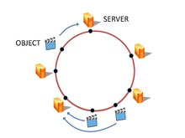
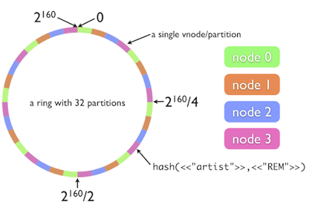
Consistent hashing (ring hash)
Imagine that you have a layer of web servers followed by layer of app servers
How do you do load balancing between layers?
How you determine to which server on the next layer to go?
How you do it consistently to take advantage of caching on layers?
How you re-hash the system when you scale numbers of server up or down?
Consistent hashing solves these problems by providing a distribution scheme which does not directly depend on the number of servers.
Idea:
Make a circle with a big number of "positions" (2³² .. 2¹⁶⁰) This circle is called "hash ring".
Map each server to 1024 random positions on circle
Map each request (IP/port/...) to the same circle, and go clockwise to find the server to process this request
Continue going clockwise to find a 2nd server (for backup)
https://medium.com/system-design-blog/consistent-hashing-b9134c8a9062
https://en.wikipedia.org/wiki/Consistent_hashing
https://www.youtube.com/watch?v=zaRkONvyGr8
Original MIT Thesis by Daniel Lewin (1998): "Consistent hashing and random trees : algorithms for caching in distributed networks"
https://dspace.mit.edu/handle/1721.1/9947
https://github.com/papers-we-love/papers-we-love/blob/master/distributed_systems/consistent-hashing-and-random-trees.pdf

Slide 7
Bloom filter
Imagine that we have a huge lookup table (~millions of words)
and we testing if a word is in this table or not.
We may use a huge hash on disk, causing big disk I/O.
Bloom filter uses a small compact bitmap instead of big hash.
This allows to reject most negatives,
while allowing very few false-positives.
The negatives are definitely negatives,
but positives are "maybe" positives.
An empty Bloom filter is a bit array of m bits, all set to 0.
There must also be k different hash functions defined,
each of which maps an element to one of m bits (sets it to 1).
So if we use k hash functions - we can get up to "k" bits set.
Example: m=30, k=10
To query for an element (test whether it is in the set),
feed it to each of the k hash functions to get k array positions.
If any of the bits at these positions is 0, the element is not in the set.
If all are 1, then it may be positive - or false-positive.
If map is big enough, the patterns will be sparse,
and probability of false-positives very low.
- https://hur.st/bloomfilter
Bloom filter was developed by Burton Howard Bloom, MIT graduate, in 1970.
https://www.cs.princeton.edu/courses/archive/spr05/cos598E/bib/p422-bloom.pdf
https://www.quora.com/Where-can-one-find-a-photo-and-biographical-details-for-Burton-Howard-Bloom-inventor-of-the-Bloom-filter
Bloom filters are called filters
because they are often used
as a cheap first pass to filter out
segments of a dataset that do not match a query

Slide 8
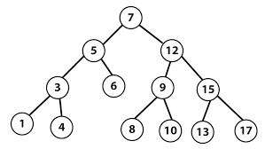
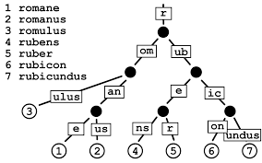

BST (Binary Search Tree)
rebalancing BST (rotations)
height of the tree h = lg2(N)..N, search time ~h
=======================================
Trie - prefix tree, good for words/characters
(one node may have 26 children)
typically implemented using dictionaries
=======================================
Linked List
head of the list
going through the list
finding cycle in the linked list
by using turtle and rabbit (slow and fast runners)

Slide 9
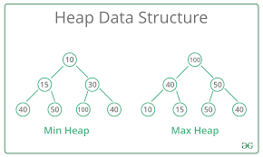
Binary Heaps (MaxHeap and MinHeap)
Data structure which looks like binary tree
where each parent is >= (or <= for min-heap) than values of children
Binary heaps are a common way of implementing priority queues.
Given an array
we can "heapify" it in place by swapping elements:
0 - top (root) element
1,2 - next layer (left and right children)
3,4,5,6 - next layer
etc.
0 1 2 3 4 5 6 ...
--- ------- ...
last parent's idx = floor(N/2) - 1
Time complexity:
building heap - O(N)
push (at bottom) and adjust - O(lg(N))
pop (from top) and adjust - O(lg(N))
heap sort - O(N*log(N))
https://stackoverflow.com/questions/9755721/how-can-building-a-heap-be-on-time-complexity

Slide 10
Sorting:
in-place
stable sort (preserves order of duplicates)
bubble sort O(n^2)
(go through whole list swapping neighbors until nothing to swap)
selection sort O(n^2)
divide list into two portions: left sorted, right not sorted yet
on each step: select min value from right - append to left
insert sort O(n^2)
(take one element, insert it in its place on the left, repeat)
merge sort O(n log n)
binary division, sort small pieces, then merge them layer by layer
heap sort O(n log n)
make MinHeap in the array,
take min value, out of the heap, fix the heap, repeat.
quick sort O(n log n) - or O(n^2) in worst case
pick an element in the middle called a pivot
move to the right of it all elements which are > pivot
move to the left of it all elements which are < pivot
Now recursively apply the same process to left and right subarrays.
tim sort O(n) - O(n log n)
used in python, combination of merge and insertion sort algorithms.
Takes advantage of runs of consecutive ordered elements

Slide 11
topological sort
schedule a sequence of jobs based on their dependencies.
Example: gnu-make files for compilation, etc.
Dependencies may be represented by a graph:
jobs are points (vertices of a graph)
x ---> y means that we need to calculate "x" before "y"
(x needed for calculating "y")
Kahn algorithm:
jobs=[1,2,3,4, 5, 6]
dependencies = [(1,3), (3,2), (3,4), (5,6)]
# (m, n) where n is a dependency of m
1. for each job calculate number of dependencies NoD
2. find jobs with no dependencies - put them into a queue.
3. process the queue one by one like this:
take queue element, append to the output
take its dependencies, reduce their NoD by one
if NoD for any of them becomes zero, add those to the queue
Complexity: O(Njobs + Ndependencies)

Slide 12
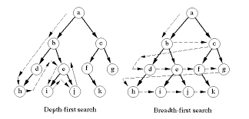
Searches:
Binary search
DFS (Depth-First Search) - recursion
BFS (Breadth-First Search) - queue, level by level
Note: Recursion can always be rewritten as iteration
factorial_recursive(n):
if n<=1:
return 1
else:
return n * factorial_recursive(n-1)
factorial_iterative(n):
ff = 1
for ii in range(1,n+1):
ff *= ii
return ff

Slide 13
Algorithm complexity (time and space):
Big "O" notation
O(1), O(N) , O(N^2) , O(N*log(N)), O(p*k), etc.
==================================
- bottoms-up and top-down algorithms
- divide-and-conquer
- greediness
==================================
declarative vs imperative procedural programming
==================================
functional programming
declarative
evaluate functions instead of simply setting values (recursion instead of for-loop)
create/modify functions at run time
pass functions as arguments
use pure functions (avoid side effects (global vars, ...))
==================================
dynamic programming = memoization
(caching results to reuse them instead of recalculating)
common to use a dictionary for that
# procedural:
def factorial(n):
f=1
for i in range(1,n+1):
f = f*i
return f
factorial(4) # 24
factorial(6) # 720
# --------------------------------
# functional
def multiply(x, y):
return x * y
def factorial(n):
from functools import reduce
return reduce(multiply, range(1,n+1))
factorial(4) # 24
factorial(6) # 720

Slide 14
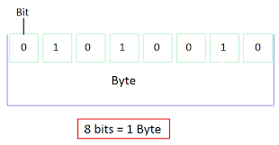
Bit manipulation
binary positive, negative, addition, shifting, masks
& – Bitwise AND
| – Bitwise OR
~ – Bitwise NOT
^ – XOR
<< – Left Shift
>> – Right Shift

Slide 15
Typical algorithmic tasks:
merging two sorted lists
finding largest word
finding duplicates (use hash)
func(N) as func of smaller numbers
calculate Fibonacci numbers
do coin-change (using memoization)
recursive staircase (1,2,3 steps - how many ways?)
shortest reach path (using BFSearch)
balanced parentheses (using stack)
queue with 2 stacks
keep contacts in a Trie
mirroring BST
finding the 2nd largest value in BST (binary tree) (or verifying that the tree is correct)

Slide 16
Turing Machine (TM) (Turing, 1936) - an very simple abstract
computational machine.
An infinite memory tape is divided into discrete "cells".
The machine positions its "head" over a cell and "reads" it.
Then it uses a "finite table" of instructions/rules to:
- optionally update the cell
- move head by one position left or right
- or halt the computation.
NTM (Non-deterministic TM) - more than one possible action
can be taken in some situations. A NTM effectively is able
to duplicate itself at any time, and have each duplicate
take a different execution path.
Turing-complete set of rules - a set which can be used
to simulate a Turing Machine.
Intractable problem - can be solved in theory, but in reality
takes too much resources/time
Time-complexity classes:
P (Polinomial time by a deterministic Turing machine)
NP (Nondeterministic Polynomial)
NP-hard is the class of decision problems to which all problems
in NP can be reduced to in polynomial time
by a TM (Deterministic Turing Machine).
NP-complete is the intersection of NP-hard and NP.
NP-complete is the class of decision problems in NP
to which all other problems in NP can be reduced to
in polynomial time by a TM (Deterministic Turing Machine).

Slide 17
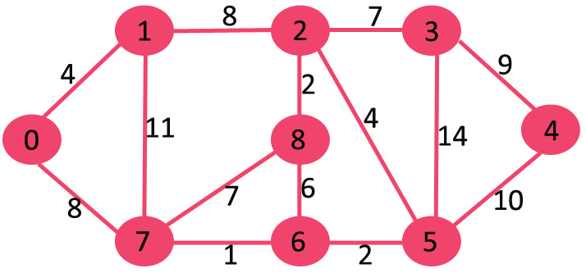
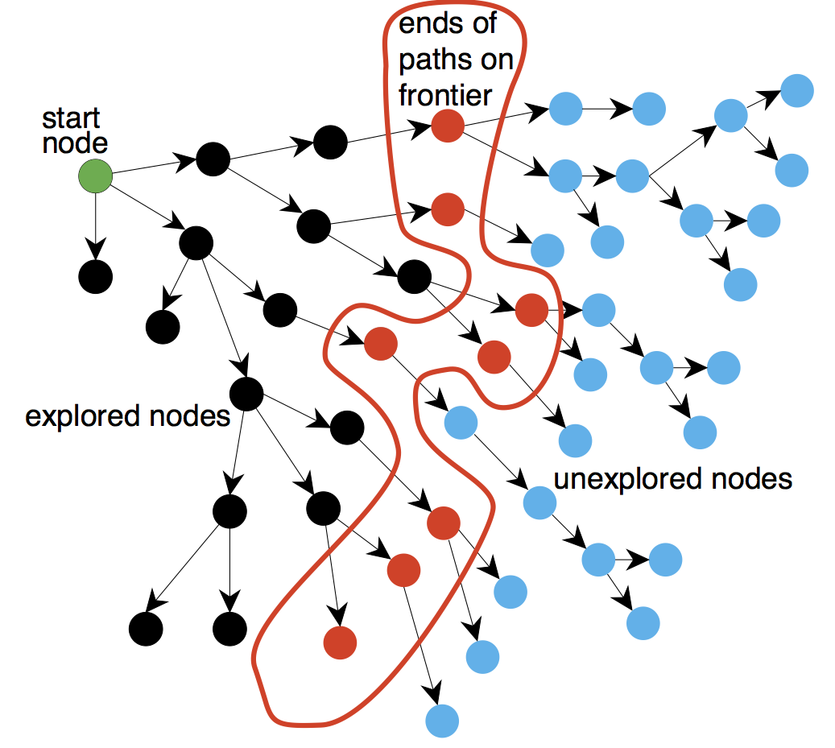
Minimum spanning tree (MST) is a tree that:
- Contains all the nodes (vertices) of the graph.
- has no cycles
- has minimal total length (sum of "weights" of edges)
Example - a cable company wanting to lay lines to multiple houses
while minimizing the amount of cable laid to save money.
Kruskal's algorithm (1956) - a minimum-spanning-tree algorithm
which finds an edge of the least possible weight
that connects any two trees in the forest.
- https://en.wikipedia.org/wiki/Kruskal%27s_algorithm
Shortest Path finding (road navigators, etc.)
- https://en.wikipedia.org/wiki/Shortest_path_problem
Multiple algorithms:
- Dijkstra - single-source shortest path problem with non-negative edge weight.
- Bellman–Ford - single-source problem if edge weights may be negative.
- A* search algorithm - single pair shortest path using heuristics
to try to speed up the search.
- Floyd–Warshall - all pairs shortest paths.
- Johnson's - all pairs shortest paths, and may be faster
than Floyd–Warshall on sparse graphs.
- Viterbi - shortest stochastic path problem with an additional
probabilistic weight on each node.
- etc.
==================================
Combinatorial search algorithms - achieve efficiency by
reducing the effective size of the search space
or by employing heuristics.
Classic combinatorial search problems include solving
the eight queens puzzle or evaluating moves in games
with a large game tree, such as reversi or chess.

