Slide 1
Data Architecture and Data Engineering
With Azure Synapse Analytics
Presented by Tyler Williams

Slide 2
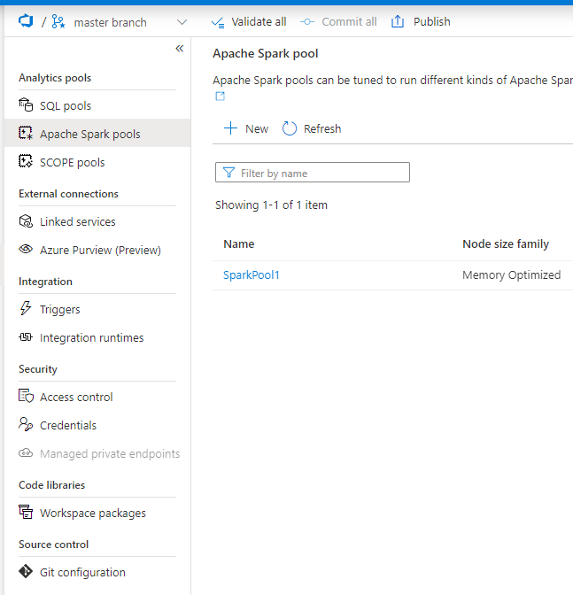
Azure Synapse Analytics - Components
Synapse Studio – IDE
Storage
Data Lake (Azure Storage Gen 2)
Dedicated SQL Pools
Compute
Serverless SQL Pools
Spark Pools
Dedicated SQL Pools
Orchestration – Pipelines/Data Flows
Git Integration

Slide 3
Synapse Origins – Azure SQL DW
Looks similar to Azure SQL DB, but different architecture behind the scenes
Massively Parallel Processing (MPP)
Database divided across 60 distributions
Supports most standard T-SQL functionality
Originally lacked support for IDENTITY columns, MERGE statement
Cannot update a table by specifying an alias from the FROM clause
More expensive than Azure SQL DB, but compute can be paused when not in use

Slide 4
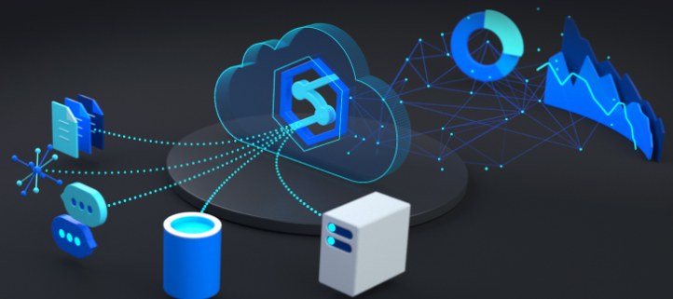
Synapse Origins – Continued
Nov 2019 – Azure SQL DW rebranded as Synapse Analytics
May 2020 – Public Preview of Synapse Analytics Workspace
Dec 2020 – General Availability of Synapse Analytics Workspace
SQL DW becomes “Dedicated SQL Pool”
Workspace introduced the full Synapse Studio experience

Slide 5
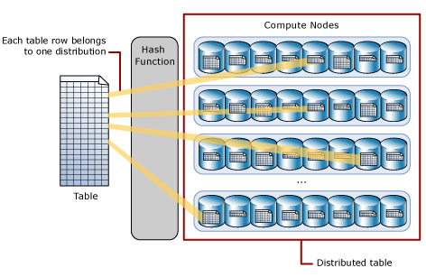
Synapse Dedicated SQL Pool
Distributed nature is key to optimization
All tables must have distribution function defined
ROUND_ROBIN
HASH
REPLICATE
Always 60 distributions, but number of nodes increases as pool is scaled
https://docs.microsoft.com/en-us/azure/synapse-analytics/sql-data-warehouse/sql-data-warehouse-tables-distribute

Slide 6
External Tables
Use compute from SQL database to query data stored elsewhere
Blob Storage
Hadoop
Azure Data Lake Store
On-prem SQL and Azure SQL DB have additional options
Oracle
Teradata
Define a virtual table, based on external data source and file format
Allows you to analyze and interact with external data using T-SQL
https://docs.microsoft.com/en-us/azure/synapse-analytics/sql/develop-tables-external-tables?tabs=hadoop

Slide 7
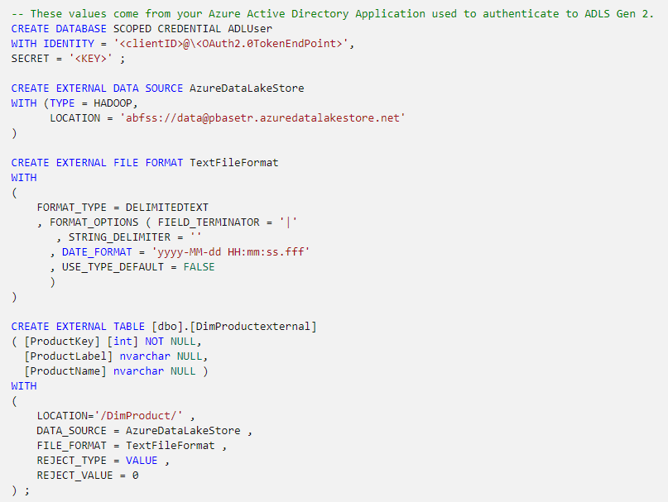
External Table – Code Example

Slide 8
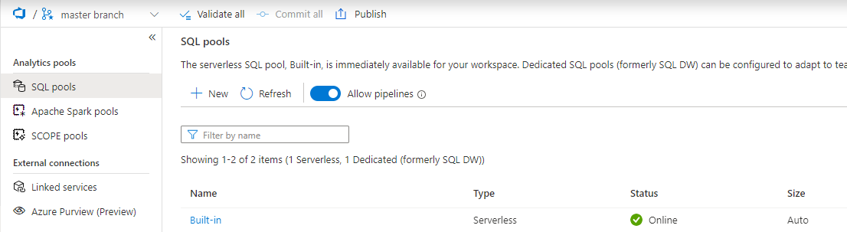
Serverless SQL Pool
Created by default in any Synapse Analytics instance
Contains only metadata/object definitions
No Storage; compute only
Can leverage External Tables, just as any other SQL DB does
Can define views, which provide visibility to underlying filenames and paths

Slide 9
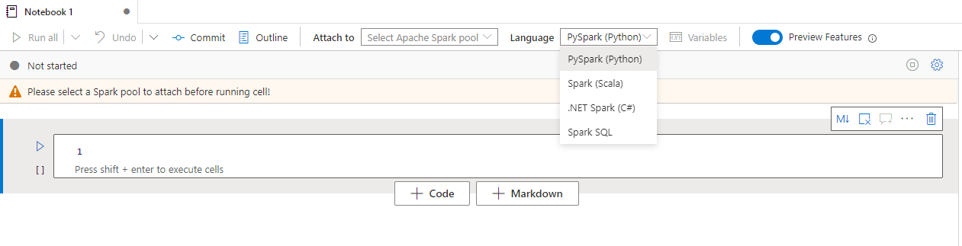
Spark Pools
Run notebooks on an Apache Spark instance
Support for Python, Scala, C#, and Spark SQL
Support for Delta Lake

Slide 10
Data Lake Storage
When creating a Synapse Analytics workspace, a default data lake must be specified
Can either link to existing Azure Data Lake, or have Synapse create a new one
Microsoft defines data lake storage as blob storage, with hierarchical namespaces enabled
Hierarchical namespaces not enabled by default when creating standalone storage account
Synapse creates linked service to data lake with name <SynapseWSName>-WorkspaceDefaultStorage
Not user friendly
Name cannot be edited
Not conducive to CI/CD deployments to other environments

Slide 11
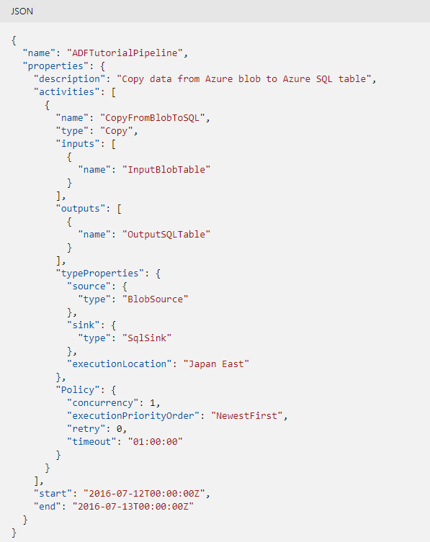
Synapse Origins – Azure Data Factory Gen 1
JSON code only; no graphical interface
Move Data: Source → Sink
Transform Data
Stored Procedures
HDInsight – Microsoft’s implementation of Hadoop
ML Studio (classic) – Gen 1 Machine Learning
https://docs.microsoft.com/en-us/azure/data-factory/v1/data-factory-data-movement-activities

Slide 12
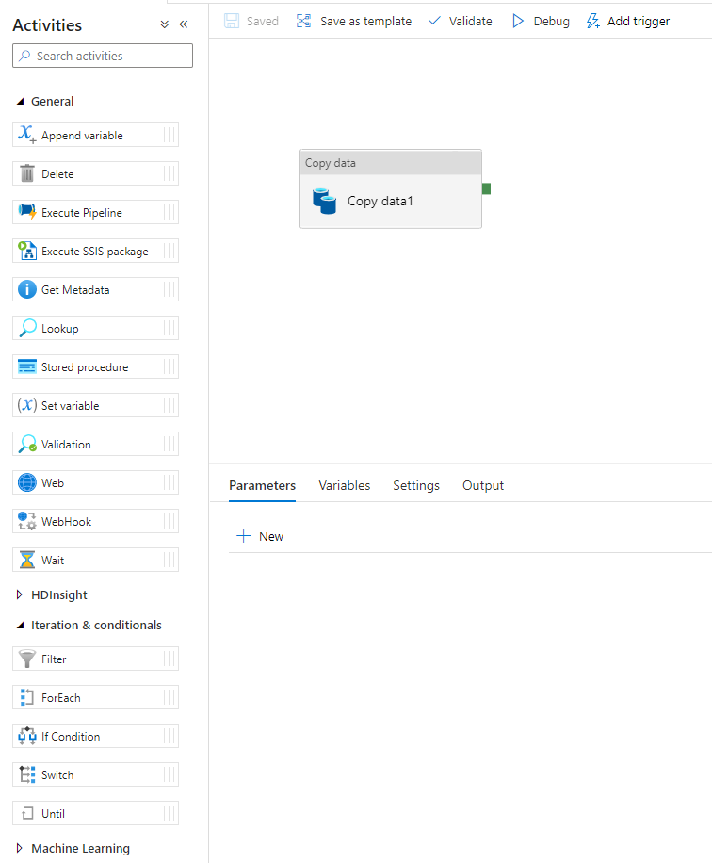
Azure Data Factory Gen 2
Web-based GUI
Still generates JSON behind the scenes
More robust toolbox for ETL
Conditionals
Iterations
API Calls
Lookups

Slide 13
Synapse Pipelines
Pipeline functionality is largely comparable to that of ADF Gen 2
Some Synapse limitations
No support for Integration Runtime sharing
Cannot execute SSIS packages
No support for Power Query
https://docs.microsoft.com/en-us/azure/synapse-analytics/data-integration/concepts-data-factory-differences

Slide 14
Next Big Feature – SCOPE Pools?
Internal Microsoft big data engine for processing data lake files – COSMOS
Not related to Cosmos DB; completely different
Language used for manipulating/processing data – SCOPE
Hybrid of SQL and C#
SELECT, FROM, JOIN, WHERE, ORDER BY, HAVING, ….
C# functions for field transformations
Public facing variant in Azure
COSMOS → Data Lake Analytics (Data Lake Storage Gen 1 only)
SCOPE → U-SQL
New SCOPE Pools in Synapse – Private Preview?

Slide 15
Questions/comments?

