Slide 1

Azure Purview
Data Governance 2.0
Malte Thesenvitz

Slide 2
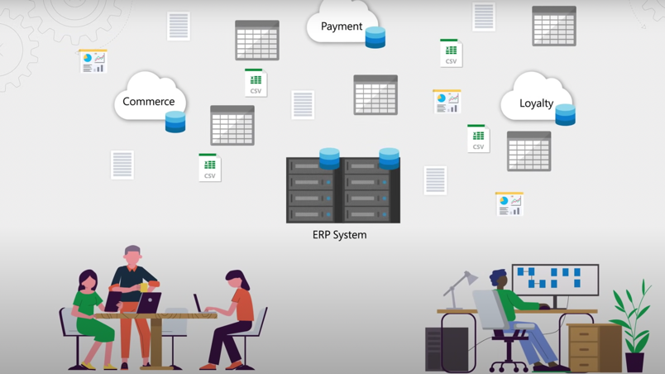
The 2 Problems.
90% of all data created in the last two years
By 2025, 80% of data will be unstructured
Information scattered around different locations (on-prem, cloud, streaming)
Adhere to ever changing data security regulations and requirements

Slide 3






What is Data Governance?
Decision rights & accountability framework for data usage
Ensure appropriate behavior in valuation, creation, consumption, and control of data analytics
Numerous competitors in the market

Slide 4
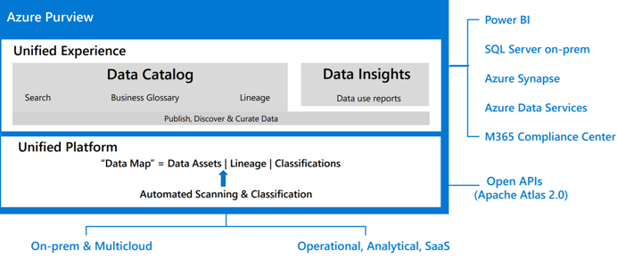
What is Purview?
Build upon popular open-source service Apache Atlas
In public preview since Dec. 2020; no set date for GA yet
Track, manage, and report on assets, right from inception, over processing, storage, consumption, to archival, retention, or disposition

Slide 5
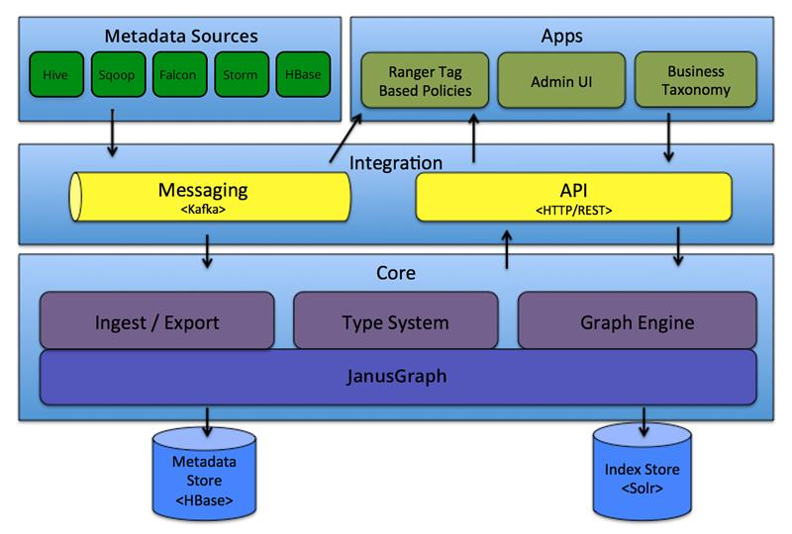
Apache Atlas
Atlas joined Apache family in 2015
Stores metadata in graph database called JanusGraph
Unlike traditional DBs, graph DBs do not use columns, rows, and tables
Instead, uses flexible structure that saves relationship between data
Nodes store information, edges store information

Slide 6
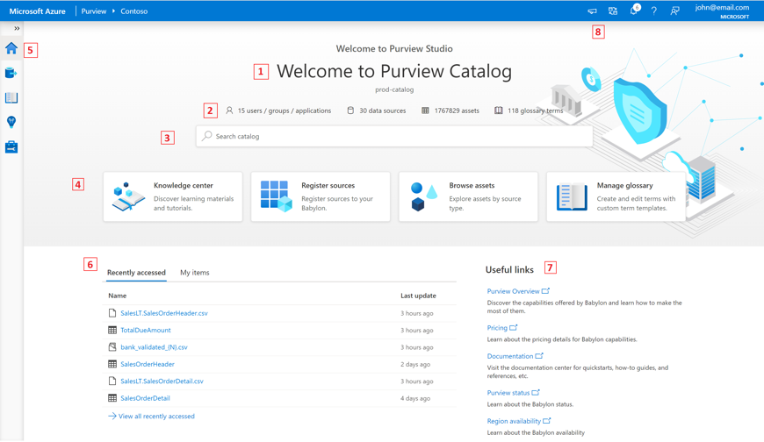
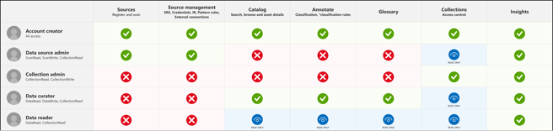
Purview Studio
Central Control Area for Data Discovery and Classification
Different Interface for different user roles
Manage access to companies' data estate

Slide 7
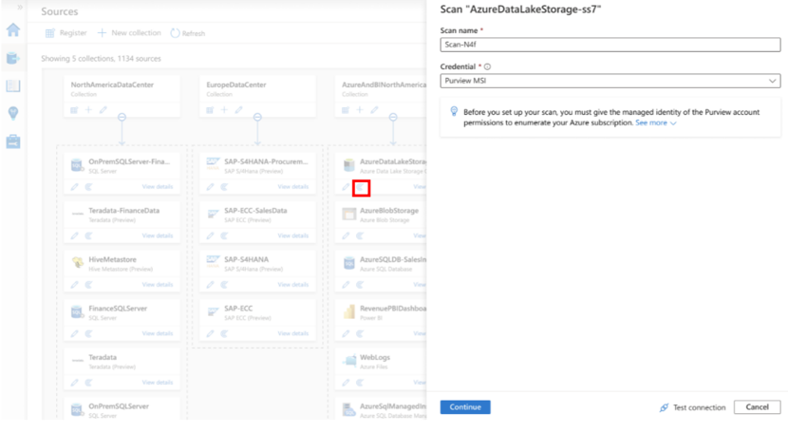
Scanning your Data Estate
Automatically discover metadata and schema
Support for over 100 different classification types
Choose scope of scan
Scan trigger determines frequency
Pay-as-you-go pricing

Slide 8
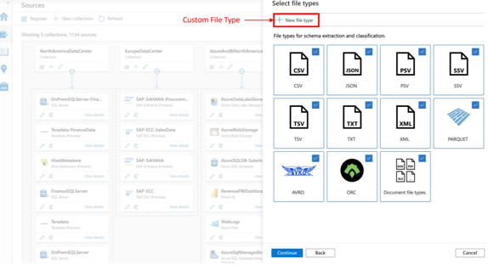
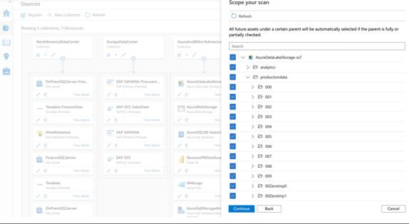
Customize Scan
Choose file type to scan
Determine scope of scan

Slide 9
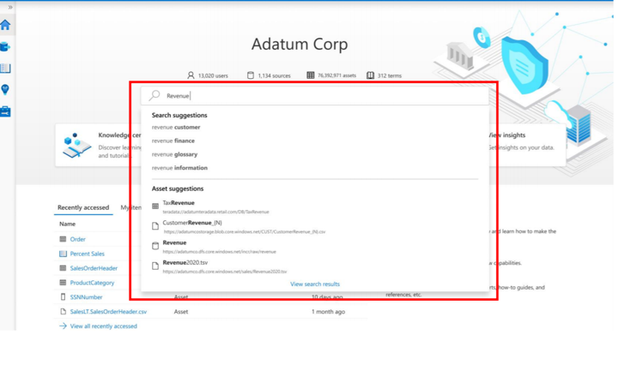
Browse your Catalog
Intelligent suggestions based on semantic search
Find data you need within seconds
Recommendations based on search history, context, data relationship

Slide 10
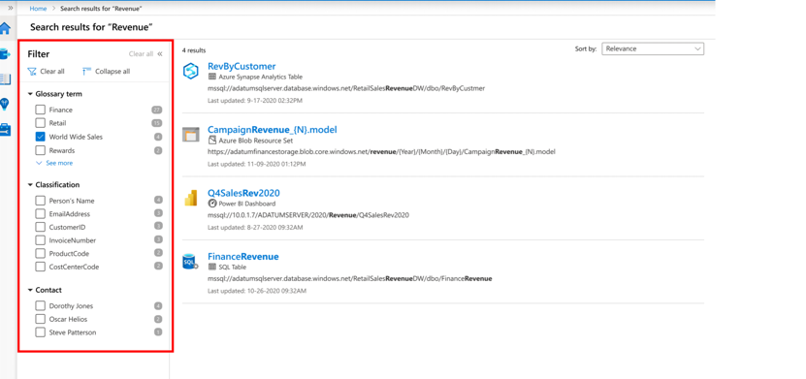
Filter Search Results
Smart Filtering based on Glossary, Classification, Contact
Find data you need within seconds
Recommendations based on search history, context, data relationship

Slide 11
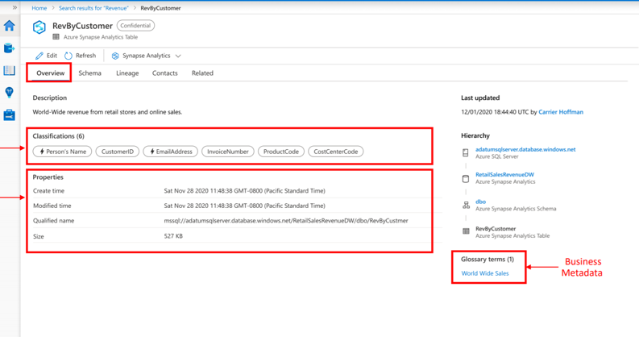
Classifying Data - Overview
Operational Metadata
Notice hierarchy (where does the data belong to)
Connect directly to Power BI
Sensitive data classification

Slide 12
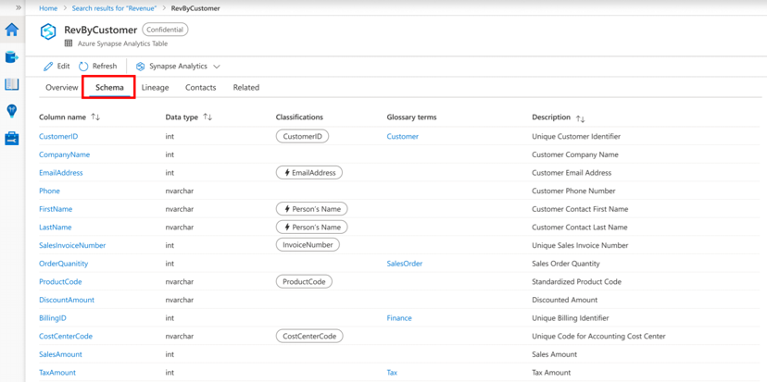
Classifying Data - Schema
Table Overview
Output of Data Scans
Notice difference between custom and system classifications
Highlights relevant glossary terms

Slide 13
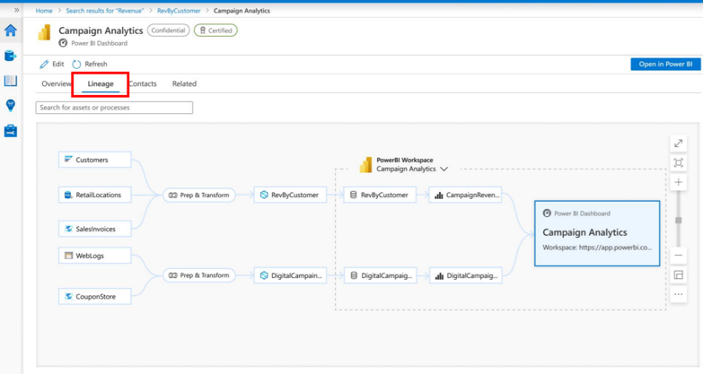
Discovering Data Lineage
Visual representation of source, transformation, and target showing data life cycle
Where a piece of data comes from and what derives from it
Native Support, Apache Atlas, REST API

Slide 14
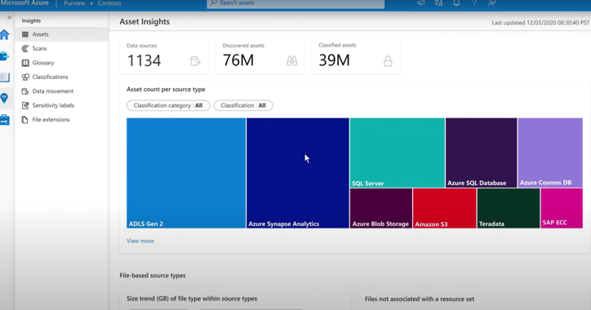
Birds-eye view with Insights
Get details about assets, scans, glossary, sensitivity labels, file extensions
Intended to quickly grasp understanding of entire data estate
Set of analytical dashboards on top of Azure Purview

Slide 15
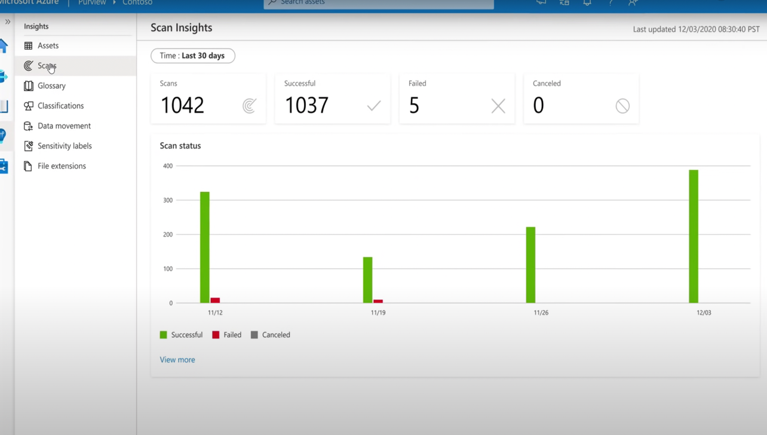
Scan Insights

Slide 16
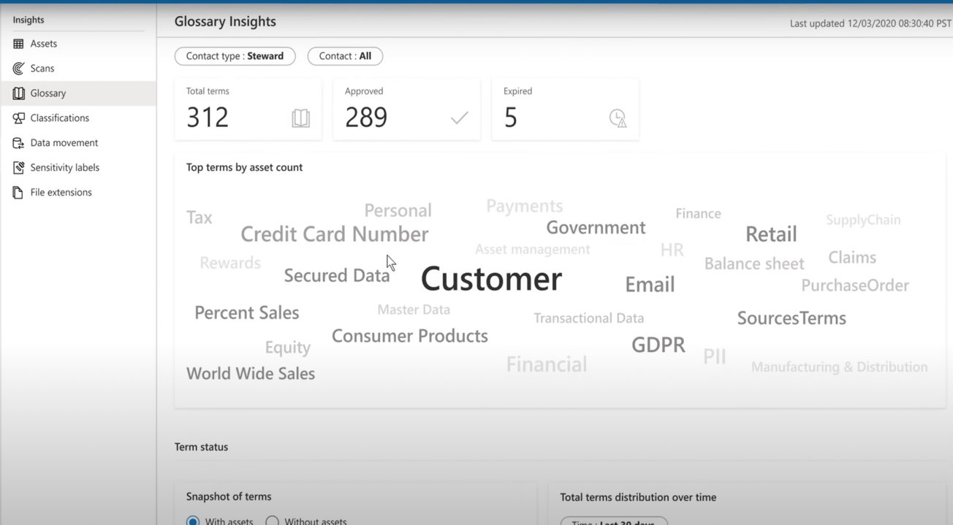

Slide 17
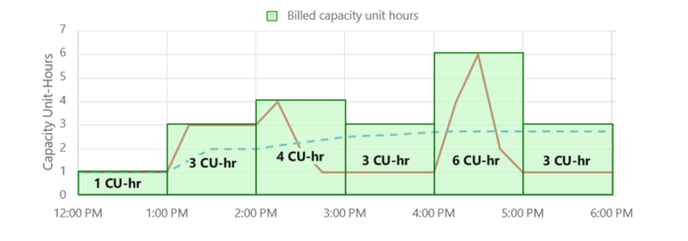
Pricing – How are we charged?
1 Capacity Unit = $0.411/h
1CU = 25 operations/sec or 2GB of metadata storage
Always billed on hourly basis for max value of either operations or storage
Can scale elastically upwards and downwards

Slide 18
Room for Improvement
Limited List of Data Sources
Can’t Classify Zip Content
UI is missing basic data management tasks (deleting assets once classified)
Max storage is 32GB for 16 Capacity Units
No support for Data Marketplace
No support for automation and alerting

Slide 19
Links and resources:
Purview MS Documentation
https://azure.microsoft.com/en-us/services/purview/
https://docs.microsoft.com/en-us/azure/purview/
Classifying: https://docs.microsoft.com/en-us/azure/purview/tutorial-schemas-and-classifications
Pricing: https://azure.microsoft.com/en-us/pricing/details/azure-purview/
Purview Studio: https://docs.microsoft.com/en-us/azure/purview/use-purview-studio
Access Control: https://docs.microsoft.com/en-us/azure/purview/catalog-permissions
Videos:
https://www.youtube.com/watch?v=pv6A5l39-iA&t=833s
https://www.youtube.com/watch?v=27bA4KFiEKk&t=1s
Articles:
https://www.linkedin.com/pulse/data-governance-gaurav-aggarwal/
https://www.analyticstechblogs.com/post/azure-purview-vs-azure-data-catalog-gen-2-what-did-we-get
https://sourceforge.net/software/compare/Apache-Atlas-vs-Azure-Purview/
https://atlas.apache.org/#/

Slide 20
Further Links and resources:
https://cloud.google.com/blog/products/data-analytics/architecting-a-data-lineage-system-for-bigquery
https://stackoverflow.com/questions/67699567/how-is-data-lineage-tracked-in-aws-athena-and-glue
Videos:
https://youtu.be/awUMmRHbWj0
https://youtu.be/eZqSE5Z4tUs
https://youtu.be/pv6A5l39-iA
https://techcommunity.microsoft.com/t5/azure-purview/march-ahead-with-azure-purview-unify-all-your-data-using-apache/ba-p/2185411
Apache Atlas:
https://www.mongodb.com/atlas/data-lake
https://janusgraph.org/

