Slide 1
Data Architecture and Data Engineering
Star Schema Data Modeling
Presented by Tyler Williams

Slide 2
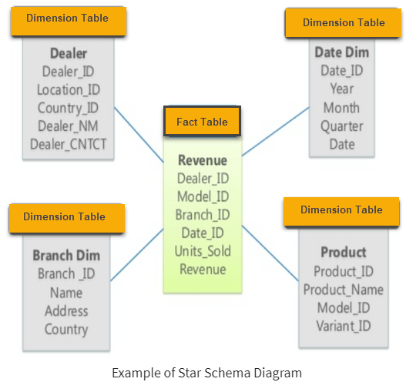
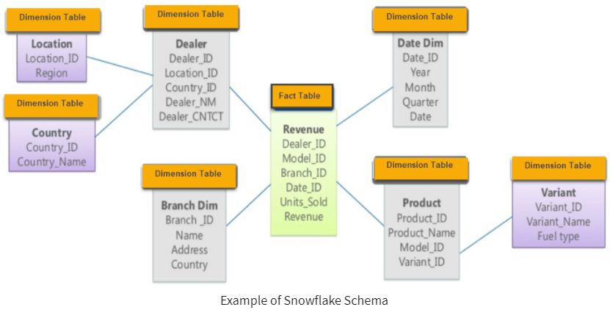
Star Schema and Snowflake Schema

Slide 3
Star Schema
Data design architecture popularized by Ralph Kimball
Flattens out 3rd normal form (3NF), making for faster and simpler querying
First Normal Form – each data field holds a single value; no composites
Second Normal Form – reduce redundant data
Third Normal Form – no attributes have transitive dependence on primary key
Attributes can be modified without having to modify the key
Quantitative metrics reside in a central fact table
Qualitative dimensions radiate from the fact table, defining attributes by which to slice and aggregate the metrics
Beneficial design for use in Analysis Services or Power BI Datasets

Slide 4
Star Schema vs Snowflake Schema
Star Schema
Snowflake Schema
Hierarchies fully contained within dimension table
Denormalized data (more redundancy)
Simple design
Faster queries due to fewer joins
Hierarchies defined by dimension relationships
Semi-normalized data
Complex design
More joins and more complex queries required to retrieve data
https://www.guru99.com/star-snowflake-data-warehousing.html

Slide 5
What is the value of a star schema, in a DB?
Ease of use for self-service BI
Better performance when used as data source for dashboards/reports
Well-defined, static schema (columns, data types, relationships)
Simple data types
String, number, Boolean
No arrays or structs
Clear, one-to-many relationships
Ease of maintenance – Dimension updates don’t require changes to facts

Slide 6
Design Considerations
Foreign Keys
Avoid DB-managed constraints
Processing overhead – engine must verify that constraints aren’t violated
Valid relationships are managed via ETL process
Surrogate Keys
No business meaning – typically use incremental IDENTITY column
Exception: DateKey – integer “smart key” – YYYYMMDD - 20210917
Separate from business key/natural key
-1 “unknown” record – default value whenever a lookup doesn’t return matches – no NULLs in fact table
Updating records
Dimensions
Which columns can change?
Do we need to maintain history?
Facts
Incremental/full loads?
Insert only? Or need to update prior records?

Slide 7
Slowly Changing Dimensions (SCD)
In most cases, one or more attributes of an entity are expected to change over time
Need mechanism to determine if/how historical values should be maintained
People
Name
Height
Profession
Property
Owner
Value
https://towardsdatascience.com/data-analysts-primer-to-slowly-changing-dimensions-d087c8327e08
Peter Venkman
College Professor → Paranormal Investigator
→ TV Host

Slide 8


SCD Type 0, Type 1
Type 0, AKA “Fixed”
Existing attributes never change, only new records added
Examples:
Date
Reference tables, single-attribute dimensions
Type 1 – No history maintained
Don’t care about previous attribute values, overwrite with current value

Slide 9

SCD Type 2
Maintain a full history of attribute values
Row Versioning
Row Effective Dates – Start Date/End Date
Use far future date for end date – 12/31/9999
Natural key preserved, new surrogate key

Slide 10
SCD Type 3
Doesn’t preserve full history of values
Only maintains current and prior values of an attribute
Includes date that the most recent change occurred

Slide 11
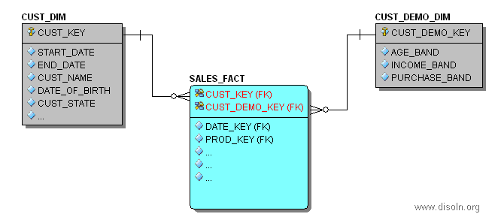
SCD Type 4
Design pattern generally used for a “Rapidly Changing Dimension”
Some attributes of a dimension may be especially volatile, so these can be spun off into a separate “mini dimension”
The remaining attributes of the original dimension can continue to be implemented as a type 1, 2, or 3 SCD
http://www.disoln.org/2013/04/SCD-Type-4-a-solution-for-Rapidly-Changing-Dimension.html

Slide 12
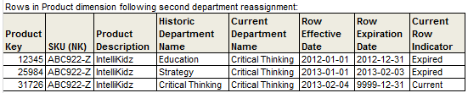
SCD – Hybrid Types
Higher SCD types (5, 6, 7, …) are not really standardized; you can find different definitions depending on where you look
The only consensus is that they are generally hybrids of the “standard” types, 1, 2, and 3 (and sometimes 4)
Type 5 = Type 1 + Type 4
Copy of the “mini dimension” joined directly to the base dimension, with the current values for the record
Type 6 uses versioned records, like type 2, but for some attributes maintains a “current value column” (Type 3). This “current value” column gets updated in-place across all historical records
1 + 2 + 3 = 6
https://www.kimballgroup.com/2013/02/design-tip-152-slowly-changing-dimension-types-0-4-5-6-7/

Slide 13
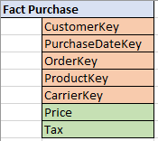
Fact Tables
Should be built at the lowest level granularity that makes sense for the fact, or that will be used in reporting
Each Record should be uniquely identified by the composite of its dimension keys
Generally don’t have identity columns, or a single primary key column
Referential integrity ensured by ETL process (dimension lookups)

Slide 14
Aggregated Fact Tables
Sometimes, for performance reasons or specific reporting needs, you will want to create an aggregated fact table
There may also be hardware or cost constraints that prohibit scaling up to get performant aggregations on large tables
Often a copy of an existing fact table, pre-aggregated to a higher level granularity
Example: FactPurchase → FactMonthlyProductSales

Slide 15
OLAP Cubes/Tabular Data Model
“Cubes” technically relate to data processed into a multi-dimensional data model in an OLAP database such as Analysis Services (SSAS)
Multi-dimensional was previously the only mode offered by SSAS
SSAS cubes use file-based storage and pre-aggregate fact tables (measure groups) across commonly used dimensional slices
Widespread adoption conditioned people to think of all SSAS data models as “cubes”, even after the introduction of Tabular mode
Tabular data models process data in a memory cache and don’t distinguish between “facts” and “dimensions”
SSAS Tabular uses the same engine as Power BI datasets
SSAS Multi-dimensional no longer receives much, if any, development focus from Microsoft
Even SSAS tabular is being de-emphasized over Power BI
SSAS Tutorial: What is, Architecture, SSAS Cube & Types (guru99.com)
Power BI Premium and Azure Analysis Services | Microsoft Power BI Blog | Microsoft Power BI

