Slide 1


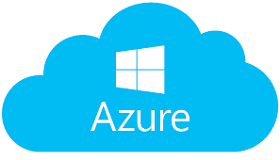
Three Clouds
Amazon AWS
Amazon Web Services
https://aws.amazon.com
https://aws.amazon.com/marketplace
Microsoft Azure
https://portal.azure.com
Google GCP
Google Cloud Platform
https://cloud.google.com

Slide 2
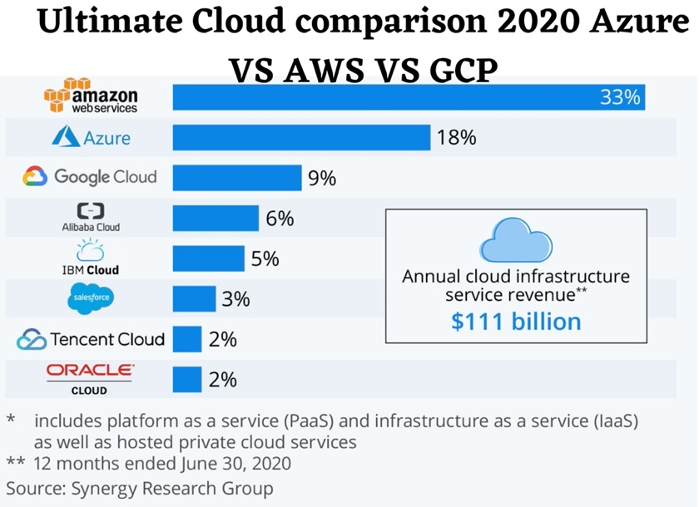
Three Clouds

Slide 3
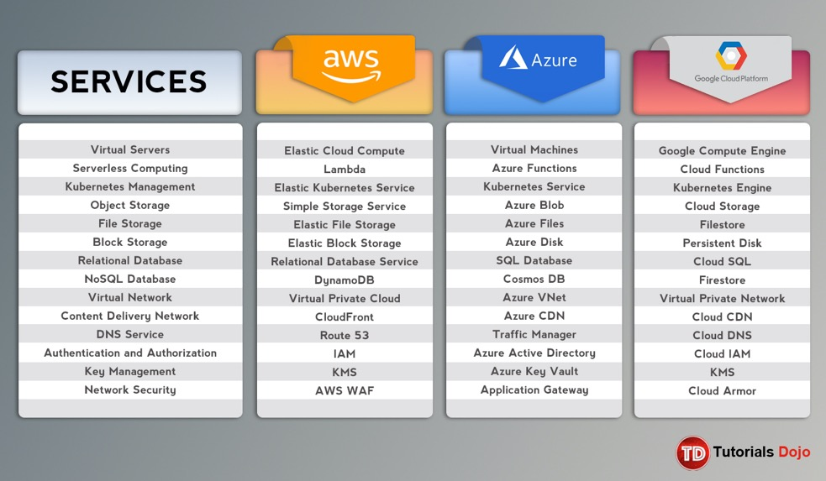
Three Clouds

Slide 4
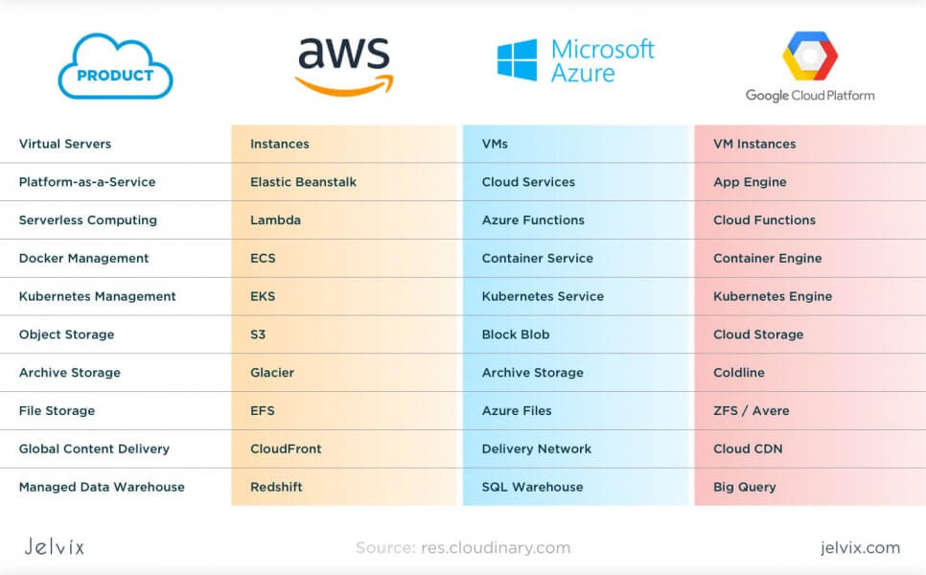

Slide 5
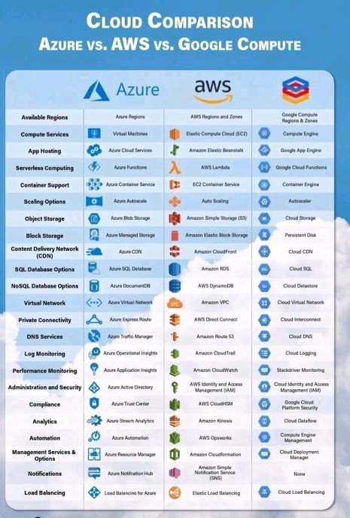
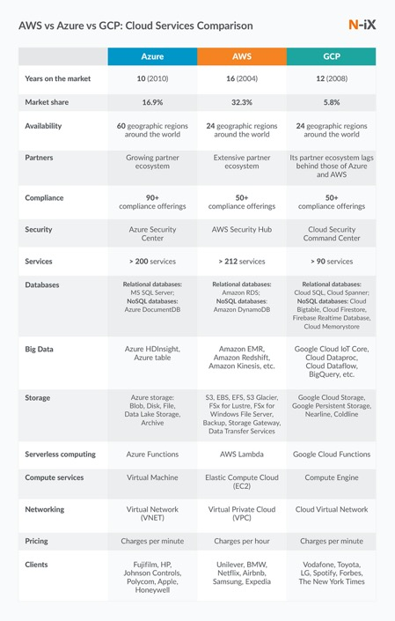

Slide 6




Virtual Machines
VM:
EC2 = Elastic Cloud Compute
Disk:
EBS = Elastic Block Storage
VM:
Virtual Machine
Disk:
Managed Disk
VM:
Google Compute
Disk:
Persistent Disk

Slide 7



Storage
S3
(Simple Storage Service)
ADLS (Azure Data Lake Storage Gen2)
Azure Blobs
Azure Files
Cloud Storage

Slide 8
Databases
RDS (Relational Database Service)
Amazon Aurora (MySQL, PostreSQL)
PostgreSQL
MySQL, MariaDB
Oracle Database
SQL Server
Redshift
Snowflake.net
Athena (serverless) = Managed Apache PrestoDB
DynamoDB (key-value, distributed, global)
Neptune Graph Database
Cloud SQL: managed MySQL, PostgreSQL, SQL Server
Cloud BigQuery: Serverless DW, globally scalable, cost-effective
Cloud Spanner: 99.999% availability, gaming, global fin. ledger, inventory
Cloud Bigtable: NoSQL wide-column (similar to HBase & Apache Cassandra)
Firestore: NoSQL for Mobile, IoT, ...
Firebase Realtime DB: mobile, personalized ads, in-app chats, ...
Memorystore: Redis or Memcached
MongoDB Atlas
Neo4j Auro (Graph DB)
Datastax (NoSQL built on Apache Cassandra)
Microsoft SQL Server
Synapse Dedicated Pools (SQL Data Warehouse)
SQL Serverless
Cosmos DB
MySQL, PostreSQL

Slide 9
Integrate
Amazon Glue: managed ETL service
Amazon Data Pipeline
AppFlow
Kinesis Firehose
AWS Datasync
AWS Data Migration Service
ADF (Azure Data Factory)
Synapse Integrate
Storage Transfer Service
Datalab
DataPrep
DataFlow

Slide 10
Serverless Functions
Lambda functions
Azure Functions
Cloud Functions
C#
Go
Java
PowerShell
Node.Js
Python
Ruby
Runtime API to use any other language
To add pandas, etc.
install locally, zip, add as zip file
create your own docker image with it
C#
F#
Java
JavaScript
Powershell
Python
TypeScript
Note: no “Go”
To add pandas, etc.
use local requirements.txt and then deploy
C#
Go
Java
Node.js
Python
Ruby
To add pandas, etc.
use requirements.txt file (pip)
package (zip) your modules

Slide 11
Hadoop, Spark, ...
Amazon EMR (Elastic MapReduce)
Databricks
PySpark
Databricks
Dataproc (Spark, Presto, Flink, ...)
Databricks

Slide 12



Dashboards
Amazon QuickSight
Power BI
Google Data Studio

Slide 13
Machine Learning
SageMaker .. python .. jupyter notebooks .. deployment
Machine Learning Studio
ML in Power BI
ML in PySpark
Machine Learning:
DataLab
ML Engine
AutoML
Colaboratory (Colab) free jupyter notebooks with GPU
Kaggle - ML competitions, code, notebooks (kernels), ... - https://www.kaggle.com/

Slide 14
ML & AI Solutions
Azure Cognitive Services
1. Vision
Image analysis and anotation
Handwriting recognition
Celebrity and landmark recognition in pictures
Read the text in images
Analyze videos in real-time (text-based descriptions)
2. Speech
Speech recognition and speech-to-text transcriptions
Text-to-speech transcriptions
Real-time translations
Speaker verification (Id a person by analyzing speech)
3. Language
Text Analytics API - key phrases, languages, sentiment, and interlinking
Bing spell check (proofreading)
Translator text
Content moderator (images, text)
4. Knowledge
Q&A maker (build FAQ)
5. Search
Bing web search
Bing custom search (filter, safety, etc.)
Bing video search
Bing image search
Bing news search
Amazon:
Comprehend (extract from text)
CodeGuru (auto code review)
Lex (Chatbots)
Forecast
Textract (extract text & data from millions of docs)
Kendra (Natural Language Search)
Fraud Detector
Rekognition - image/video analysis,
Personalize - recommendation engine,
Translate - real time translation
Polly - text-to-speech
Transcribe - speech to text
QuickSight - Analytics dashboards
Google Cloud AI Services
Cloud Vision API
Video Intelligence API
Cloud Speech API
Cloud Natural Language
Cloud Translation

Slide 15
Data Governance & Lineage
BigID
Collibra
PKWARE
Reltio
Zaloni
Azure Purview
Cloud Governance
BigQuery Data Governance

Slide 16
Dev Ops, CD/CI
AWS Developer Tools
AWS CodePipeline
AWS CodeBuild
AWS CodeDeploy
AWS CodeStar
Microservices, containers , serverless computing
ECS = Amazon Elastic Container Service
AWS CloudFormation
AWS OpsWorks (Chef)
AWS Systems Manager
AWS Config
Amazon CloudWatch
AWS X-Ray
AWS CloudTrail
AWS Elastic Beanstalk
AWS CodeCommit
https://aws.amazon.com/devops
Azure DevOps
Azure Web Apps
Azure Pipelines CI/CD
Cloud Build
Artifact Registry
Cloud Source Repositories
Tekton Pipelines
Jenkins

Slide 17
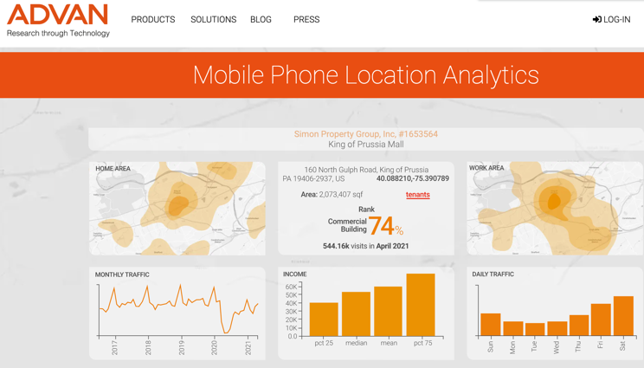
Use Case - Advan Research Corporation
https://www.advanresearch.com/
0.75 TB of compressed data daily
2PB+ of storage
Google BigQuery
Loading, Sharding, Clustering

