Slide 1
Data Architecture - ETL, Git, CI/CD, DevOps, . . .
ETL = Extract Transform Load
Git
CI/CD = Continuous Integration / Continuous Delivery
DevOps
YAML
Fuzzing
Protocol Buffers
High-Availability Clusters, Consistent Hashing

Slide 2
ETL – Extract Transform Load
Good ETL Architecture with one central Layer
Extract data from one system (database?)
Transform to different formats (filter, clean, join, etc.)
Load into another system (database)
A
B
files
ETL
Layer
files
C
B
Good Practices
C
D
- Try to separate process into 3 distinct steps: Extract, Transform, Load.
- Avoid chaining. Embrace parallel processing. Use FedEx architecture – use central "Airport" to get all data into one processing center at the same time, process fully in one place, and only then deliver to targets at the same time.
- All individual steps should be re-runnable.
- Think about moving data as a big set of distributed transactions. Expect that individual steps will often fail. All steps should be logged. Logs allow to design system to do self-recovery.
- All rows of data should be tagged with individual unique row_id, individual unique load_id, timestamp, user, and other metadata to allow cleaning and rerunning.
- Use bulk loaders/unloaders whenever possible. Bulk operations are much faster than querying or inserting one row at a time.
- Split huge chunks of data into reasonably sized pieces. In case of failure, smaller pieces allow to rerun only failed pieces – not the whole thing.
- Do all processing externally in ETL layer. This includes validation, joining, key-generation, etc. Try to avoid post-processing in the target.
- When loading into databases – disable triggers, drop indices, etc.
- Monitor memory usage to avoid crashes.
E
T
L
Bad Architectures – chaining or multiple mutual inter-connections
A
B
C
D
E

Slide 3
Some ETL Tools & Vendors
AWS Glue
Ab Initio
Actian DataConnect
Adeptia Integration Server
Airbyte (open source)
Alooma
Apache Airflow (open Source, python)
Astronomer (based on Apache Airflow)
Apache Camel (open source)
Apache Kafka (open source)
Apache NiFi
Apatar (Deprecated)
ApatarForge (open source)
Atom (from ironSource)
BODS (Business Objects Data Services) from SAP
BiG EVAL
Blendo
Bubbles (open source)
CDAP
CData Sync
Centerprise Data Integrator
CloverDX Data Integration Software
CloverETL (open source)
Cognos Data Manager
DBConvert Studio By SLOTIX s.r.o.
DBSoftlab
Dataddo
Dell Boomi
Elixir Repertoire for Data ETL
Etleap
Fivetran
FlyData
Heka (Deprecated)
Hevo Data
IBI Data Migrator
IBM Cognos Data Manager (Formerly known as Cognos Decision Stream)
IBM Infosphere Information Server
IBM Websphere DataStage (Formerly known as Ascential DataStage)
IBM Datastage = IBM Information Server
IBM Infosphere Information Server
IBM Infosphere Warehouse Edition
IRI Voracity
Informatica Power Center
Jaspersoft ETL
Logstash (open source)
Matillion
Microsoft Azure Data Factory (same as Azure Synapse Integration)
Microsoft SQL Server Integration Services (SSIS)
N8n
Nexla
OWB and ODI from Oracle
Open Text Integration Center
Open source Clover ETL
Oracle − Data Integrator ODI (Formerly known as Sunopsis Data Conductor)
Oracle − Warehouse Builder
Oracle Data Integrator (ODI)
Oracle Warehouse Builder (OWB)
PDI (Pentaho Data Integration) from Pentaho (now Hitachi Data Systems)
Panoply
Pentaho Data Integration (Kettle) (open source)
Pentaho Data Integration (PDI)
Petl (open source)
Pygrametl (open source)
QlikView Expressor
QuerySurge
Relational Junction
SAP − Business Objects Data Services BODS
SAP – BusinessObjects Data Integrator
SAP Data Services
SAS − Data Integration Studio
SAS Data Integration Studio from SaS
SAS Data Management
Sagent Data Flow
Scriptella (open source, Deprecated)
Segment
Singer (open source)
Skyvia
Stitch
StreamSets
Striim
Sybase ETL
Syncsort DMX
Talend Open Studio & Integration Suite
Talend Open Studio (open source)
Vendia
Web Data Extraction & Aggregation Services
Xplenty
Xtract.io

Slide 4
ETL – continued …
Microsoft SQL Server on Azure cloud - very standard SQL database
(1st release 30+ years ago, in 1989)
- https://azure.microsoft.com/en-us/services/sql-data-warehouse
Power BI - Standard Microsoft Business Intelligence tool
- https://powerbi.microsoft.com
Demo of how fast Power BI works with MS SQL Server - 500+ Mln rows of data
- https://www.youtube.com/watch?v=mQyFp2MSl-s
Demo of Kinetica DB using Tableau & Power BI:
- https://www.youtube.com/watch?v=7XliLU7ZC_s
Notice:
- sub-second response on billions of rows of data
- no need to create indexes, no wait time, fast load (even live streaming) of data
Benefits:
- you can select from many different BI tools - they all support SQL
- you can select from many SQL databases - they are fast
- you can simplify your development time using standard SQL features
- you can select dedicated hardware to tune your speed
- you can achieve very fast response time
- you can enjoy lower prices

Slide 5

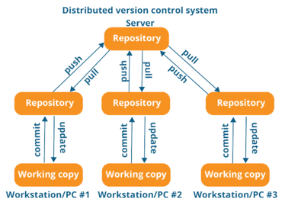




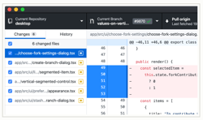
Git
Linus Torvalds has developed Git in 2005
to use in Linux development community.
(before Git they used BitKeeper).
Some of the goals of the new system were:
Speed
Simple design
Strong support for non-linear development (thousands of parallel branches)
Fully distributed
Able to handle large projects like the Linux kernel efficiently (speed and data size)
Linus Torvalds
Linux - https://www.linux.org
Git - https://git-scm.com - https://github.com
GitHub - founded in 2008
Microsoft acquired GitHub for $7.5B in 2018
In 2020:
- 40 Million users
- 190 Million repositories
- 2.5 Thousand employees
GutHub
Desktop
GutHub
Linux
Git

Slide 6
Git – continued …
.gitconfig. (example)
Git is a source control system
- http://git-scm.com
- https://git-scm.com/doc
git config --global user.name "Last, First"
git config --global user.email FLast@example.com
Some files to know:
~/.git-completion.bash
~/.gitconfig
~/.gitexcludes
mkdir ~/workdir
cd ~/workdir
git clone git@github.com:myuser/repo1.git
git clone git@github.com:myuser/repo2.git
cd repo1
edit .gitignore
git add .
git commit -m'soem comment'
git remote add origin git@github.com:myuser/repo1.git
git push -u origin master
git fetch
git pull
git log
...
Check your remote:
git remote -v (base)
origin git@github.com:lselector/ml_ai_doc.git (fetch)
origin git@github.com:lselector/ml_ai_doc.git (push)
(base)
[filter "lfs"]
process = git-lfs filter-process
required = true
clean = git-lfs clean -- %f
smudge = git-lfs smudge -- %f
[user]
name = Lev Selector
email = lev.selector@gmail.com
[credential]
username = lselector
[color]
ui = auto
[alias]
st = status
ci = commit
co = checkout
staged = diff --cached
unstage = reset HEAD --
amend = commit --amend
unci = reset --soft HEAD^
oneline = log --oneline
unstaged = diff
both = diff HEAD
lg = log --graph --pretty=oneline --abbrev-commit --decorate
wdiff = diff --word-diff
[log]
decorate = short
[push]
default = tracking
[branch]
autosetuprebase = always

Slide 7
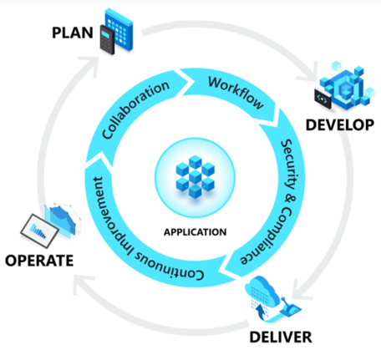



DevOps
What is DevOps
DevOps = Development (Dev) + Operations (Ops)
DevOps is the union of people, process, and technology.
DevOps enables formerly siloed roles
development
IT operations
quality engineering
security
to coordinate and collaborate to produce better, more reliable products.
By adopting a DevOps culture, practices and tools,
teams gain the ability to better respond to customer needs, increase confidence in the applications they build, and achieve business goals faster
Azure DevOps Server - a Microsoft product that provides version control, reporting, requirements management, project management, automated builds, testing and release management capabilities. It covers the entire application lifecycle, and enables DevOps capabilities
AWS
Google

Slide 8
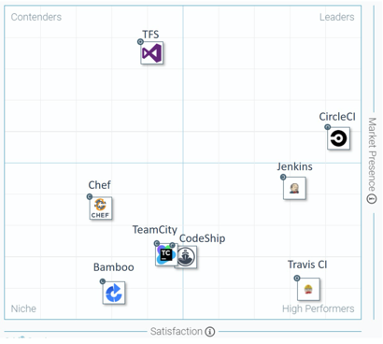
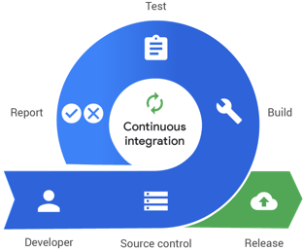
Continuous Integration / Continuous Delivery CI/CD
CI Software for DevOps
Review - https://www.guru99.com/top-20-continuous-integration-tools.html
Leaders:
CircleCI - free and commercial, good for small projects - https://circleci.com/
Jenkins - open source, java, need dedicated server, good for big projects - https://www.jenkins.io/
Travis CI - similar to CircleCI (more options, but also more expensive, no free options) - https://travis-ci.org/
Others:
CodeShip - https://codeship.com/
TeamCity – from JetBrains, $300+, has many features - https://www.jetbrains.com/teamcity/
Bamboo CI – commercial - https://www.atlassian.com/software/bamboo
Chef - https://www.chef.io/
Ansible - RedHat - https://www.ansible.com/
GitLab CI - https://about.gitlab.com/
AirFlow - https://airflow.apache.org/
Azure devops - https://azure.microsoft.com/en-us/services/devops/
Jenkins X - https://jenkins-x.io/
OpenShift - Red Hat - Enterprise Kubernetes container platform to automate hybrid cloud and multi-cloud deployments - https://www.openshift.com/

Slide 9




YAML
YAML Example:
YAML = YAML Ain't Markup Language (original name was Yet Another Markup Language)
serialization language, mostly used for config files, DevOps
human-friendly
since 2001 (20+ years)
by Clark Evans, Ingy döt Net, Oren Ben-Kiki
rhymes with “camel”
unicode based
uses indentation (like python) to indicate nesting
uses [...] for lists and {...} for maps
JSON files are valid YAML
uses "#" for comments (benefit in comparison with JSON)
https://yaml.org -
https://en.wikipedia.org/wiki/YAML -
http://ben-kiki.org/oren - https://github.com/orenbenkiki -
https://github.com/ingydotnet -
https://github.com/clarkevans -
---
# Employee records
- martin:
name: Martin D'vloper
job: Developer
skills:
- python
- perl
- pascal
- tabitha:
name: Tabitha Bitumen
job: Developer
skills:
- lisp
- fortran
- erlang
Ingy döt Net
Clark Evans
YAML in Python:
# https://pyyaml.org/wiki/PyYAMLDocumentation
# pip install pyyaml
import yaml
with open(myfile) as fh:
data = yaml.load(fh, Loader=yaml.FullLoader)
print(data)
data = [ ... ]
with open('myfile.yaml', 'w') as fh:
out = yaml.dump(data, fh)
The reason why we like working with YAML
is because it is optimized for data serialization, formatted dumping, configuration files, log files, Internet messaging and filtering.
There are many advantages of localizing files in YML file format: Files are easy to work in a text editor.
Oren Ben-Kiki

Slide 10
Fuzzing for Test Automation.
Fuzzing or fuzz testing - test software by feeding it with random data – was done since 1950s.
The term "fuzzing" originates from a 1988 class project (fuzz testing unix utilities) taught by Barton Miller at the University of Wisconsin.
Fuzzer generate
data
SUT
System
Under Test
Report
Feedback
Prof. Barton P. Miller
Univ. of Wisconsin
https://en.wikipedia.org/wiki/Fuzzing
https://www.guru99.com/fuzz-testing.html
2012 – ClusterFuzz (Google cloud-based fuzzing infrastructure)
2014 – fuzzer AFL success in disclosing Sellchock bugs in Unix Bash shell
2014-15 – fuzzer AFL disclosed the Heartbleed vulnerability in OpenSSL
2016 – DARPA (Defense Advanced Research Projects Agency) competition for developing automatic defense systems that can discover, exploit, and correct software flaws in real-time – used fuzzing as offense strategy to discover flaws in the software of the opponents.
2016 - Project Springfield - Microsoft cloud-based fuzz testing service for finding security critical bugs in software.
2016 - OSS-Fuzz (Google) - continuous fuzzing of security-critical open-source projects.
2018 - At Black Hat 2018, Christopher Domas demonstrated the use of fuzzing to expose the existence of a hidden RISC core in a processor. This core was able to bypass existing security checks to execute Ring 0 commands from Ring 3.
Fuzzy testing known to find the most serious security faults or defects.
Fuzzing is one of the most common method hackers used to find vulnerability of the system.

Slide 11
Protocol Buffers
A protocol buffer is simply a binary message.
The structure of the messages is defined in a .proto file.
Google provides open-source libraries for different languages for encoding/decoding these messages.
- https://en.wikipedia.org/wiki/Protocol_Buffers
- https://developers.google.com/protocol-buffers/docs/pythontutorial
Protobuf-s are much smaller than XML, CSV, etc.
Protobuf-s specs don't specify compression, but they have binary optimizations, which make them even smaller.
You can further decrease messages using compression:
- https://github.com/protocolbuffers/protobuf/blob/master/src/google/protobuf/io/gzip_stream.h
Example of a proto file: addressbook.proto
syntax = "proto2";
package tutorial;
message Person {
optional string name = 1;
optional int32 id = 2;
optional string email = 3;
enum PhoneType {
MOBILE = 0;
HOME = 1;
WORK = 2;
}
message PhoneNumber {
optional string number = 1;
optional PhoneType type = 2 [default = HOME];
}
repeated PhoneNumber phones = 4;
}
message AddressBook {
repeated Person people = 1;
}

Slide 12
High Availability Clusters
Question:
If a load balancer is used - isn't that the single point of failure?
Answer:
Yes, it will become a single point of failure if it is a single device. So to avoid this, we need to use more than one balancer,
and we need to run them as a HA (High Availability) cluster.
- https://en.wikipedia.org/wiki/High-availability_cluster
There are multiple ways to achieve High Availability.
For example, consider simple fail-over mechanism with just two servers (master/slave).
They receive the same input, do the same calculations, constantly in sync, but only the master provides the output.
The slave server monitors the heartbeat of the master. If the master server dies (heartbeat stops), the slave server becomes the new master.
In the above simple master/slave architecture, the slave is mostly doing nothing.
In real life you may have many servers receiving same inputs and separating their responsibilities to achieve higher performance. Then if one of the servers dies, others can take over its responsibilities.
Common method of separating responsibilities (and doing fail-over) is called "consistent hashing".
- https://en.wikipedia.org/wiki/Consistent_hashing
Good explanation:
- https://dzone.com/articles/simple-magic-consistent
- https://www.toptal.com/big-data/consistent-hashing
Original paper (Karger et al, 1997):
- Consistent Hashing and Random Trees: Distributed Caching Protocols for Relieving Hot Spots on the World Wide Web – by David Karger, Eric Lehman, Tom Leighton, Matthew Levine, Daniel Lewin, Rina Panigrahy.
Consistent Hashing

Slide 13
Consistent Hashing Explained
Adapted from: - https://www.mikeperham.com/2009/01/14/consistent-hashing-in-memcache-client/
How do we distribute requests from clients between several servers.
Suppose each client has a key. Or we generate a key based on its IP address and port.
Now we can hash the key to an integer and do a modulo based on the size of the server set.
server_id = int_hash(key) % N_servers
So for a given key we get the same server every time. Great!?
But what if one of the servers dies ?
Here is a better algorithm.
Instead of using modulo, we can use random numbers.
Suppose N_servers=20, and for each server we want 200 random numbers.
Total: 200*20=4,000 values – we will call them "virtual servers".
Let's take a big range of numbers [0 .. 2^160] and put them on a circle.
Let's randomly choose 200 numbers for each server (no sharing).
So now on the circle we have 4,000 positions of "virtual servers".
So now how we map a key to a real server?
We use hash function to map a key to some value in range up to 2^160.
We find corresponding position on the circle.
We move (clockwise?) until we hit the first position corresponding
to some "virtual server". We map from this "virtual server" to actual server.
DONE.
Building a Consistent Hashing Ring (2011) – very good, with code in Python:
- https://docs.openstack.org/swift/latest/ring_background.html
A Fast, Minimal Memory, Consistent Hash Algorithm (2014, Google)
- by John Lamping, Eric Veach - https://arxiv.org/abs/1406.2294
Notes:
Randomness helps to avoid hotspots
Consistent Hashing Enables Partitioning
Partitioning Makes Scaling Up and Down More Predictable
Consistent Hashing and Partitioning Enable Replication
There doesn't need to be a master for any piece of data
Every node is simply a replica of a number of partitions
Replication Reduces Hotspots (Even More by using load-balancing)
Consistent Hashing Enables Scalability and Availability

