Slide 1

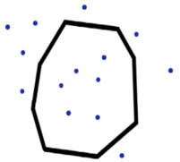
Google BigQuery trick
BigQuery is designed for map-reduce over huge amount of data (Tera-bytes and Peta-bytes).
It charges not for compute usage, but for amount of data your query is touching.
Here is an interesting illustration how a huge set of queries was running for 30 hrs,
but the total charge was only $2.
A client is using geographical location data – matching footprints of people to locations of stores.
"Recently I was matching 150M of footprints to 4M blocks.
Blocks were in 20 US cities. So I did per city.
But for New York it was still too much (4M footprints vs 1.5M blocks).
The size of the cross join was enormous.
So I had to split it in 24 sub-blocks and to do some other optimizations to reduce it.
We ended up running it for something like 30 hours (in a loop).
The query is trivial.
I had to reduce usage of geometrical polygons_cover(point) function
by the distance between polygon center to point in order to make it run,
to filter the coverage after the join (thus reducing the
potential cover_ calls, which are expensive as you can imagine)
only to candidates, which is linear vs quadratic.
I cannot even imagine how much it would cost us with compute credits.
But total BQ cost was ... take a guess ... only $2 !!
Why?
Because the data I have touched were approx. 100 GB, and BQ charges $5/TB. You do not pay for compute time.
You pay only for the data you touch"

