Slide 1
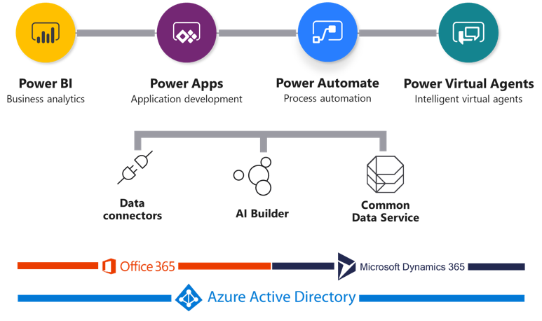
Power Platform

Slide 2
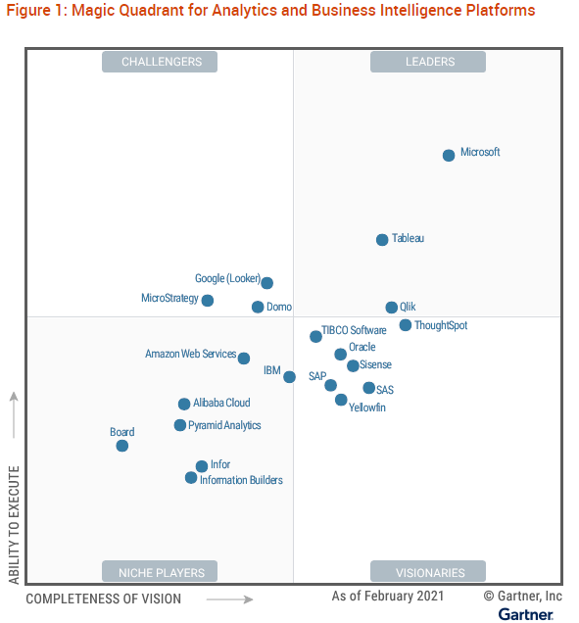
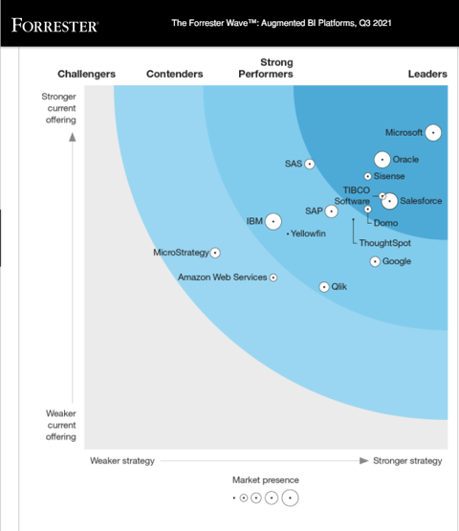
BI & Analytics Platform

Slide 3
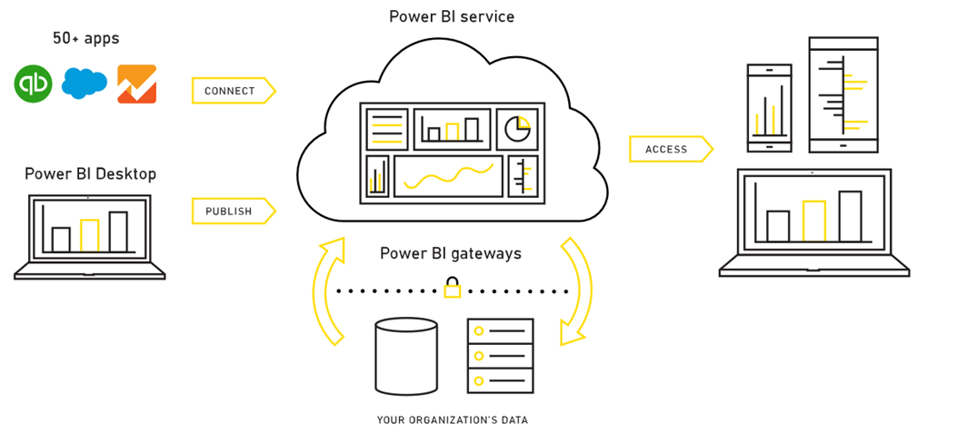
Components of Power BI

Slide 4
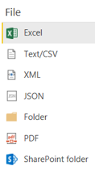
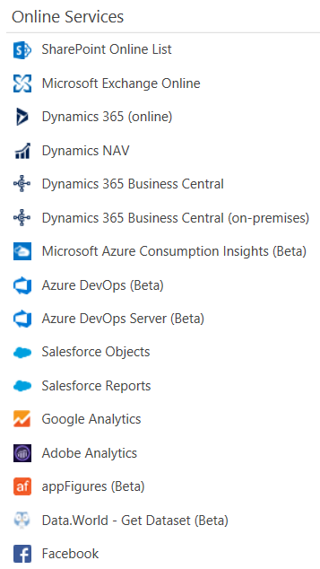
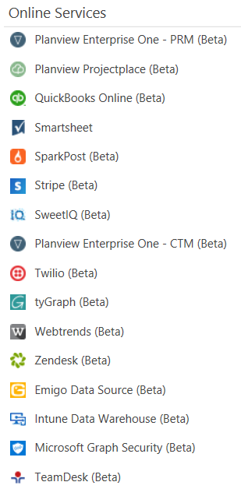
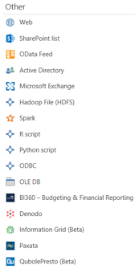
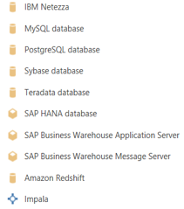
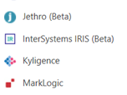
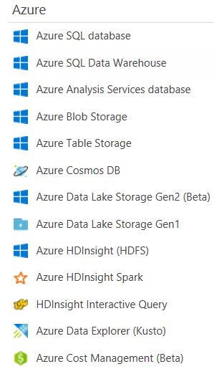
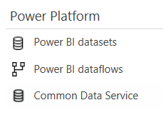
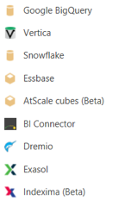
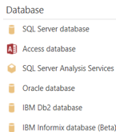
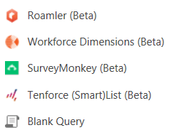
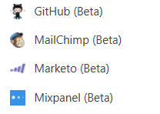
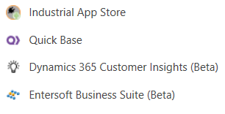
Power BI data sources

Slide 5
High Level areas companies need help with
Governance/Adoption/Rolling out Power BI
Security/Report Access
Premium or Pro
Sharing
Performance issues

Slide 6
Governance Model
TIGHT CONTROLS
EDW
Permanent record
Subject to compliance
Push down content
Reporting services
BUSINESS UNIT
DASHBOARDS, KPIs & SCORECARDS
Push up content
Power BI Desktop
Excel or other reports
Knowledge management
Information sharing
DEPARTMENTAL, TEAM OR GROUP REPORTING
PROJECT REPORTING
Personal/Private views
Data science exploration
PERSONAL REPORTING
LESS CONTROLS

Slide 7
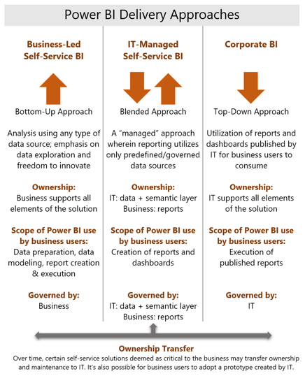
Power BI Delivery Approaches
More
procedural
Corporate BI
IT-Managed Self-Service BI
Business-Led Self-Service BI
Requires tighter, more thorough controls
More agile
Less controls

Slide 8


Business-Led Self-Service BI Workflow
3
Recommend using OneDrive for Business / SharePoint to version PBIX report files
Create 1 folder per App Workspace
Create sub-folder for in progress work
Create sub-folder for what is published in App
Once changes are verified, Power BI App is published for update
1
Team creates all dashboards, reports and datasets in the App Workspaces
App Workspace
Dashboards
Reports
Datasets
Power BI App
Dashboards
Reports
Datasets
Content
Creator Team
Users
Recommended for Usage Scenarios:
Personal BI/ Prototyping
Small Team Collaboration
Recommended dataset storage modes:
Import
DirectQuery
Hybrid/Composite
2
Team reviews, validates dashboards, reports and dashboards with SMEs who have read-only access to the App workspace
Notes:
Separate App Workspaces into functional areas
Base access on “need to know” and security
Leverage Enterprise gateway when possible

Slide 9

IT Managed Self-Service BI Workflow
2
4
Team creates all dashboards, reports in the App Workspaces
Recommend using OneDrive for Business / SharePoint to version PBIX report files
Create 1 folder per App Workspace
Create sub-folder for in progress work
Create sub-folder for what is published in App
Once changes are verified, Power BI App is published for update
App Workspace
Dashboards
Reports
Datasets
Power BI App
Dashboards
Reports
Datasets
Content
Creator Team
Users
Recommended for Usage Scenarios:
Personal BI/ Prototyping
Small Team Collaboration
Large Team Collaboration and Distro
IT BI Team
Recommended dataset storage modes:
Import
DirectQuery
Hybrid/Composite
Live Connection
Streaming
3
BI and Business reviews, validates reports and dashboards with SMEs who have read-only access to the App workspace
1
IT creates all datasets in the App Workspaces
Notes:
Benefit here, is greater centralization and governance around datasets and their management, while retaining “ownership” with the business for reports and dashboards

Slide 10


Corporate BI Workflow
4
Once changes are verified, Power BI App is published for update
Recommend using GitHub or VSTS for versioning of reports and datasets
Create PowerBI templates to save on storage space
App Workspace
Dashboards
Reports
Datasets
Power BI App
Dashboards
Reports
Datasets
IT BI Team
Users
1
Recommended for Usage Scenarios:
Personal BI/ Prototyping
Small Team Collaboration
Large Team Collaboration and Distro
IT creates all datasets, dashboards and reports in the App Workspaces
Recommended dataset storage modes:
Import
DirectQuery
Hybrid/Composite
Live Connection
Streaming
3
BI and Business reviews, validates reports and dashboards with SMEs who have read-only access to the App workspace
Notes:
Benefit here, is greater centralization and governance around datasets and their management, while retaining “ownership” with the business for reports and dashboards

Slide 11




Power BI Adoption Framework Components
Governance
Service Management
Security
Rollout &
Support
Current State
Why Govern?
Governance Considerations
Governance Model
Data Sources
Data governance
Master Data Management
Enterprise Data Catalog
Enterprise Data Dictionary
Licensing
Setup
Group Management
Tenant Administration
Application Management
Monitoring
Connectivity
Identity
Power BI Architecture
Access Controls
Connectivity
Data Security
Sharing
Roles and responsibilities
Phased vs organization wide roll out
Rollout Planning
Training requirements
Communication
Support Scenarios
Ways of working
Center of Excellence

Slide 12
Factors of Adoption
Overall data culture vision
An overall corporate vision to be data driven
Corporate Sponsorship
C-level or line of business heads which support data-driven decision making
Power BI Champions
Champions to evangelize the vision of highly valuable reports and dashboards
Measure Adoption
Usage of reporting on reporting to see what’s working and identify champions

Slide 13
Security Considerations
Database security
Direct Query has an option to send User Principal Name to the source and only data returned is based on security defined in the database
Row Level Security
Import Models mostly
For more information:
https://radacad.com/row-level-security-on-a-directquery-to-power-bi-dataset-composite-model-my-findings

Slide 14
Premium by Capacity or Premium per User
Premium by Capacity (costs $4,999/month)
Features apply to the whole Power BI tenant
Pro, Bring your own License, and users outside your tenant can have access
Gen 2 is an option
Management of Capacity, such as sizing is available
Premium per User (costs $20/month per user)
Premium features are available
Only users with Premium per User license can access Premium features
Can access Pro workspaces
Monitoring of premium workspaces not available (at this time)
Management of Capacity exists of selecting Large dataset or Small datasets for workspaces

Slide 15
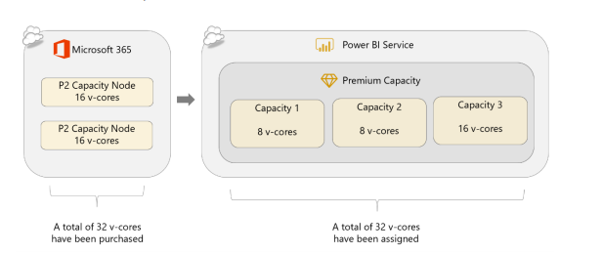
Capacities
A capacity is a set of resources reserved for exclusive use by your organization.
It enables you to publish dashboards, reports and dataset across your organization without having to purchase per-user licenses

Slide 16
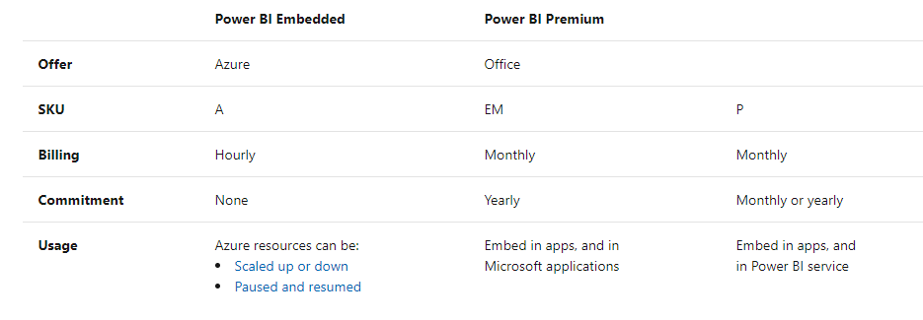
Which Sku to use

Slide 17
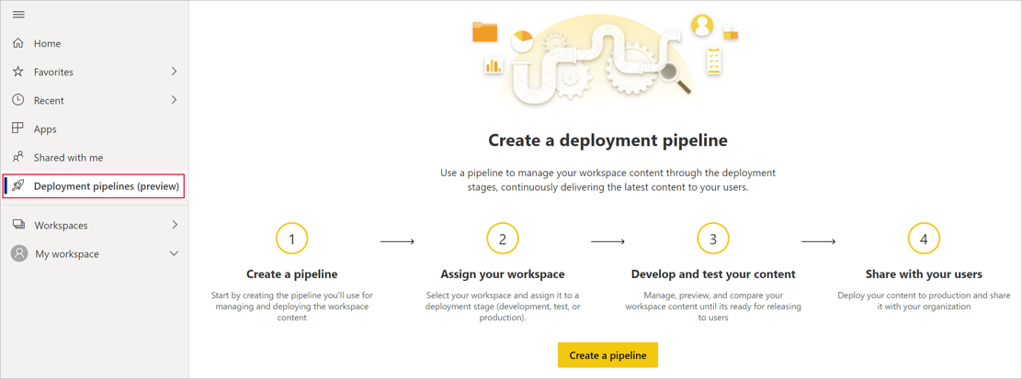
Creating a deployment pipeline

Slide 18
Power BI Premium – Gen 2
Currently in Preview, going GA soon
Enhanced performance– Better performance on any capacity size, anytime. Operations will always perform at top speed and won’t slow down when the load on the capacity approaches the capacity limits.
Greater scale – No limits on refresh concurrency, fewer memory restrictions and complete separation between report interaction and scheduled refreshes
Lower entry level for paginated reports and AI workloads – Customers can start with an A1 SKU and grow as they need.
Scaling a resource instantly – From scaling a Gen 1 resource in minutes, to scaling a Gen 2 resource in seconds.
Scaling without downtime – Customers can scale an Embedded Gen 2 resource without experiencing any downtime.
Improved metrics – Coming in a few weeks to simplify monitoring and metrics-based automation. Instead of various Gen 1 metrics, there will be one CPU utilization metric in Gen 2. In addition, a built-in reporting tool will allow customers to perform utilization analysis, budget planning and chargebacks.

Slide 19
Power BI Apps
A group of reports and dashboards targeted to a specific group of users
“A Power BI App is a set of packaged up content in the Power BI Service for the purpose of distributing related reports and dashboards to a larger base of consuming users.”
App Workspace
Dashboards
Reports
Datasets
Power BI App
Dashboards
Reports
Datasets
Content
Creator Team
Create/Publish
View Only
Users

Slide 20
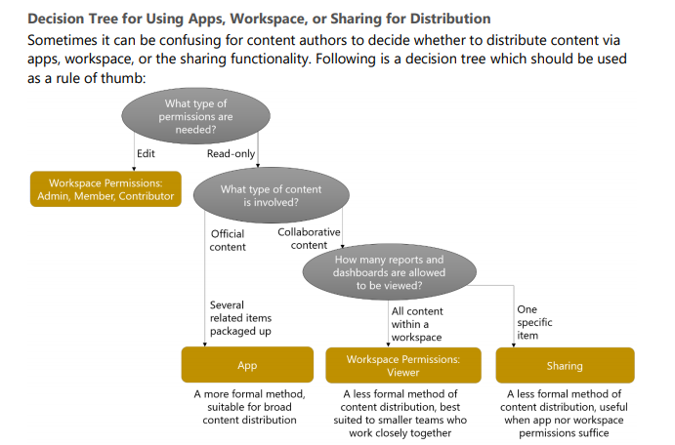
What’s the best way to share

Slide 21
Performance Issues

Slide 22
Import or Direct Query
Import models have the data in the in-memory engine
Require scheduled refreshes
Row Level Security to control the data (if needed)
Faster in serving up the data
Direct Query Model will query the data engine to return the data
Real-time or near real time data
Generally, a bit slower than Import
No schedule refresh required
Users may need access to the source system

Slide 23
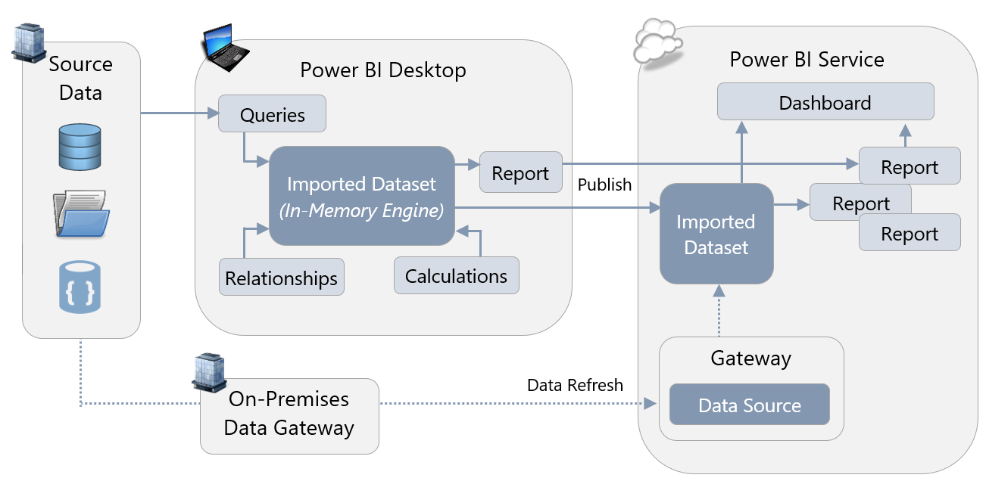
Importing data

Slide 24
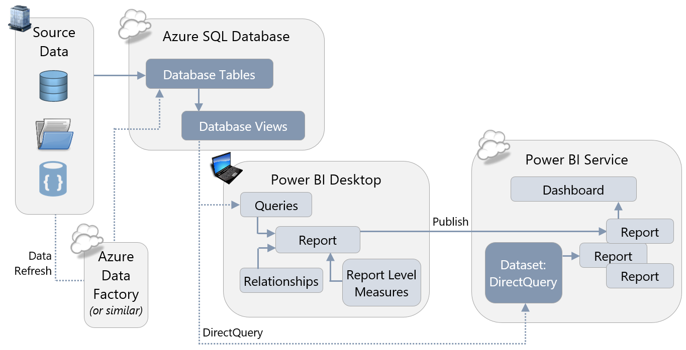
DirectQuery Mode

Slide 25
Composite Model and Hybrid Mode
Composite Models allow for some tables to be imported and some direct query
More frequent changing tables would be direct query
Hybrid tables, also known as dual mode, can be used as import or direct query
Power BI will decide which mode to use for better performance

Slide 26
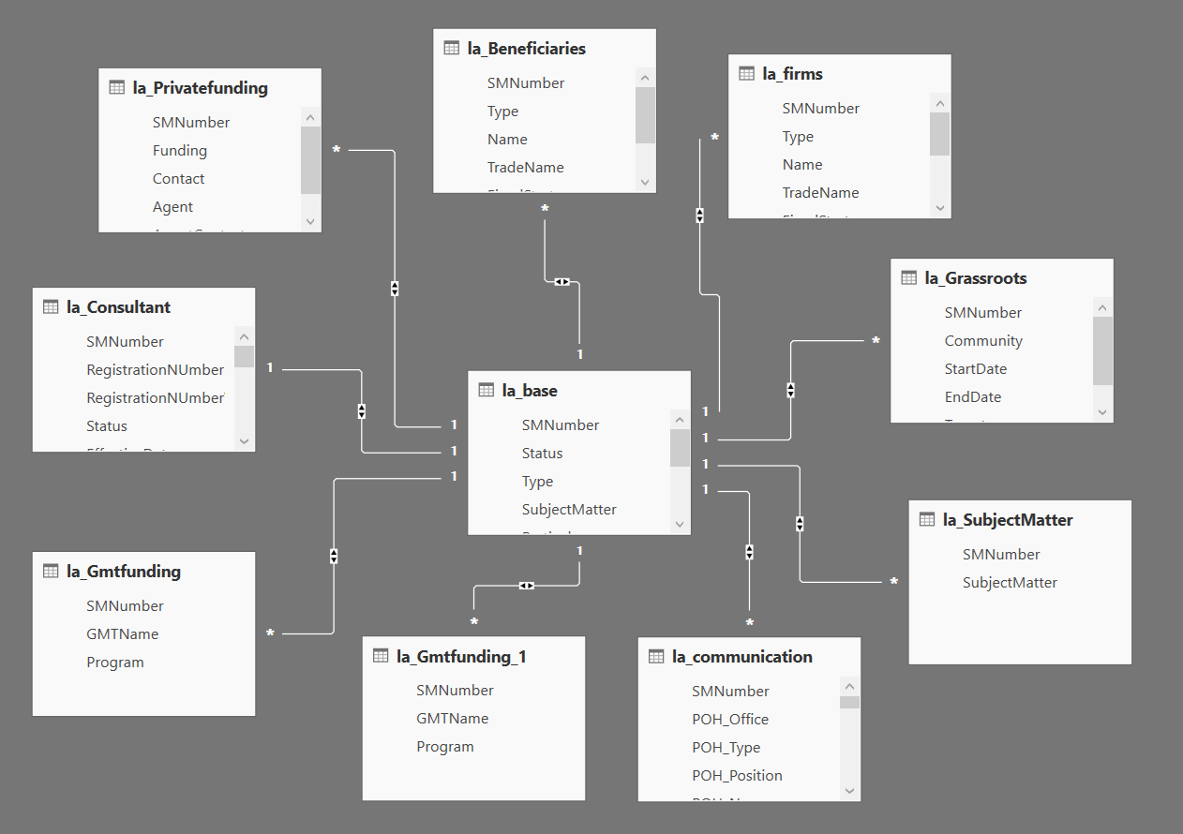
Optimizing the data model
https://docs.microsoft.com/en-us/power-bi/guidance/power-bi-optimization
Use a star schema
Reduces complicated DAX
Makes the columns and data easier to understand
Turn off Auto Date/Time in the options
This also helps reduce the Model size
Add a date table for Time measures
Remove unnecessary columns
Remove any Id fields not unused in reporting
ETL audit fields if they are there
Try to remove high cardinality columns not used in reporting
Remove unnecessary rows
Filter by time, trust us no one reports on 10 years worth of data every week.
Optimize column data types

Slide 27

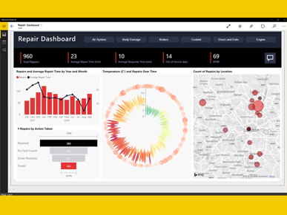
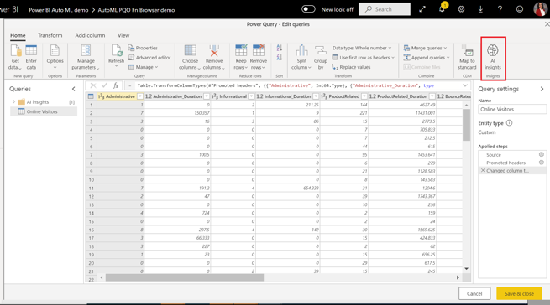
Power BI
Power Platform:
Power BI
Power Apps
Power Automate
Power Virtual Agents
https://powerbi.com
Power BI is a business analytics service by Microsoft.
It allows users to create their own reports and dashboards.
Data can come from SQL databases, spreadsheets, web pages, etc. Business Intelligence (BI) may include time series forecasting, regression, and other ML methods, even AutoML.
There are many tutorials on YouTube, for example:
- https://www.youtube.com/watch?v=TmhQCQr_DCA
No-code ML in Power BI is similar to AutoML in Azure ML Studio
Tutorial: Build a Machine Learning model in Power BI
- https://docs.microsoft.com/en-us/power-bi/connect-data/service-tutorial-build-machine-learning-model
Create a dataflow with the input data
Create and train a machine learning model
Review the model validation report
Apply the model to a dataflow entity
Using the scored output from the model in a Power BI report

Slide 28
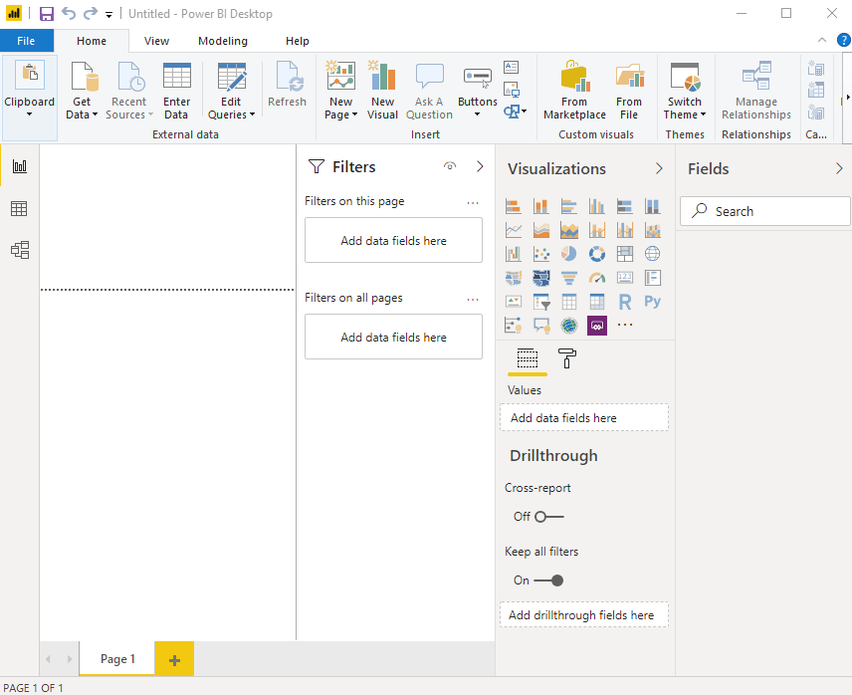
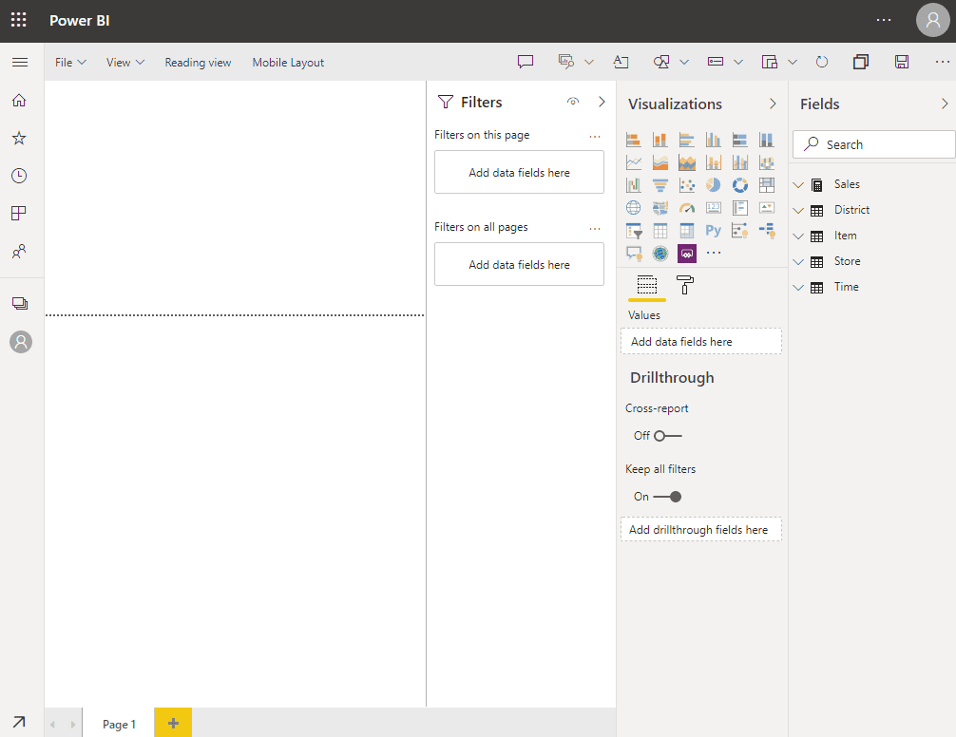
Power BI Online (in browser)
Windows – Desktop app
Power BI Desktop (a.k.a. Designer) is available ONLY on Windows.
If you are on a Mac, your choices are: - https://www.macworld.co.uk/feature/best-virtual-machine-software-3671133/
FREE - Wine ( https://www.winehq.org/ ) or VirtualBox ( https://www.virtualbox.org/ ) https://www.youtube.com/watch?v=J-S_TvtIm5Y
Parallels - $80 - https://www.youtube.com/watch?v=r89fGOM1bq0
Dual Boot (Apple's Boot Camp)
Trend.net $9/mo
Azure VM $100/mo
Available in Desktop Designer:
Data transformation, modeling, and shaping
Calculated columns
Python and DAX
RLS creation (row-level security)
in browser – online service
DAX = Data Analysis Expressions
(available only in Windows Desktop app)
Formula language with functions - similar to Microsoft Excel
Good introduction video:
- https://www.youtube.com/watch?v=waG_JhBgUpM
Measure = <some DAX function>.
Total Number = sum(TabName[ColName])
Power BI Service (online) include:
Dashboards
Sharing
RSL management
Gateway connections
Comparison: desktop vs online:
https://spreadsheeto.com/power-bi-desktop-vs-online/#desktop-vs-online

Slide 29
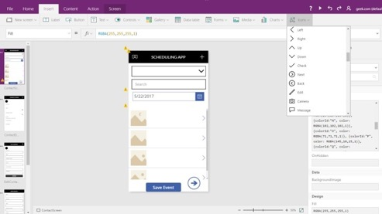
Microsoft Power Apps
Power Platform:
Power BI
Power Apps
Power Automate
Power Virtual Agents
powerapps.com
Good short demo video:
- https://www.youtube.com/watch?v=2RzCbd5XgJg
Power Apps:
rapid application development environment
build custom apps for your business needs
suite of apps, services, connectors, and data platform
responsive design - apps can run in browser, tablet, or phones
https://docs.microsoft.com/en-us/powerapps/
https://powerapps.microsoft.com/en-us/downloads/
https://create.powerapps.com/studio/#
Benefits of Power Apps:
Fast and easy App Creation (responsive custom forms)
Easy Standard Connectors (to data sources ...)
Easy integrate with Office 365, Power BI, SharePoint, ...
Mobile Ready
Microsoft Flow (process and task automation)
Low Cost
Disadvantages:
Separate apps for Android and iOS
Can retrieve only 500-2,000 items
Can't integrate JavaScript
Meant only for internal use (licensing model)
Microsoft Dataverse:
Common Data Service (CDS) has been renamed
to Microsoft Dataverse (2020)
https://docs.microsoft.com/en-us/powerapps/developer/data-platform/entities
CDM = Common Data Model
CDS = Common Data Service = Dataverse
Power Query:
data transformation and data preparation engine
graphical interface for getting data from sources
Power Query Editor for applying transformations
...

Slide 30
Integrate external model to work from Power BI
You can train the model in ML Studio, deploy it as an endpoint, call this endpoint from Power BI.
You can also use Python in Power BI desktop – then you can read model file directly:
-- https://docs.microsoft.com/en-us/power-bi/connect-data/service-aml-integrate
-- https://docs.microsoft.com/en-us/power-bi/connect-data/desktop-python-scripts
-- https://docs.microsoft.com/en-us/power-bi/connect-data/desktop-python-in-query-editor
Microsoft power BI Integration (part 1 of 2) Create the predictive model with a notebook
-- https://docs.microsoft.com/en-us/azure/machine-learning/tutorial-power-bi-custom-model
Microsoft power BI Integration (part 2 of 2) Tutorial: Consume an Azure Machine Learning model in Power BI
-- https://docs.microsoft.com/en-us/power-bi/connect-data/service-aml-integrate?context=azure/machine-learning/context/ml-context
StackOverflow - consuming a deployed Azure ML model in PowerBI
-- https://stackoverflow.com/questions/65899552/consuming-an-deployed-azure-ml-model-in-powerbi
Also – you can use AI Insights:
-- https://docs.microsoft.com/en-us/power-bi/transform-model/desktop-ai-insights
or this (deploying onnx models in SQL):
-- https://docs.microsoft.com/en-us/azure/azure-sql-edge/deploy-onnx
Related links:
Premium options: P1 vs P2 vs P3:
-- https://www.encorebusiness.com/blog/power-bi-premium-p1-vs-p2-vs-p3
What are endpoints (preview) - Azure Machine Learning
-- https://docs.microsoft.com/en-us/azure/machine-learning/concept-endpoints

