Slide 1
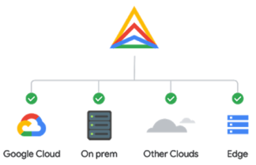
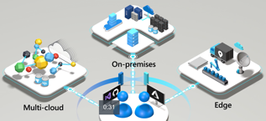

Cross-Cloud Architectures
Anthos
Kubernetes deployment
Two cloud strategies:
Cloud-First + Single Cloud Provider
Hybrid and Multicloud
Google Anthos - Uses Google Kubernetes to manage infrastructure and applications across on-premises, edge, and in multiple public clouds, providing integrated security, policy management, visibility.
Azure Arc – Similar to Anthos. Also can use Kubernetes to deploy and manage container-based applications on prem or any cloud. Also helps to organize other resources like Windows and Linux services. Can also support non-kubernetes (edge) environments.
AWS Outposts – AWS provides hardware to be used "on on-premises" as AWS compute and storage (AWS EC2 and EBS). By using only AWS hardware, Outposts effectively prevents multicloud scenarios and even the use of your own hardware.
https://iamondemand.com/blog/google-anthos-azure-arc-aws-outposts-the-race-to-dominate-hybrid-and-multicloud/
Azure Arc – Kubernetes deployment
AWS Outpots
Standard racks
installed by AWS

Slide 2

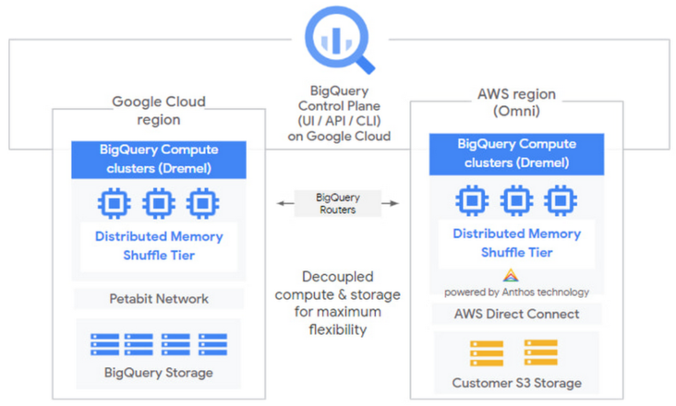
BigQuery Omni - Google Cross-Cloud Analytics
Omni:
the same BigQuery interface on Google Cloud
now lets you also query the data accross all major clouds
( Google Cloud, AWS and Azure ) without any cross-cloud ETL.
This is possible because BigQuery de-couples (separates) compute and storage.
For better performance the BQ Omni runs the necessary compute
on clusters in the same region where your data resides.
BigQuery Omni runs on Google Anthos.
Anthos is a Google platform for managing
infrastructure and applications
across on-premises, edge, and in multiple public
clouds, providing integrated security, policy management, visibility.
Anthos
In Greek mythology, Athos was one of the Giants (Gigantes).
- https://www.youtube.com/watch?v=tSwFW6M7dYk

Slide 3


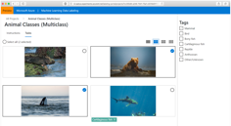
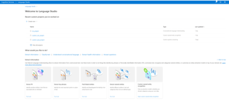
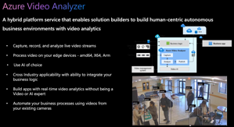
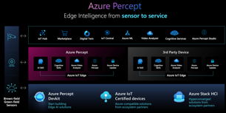

Azure Updates November 2021
Microsoft Ignite - an annual conference for developers .. https://news.microsoft.com/november-2021-ignite/
Azure Open AI Service (Preview) language models (large, pre-trained, even GPT3) .. https://azure.microsoft.com/en-us/services/openai-service/ .. https://www.youtube.com/embed/mD_tJMZmZ7U
Azure Data Labeling https://docs.microsoft.com/en-us/azure/machine-learning/how-to-label-data
Azure Arc - Unify on-premises, hybrid, and multicloud infrastructure with Kubernetes based deployment .. https://azure.microsoft.com/en-us/services/azure-arc
Azure video analyzer platform extract actionable insights from videos, whether stored or streaming .. https://azure.microsoft.com/en-us/products/video-analyzer/
Azure Language Studio .. https://docs.microsoft.com/en-us/azure/cognitive-services/language-service/language-studio
Container Apps Preview managed serverless container service – deploy containers .. https://azure.microsoft.com/en-us/updates/public-preview-azure-container-apps/ .. https://www.youtube.com/embed/fmGHEJL81rU
Azure Percept (for Edge apps) .. https://azure.microsoft.com/en-us/services/azure-percept/
Arc – Kubernetes deployment
Data Labeling
Language
Video Analyzer
Percept for Edge
Container Apps

Slide 4
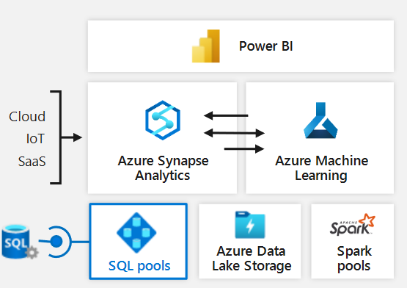
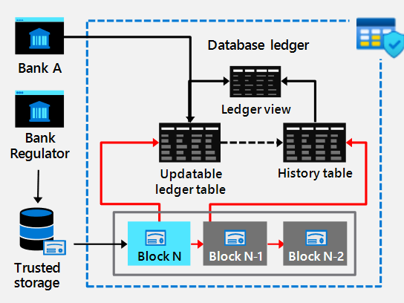
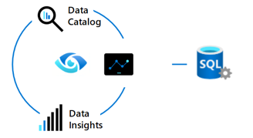
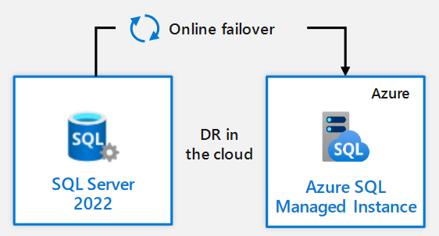
SQL Server 2022 – "Azure Enabled"
Announced November 2, 2021 fro private preview
https://www.sqlshack.com/sql-server-2022-private-preview-announcement/
SQL Server 2022 integrates with:
Azure Synapse Link ( avoid big ETL jobs between SQL Server and Azure Synapse)
Azure Purview
Failover back/forth from SQL Server 2022 and Azure SQL DB Managed Instances. Including restoring versionless databases from Azure SQL DB Managed Instances down to on-premises SQL Server 2022
SQL Server Ledger – blockchain immutable histories of tables
Performance! Parameter-sensitive plan optimization that caches multiple plans per stored procedure
Azure Synapse Link

Slide 5


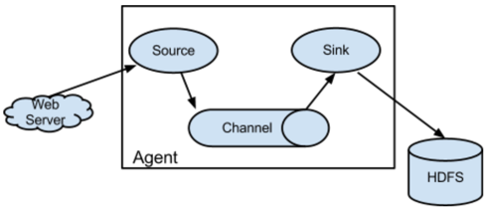

Apache Flume
A flume is a man-made gravity chute for water, with raised walls.
Flume is a distributed, reliable, and available service for efficiently collecting, aggregating, and moving large amounts of log data.
It has a simple and flexible architecture based on streaming data flows.
It is robust and fault tolerant with tunable reliability mechanisms and many failover and recovery mechanisms.
It uses a simple extensible data model that allows for online analytic application.
It is specifically designed for Hadoop
Flume vs Kafka:
Kafka uses "pull" model, fault tollerant, easy to scale, can handle high volume in real time
Flume uses "push" model, not easily scalable, designed specifically to collect logs from distributed system, designed specifically for Hadoop, not fault tollerant - may lose data if one of agents fails

Slide 6



Azure Data Explorer, Kusto, KQL
In 2014 – Israeli Microsoft Research group started project "Kusto" to provide analytics on top of Azure log and telemetry data.
The name "Kusto" comes after Jacques Cousteau, "the father of scuba diving" (1910-1997), as a reference to "exploring the ocean of data". https://en.wikipedia.org/wiki/Jacques_Cousteau
Later Kusto project was renamed as "Azure Data Explorer" (ADE).
In 2016 it has become the backend big-data and analytics service for Application Insights Analytics.
In 2019 it has become generally available on Azure Cloud as PaaS (Platform as a Service).
ADE is basically a distributed relational database. It has databases, tables, functions, and columns. It supports calculated columns, searching and filtering on rows, group by-aggregates and joins.
ADE can use different types of data: structured data (CSV, Parquet files), log and telemetry files, JSON files, free text (unstructured data)
ADE uses KQL = Kusto Query Language (query only, no updates)
KQL is also used in CMPivot tool (real-time state of devices).
ADE does indexing (including full text indexing).
It also has time series analysis capabilities, regular expressions.
// KQL is like SQL
// but with pipes "|", regex, etc.
// Examples:
MySessions
| where s_name == 'Ignite 2018'
| order by s_title
// Case-insensitive comparison:
conference =~ 'ignite 2018'
// dates:
starttime > now(-7d)
// count rows:
MySessions
| count
Jacques Cousteau
In 2021 ADE was integrated into Synapse as "Azure Synapse Data Explorer".
Understand the difference:
.. Synapse serverless pool - SQL
.. Synapse data explorer - KQL
Desktop apps:
.. Azure Storage Explorer
.. Azure azcopy utility

Slide 7
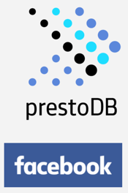
Apache Presto
Presto is an open source high performance, distributed (serverless) SQL query engine for big data.
Presto was originally designed and developed at Facebook for their data analysts to run interactive queries on its large data warehouse in Apache Hadoop.
Its architecture allows users to query a variety of data sources such as Hadoop, Cassandra, Kafka, AWS S3, Alluxio, MySQL, MongoDB and Teradata.
One can even query data from multiple data sources within a single query.
Presto is used as a DW in Facebook, Netflix, etc.
Amazon Athena is a hosted version of Presto with ANSI SQL support.
"At Facebook alone, over a thousand employees use Presto, running several million queries and processing petabytes of data per day.
After creating Presto we open sourced it to see if other companies were having the same issues and wanted to collaborate. It turns out many other companies were interested and so under The Linux Foundation, we believe the project can engage others and grow the community for the benefit of all."
- Kathy Kam, Head of Open Source at Facebook.

Slide 8

BIML
Biml = Business Intelligence Markup Language
Biml uses XML and small nuggets of C# or VB code to automatically create huge amounts of SQL scripts, SSIS packages, SSAS cubes, tabular models, and more.
.. http://www.bimlscript.com
.. https://varigence.com/Biml
.. https://en.wikipedia.org/wiki/Business_Intelligence_Markup_Language
Example:
<Biml xmlns="http://schemas.varigence.com/biml.xsd">
<Connections>
<Connection Name="AdventureWorks" ConnectionString="Server=.;Initial Catalog=AdventureWorks;Integrated Security=SSPI;Provider=SQLNCLI10"/>
</Connections>
<Packages>
<Package Name="Biml Sample" AutoCreateConfigurationsType="None" ConstraintMode="Linear">
<Tasks>
<Dataflow Name="Extract Table List">
<Transformations>
<OleDbSource Name="Get Table List" ConnectionName="AdventureWorks">
<DirectInput>SELECT * FROM sys.tables</DirectInput>
</OleDbSource>
<Multicast Name="Multicast"/>
</Transformations>
</Dataflow>
</Tasks>
</Package>
</Packages>
</Biml>

Slide 9


SSIS = SQL Server Integration Services (since 2005)
SSIS is a component of the Microsoft SQL Server database software
SSIS can perform broad range of ETL / data migration tasks
In SSIS you create and execute SSIS packages, (files with extension .dtsx). The packages have XML format. The packages include all ETL components as needed for specific ETL job (connection cmanager, tasks, control flow, data flow, parameters, event handlers, and variables)
SSIS packages are created using Microsoft Visual Studio with SSDT (SQL Server Data Tools) Note - before 2015 there was BIDS (Business Intelligence Development Studio)
SSIS package can be executed from GUI, from SQL database, or from command line (Windows or Linux): dtexec /File “D:\packagetest.dtsx” dtexec /Server “My-Pc/SQLInstance” /ISServer “SSISDB\MyFolder\MyProject\MyPackage.dtsx”
Advantages (Pros) of SSIS:
SSIS was around since 2005, when it substituted DTS (Data Transformation Services, 1998-2005)
SSIS has many connectors, can consume data from "difficult" sources FTP, HTTP,MSMQ, SSAS, etc.
SSIS can work with "non-Microsoft" data systems (for example, DB2 to Oracle)
Can handle complex transformations, multi-step operations, aggregating data from different data sources or types, and structured exception handling
Data can be loaded in parallel to many varied destinations
Package deployment methodology is good
SSIS is easy to use. All you need is knowledge of T-SQL and SSIS itself, no coding required (although you can use C# or Visual Basic if needed).
Disadvantages (Cons):
To see package execution report need Management Studio rather than being published to reporting services or other way
SSIS memory usage is high and it conflicts with SQL, difficult to run multiple packages in parallel, and slows down SSIS.
Andy Leonard
ETL, SSIS, BIML expert
https://dilmsuite.com
https://www.datachannel.tv

Slide 10
SSIS Package Files
The following is the XSD definition for the ExecutableTypePackage complex type.
<xs:complexType name="ExecutableTypePackage">
<xs:sequence>
<xs:element name="Property" maxOccurs="unbounded">
<xs:complexType>
<xs:complexContent>
<xs:extension base="DTS:PropertyElementBaseType">
<xs:attribute name="Name"
type="DTS:ExecutableTypePackagePropertyNameEnum"
use="required"/>
</xs:extension>
</xs:complexContent>
</xs:complexType>
</xs:element>
<xs:element name="ConnectionManager" type="DTS:ConnectionManagerType"
minOccurs="0" maxOccurs="unbounded"/>
<xs:element name="Configuration" type="DTS:ConfigurationType"
minOccurs="0" maxOccurs="unbounded"/>
<xs:element name="LogProvider" type="DTS:LogProviderType"
minOccurs="0" maxOccurs="unbounded"/>
<xs:element name="Variable" type="DTS:VariableType"
maxOccurs="unbounded"/>
<xs:element name="LoggingOptions" type="DTS:LoggingOptionsType" />
<xs:element name="PropertyExpression"
type="DTS:PropertyExpressionElementType"
minOccurs="0" maxOccurs="unbounded"/>
<xs:element name="Executable" type="DTS:AnyNonPackageExecutableType"
minOccurs="0" maxOccurs="unbounded"/>
<xs:element name="PrecedenceConstraint"
type="DTS:PrecedenceConstraintType"
minOccurs="0" maxOccurs="unbounded"/>
<xs:element name="EventHandler" type="DTS:EventHandlerType"
minOccurs="0" maxOccurs="unbounded"/>
<xs:element name="PackageVariable" type="DTS:PackageVariableType"
minOccurs="0" maxOccurs="unbounded"/>
</xs:sequence>
<xs:attribute name="ExecutableType" use="required"
fixed="SSIS.Package.2" />
</xs:complexType>
In SSIS you create and execute SSIS packages, (files with extension .dtsx).
https://docs.microsoft.com/en-us/sql/integration-services/ssis-quickstart-run-cmdline?view=sql-server-ver15
The packages have XML format.
https://docs.microsoft.com/en-us/openspecs/sql_data_portability/ms-dtsx/

Slide 11
SSIS vs Azure ADF and Azure Synapse Integrate
SSIS is relatively old technology developed before people started using the clouds (AWS, Azure, Google).
Nowadays when everyone moves to cloud,
it is natural to use cloud-based ETL tools.
Microsoft provides ADF (Azure Data Factory) on Azure cloud.
Most of ADF functionality was also integrated into Synapse
("Azure Synapse Integrate").
Creating tasks/pipelines in ADF is done in Azure browser interface.
No desktop GUI is required.
The ADF tasks can be saved in JSON format
and deployed using YAML format in Azure DevOps.
XML
JSON
YAML

Slide 12

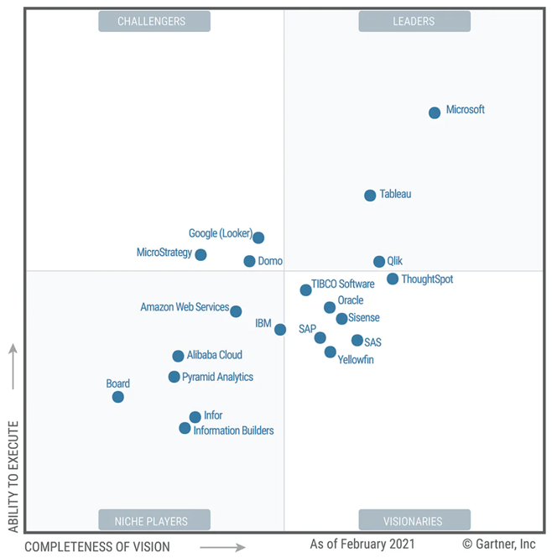
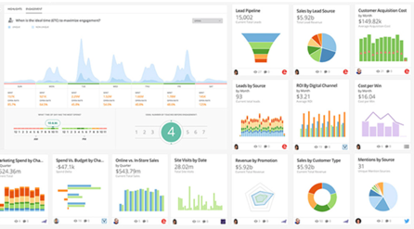
Domo
Analytics and BI Platforms, 2021
- https://www.domo.com/
- https://en.wikipedia.org/wiki/Domo_(company)
Domo is a cloud based dashboarding tool.
It uses Oracle as a DB. Also has "live cache".
Expensive ($2K/year per user).
I would recommend to use Power BI
or Tableau instead of Domo.
Domo, Inc. is a cloud software company (in Utah, US).
Since 2010, ~1K employees, valued at $2 Bln

Slide 13

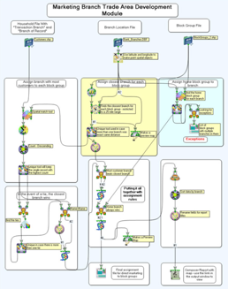
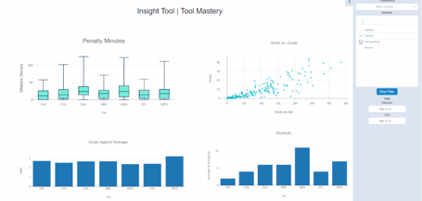
Alteryx
- https://www.alteryx.com/
- https://en.wikipedia.org/wiki/Alteryx
- https://gallery.alteryx.com
Alteryx – software products for data science and analytics:
Based in California and Colorado
1997 - SRC LLC – tools for demographic mapping and reporting
2000 – contract with U.S. Census Bureau
2006 – Alteryx was released as a unified set of tools for building analytical processes and applications
2010 – SRC LLC renamed into Alteryx
2016 - Alteryx was ranked #24 on the Forbes Cloud 100 list
2017 - Alteryx went public in an IPO listed on the NYSE
2018 - Alteryx was named a leader in Gartner's 2018 Magic Quadrant for Data Science and Machine Learning Platforms
2020 – Alteryx Analytics platform products: Connect, Designer, Promote, Server, Hub, Intelligence Suite
Alterix pricing (per user, year)
Designer - $5,195
Intelligence Suite - $2,300
Data Package - Location Intelligence - $11,700
Data Package - Consumer Intelligence - $33,800

Slide 14

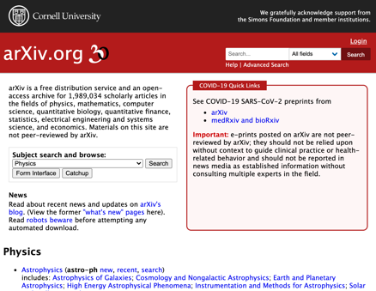
ArXiv.org
Cornell University
arXiv is a free distribution service and an open-access archive
for ~ 2 Mln scholarly articles (physics, math, CS, biology, finance, statistics, electrical engineering and systems science, and economics).
Materials are NOT peer-reviewed by arXiv.
Paul Ginsparg
Cornell Physics Professor
Started arXiv in 1991
In 1989, Joanne Cohn, a physicist then at the Institute for Advanced Study, began distributing TeX files of string theory papers via email.
By August of 1991, the email list had grown to 180 physicists—an unwieldy number for Cohn to individually respond to requests for papers.
As Cohn recounts, a young physicist then at Los Alamos National Laboratory offered to automate the list, and arXiv was born.
“Day one, something happened, day two, something happened. Day three, Ed Witten posted a paper,” said Cornell University physicist Paul Ginsparg, founder of arXiv.org. “That was when the entire community joined.”

Slide 15
How to use Python on Azure cloud
There are multiple ways to use Python on Azure cloud
ML Studio (scripts, notebooks, pipelines), use these pipelines from Synapse Integrate pipelines: - https://docs.microsoft.com/en-us/azure/machine-learning/concept-ml-pipelines -
ML Endpoint (web service) - https://docs.microsoft.com/en-us/azure/machine-learning/concept-endpoints -
Python Web App via Azure Stack - https://docs.microsoft.com/en-us/azure-stack/user/azure-stack-dev-start-howto-vm-python -
using "Azure Batch" in ADF (Azure Data Factory) or Synapse Integrate: - https://docs.microsoft.com/en-us/azure/batch/tutorial-run-python-batch-azure-data-factory - - https://docs.microsoft.com/en-us/answers/questions/595214/execute-the-python-script-from-azure-synapse.html -
Azure Functions: - https://docs.microsoft.com/en-us/azure/azure-functions/create-first-function-cli-python -
Synapse PySpark notebooks - https://docs.microsoft.com/en-us/azure/synapse-analytics/spark/apache-spark-development-using-notebooks -
Databricks notebooks - https://docs.microsoft.com/en-us/azure/databricks/languages/python -
Linux VM (Virtual Machine)
Azure Web Apps - https://azure.microsoft.com/en-us/develop/python/ - https://azure.microsoft.com/en-us/services/app-service/web/ -
Containers - https://azure.microsoft.com/en-us/product-categories/containers/ -

Slide 16
CICD in Azure DevOps
CICD = Continuous Integration / Continuous Deployment
Here is a nice series of 10 videos explaining DevOps for ML in Azure.
Azure MLOps - DevOps for Machine Learning
part1 - Complete Intro to Azur Machine Learning Service - https://www.youtube.com/watch?v=-QxwB7PoSdA -
part 2 - Intro to Azure DevOps - https://www.youtube.com/watch?v=Gzjr716RU9g -
part 3 - Setting up Azure DevOps Configurations - https://www.youtube.com/watch?v=L-nIreup0HQ -
part 4 - Create & Deploy Infrastructure as Code Pipeline - https://www.youtube.com/watch?v=b15l4BLAnmc -
part 5 - CI Pipeline ( Continuous Integration) for ML - https://www.youtube.com/watch?v=C79hIHRBSsQ -
part 6 - CI Pipeline ( Continuous Integration) for ML - https://www.youtube.com/watch?v=rPowmr43kzc -
part 7 - Automated Training with CI Pipeline - https://www.youtube.com/watch?v=iq4hGqC_JMs -
part 8 - CD Pipeline (Continuous Deployment) for Staging - https://www.youtube.com/watch?v=p9CxWhpE4uQ -
part 9 - CD Pipeline(Continuous Deployment)for Production - https://www.youtube.com/watch?v=y9NMFLBo3bQ -
part 10 - Testing End to End MLOps Pipelines - https://www.youtube.com/watch?v=KHD2oyP8W94 -

Slide 17


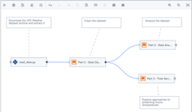
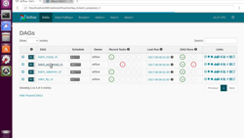
Apache Airflow
https://airflow.apache.org
Author, schedule and monitor workflows
pipelines
pure python
dynamic pipelines generation
scalable, extensible, elegant
robust integrations
easy to use
open source
Airflow is running on all major clours:
AWS: astronomer
- https://aws.amazon.com/marketplace/pp/prodview-mrexhwyzepx44 -
- https://www.astronomer.io -
Azure: astronomer
- https://www.astronomer.io/azure-airflow-lp -
- http://azuremarketplace.microsoft.com/en-us/marketplace/apps/meanio.linnovate-airflow -
Google: Cloud Composer
- https://cloud.google.com/composer/docs/concepts/overview -

Slide 18
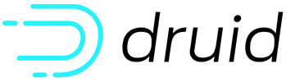
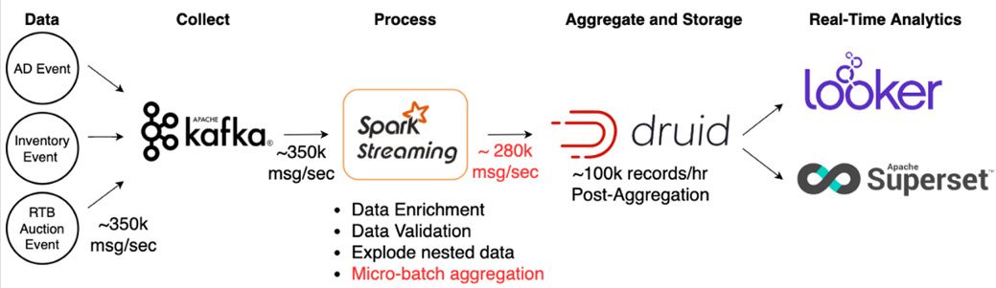
Apache Druid
- http://druid.io -
- https://druid.apache.org -
Druid = open source analytics data store (OLAP)
fast data ingestion and aggregation
scales to trillions of events and petabytes of data
druid is best used to power analytic dashboards and applications
Example:

Slide 19



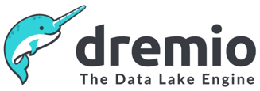
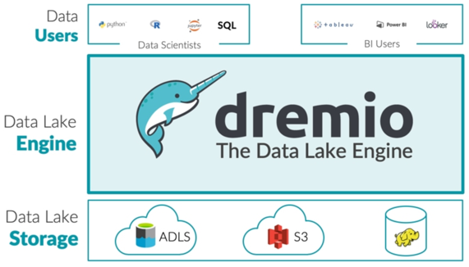
Dremel
https://en.wikipedia.org/wiki/Dremel_(software)
Dremel is a distributed system developed at Google for interactively querying large datasets
Dremel is the query engine used in Google's BigQuery service
Dremel is the inspiration for:
Apache Drill - https://drill.apache.org - Schema-free SQL Query Engine for Hadoop, NoSQL and Cloud Storage
Apache Impala - https://impala.apache.org - native analytic database for Apache Hadoop
Dremio - https://www.dremio.com - an Apache licensed platform that includes a distributed SQL execution engine
Apache
Impala
Dremio may be configured on all 3 major clouds (AWS, Azure, Google)
Dremio added support for Apache Iceberg tables - https://iceberg.apache.org
In 2021 Dremio achieved Unicorn status (more than a Billion $ valuation).

Slide 20
Do Not Optimize your SQL and Schema
Optimizing DB schema and SQL requires paying salaries.
But as storage and compute gets cheaper and cheaper,
it is getting more cost-effective to avoid optimization.
It is quite a shift in architecture philosophy.
"Learn From Google’s Data Engineers: Don’t Optimize Your SQL"
- https://blog.devgenius.io/learn-from-googles-data-engineers-don-t-optimize-your-sql-43f0da30701
Use ELT instead of ETL
" ... we are seeing a consistent shift from ETL to ELT architecture ... "
Legacy ETL pipelines are not that flexible to easily adapt according to the exponential data growth
Nowadays there is no need to do strict "legacy" transformations between Extract and Load phases
Simply Extract – and immediately Load with minimum transformations
Cloud storage is cheap and efficient, analytics services are powerful – which allows to flexibly work on the loaded data (transform, query)
"Modern Data Stack for Startups"
- https://medium.com/nybles/modern-data-stack-for-startups-b63bc383e1d0

Slide 21
SQL in Azure DW
===========================================
no foreign key
===========================================
no triggers
===========================================
FROM clause in UPDATE and DELETE statement cannot contain subquery sources or joins
(you can not use words "INNER JOIN" ...).
But this old Sybase syntax works:
update t1
set t1.mycol = 1
from t1, t2
where t2.cust_id = t1.cust_id
and t2.country = 'Norway'
===========================================
can not imbed .NET (so no regular expressions)
===========================================
Note: before Synapse there was a tool "Scope" ( pay per query on data lake using C# )
It had a language U-SQL (SQL +.NET)
https://docs.microsoft.com/en-us/sql/integration-services/control-flow/azure-data-lake-analytics-task?view=sql-server-ver15

Slide 22

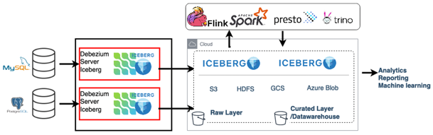
Apache Iceberg
https://iceberg.apache.org
https://iceberg.apache.org/docs/latest/getting-started/
Iceberg is a high-performance format for huge analytic tables
Iceberg brings the reliability and simplicity of SQL tables to big data
Spark, Trino, Flink, Presto, and Hive can safely work simultaneously with the same Iceberg tables
CREATE TABLE local.db.table (id bigint, data string) USING iceberg
CREATE TABLE ... PARTITIONED BY
CREATE TABLE ... AS SELECT
ALTER TABLE
DROP TABLE
INSERT INTO local.db.table VALUES (1, 'a'), (2, 'b'), (3, 'c');
INSERT INTO local.db.table SELECT id, data
FROM source WHERE length(data) = 1;
MERGE INTO local.db.target t USING (SELECT * FROM updates) u ON t.id = u.id
WHEN MATCHED THEN UPDATE SET t.count = t.count + u.count
WHEN NOT MATCHED THEN INSERT *
spark.table("source").select("id", "data")
.writeTo("local.db.table").append()
SELECT count(1) as count, data
FROM local.db.table
GROUP BY data
SELECT * FROM local.db.table.snapshots
val df = spark.table("local.db.table")
df.count()

