Slide 1

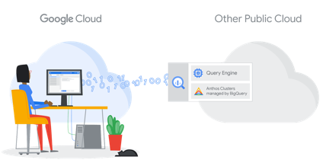
BigQuery Omni - Multi-Cloud queries
Google BigQuery is Google Cloud's enterprise data warehouse for analytics
Gigabyte to Exabyte scale
SQL queries
Encrypted, durable, highly available
Fully managed and serverless for maximum agility and scale
Real-time insights from streaming data
Built-in ML for out-of-the-box predictive insights
High-speed, in-memory BI Engine for faster reporting and analysis
BigQuery Omni is an option to run queries accross multiple clouds (Google, AWS, Azure, ...)
“A flexible, multi-cloud analytics solution that lets you analyze data across public clouds without leaving the familiar BigQuery user interface”

Slide 2
BigQuery | Architecture - overview Decoupled storage and compute for maximum flexibility
SQL:2011
Compliant
Replicated, Distributed Storage
(99.9999999999% durability)
BigQuery
High-Available Cluster Compute (Dremel)
Streaming Ingest
REST API
Distributed Memory Shuffle Tier
Web UI, CLI
Free Bulk
Loading
Client Libraries
In 7 languages
Petabit Network

Slide 3
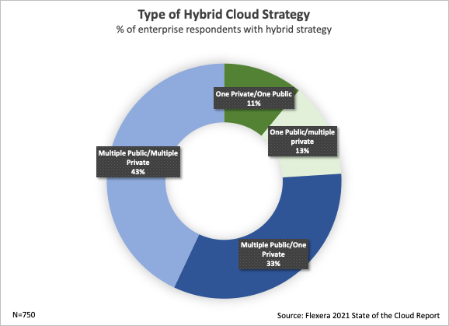
Why worry about multi-cloud queries?
Multi-Cloud is here to stay
Benefits:
Optimization by workload
Bulwark against vendor lock-in
Improve up-time
Reducing latency
Multi-cloud challenges:
Governance
Cohesive solution architecture
Managing costs
Data protection
Skillset coverage
Multiple divergent data sources

Slide 4

BigQuery Omni | Architecture - review
Google Cloud region
AWS region
(Omni)
BigQuery UI / API / CLI
Control Plane & Metadata on Google Cloud
BigQuery Compute clusters (Dremel)
BigQuery Compute clusters (Dremel)
Distributed Memory Shuffle Tier
BigQuery Routers
Distributed Memory Shuffle Tier
powered by Anthos
Petabit Network
AWS APIs
BigQuery Storage
Customer S3 Storage
Note about getting connected to access S3:
Create AWS IAM role with policy attachment allowing access to S3 bucket
Create GCP connection with ARN of AWS IAM role created on AWS
Attach trust policy to AWS IAM role

Slide 5
Google Anthos is used to manage clusters to run queries on other clouds - https://cloud.google.com/anthos
AWS region
(Omni)
Azure region
(Omni)
BigQuery Compute clusters (Dremel)
BigQuery Compute clusters (Dremel)
BigQuery account
BigQuery account
Distributed Memory Shuffle Tier
Distributed Memory Shuffle Tier
powered by Anthos
powered by Anthos
AWS APIs
Azure APIs
Customer account
Customer account
Customer S3 Storage
Customer Storage

Slide 6

Things to know
There is no on-premise implementation.
Cross-cloud joins are in alpha
Requires slot commitment (Flat-rate or Flex-slot)
There is no additional GCP costs for queries with results exported to connected cloud
There are additional cost on external cloud on which the query runs
If queries run either in BQ console, ingested to BQ, or to GCS they will incur ingress costs
This PPT is a shortened version of the YouTube presentation by Chris von Rabenau
- https://www.youtube.com/watch?v=GCzcMUS_8og -
Chris is a BI Architect and Google Professional Cloud Architect:
- https://www.linkedin.com/in/cvr/ -

