Slide 1


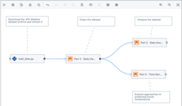
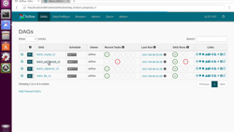
Apache Airflow
https://airflow.apache.org
Author, schedule and monitor workflows
pipelines
pure python
dynamic pipelines generation
scalable, extensible, elegant
robust integrations
easy to use
open source
Airflow is running on all major clours:
AWS: astronomer
- https://aws.amazon.com/marketplace/pp/prodview-mrexhwyzepx44 -
- https://www.astronomer.io -
Azure: astronomer
- https://www.astronomer.io/azure-airflow-lp -
- http://azuremarketplace.microsoft.com/en-us/marketplace/apps/meanio.linnovate-airflow -
Google: Cloud Composer
- https://cloud.google.com/composer/docs/concepts/overview -

