Slide 1
Introduction to Airflow

Slide 2
What is Airflow?
Open source workflow engine
Program with Python
Schedule
Monitor
Scalable
Dynamic
Extensible
Notes:
It is an orchestration tool.

Slide 3
Basic components of Airflow environment
Airflow Database
Simplest for a SQLite DB
Can be hosted in MySQL, PostgreSQL, or MSSQL
Used for:
Holds component relationship information
Stores state
All process reads and writes here.
Airflow webserver
Manages web GUI for seeing workloads
Flask web server
Airflow scheduler
Responsible for orchestrating tasks
Retrieves information from Airflow database
Airflow executor
Responsible for actually execution of defined code

Slide 4
Installation:
Add an ENV variable for AIRFLOW_HOME
`export AIRFLOW_HOME=~/[path for your Airflow home]`
Install airflow with pip
`pip3 install apache-airflow`
Initialize Airflow DB - this will initialize a SQLite DB
`airflow db init`
Start the Airflow webserver
`airflow webserver -p [local port]`
Start the Airflow scheduler
`airflow scheduler`
Create an Airflow user
`airflow users create -e [email] -f [firstname] -l [lastname] -u [username] -r [role]

Slide 5
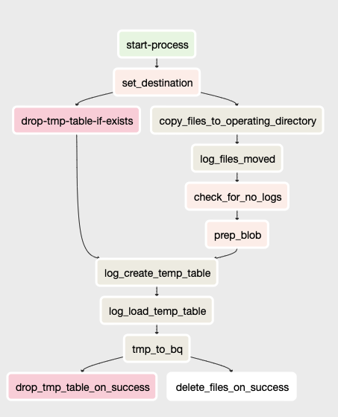
DAGS
DAG - Directed Acyclic Graph
Collection of tasks defined in Python code
Show relationship and dependency between tasks
Flow in one direction
Notes:
DAGs are made up of tasks.
Best practice is for each task to have a discrete function

Slide 6
Operators are key components to DAGs
Basic operators:
DummyOperator
BashOperator
PythonOperator
ShortCircuitOperator
API operators:
Azure
AzureDataFactoryRunPipelineOperator
ADLSDeleteOperator
AWS
S3CopyObjectOperator
RedshiftSQLOperator
Google
BigQueryOperator
GoogleCloudStorageOperator

Slide 7
Passing information from one task to another
XCOMs
Built-in functionality
Allows access to information from tasks
All tasks have a ‘result’ XCOM, but others can be set intentionally
Limited to 48KB
Use for simple passage of results
Results in tasks being overly dependent on upstream tasks
External storage
Database
Object store
Use for passing large data between tasks

Slide 8
Demo
http://localhost:8080
Sample dags are in my git repo here: https://github.com/cgapperi/airflow_demo
Notes:
Show:
DAGs list
Look at DAGs
Graph, Tree, Code, Details
Tree

Slide 9
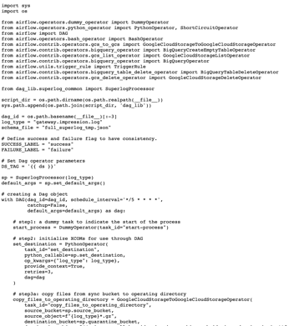
More complex Code

Slide 10
Resources
Official Airflow documentation
Operator documentation
Mark Lamberti!
Medium author: Kaxil Naik
Astronomer.io Resources
Blog:
7 Common Errors to Check When Debugging Airflow DAGs
Useful SQL queries for Apache Airflow
Guides
Airflow: Tips, Tricks & Pitfalls
Testing DAGS (in Google Composer)

Slide 11
Questions?

Slide 12
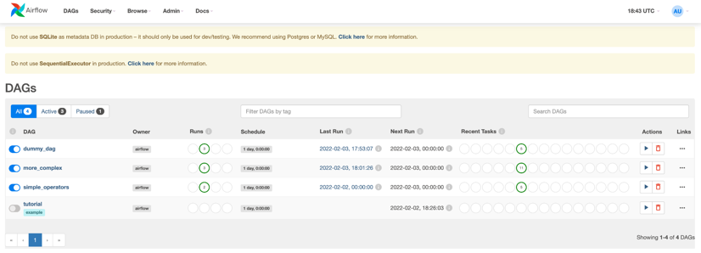
Airflow web interface

Slide 13
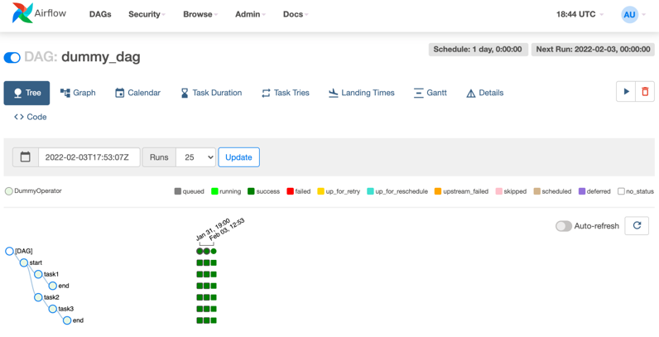
DAG Tree view

Slide 14
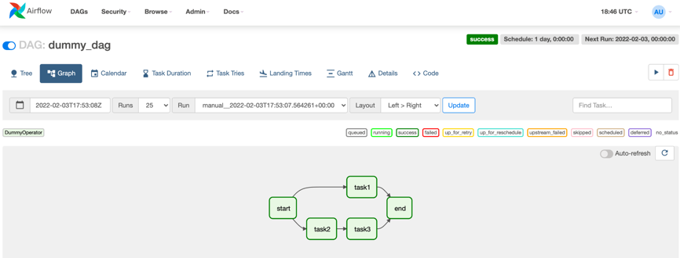
DAG graph view

Slide 15
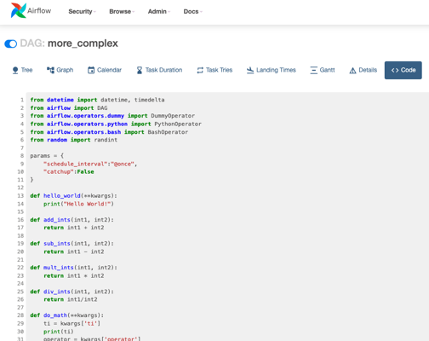
Airflow code view

