Slide 1
Introduction to PyDeequ
Data Quality at Scale
PyDeequ is a Python API for Deequ,
a library built on top of Apache Spark
for defining "unit tests for data",
which measure data quality in large datasets.
.. https://pydeequ.readthedocs.io/en/latest/

Slide 2
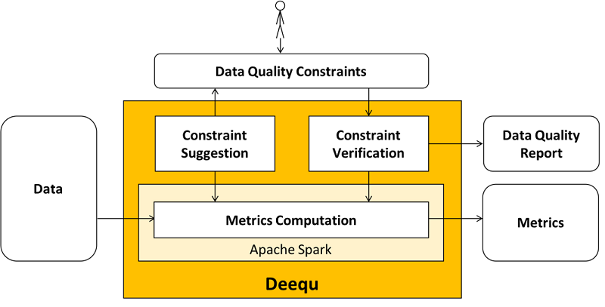
Issues caused by poor data quality
Missing values can lead to failures
Data distribution issues
Use of bad data can result in unreliable results
Monitoring and logging data profile
Data quality issues erodes trust
Types of data validation
Completeness – are there values present?
Validation of expected values – are all values the values expected
Data type validation – are the values integers, strings, Booleans, etc.
Size – is the data the size expected
Uniqueness – how unique are the values
Min/Max/Mean – how do the values meet expected range of values
Data validation moments
On arrival
During ETL/ELT
After ETL/ELT
Some options for data validation
Great Expectations – python
Apache Griffin – java based
Amazon Deequ/PyDeequ – java based, with python implementation
DBT – commercial software
What does it do?
Metrics Computation
Profiler
Analyzer
Constraint Verification
Constraint Suggestion
Metrics Repository
What does it does not do?
Locate
Fix
Isolate
Strictly a data profiling/validation tool
pip install pydeequ

Slide 3
# pip install pydeequ
from pyspark.sql import SparkSession, Row
import pydeequ
spark = (SparkSession
.builder
.config("spark.jars.packages", pydeequ.deequ_maven_coord)
.config("spark.jars.excludes", pydeequ.f2j_maven_coord)
.getOrCreate())
df = spark.sparkContext.parallelize([
Row(a="foo", b=1, c=5),
Row(a="bar", b=2, c=6),
Row(a="baz", b=3, c=None)]).toDF()
from pydeequ.profiles import *
result = ColumnProfilerRunner(spark) \
.onData(df) \
.run()
for col, profile in result.profiles.items():
print(profile)
from pydeequ.suggestions import *
suggestionResult = ConstraintSuggestionRunner(spark) \
.onData(df) \
.addConstraintRule(DEFAULT()) \
.run()
# Constraint Suggestions in JSON format
print(suggestionResult)
from pydeequ.analyzers import *
analysisResult = AnalysisRunner(spark) \
.onData(df) \
.addAnalyzer(Size()) \
.addAnalyzer(Completeness("b")) \
.run()
analysisResult_df = AnalyzerContext.successMetricsAsDataFrame(
spark, analysisResult)
analysisResult_df.show()

Slide 4
from pydeequ.checks import *
from pydeequ.verification import *
check = Check(spark, CheckLevel.Warning, "Review Check")
checkResult = VerificationSuite(spark) \
.onData(df) \
.addCheck(
check.hasSize(lambda x: x >= 3) \
.hasMin("b", lambda x: x == 0) \
.isComplete("c") \
.isUnique("a") \
.isContainedIn("a", ["foo", "bar", "baz"]) \
.isNonNegative("b")) \
.run()
checkResult_df = \
VerificationResult.checkResultsAsDataFrame( \
spark, checkResult)
checkResult_df.show()
from pydeequ.repository import *
from pydeequ.analyzers import *
metrics_file = FileSystemMetricsRepository.helper_metrics_file(spark, 'metrics.json')
repository = FileSystemMetricsRepository(spark, metrics_file)
key_tags = {'tag': 'pydeequ hello world'}
resultKey = ResultKey(spark, ResultKey.current_milli_time(), key_tags)
analysisResult = AnalysisRunner(spark) \
.onData(df) \
.addAnalyzer(ApproxCountDistinct('b')) \
.useRepository(repository) \
.saveOrAppendResult(resultKey) \
.run()
result_metrep_df = repository.load() \
.before(ResultKey.current_milli_time()) \
.forAnalyzers([ApproxCountDistinct('b')]) \
.getSuccessMetricsAsDataFrame()
spark.sparkContext._gateway.shutdown_callback_server()
spark.stop()

