Slide 1
Data Architecture Use Cases

Slide 2
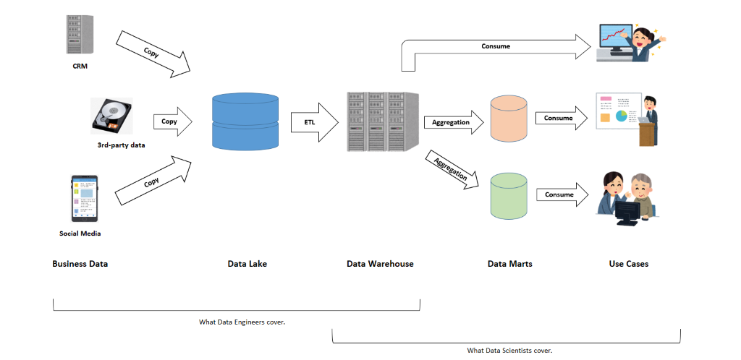
Three Components in Data Architecture:
Data Lake
Data Warehouse
Data Mart
These typical components in the architecture of data platform. In this order, data produced in the business is processed and set to create another data implication.

Slide 3
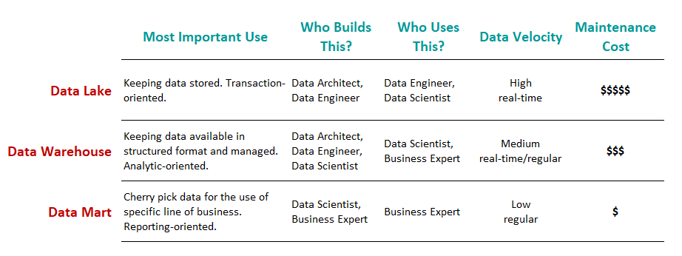
Three components take responsibility for three different functionalities as such:
Data Lake: holds an original copy of data produced in the business. Data processing from the original should be minimal if any; otherwise in case some data processing turned out to be wrong in the end, it will not be possible to fix the error retrospectively.
In the data lake stage, we want the data is close to the original
Data Warehouse: holds data processed and structured by a managed data model, reflecting the global (not specific) direction of the final use of the data. In many cases, the data is in tabular format.
It meant to keep the data sets more structured, manageable with a clear maintenance plan, and having clear ownership. In the data warehouse, we also like the database type to be analytic-oriented rather than transaction-oriented
Data Mart: holds a subpart and/or aggregated data set for the use of a particular business function, e.g. specific business unit or specific geographical area. A typical example is when we prepare the summary of KPIs for a specific business line followed by visualization in BI tool.
It should have easy access to non-tech people who are likely to use the final outputs of data journeys.

Slide 4
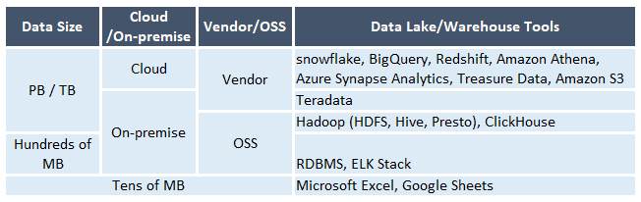
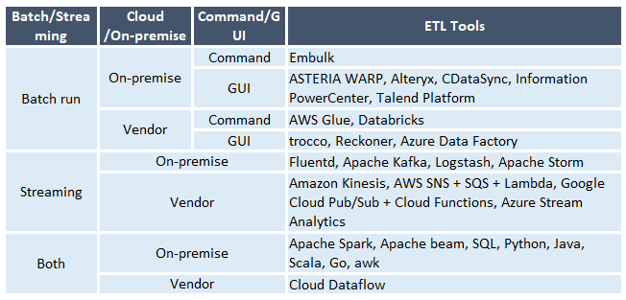

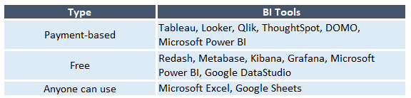
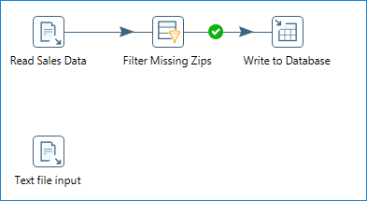
Tools Used in Each Component
1
2
Data Lake Database
ETL tools (automated data pipeline and streaming architecture )
Workflow engine
Data mart/BI tools
3
Example: Pentaho Data Integration (Spoon client)
The choice will be dependent on the business context
what tools your company is familiar with (Tableau, Power BI)
the size of aggregated data (Excel or Google Sheets can meet the goal)
what data warehouse solution do you use (BigQuery, Google DataStudio), and etc.

Slide 5
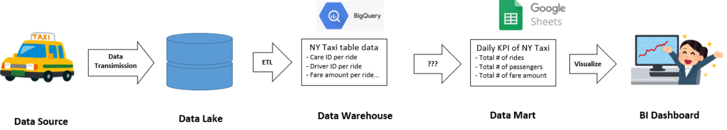
Case Study
Request: build a data warehouse and data streaming pipeline platform to utilize the data. End-user still wants to see daily KPIs financial reports on a highly aggregated basis.
Start from cloud storage data warehouse RedShift, Snowflake
Set up scheduling — run message service every day at a certain time via Workflow engine
Set up code — prepare code on to query Database tables and push it to RedShift, Snowflake
Finally – retrieve aggregated data via any Visualization tool

Slide 6
Outline of Steps Taken to Facilitate Migration Process:
Set up resource groups for DEV & PROD environments
Create users, Service Principal accounts for both environments
Create Key Vaults in both environments
Create DevOps (users, tickets, ...)
Create Synapse Data Lake & Synapse Dedicated Pool (SQL DW)
Set up permissions and privacy (row/column) as needed
Set up jobs in DEV for one-time load of Synapse SQL DW from original on-prem DW using Synapse Integrate pipelines
Schedule jobs for incremental loads using Synapse Integrate
Set procedures for checking data quality (compare on-prem with Cloud DEV)
Promote code from DEV to PROD, load data into PROD, schedule incremental updates
Confirm data quality (compare on-prem with Cloud PROD)
Power BI - Set up and connect to Synapse DW
Power BI - create several dashboards with top KPI as per client needs
Confirm that privacy and compliance requirements are met
Design on-going monitoring and maintenance procedures
Configure usage reporting
Create documentation

