Slide 1
Migrate Data from Amazon RDS Oracle DB to AWS Redshift
Data Science Seminar - Dec 10th, 2021.
Malte Thesenvitz

Slide 2

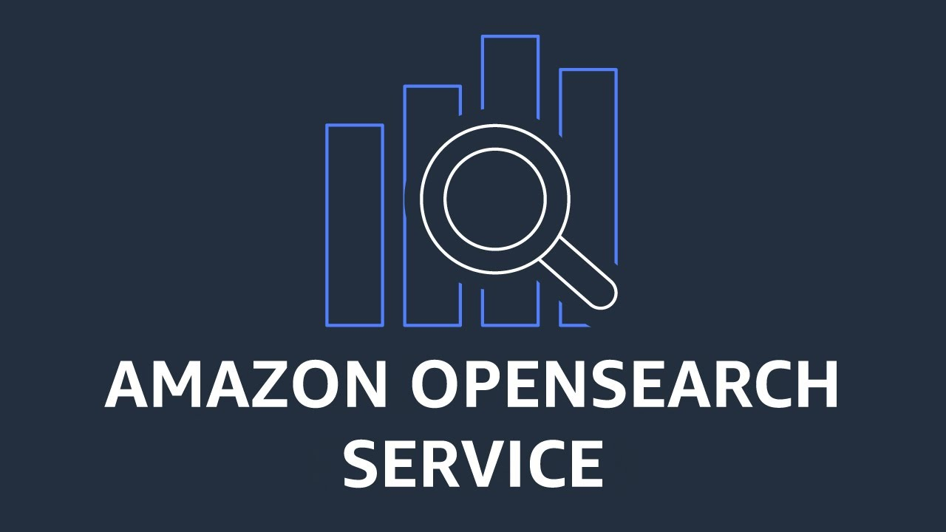
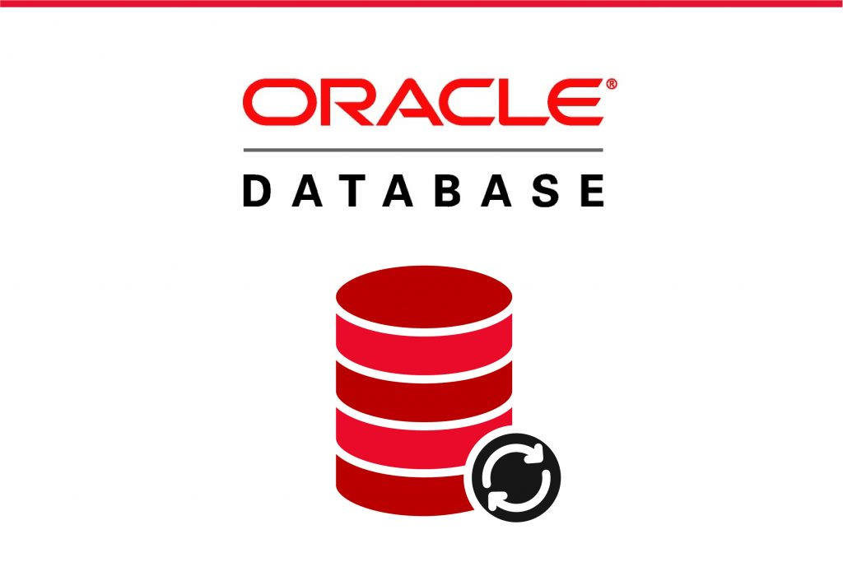
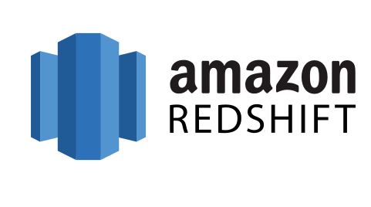
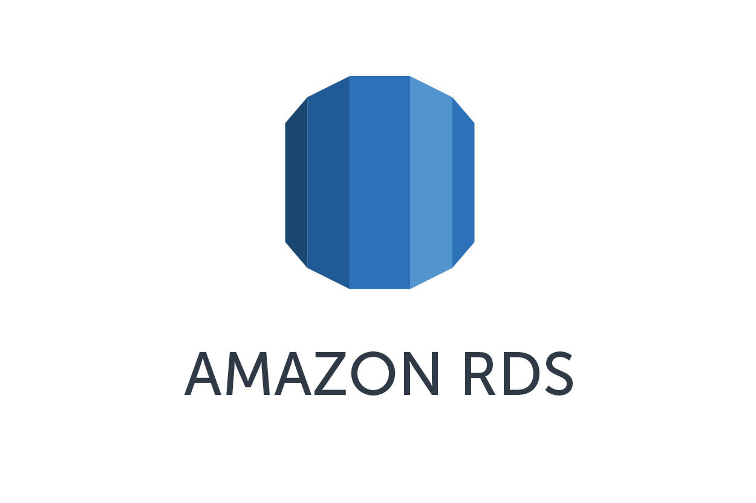
The Problem Statement.
migrate
Why?
Optimized queries
Automated administration & maintenance tasks
Unlimited scalability
Data Exploration in S3 Data Lake
Native ML integration
Amazon RDS Oracle source DB
RDS = Relational Database Service

Slide 3
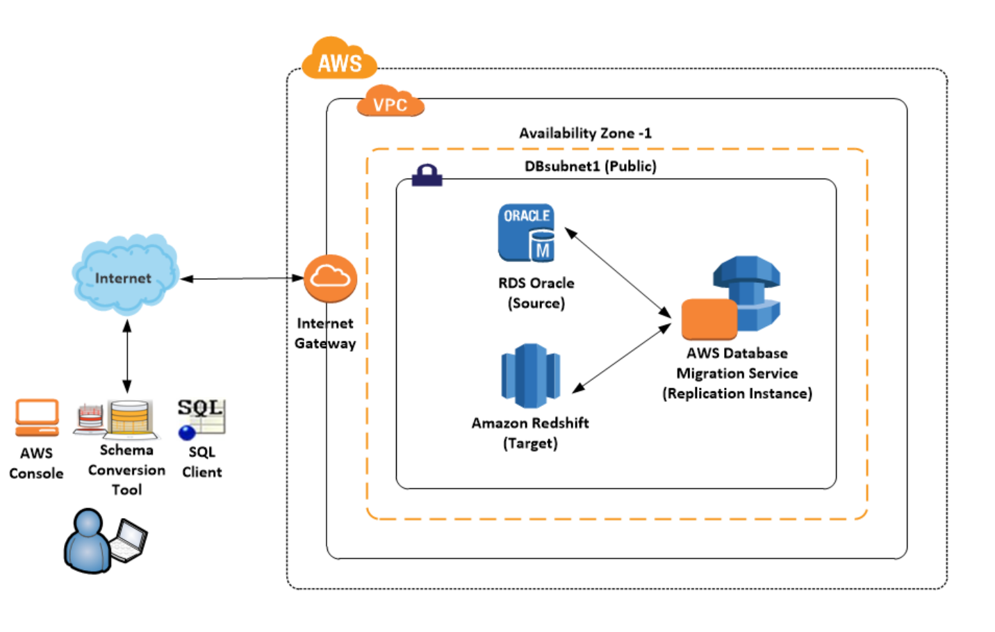
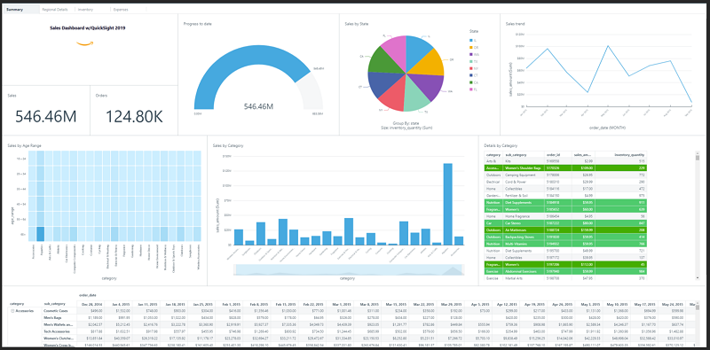
The Migration Architecture.
AWS Schema Conversion Tool enables migration of heterogeneous DBs
Visualization

Slide 4
Most Important Steps.
Using the AWS SCT to do the following:
Run the conversion report for Oracle to Amazon Redshift to identify the issues, limitations, and actions required for the schema conversion.
Generate the schema scripts and apply them on the target before performing the data load by using AWS DMS. AWS SCT performs the necessary code conversion for objects like procedures and views.
Identify and implement solutions to the issues reported by AWS SCT.
Disable foreign keys or any other constraints that might impact the AWS DMS data load.
AWS DMS loads the data from source to target using the Full Load approach. Although AWS DMS can create objects in the target as part of the load, it follows a minimalistic approach to efficiently migrate the data so that it doesn’t copy the entire schema structure from source to target.
Perform postmigration activities such as creating additional indexes, enabling foreign keys, and making the necessary changes in the application to point to the new database.

