Slide 1
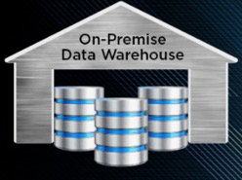
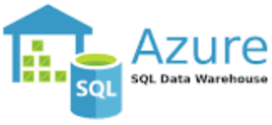
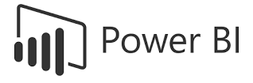

Use Case: Migration of on-prem Data Warehouse to Azure Cloud
Benefits of migration:
scalability
flexibility
easy integration with multiple cloud services
Current State:
On-Prem SQL DW
ETL implemented using SSIS and some python scripts
Analytics is done in Excel on data exported from the database
Desired state:
SQL DW in Azure
ETL processes to load data from same sources as before – but directly into Azure DW
Analytics is implemented using PowerBI

Slide 2
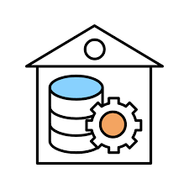

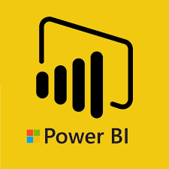







On Premises DW
Migration Diagram
SQL DW
Azure Synapse Studio
Original ETL
Ingestion
via Synapse
Integrate
Staging area
DB tables and Data Lake files
Synapse data
visualization
Data Sources

Slide 3
Outline of Steps Taken to Facilitate Migration Process:
Set up resource groups for DEV & PROD environments
Create users, Service Principal accounts for both environments
Create Key Vaults in both environments
Create DevOps (users, tickets, ...)
Create Synapse Data Lake & Synapse Dedicated Pool (SQL DW)
Set up permissions and privacy (row/column) as needed
Set up jobs in DEV for one-time load of Synapse SQL DW from original on-prem DW using Synapse Integrate pipelines
Schedule jobs for incremental loads using Synapse Integrate
Set procedures for checking data quality (compare on-prem with Cloud DEV)
Promote code from DEV to PROD, load data into PROD, schedule incremental updates
Confirm data quality (compare on-prem with Cloud PROD)
Power BI - Set up and connect to Synapse DW
Power BI - create several dashboards with top KPI as per client needs
Confirm that privacy and compliance requirements are met
Design on-going monitoring and maintenance procedures
Configure usage reporting
Create documentation

Slide 4

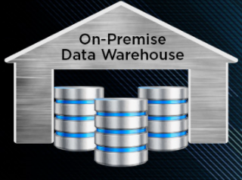

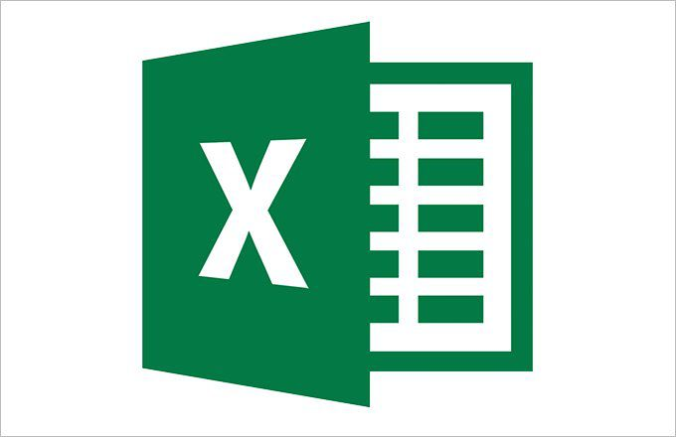
Use Case: Migration of on-prem Data Warehouse to Google Cloud
Current State:
On-Prem SQL DW
ETL implemented using SSIS and some python scripts
Analytics is done in Excel on data exported from the database
Desired state:
SQL DW (BigQuery) in Google Cloud
ETL processes to load data from same sources as before – but directly into BigQuery
Analytics is implemented using Google Cloud Data Studio
Why Migrate?
Scalability
Flexibility
Integration

Slide 5




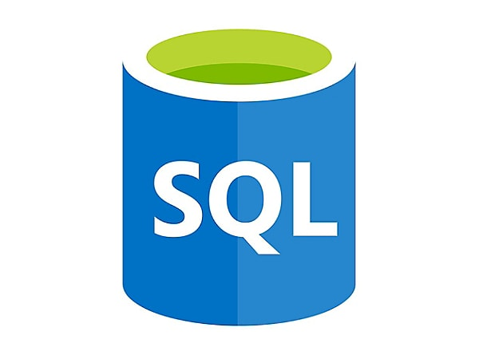
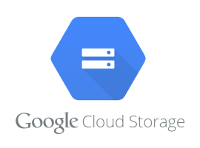
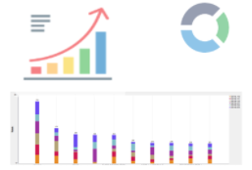
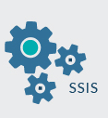


Migration Diagram
SQL DW
Data Visualization
Google Cloud DW
Staging Area
ingest
Original ETL
Note: In modern migrations, it is typical to Extract, Load, then Transform
Data Sources

Slide 6
Outline of Steps Taken during Google Cloud Migration Process:
Set up cloud resource groups for DEV & PROD environments
Create users, Service Accounts for both environments
Create Google Cloud KMS(Key Management Services) Vaults in both environments
Create Google Cloud Platform DevOps Service (users, tickets, ...)
Stand up components of BigQuery Data Warehouse
Set up permissions and privacy (row/column) as needed
Set up jobs in DEV for load of BigQuery from original on-prem DW using BigQuery Data Transfer Service
Schedule jobs for incremental loads using Google Cloud Data Fusion pipelines
Set procedures for checking data quality (compare on-prem with Cloud)
Promote code from DEV to PROD, load data into PROD, schedule incremental updates
Confirm data quality, schedule incremental updates
Google Data Studio and/or Looker -- Set up and connect it to BigQuery
Google Data Studio and/or Looker -- Create several dashboards with top KPIs as per client needs
Confirm that privacy and compliance requirements are met
Design on-going monitoring and maintenance procedures
Enable Google Cloud logging for Resource Usage Reporting
Create documentation

