Slide 1
Media log ingestion to BigQuery using Cloud Composer

Slide 2
Client: Podcast/Radio advertising merchant
Key Components:
Podcast advertising servers and radio advertising servers transmit JSON log data to S3
JSON log format includes detailed metadata about the advertisement blocks including details about the ads run inside the block if they were actually filled
Challenge:
JSON logs were being ingested into BigQuery using a Dataflow process that parsed and aggregated the contents based on 20 key data fields.
As a result of the aggregation, analytics could really only provide value at the aggregated level. There was significant data, particularly, demographic target data that could not be analyzed.
In addition, this process ran once a day, and was a fairly complex and fragmented system.

Slide 3
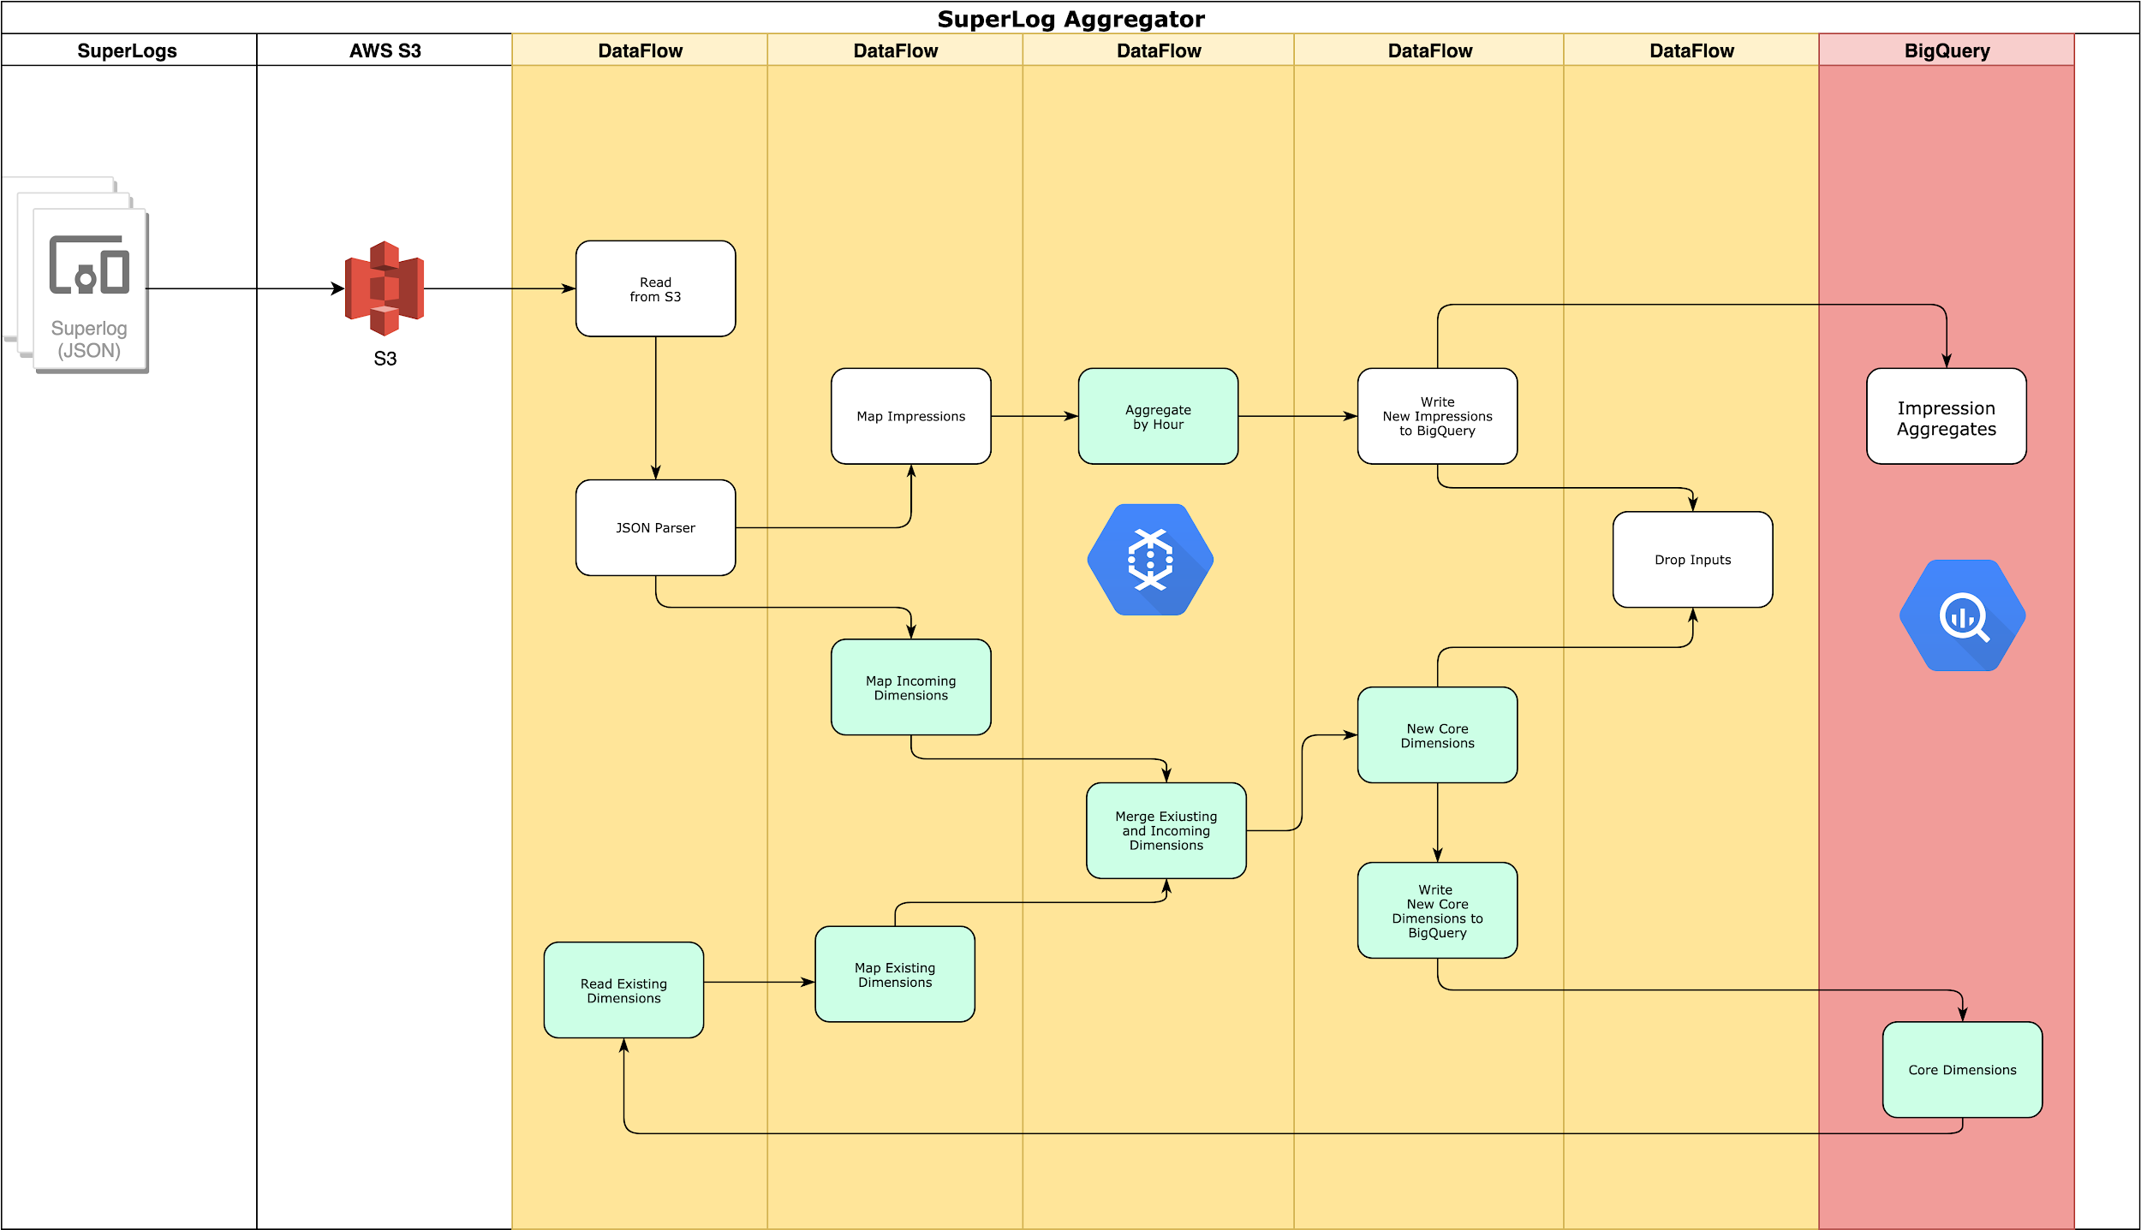
Legacy ingestion process

Slide 4
Legacy BigQuery
Aggregated Facts
Dimensions Key
Enhancement Dimensions
From SuperLog via Dataflow
From Dataflow
External to Superlogs
allocations
facts
facts_filled
facts_unfilled
forecasts
forecasts_filled
forecasts_unfilled
coredimensions
dimension_devices
dimension_markets
stations
ads
Notes:
Aggregated facts - breaking out individual data types into separate tables with aggregations
Dimensions key - create during Dataflow process from superlogs
Enhancement dimensions come in from sources external to superlogs

Slide 5
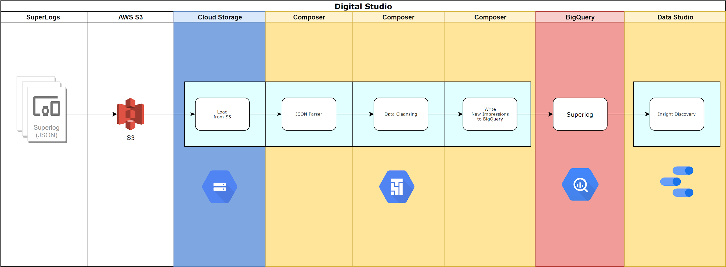
Updated solution with Composer
Google Composer (Apache Airflow) direct ingestion of raw JSON logs into BigQuery
Simplifying cleansing process
Full access to all metadata for analysis

