Slide 1
Data Security Use Case

Slide 2
Three questions to consider:
When configuring access to data along its journey from creation to transformation to consumption it’s helpful to think about the following questions in determining who needs access and where:
Who owns the data?
Who manipulates the data?
Who can access the data?
Who can access all the data?
Who can access subsets of data?

Slide 3
Principle of least privilege
Users should be given the fewest permissions required to do their jobs, and no more.
Examples:
Developers shouldn’t need admin permissions in Production
Analysts shouldn’t need write permissions on tables in the database
Deployment managers don’t need permissions to read data

Slide 4
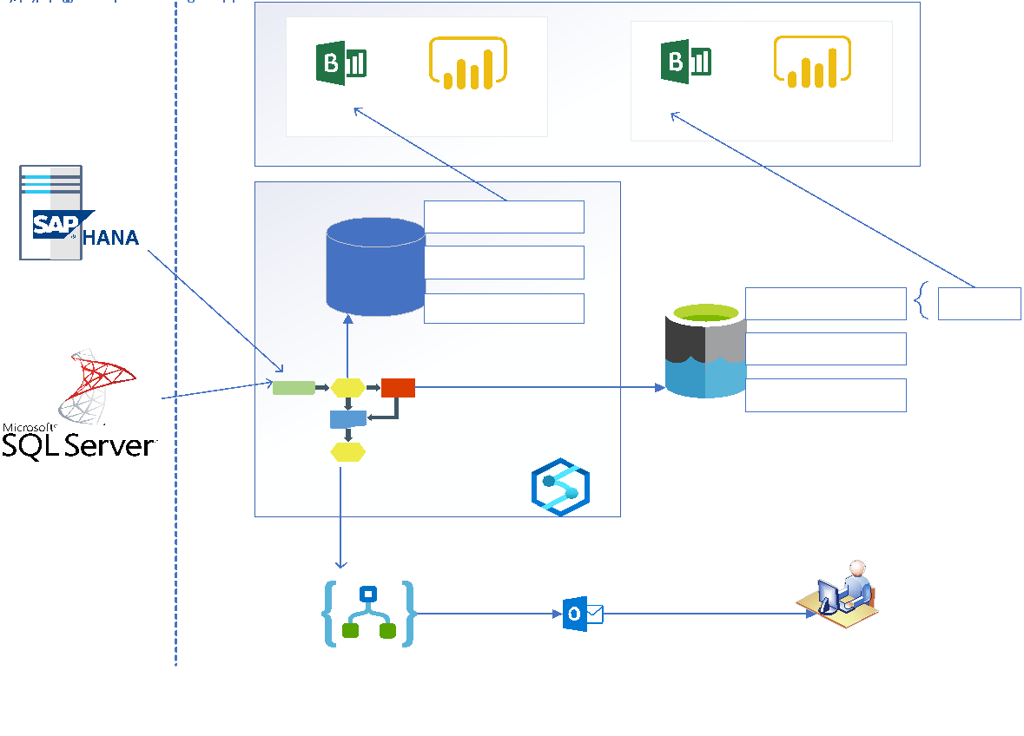
Simple Reporting Architecture

Slide 5
Data Touchpoints
Different users will need different access to data at various points along the data’s journey. Using the prior architecture slide as a guide, here are some different touchpoints to examine:
Source Data Systems
Orchestration Systems
Raw Storage/Data Lake
Database
Reporting Layer/Visualizations

Slide 6
Security Roles
At a minimum, you should have three levels of roles for any given touchpoint. You may want to fine tune the approach with additional roles, but must strike a balance between least privilege and complexity.
Core roles to consider:
Administrators/Owners
Full access to a resource, with ability to manage permissions
Power Users/Developers
Read, write, modify
Standard Users
Read only, maybe write permissions in some scenarios

Slide 7
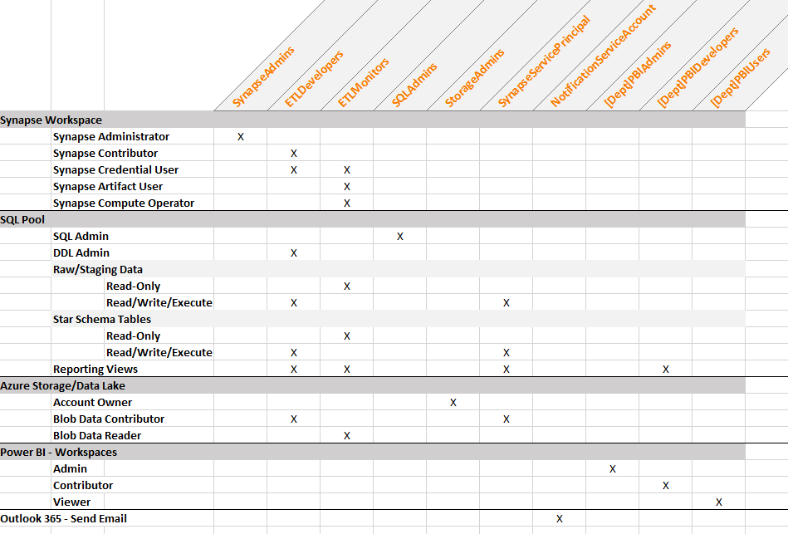
Data Security Matrix

Slide 8
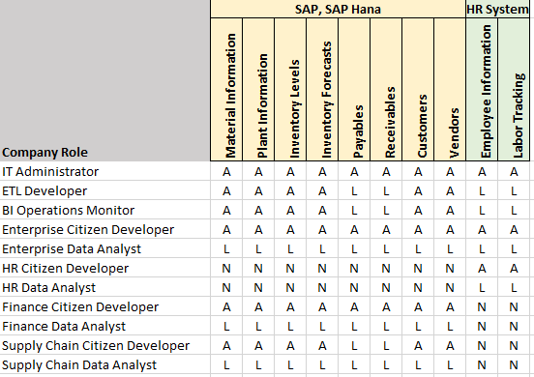
Data Access Persona Matrix
A=All Access
L=Limited Access
N=No Access

Slide 9
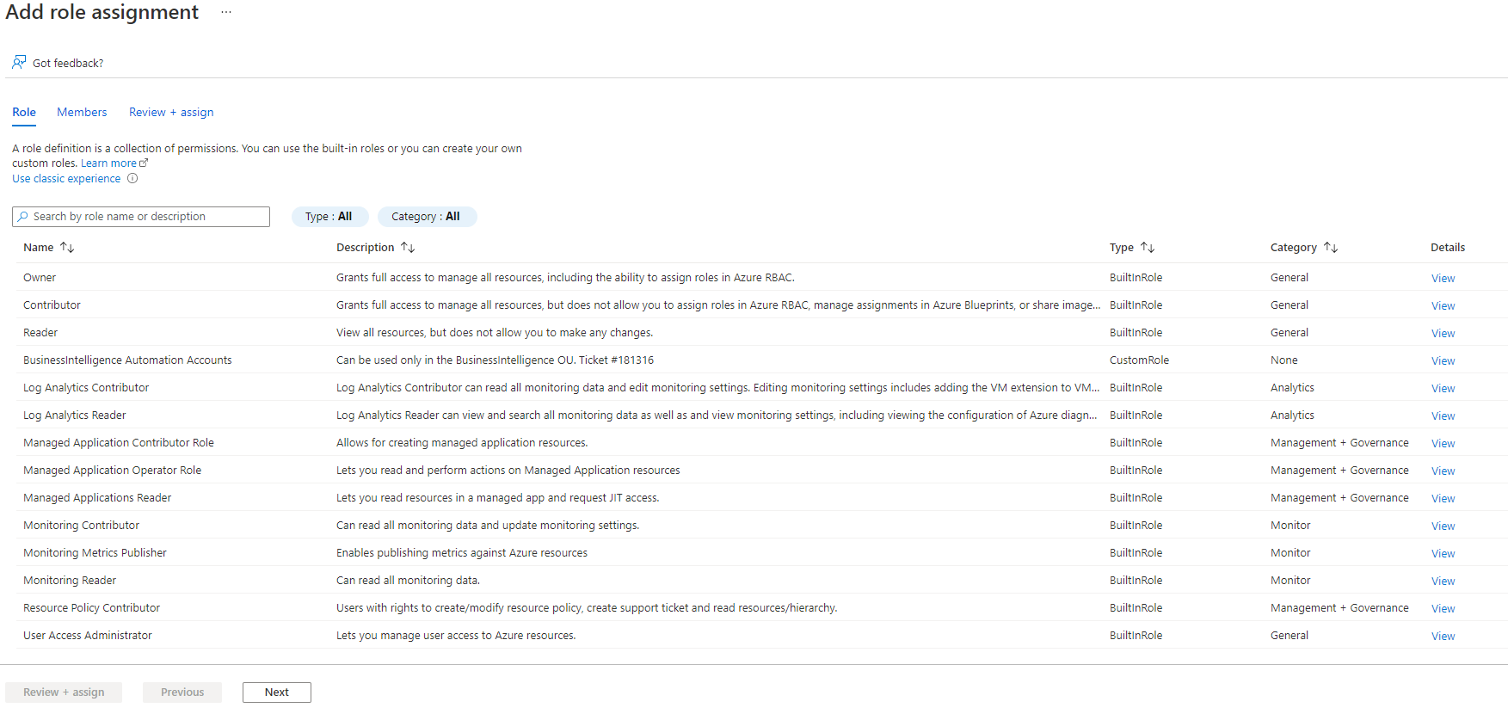
Implementing Security with Built-in Azure Roles
Once the matrices are complete, you can apply the security using Azure Role-Based Access Control (RBAC). In this example, roles are assigned at the level of each Resource, within Synapse Studio, and within the database.

