Slide 1
Time Series Forecasting (with Python)
A Review of Jason Brownlee’s Intro
- Malte Thesenvitz

Slide 2

About me:
Malte Thesenvitz, MBA, BS Physics – Seattle University
2021 – Tech Consulting Industry
- Microsoft Azure Environment
- Cosmos DB, Synapse, ML Studio, Power Bi…
- Sports Analytics

Slide 3
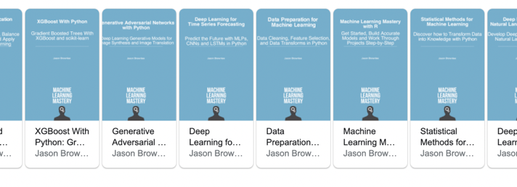

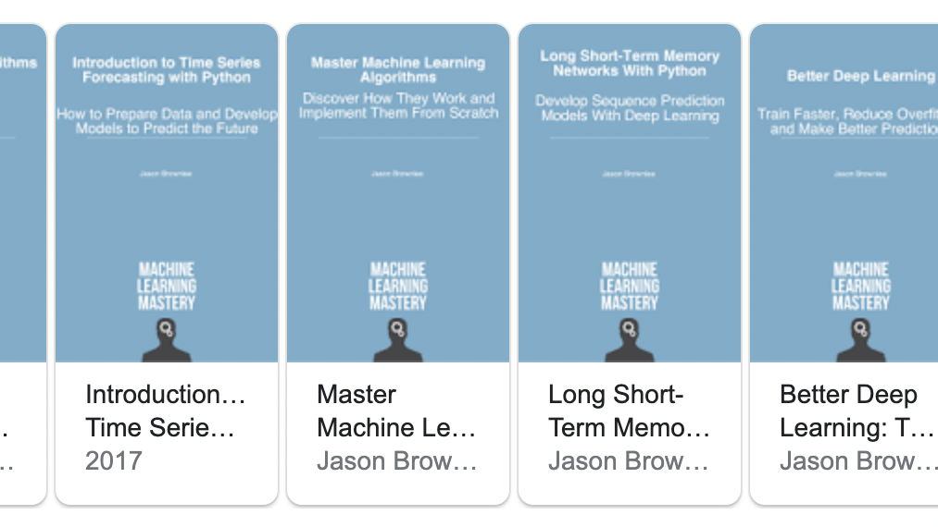
Jason Brownlee
Founder of SuperFast Python & Machine Learning Mastery
https://machinelearningmastery.com
Published more than 20 books/pdfs

Slide 4
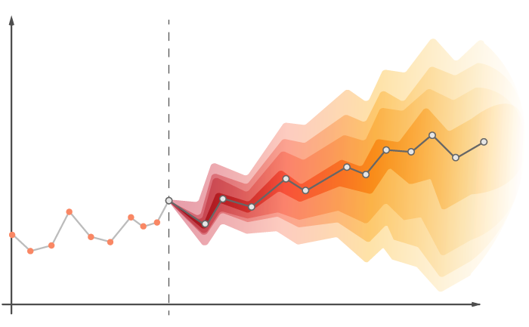



What is Time Series Forecasting?
Describing vs. Predicting
Four Components (Level, Trend, Seasonality, Residuals)
Normal ML Data Set vs. Time Series
The Tool:

Slide 5

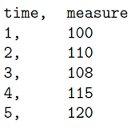
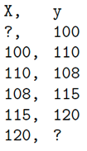

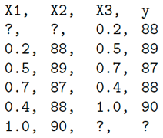
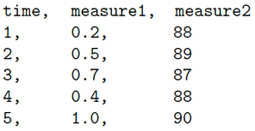
How to convert Time Series Data to a Supervised Learning Problem (SL)
Prev, Next
Univariate
A Time Series Data Set
A Time Series Converted to a ML SL Data Set
A small SL Data Set
Multivariate

Slide 6
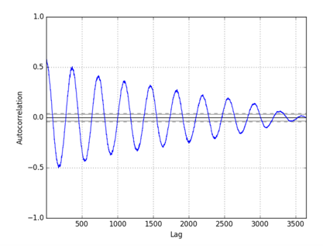
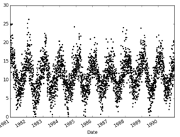
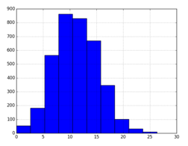
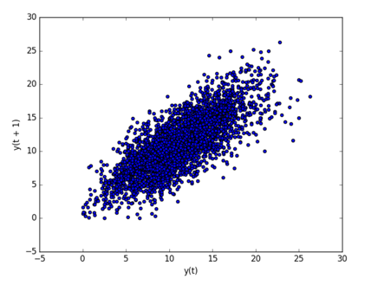
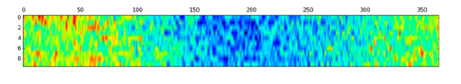
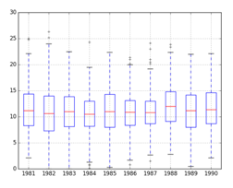
Different Data Visualizations
Autocorrelation Plot
Dot Line Plot Histogram
Heat Map
Lag Plot
Box & Whisker Plot

Slide 7
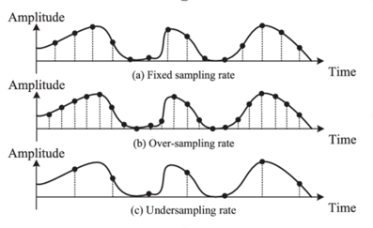
Resampling and Interpolation
About changing the frequency of your observation
Upsampling: increase frequency of observations
Ex: Going from monthly observations to daily observation
Question of how to fill in the missing values
Usually use a line or a polynomial to connect two points
Downsampling: decrease frequency of observation
Same idea as above, but now we are going from monthly measurements, to quarterly observations
Usually use means to get the summarized data

Slide 8
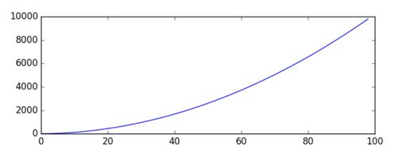
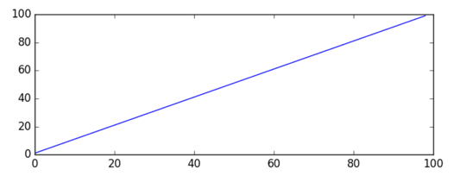
Power Transforms
Ex: Square Root Power Transform
Data transforms are intended to make time series stationary and remove trend
Square Root Transform:
A time series that has a quadratic growth trend can be made linear by taking the square root.
Log Transform:
Time series with an exponential distribution can be made linear by taking the logarithm of the values.
Box-Cox Transform:
The Box-Cox transform is a configurable data transform method that supports both square root and log transform, as well as a suite of related transforms.
it can be configured to evaluate a suite of transforms automatically and select the best fit.
See boxcox() function
Notice the quadratic trend.
By taking the square root of every term in the original time series, we can remove the quadratic trend

Slide 9
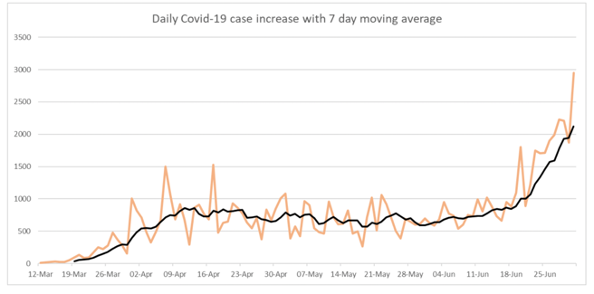
Moving Average Smoothing
Technique applied to time series to remove the fine-grained variation between time steps (removes noise)
Calculating a moving average involves creating a new series where the values are comprised of the average of raw observations in the original time series
Two different techniques:
Centered moving average: center ma(t) = mean(obs(t - 1); obs(t); obs(t + 1))
Trailing moving average: trail ma(t) = mean(obs(t - 2); obs(t - 1); obs(t))
Use Python’s rolling(window_size) function to achieve this

Slide 10
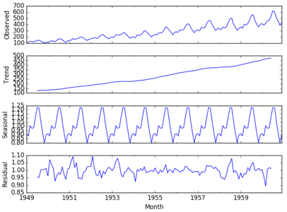

Time Series Components
Systematic: Level, Trend, Seasonality
Non-Systematic: Residual
y(t) = Level + Trend + Seasonality + Residual (additive)
y(t) = Level $×$ Trend $×$ Seasonality $×$ Residual (multiplicative)
Statsmodels library provides automated decomposition tools

Slide 11
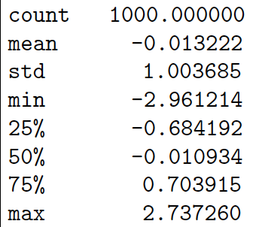
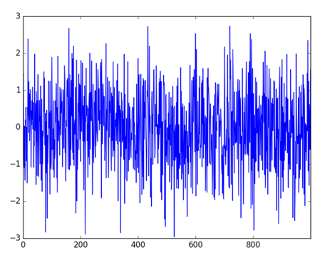
Noise
Signal(t) = level + trend + seasonality + noise
A time series is white noise if the observations are independent and identically distributed with a mean of zero. => complete random error
Filtering on horizontal and vertical scale
Check basic stats for noise type
Ex: White noise (complete random)

Slide 12
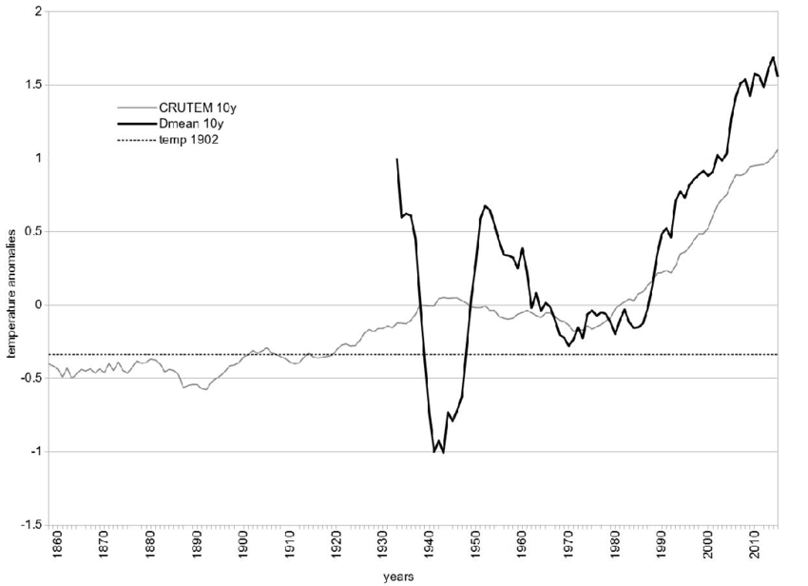
Using and Removing Trend/Seasonality
Trends: deterministic vs. stochastic, global vs. local
Time series with trend = non-stationary
Use augmented Dickey-Fuller test to check for stationarity
Why do we care?
Removing or Adding Information to ML Model
Detrend by Differencing: value(t) = observation(t) - observation(t-1)
Detrend by Model Fitting: value(t) = observation(t) - prediction(t)

Slide 13
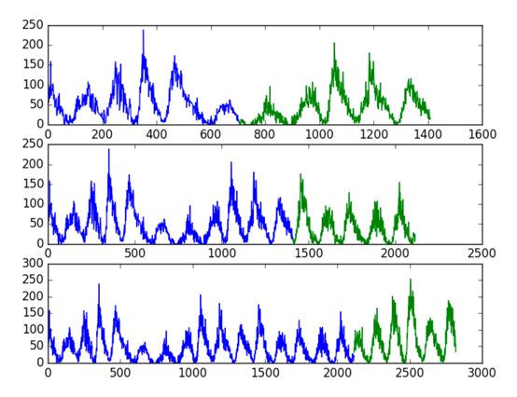
Backtest Forecast Model
Normal train-test splits or k-fold cross validations won’t work because time series data are dependent on time
Train-Test split that respect temporal order of observations.
Multiple Train-Test splits that respect temporal order of observations.
Walk-Forward Validation where a model may be updated each time new data is received.
Example of Multiple Train-Test Split

Slide 14
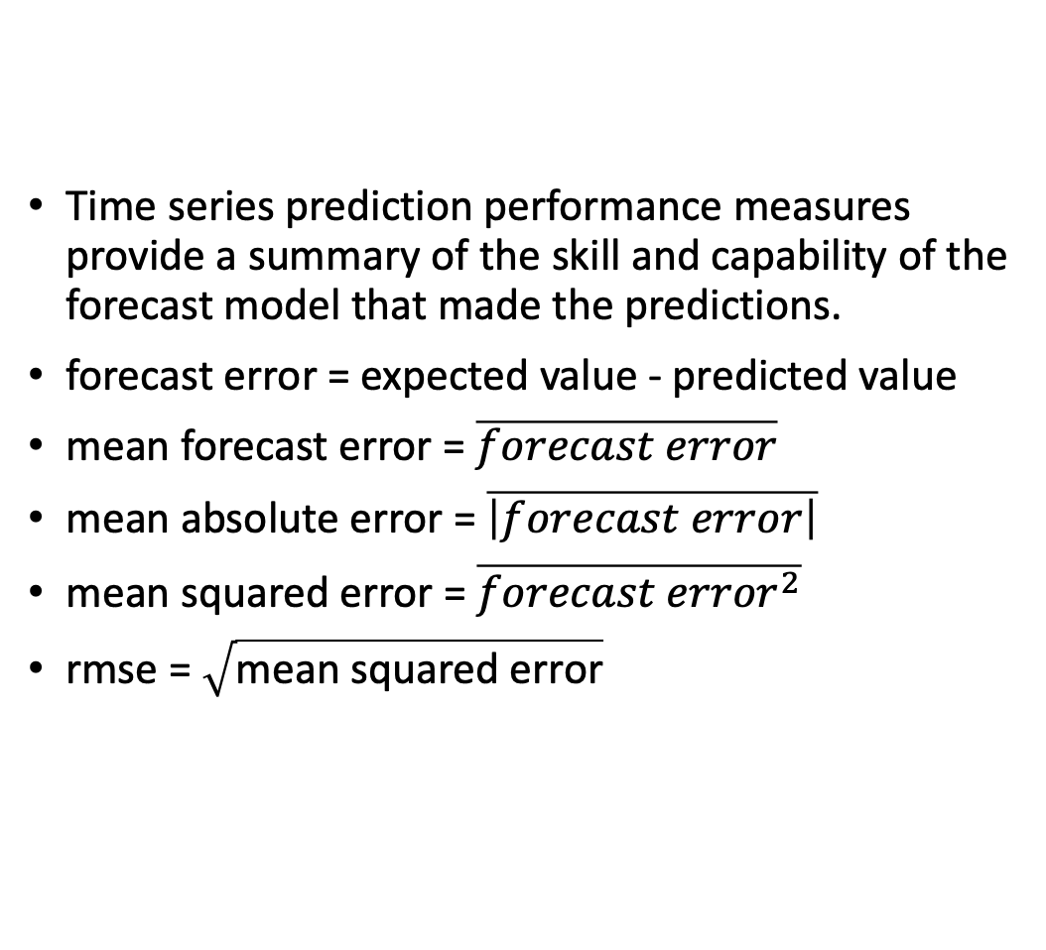
Forecasting Performance Metrics
Time series prediction performance measures provide a summary of the skill and capability of the forecast model that made the predictions.
forecast error = expected value - predicted value
mean forecast error = $\overline{forecast error}$
mean absolute error = $\overline{\left|forecast error\right|}$
mean squared error = $\overline{{forecast error}^{2}}$
rmse = $\sqrt{\text{mean} \text{squared} \text{error}}$

Slide 15
ARIMA (a.k.a. Box-Jenkins Model)
Autoregressive Integrated Moving Average Model
Three Steps:
Identify model that best summarizes the data
Use data to train the model
Diagnostic checking. How good is the fitted model?
Notation: ARIMA(p, q, d)
p = lag order, number of lag observations included in model
q = difference order, number of times the raw observations are differenced
To remove trend and make time series stationary
d = order of moving average, size of moving average window

Slide 16


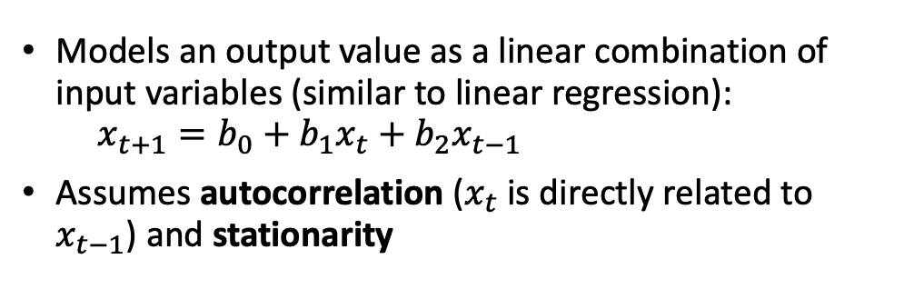
Autoregressive (AR) Models
Models an output value as a linear combination of input variables (similar to linear regression): $x_{t+1}=b_{0}+b_{1}x_{t}+b_{2}x_{t−1}$
Assumes autocorrelation ($x_{t}$ is directly related to $x_{t−1}$) and stationarity
Example of Lag plot
Example of autocorrelation plot

Slide 17
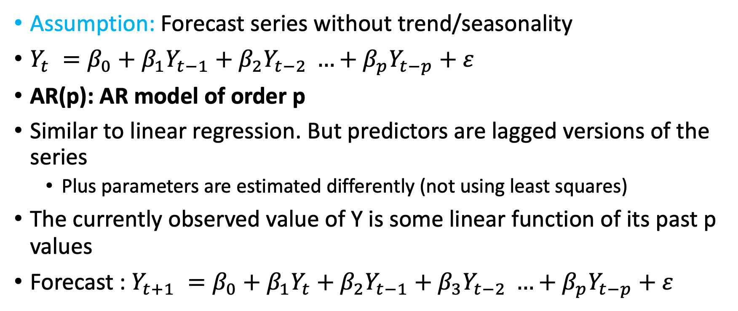
AR Model Details:
Assumption: Forecast series without trend/seasonality
$Y_{t} =β_{0}+β_{1}Y_{t−1}+β_{2}Y_{t−2} …+β_{p}Y_{t−p}+ε$
AR(p): AR model of order p
Similar to linear regression. But predictors are lagged versions of the series
Plus parameters are estimated differently (not using least squares)
The currently observed value of Y is some linear function of its past p values
Forecast : $Y_{t+1} =β_{0}+{β_{1}Y}_{t}+β_{2}Y_{t−1}+β_{3}Y_{t−2} …+β_{p}Y_{t−p}+ε$

Slide 18
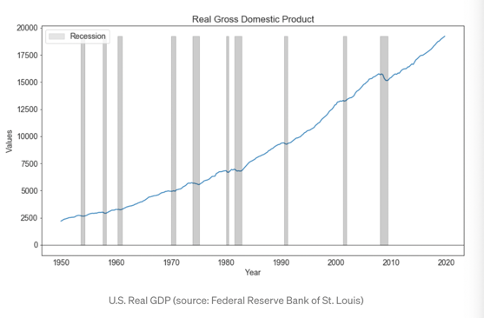
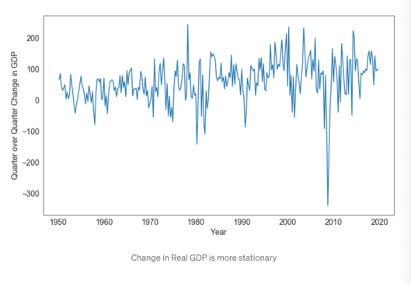
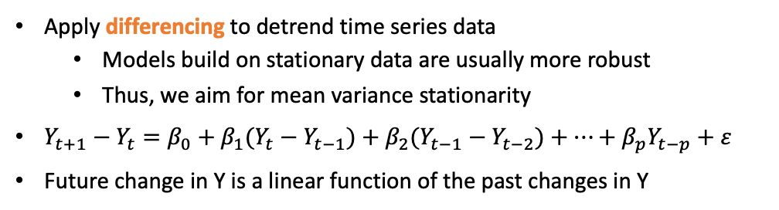
Integrated
Apply differencing to detrend time series data
Models build on stationary data are usually more robust
Thus, we aim for mean variance stationarity
$Y_{t+1}−Y_{t}=β_{0}+{β_{1}(Y}_{t}−Y_{t−1})+β_{2}(Y_{t−1}−Y_{t−2})+…+β_{p}Y_{t−p}+ε$
Future change in Y is a linear function of the past changes in Y

Slide 19
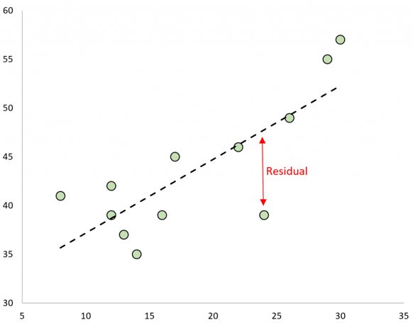

Moving Average Model
Residuals provide another piece of information we can use to model the data
Forecasts Y using the model’s past errors
This model is called moving average model!! Don’t’ confuse with moving average smoothing
$ε_{t} =α_{0}+α_{1}ε_{t−1}+α_{2}ε_{t−2}+α_{3}ε_{t−3}…+α_{q}ε_{t−q}+ε$
Modelling the time series of the errors to improve forecast!

Slide 20
How does it work?
Training of the model is done iteratively. Training process goes through multiple steps.
Create Integrated Autoregressive model
Get residuals: residuals = test_y – predictions
I - This gives us a time series of residual errors.
II - Then model these residual errors using normal autoregression to obtain coefficients & intercept
3. Walk through each time series data point and:
I – calculate AR prediction (t+1)
II – Predict residual error using autoregressive model
III – Update residual errors time series lag values so we can calculate next error
4. Correct initial predictions from AR model with forecasted errors from the autoregressive model
I – Improved forecast = Old AR Forecast + New Estimated Error Forecast
II – Ex: if Autoregressive model predicted value of 8, but our AR Model of the errors predicted an error of 3 for this time stamp, we would have an updated prediction of 8 + 3 = 11

Slide 21
Tips:
Use differencing to remove trend and seasonality
Keep it Simple! Over differencing can cause problems.
“In most cases either p is zero or q is zero, and p + q is less than or equal to 3”
Duke Prof. Robert Nau (http://people.duke.edu/~rnau/411home.htm)

Slide 22
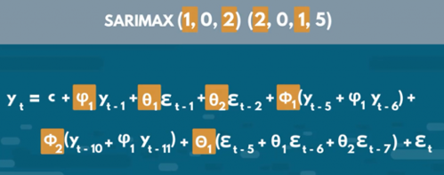
AR, MA, ARMA, ARIMA, ARIMAX, SARIMAX
AR = Auto-Regressive (next point as linear combination of several previous) Y_forward1 = B0 + B1*Y + B2*Y_lag1 + ...
MA = Moving Average Y = B0 + B1*E_lag1 + B2*E_lag2 + ... + Bn*E_lagn , where "E" = residual errors (which change as we iteratively train the model)
"I" = Integrated (use differences to remove trend while modeling): Y_forward1 - Y = B0 + B1*(Y - Y_lag1) + B2*(Y_lag1 - Y_lag2) + ...
ARMA = AR + MA = Auto Regressive Moving Average model
ARIMA = AR + I + MA = Auto-Regressive Integrated Moving Average model
"X" = eXogenous variables (additional variables, think "multivariate regression")
ARIMAX = ARIMA with exogenous variables. An exogenous variable is a covariate that influence the observed time-series values
SARIMAX = Seasonal ARIMAX – includes seasonal factors
ACF = Auto-Correlation Function
PACF = Partial ACF
.. https://people.duke.edu/~rnau/411arim.htm
ARIMA(p, d, q) = ARIMA (AR, I, MA)
p = number of lagged values in AR model (number of autoregressive terms)
d = order of differencing (used for stationarity)
q = number of lagged errors in MA model
ARIMA(1,0,0) - 1st order autoregressive model
ARIMA(2,0,0) - oscillations
ARIMA(0,1,0) - random walk
ARIMA(1,1,0) - differenced first-order autoregressive model
ARIMA(0,1,1) - simple exponential smoothing:
ARIMA(0,1,1) - simple exponential smoothing with growth
ARIMA(1,1,1) - ...
ARIMA(0,2,1) - linear exponential smoothing
ARIMA(0,2,2) - linear exponential smoothing
Great explanation: .. https://towardsdatascience.com/understanding-arima-time-series-modeling-d99cd11be3f8
More links:
.. https://en.wikipedia.org/wiki/Autoregressive%E2%80%93moving-average_model
.. https://en.wikipedia.org/wiki/Autoregressive_integrated_moving_average
.. https://www.statsmodels.org/dev/examples/notebooks/generated/statespace_sarimax_stata.html
.. https://365datascience.com/tutorials/python-tutorials/sarimax/
.. https://people.duke.edu/~rnau/411arim.htm
Autoregressive Model: - https://www.youtube.com/watch?v=5-2C4eO4cPQ -
Autocorrelation and Partial Autocorrelation - https://www.youtube.com/watch?v=DeORzP0go5I -
ACF and PACF:
- https://towardsdatascience.com/significance-of-acf-and-pacf-plots-in-time-series-analysis-2fa11a5d10a8
SARIMAX

Slide 23
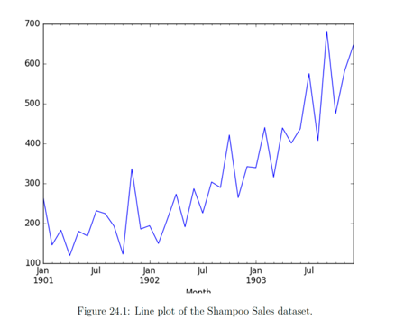
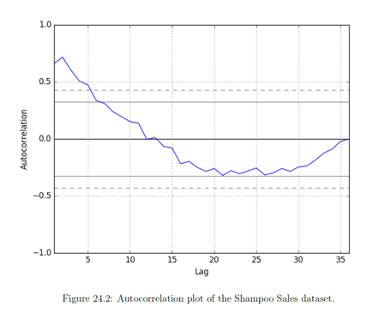
How to find the parameters?
Trend observable => need differencing to remove
Autocorrelation plot suggests significant relationship up to a lag of 5

Slide 24
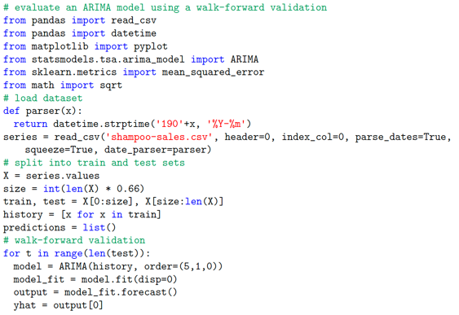
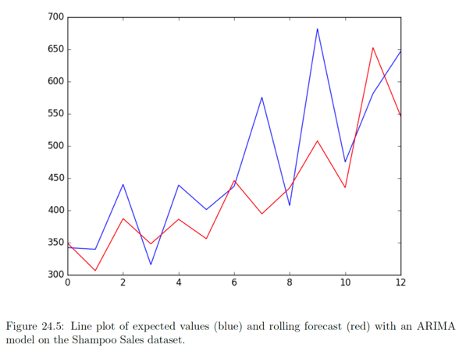
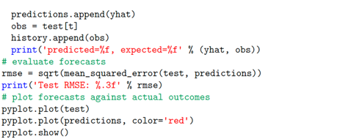
ARIMA with Python
Fitting an ARIMA model to a time series data set

Slide 25
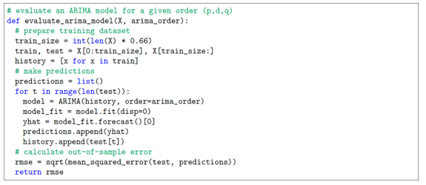
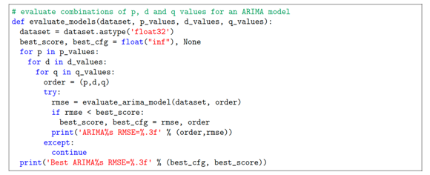
Grid Search Arima
How to configure the three ARIMA parameters (p, d, q)?
Two Steps:
1. Evaluate an ARIMA model. (find error score)
2. Evaluate sets of ARIMA parameters.
1. Evaluate Model
2. Evaluate ARIMA Parameters

Slide 26
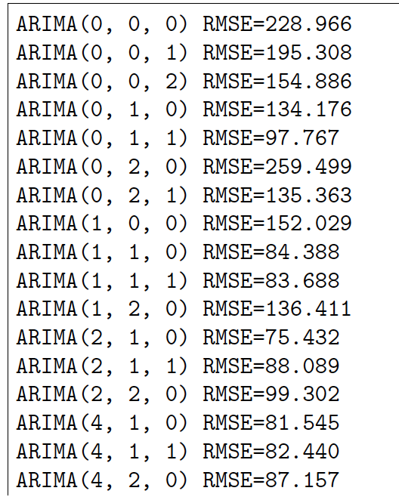
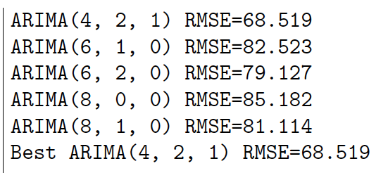
Results:

Slide 27
Resources:
https://machinelearningmastery.com/about/
https://scholar.google.com/citations?user=hVaJhRYAAAAJ&hl=en
https://superfastpython.com/
https://www.youtube.com/watch?v=Aw77aMLj9uM
https://youtu.be/4WWQWeMXvas
https://youtu.be/0xHf-SJ9Z9U
https://towardsdatascience.com/understanding-arima-time-series-modeling-d99cd11be3f8

