Slide 1
Comparison of SQL Server Variants
By Tyler Williams

Slide 2

Flavors of SQL Server
SQL Server on-premises
Latest GA: SQL Server 2019
SQL Server on Azure VM (IaaS)
Azure SQL Server Managed Instance (PaaS)
Azure SQL DB (PaaS/DBaaS)
Azure Synapse Dedicated SQL Pools (PDW)
Azure Synapse Serverless SQL Pools

Slide 3
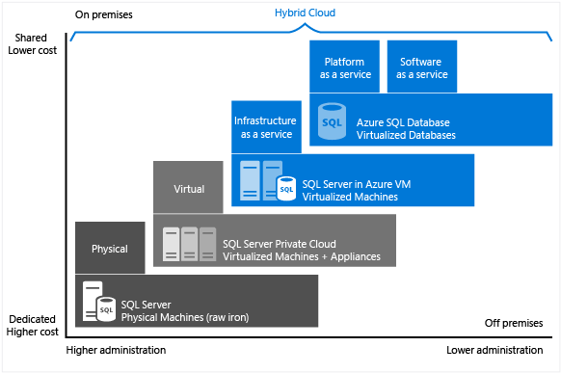
Service Comparison

Slide 4
“Traditional” SQL Server
 | On-prem SQL Server | SQL Server on VM (IaaS) | SQL Server Managed Instance (PaaS w/ server) | Azure SQL DB (PaaS w/o server)
Feature parity with on-prem | 100% | 100% | Near-100% | Nearly all DB features, no server
SQL Server Agent | Yes | Yes | Yes | No
SSIS Catalog | Yes | Yes | Yes* | No
Cross-DB queries | Yes | Yes | Yes | No
DB Mail | Yes | Yes | Yes | No
Common Language Runtime (CLR) | Yes | Yes | Yes | No
*Doesn’t run the packages natively, but works in conjunction with Azure Data Factory or Synapse Analytics
https://docs.microsoft.com/en-us/azure/azure-sql/database/features-comparison
https://docs.microsoft.com/en-us/azure/azure-sql/managed-instance/transact-sql-tsql-differences-sql-server

Slide 5
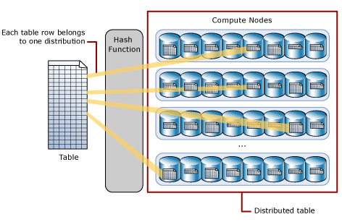
Synapse Dedicated SQL Pool
Distributed nature is key to optimization
All tables must have distribution function defined
ROUND_ROBIN
HASH
REPLICATE
Always 60 distributions, but number of nodes increases as pool is scaled
https://docs.microsoft.com/en-us/azure/synapse-analytics/sql-data-warehouse/sql-data-warehouse-tables-distribute

Slide 6
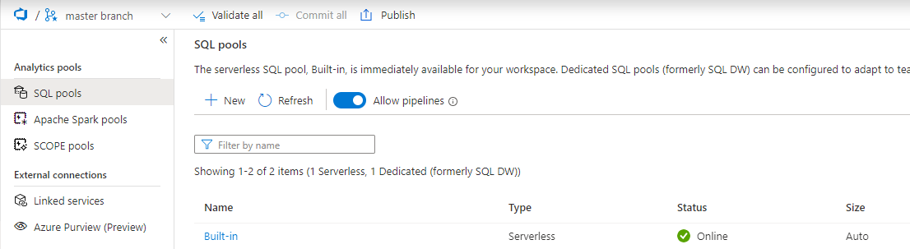
Serverless SQL Pool
Created by default in any Synapse Analytics instance
Contains only metadata/object definitions
No Storage; compute only
Can leverage External Tables, just as any other SQL DB does
Can define views, which provide visibility to underlying filenames and paths

Slide 7
Synapse Dedicated SQL Pool versus “Traditional” SQL Server

Slide 8
Online Transaction Processing (OLTP)
Optimized for processing individual records or isolated groups of records
Banking application for paying bills
Enterprise Resource Planning (ERP) system for managing warehouse inventory
Travel website for booking a vacation
Normalized data to minimize data redundancy
Entities and attributes have their own tables, with their own keys, and relationships defined between tables
Relationships must be enforced to prevent “orphaned” records
Row-based storage and indexing
Data manipulation processes are grouped into transactions, where if any component fails, the system can ensure data integrity remains

Slide 9
Online Analytical Processing (OLAP)
Optimized for reading and aggregating large data sets
Data is often denormalized, or flattened
Storage is cheap, so redundant data is not as much an issue if it helps speed up and simplify data queries
Often utilizes columnar storage and/or indexing
Data is loaded and processed in batches, not transactions
Azure Synapse Analytics aligns with this type of system

Slide 10
Why don’t Synapse Pools have feature parity with SQL Server?
Even though both utilize T-SQL as the query language, the underlying architecture is very different
SQL Server is a single query engine, but Synapse spreads compute across 60 parallel distributions and multiple nodes
Several common SQL Server features are difficult or impossible to implement in Synapse SQL Pools, due to the distributions
IDENTITY columns and MERGE statements are only recently supported in Synapse

Slide 11
Data Types
Data types supported in both databases
String Types (char, varchar, nvarchar, …)
Date Types (date, datetime, datetime2, datetimeoffset, …)
Numeric Types (int, float, decimal, …)
varbinary
Data types unsupported in Synapse Dedicated SQL Pools
XML
Geometry
Geography
Image
Table
User-defined types

Slide 12
Column Constraints in Synapse SQL Pools
Foreign Key Constraints not supported
Not needed in a Kimball model (star/snowflake schema) anyway
Fact inserts always use lookups to get surrogate keys
Too much maintenance overhead
Primary Keys are partially supported
Only when NONCLUSTERED is used
Only when NOT ENFORCED is used
Unique Keys are partially supported
Only when NOT ENFORCED is used

Slide 13
Example of “non-enforced” PK
When columns are defined as unique or primary key, query optimizer will consider the constraint
It is up to the application or user to ensure that the PK remains unique
TableId (PK) | Code
1 | abc
2 | def
3 | ghi
1 | abc
4 | jkl
SELECT TableId, COUNT(0)
FROM ExampleTable
GROUP BY TableId
TableId | COUNT
1 | 2
2 | 1
3 | 1
4 | 1
TableId | COUNT
1 | 1
2 | 1
3 | 1
1 | 1
4 | 1
Query with aggregate
ExampleTable
Expected result set
Actual result set

Slide 14
Stored Procedures
In “Traditional” SQL Server, stored procs are compiled the first time they are executed, and the execution plan is cached
In Synapse Dedicated SQL Pools, stored procs are parsed, translated, and optimized at runtime
Each statement is converted into distributed queries
Other Synapse limitations
No INSERT…EXECUTE support
No table-valued parameters
No default parameters
No encryption option

Slide 15
Triggers and Cursors
Triggers – programmatic constructs that execute before, after, or instead of INSERT, UPDATE, or DELETE commands on a table
Other triggers run in response to DDL events (CREATE, ALTER, DROP) or to LOGON events
Cursors allow code to loop through a data result set one record at a time
These objects are supported by “traditional” SQL Server, but NOT Synapse Dedicated SQL Pools

Slide 16
Update/Delete
Standard T-SQL
Synapse Dedicated SQL Pool
UPDATE a
SET a.[Description] = b.NewDesc
FROM FirstTable a
INNER JOIN SecondTable b
ON a.FirstId = b.FirstId
UPDATE FirstTable
SET [Description] = b.NewDesc
FROM SecondTable b
WHERE b.FirstId = FirstTable.FirstId

Slide 17
Other Unsupported Features
Triggers are not supported
Cursors are not supported
Table-valued functions not officially supported
You can still create them and call them, but they aren’t visible in Management Studio
They also won’t build as part of a Visual Studio Database Project

Slide 18
References
https://docs.microsoft.com/en-us/azure/synapse-analytics/sql-data-warehouse/sql-data-warehouse-tables-data-types
https://docs.microsoft.com/en-us/azure/synapse-analytics/sql-data-warehouse/sql-data-warehouse-table-constraints
https://docs.microsoft.com/en-us/azure/synapse-analytics/sql-data-warehouse/sql-data-warehouse-develop-stored-procedures
https://docs.microsoft.com/en-us/sql/t-sql/queries/update-transact-sql?view=sql-server-ver15

