Slide 1
Data Science Seminar: Time Series Forecasting with Tree-Based Ensemble Methods
February 25, 2022

Slide 2

About the Presenter
Brett Efaw
Data Scientist at Idaho Power Company
BEfaw@idahopower.com or brettefaw@gmail.com
Work with various business groups to implement Data Science solutions
Decision support
Predictive modeling
Forecasting
BI and DS reporting/analysis applications

Slide 3
Agenda
Traditional vs. (non-DL) ML Forecasting Methods
Simulated daily data set in Python
Trend + Tree-based ensemble
Feature engineering from date components
De-trend (fit past and forecast future trend)
Train tree-based model on de-trended target ~ date components
Combine trend forecast + tree-based prediction
Compare to traditional time series method (ARIMA)
Discuss pros and cons of this approach

Slide 4
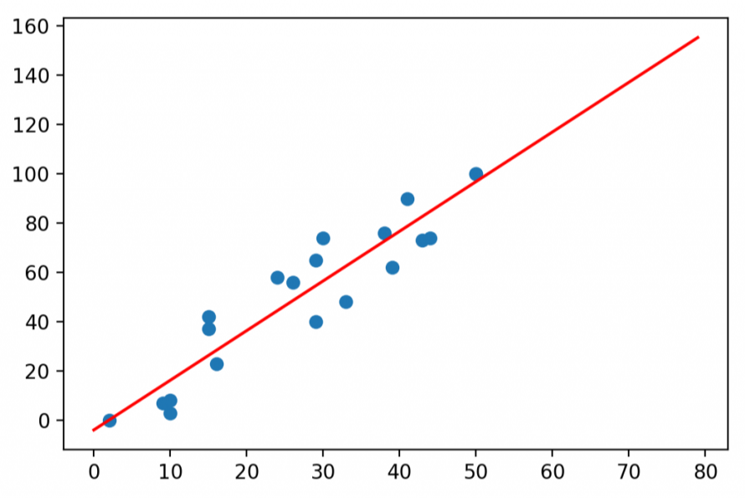
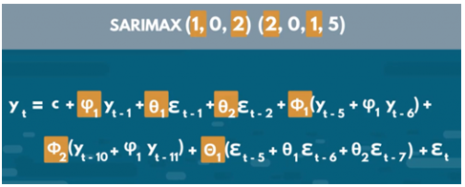
Traditional Forecasting Methods
Predict future values as function of past values
Classic statistical methods: linear regression (or similar) to extrapolate (trend) into the future
Classic time series methods: auto-regressive = regress data onto itself (from past) into the future

Slide 5
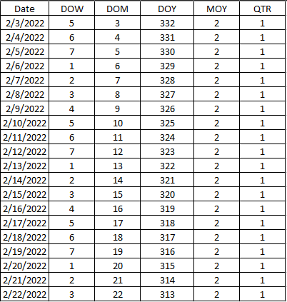
Forecasting with Machine Learning
Predict future values as function of (calendar) features
Extract features from Date/Time:
Day of week, month, quarter, year
Month of year
Quarter of year
Hour of day, week, month, year
Minute of hour, day
AM/PM
Holiday/special event
Business-specific process/change
Some features are cyclic and can be transformed to a trigonometric scale
Take advantage of knowing these features for future dates/times

Slide 6
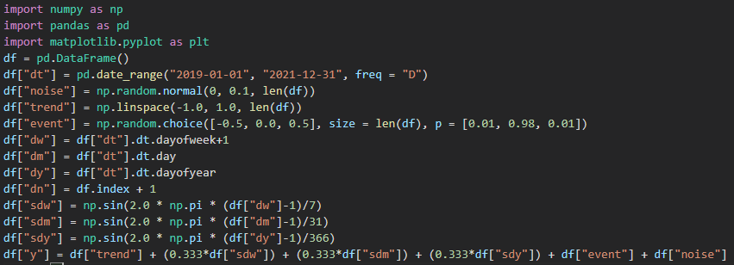
Simulated Data Set
Create a Pandas data frame with 3 years of daily data using date_range()
Fill this data frame with columns for:
noise: random noise from N(0,0.1)
trend: linear trend from -1 to 1
event: -0.5 (dip), 0.5 (spike) or 0.0
dw: day of week
dm: day of month
dy: day of year
dn: day (row) index
Trig Conversion for Date Components:
sdw: sine representation for day of week
sdm: sine representation for day of month
sdy: sine representation for day of year
Target Variable:
trend + sine components + event + noise

Slide 7
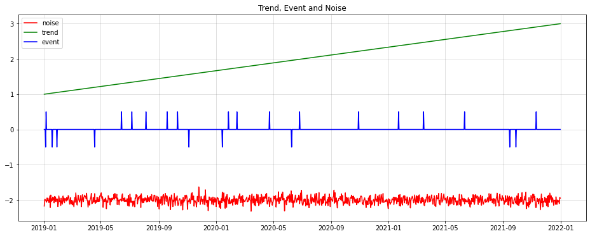
Trend, Event and Noise

Slide 8
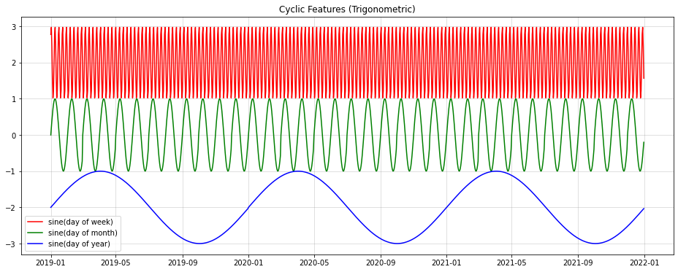
Cyclic Features (Trigonometric)

Slide 9
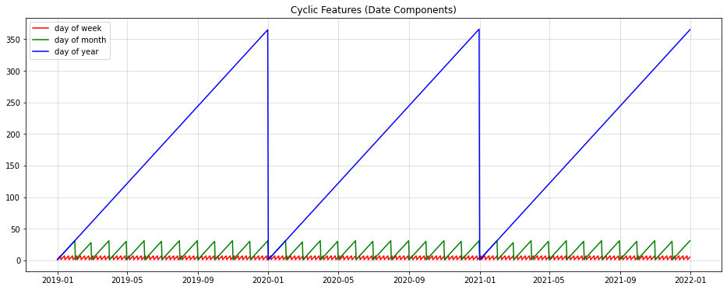
Cyclic Features (Date Components)

Slide 10
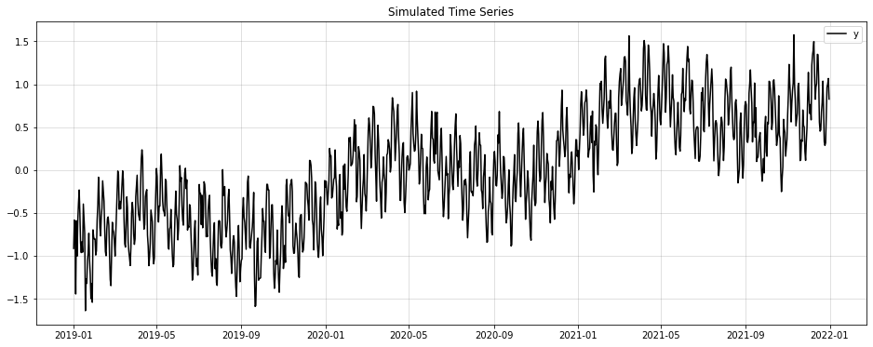
Target Variable
Long-term trend
Multiple seasonal periods

Slide 11
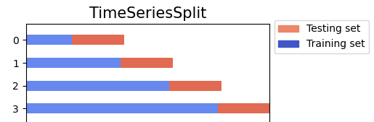
Time Series Splitting
Primarily used for evaluating a model’s forecast accuracy
Split data into training/testing partitions while preserving order
Number of splits (like number of folds in cross-validation)
For example: 10 splits
Test size = desired forecast horizon
For example: 30 dates in future
Maximum train size (default is all past data before test partition)
See TimeSeriesSplit from sklearn.model_selection for more details sklearn.model_selection.TimeSeriesSplit — scikit-learn 1.0.2 documentation
Visualizing cross-validation behavior in scikit-learn — scikit-learn 1.0.2 documentation

Slide 12
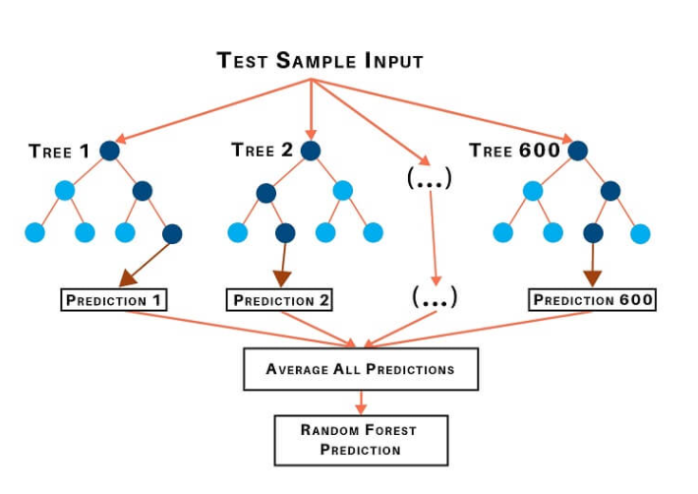
Tree-Based Ensemble Methods
Tree-based ensembles are an extension of Decision Trees
Very flexible and fast algos used for both classification and regression
Can handle numeric or categorical inputs
No feature scaling/normalization required
Random Forests
sklearn.ensemble.RandomForestRegressor — scikit-learn 1.0.2 documentation
Gradient Boosting
sklearn.ensemble.GradientBoostingRegressor — scikit-learn 1.0.2 documentation

Slide 13
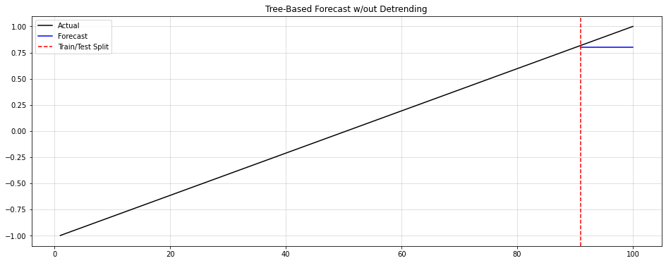
Tree-Based Ensembles Can’t Extrapolate
One fundamental drawback for tree-based models:
Can’t predict outside the range of observed values
This can be a problem if the target variable extrapolates outside the range of past values

Slide 14
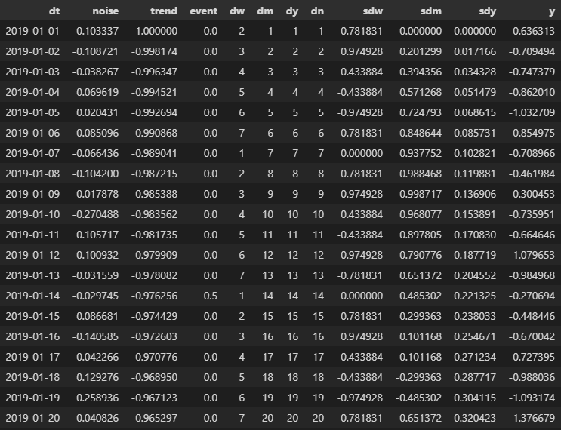
Trend + Tree-Based Ensemble
y: Target variable
dn: day number (row sequence)
Trend Model Formula:
y = f(dn)
ydetrend: Target variable detrended
dw: day of week (1-7)
dm: day of month (1-31)
dy: day of year (1-366)
Tree-Based Model Formula:
ydetrend = f(dw, dm, dy, event)

Slide 15
Trend + Tree-Based Ensemble Steps
Steps:
1. Fit trend to past (training data)
2. Predict trend into future (test data)
3. Detrend past (training data)
4. Fit tree-based model on detrended target calendar-based features
5. Predict tree-based model in future
6. Combine trend and tree-based prediction for final forecast
Trend Considerations:
How to fit and forecast the trend?
Linear Regression
Polynomial Regression
Spline/Loess/Kernel Regression
Seasonal Decomposition
Signal Filtering
Do Nothing
Trend fit and forecast could be different methods

Slide 16
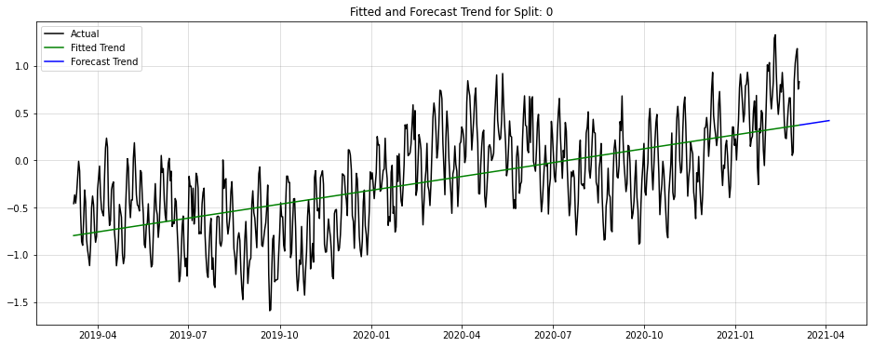
Fit and Forecast the Trend
LinearRegressor() from sklearn.linear_model

Slide 17
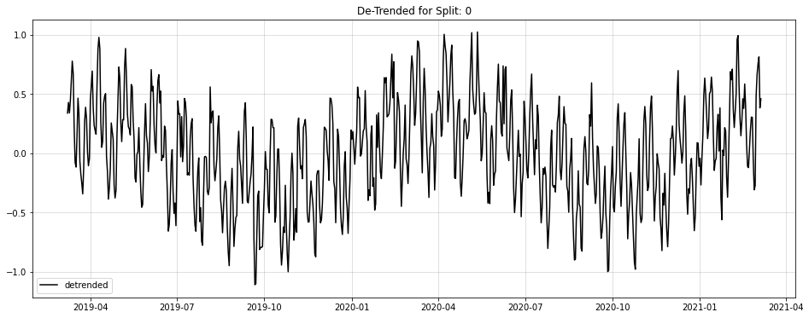
De-Trend the Target Variable
Detrend = Actual – Trend Fit

Slide 18
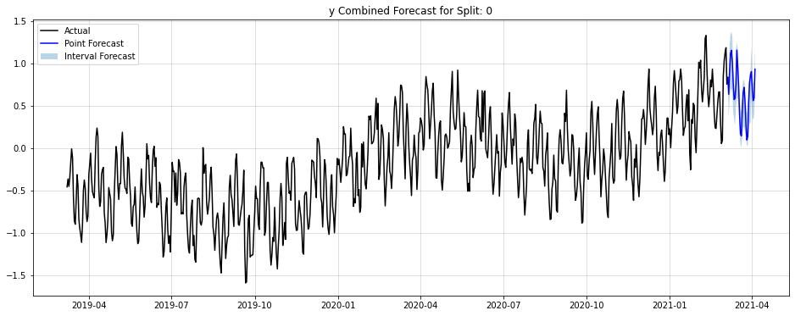
Train Tree-Based Model + Make Forecast
Final Forecast =
Trend Forecast (LinearRegressor) +
Tree Prediction (GradientBoostingRegressor)

Slide 19
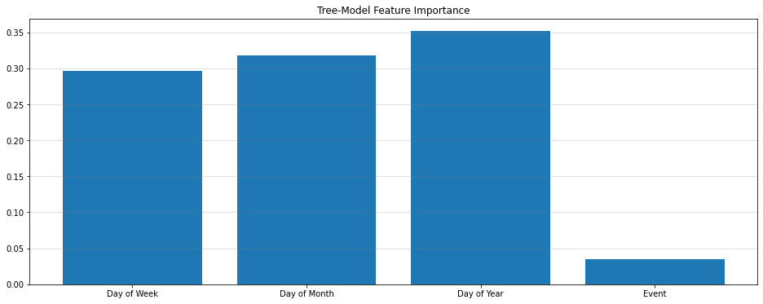
Feature Importance for Tree-Model

Slide 20
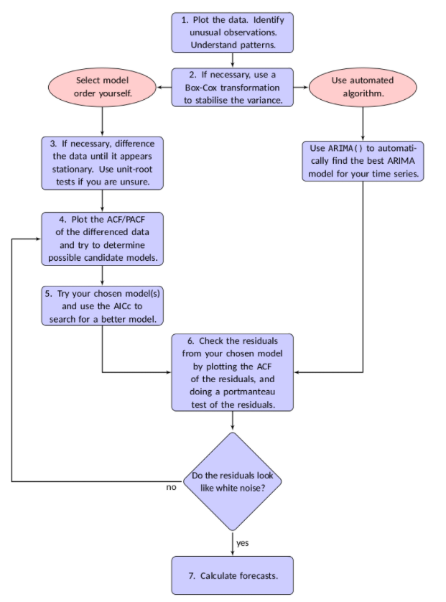
ARIMA
ARIMA = Auto-Regressive Integrated Moving Average
Use auto_arima() from pmdarima
See: https://alkaline-ml.com/pmdarima/tips_and_tricks.html
Also see Rob Hyndman’s online textbook (FPP):
https://otexts.com/fpp2/arima-r.html (Version 2 - forecast::auto.arima)
https://otexts.com/fpp3/arima-r.html (Version 3 - fable::ARIMA)
Searches for “best” ARIMA parameters (p, d, q)
Note: set the “m” parameter (number of observations per seasonal cycle)
7 for daily (used this for simulated data)
12 for monthly
52 for weekly

Slide 21
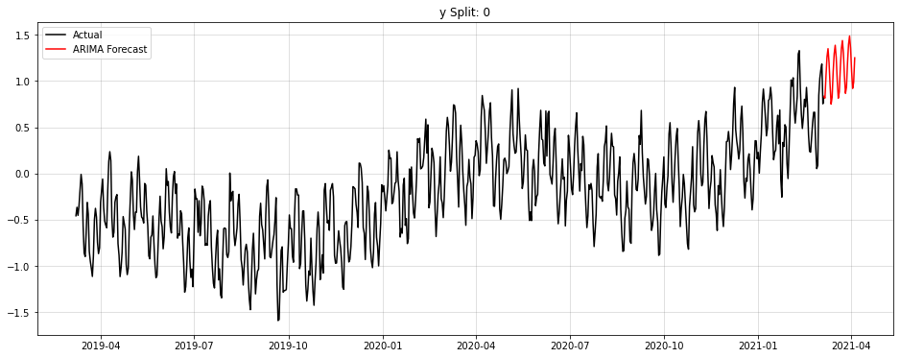
ARIMA Forecast

Slide 22
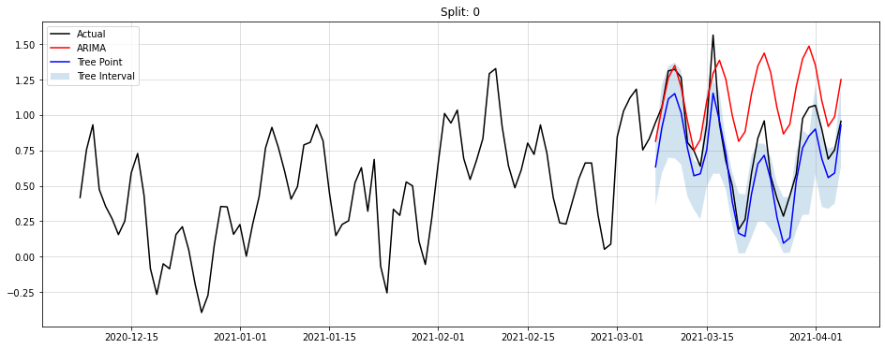
Trend + Tree-Based vs. (Auto) ARIMA
*Across 10 splits with:
test size = 30 and train size = 365*2
Using Lev’s fin_err() function
statistics/nb_Time_Series_Forecast_Error.ipynb at master · lselector/statistics · GitHub
Method | Avg. % Error* | Train Time*
Tree-Based w/ Detrend | 10.9% | ~15sec
Auto-ARIMA | 18.3% | ~12min

Slide 23
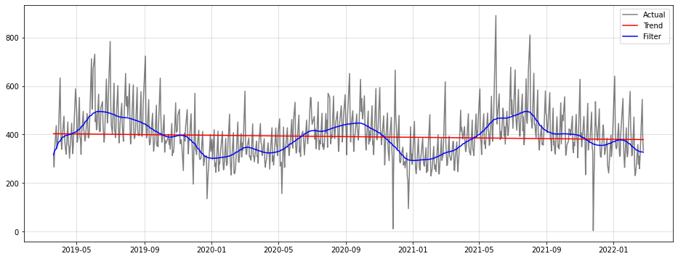
Example Trend with Real-World Data Set
Below is an example of real time series data set (blue line)
Trend fit with linear regression (red line) vs. signal filter (blue line)

Slide 24
Conclusion
What is the frequency?
Topic: use tree-base ensemble algo for time series forecasting (model trend + use calendar features)
Hyper-parameter tuning of tree-based ensemble algo
Default params used in the demo
Feature engineering options
Date/time components vs. trigonometric representation
Add other features that may be relevant to the time series being forecast
Other considerations:
Regular vs. irregular time series
Ease of automation and/or implementation
Low (weekly or lower)
High (daily or higher)
Regular
Irregular
Strong ACF
Weak ACF
Traditional method (ARIMA, ETS)
Tree-based ensemble method

