Slide 1
What is Cryptocurrency ?
Why you need to know about Cryptocurrency?

Slide 2
Criticism of Crypto
Proof of Stake Validation makes Crypto faster than VISA – and takes little electricity:
Cardano
Solana
Algorand
Ethereum
Cryptocurrencies failed at their main design intent of creating a distributed anonymous currency not controlable by any government. Nowadays every crypto transaction is a taxable event in US (similar to trading stocks or bonds)
Crypto networks consume ~ 1% of planet's electricity and cause electronic chips shortages (being fixed by "proof of stake")
Crypto networks are slow (being fixed by "proof of stake")
Crypto caused lots of fraud and criminal activity
Crypto is very volatile
Some countries prohibit crypto (like China)
Billionaire John Paulson Calls Crypto "A Limited Supply of Nothing"
Billionaire Warren Buffet advises against it as well: “It does not meet the test of a currency, ... it is not a durable means of exchange, it's not a store of value.”
""" The world has never been fond of crypto. Famous economists have called it a Ponzi scheme, notable investors have called it “rat poison squared,” the Fed president described it as a “giant garbage dumpster,” and governments around the world have banned, financially strangled and booted out crypto companies. """
Total TPS (Transactions Per Second):
Solana: 65,000
Ethereum: 20 (will be 100,000)
Cardano – 250 (will be Millions)
Visa: 24,000
Algorand: 1,300
Ripple: 1,500
PayPal: 193
Bitcoin Cash: 60
Litecoin: 56
Dash: 48
Bitcoin: 7 (slow!!)
https://www.fool.com/investing/2018/01/14/which-cryptocurrencies-have-the-fastest-transactio.aspx -

Slide 3
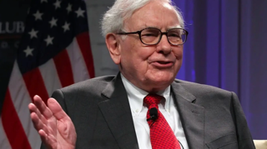
But ...
Years after calling Bitcoin "rat poison", Warren Buffett just invested $1 Billion in a crypto-friendly bank. February 2022
https://fortune.com/2022/02/16/warren-buffett-invested-1-billion-crypto-bank/

Slide 4
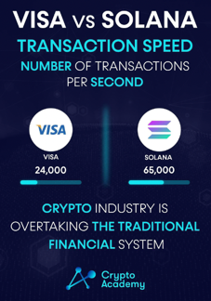
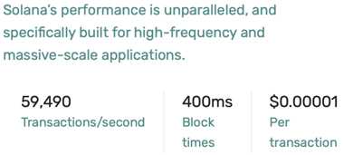
Revolution in Cryptocurrencies
Shifting validation from "proof-of-work" to "proof-of-stake"
increases speed of crypto-transactions x1000s times
(Etherium 2.0 projected speed ~ 100,000 transactions/sec),
and correspondingly decreases transaction fees to small fractions of a cent.
Fast speed and low transaction costs is already a reality for some networks, like, for example, Solana:

Slide 5
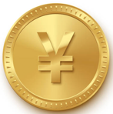


China - Digital Yuan
China has released the new digital yuan app , e-CNY, for iOS and Android.
It is NOT a decentralized cryptocurrency
It does NOT operate on a blockchain
It is controlled and issued by the China's central bank – PBOC (The People’s Bank of China). It was developed since 2014
It is designed to replace the cash and coins already in circulation
China is pushing for broader use of its digital currency
China is way ahead of its global peers. The US Federal Reserve is only discussing the idea of issuing a U.S. digital currency similar to China's CBDC (Central Bank Digital Currency)
The two dominant payment systems in China are:
Tencent’s WeChat Pay anounced support of digital yuan for its morethan a Billion WeChat users
Alipay (Alibaba) is also a partner for the digital yuan.

Slide 6
Central banks strike back against crypto
with their own digital currencies.
Almost 100 countries are actively investigating launching their own digital currency, according to the IMF (Inernational Monetary Fund).
If you can’t beat them, copy them. Some central banks have decided to create crypto competitors that they control. The value of this CBDC (Central Bank-controlled Digital Currency) mirrors the price of its physical equivalent.
CBDC is not similar to cryptocurrencies like Bitcoin and Ethereum, which are distributed (not centrally-controlled) and whose values aren’t pegged to any fiat currency (thus can swing wildly).
Benefits of CBDCs could include letting people without bank accounts use digital payments, and giving central banks a lower-cost alternative to cash for providing a national payment method.

Slide 7
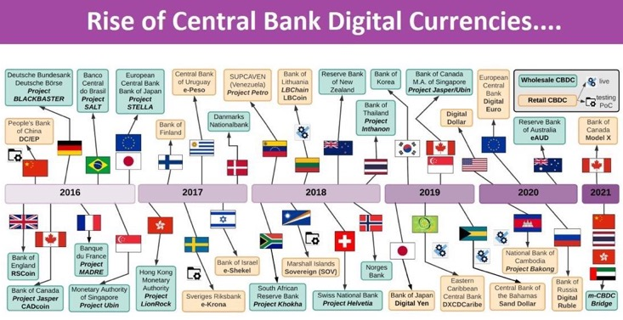
When USA Government will get into Crypto?
As of 2022, there are only discussions of launching a "Digital Dollar" in the USA: https://www.investopedia.com/fed-to-release-paper-exploring-launch-of-digital-dollar-5204490

Slide 8
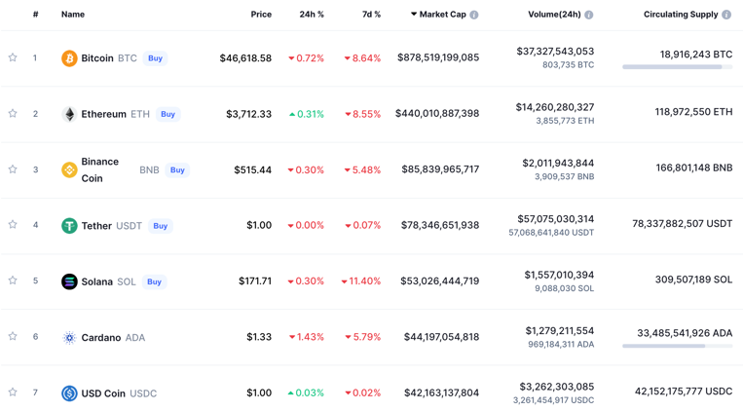
As of the end of 2021 there are approx 8,000 crypto-currencies
- https://coinmarketcap.com

Slide 9
Top 25 Cryptocurrencies as of mid-February, 2022
 | Name | Market Cap
1 | BTC = Bitcoin | $761,038,243,091
2 | ETH = Ethereum | $334,141,565,566
3 | USDT = Tether | $78,738,030,288
4 | BNB = BNB | $65,864,119,793
5 | USDC = USD Coin | $52,494,970,088
6 | XRP = XRP | $36,922,069,357
7 | ADA = Cardano | $33,850,389,831
8 | SOL = Solana | $28,991,691,641
9 | AVAX = Avalanche | $20,896,330,175
10 | LUNA = Terra | $19,861,982,821
11 | DOGE = Dogecoin | $18,447,068,758
12 | BUSD = Binance USD | $18,185,409,339
13 | DOT = Polkadot | $17,719,838,307
14 | SHIB = Shiba Inu | $15,511,500,430
15 | MATIC = Polygon | $12,169,172,624
16 | UST = TerraUSD | $11,947,612,991
17 | CRO = Crypto.com Coin | $11,053,395,927
18 | WBTC = Wrapped Bitcoin | $10,533,626,439
19 | DAI = Dai | $10,197,240,111
20 | LTC = Litecoin | $8,130,543,341
21 | ATOM = Cosmos | $7,833,196,168
22 | LINK = Chainlink | $7,161,689,625
23 | NEAR = NEAR Protocol | $6,574,018,803
24 | UNI = Uniswap | $6,496,617,082
25 | TRX = TRON | $6,423,796,753

Slide 10
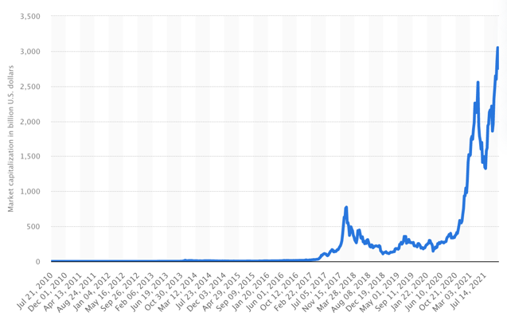
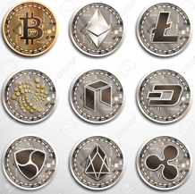
In 2021 total crypto market was worth more than 3 Trillion dollars
https://www.statista.com/statistics/730876/cryptocurrency-maket-value/

Slide 11
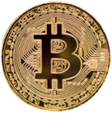
Cryptocurrency - History
A cryptocurrency is a digital asset designed to work as a medium of exchange (currency) that uses cryptography to secure its transactions, to control the creation of additional units, and to verify the transfer of assets.
The first widely successful and well known cryptocurrency is Bitcoin developed in 2007-2009 by Satoshi Nakamoto (a person or a group).
Before Bitcoin:
Digicash (David Chaum, 1989-1998, electronic anonymous crypto money)
Hashcash (Adam Back, 1997, a proof-of-work system used to limit email spam and denial-of-service attacks, later has become a part of bitcoin mining algorithm)
B-Money (1998, Wei Dai, anonymous, distributed electronic cash system)
Bit Gold (1998, Nick Szabo, decentralized, blockchain)
E-gold (1996-2009) - digital gold currency, was incorporated on one of Caribbean Islands, in 2006 was processing more than $2 Bln worth of transactions per year, grown to 5 Mln accounts by 2009, was shut down due to legal issues (under US Patriot Act)
Bitcoin, 2009

Slide 12
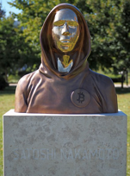
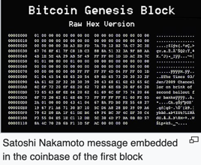
Bitcoin History
Satoshi Nakamoto is the name of a person(s) who invented blockchain and created bitcoin. Nobody knows his/theirs true identity.
- https://blog.bitstamp.net/post/who-is-satoshi-nakamoto –
- https://en.wikipedia.org/wiki/Satoshi_Nakamoto -
2007 - the work has begun
2008 - domain bitcoin.org
2008 October - whitepaper on metzdowd.com "Bitcoin: A Peer-to-Peer Electronic Cash System"
2009 January - Bitcoin software released on SourceForge, network launched with the block #0 with 50 bitcoins reward
On 17 Mar 2010 bitcoinmarket.com starts operating
On 22 May 2010, Laszlo Hanyecz made the first real-world transaction by buying two pizzas in Jacksonville, Florida for 10,000 BTC
2010 - Nakamoto released control to Gavin Andresen and other members of bitcoin community
2011 April – Nakamoto wrote "I’ve moved on to other things…" and disappeared
Nakamoto owns between 750-1,100K bitcoin (~$73 Bln in Nov 2021).

Slide 13
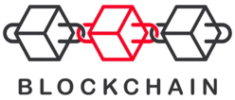
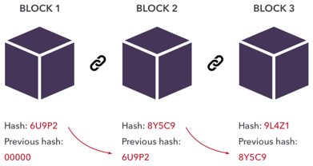
Blockchain
"Blockchain is a system of recording information
in a way that makes it difficult or impossible
to change, hack, or cheat the system.
A blockchain is essentially a digital ledger of transactions
that is duplicated and distributed across the entire network
of computer systems on the blockchain."
GitHub:
Bitcoin (C++ mostly):
https://github.com/bitcoin
Simple blockchain in python:
https://github.com/dvf/blockchain
Ethereum in Golang:
https://github.com/ethereum/go-ethereum
https://github.com/ripple -

Slide 14
Etherium
- https://www.investopedia.com/terms/e/ethereum.asp
- https://etherscan.io/
- https://www.investopedia.com/terms/g/gas-ethereum.asp -
Programming languages used in Ethereum:
Vyper – similar to Python
Solidity – similar to JavaScript
Serpent – similar to Python, not recommended
LLL (Lisp-Like Language)
https://merunasgrincalaitis.medium.com/dont-code-another-smart-contract-without-understanding-the-4-languages-in-10-minutes-first-1c2dea165fcf
Ethereum is a platform powered by distributed blockchain technology
Its own (native) cryptocurrency is called Ether, or ETH, or simply Ethereum
dApps - decentralized apps supported by Ethereum platform
Smart contracts, which originated on the Ethereum platform, are a central component of how the platform operates.
Solidity – common programming language for writing Smart Contracts - https://en.wikipedia.org/wiki/Solidity .
EVM – Ethereum Virtual Machine.
Miners and validators who participate in operating the Ethereum network, usually by mining, earn ETH rewards for their contributions

Slide 15
Solidity
pragma solidity >= 0.7.0 <0.8.0;
contract Coin {
// The keyword "public" makes variables
// accessible from other contracts
address public minter;
mapping (address => uint) public balances;
// Events allow clients to react to specific
// contract changes you declare
event Sent (address from, address to, uint amount);
// Constructor code is only run when the contract
// is created
constructor() public {
minter = msg.sender;
}
// Sends an amount of newly created coins to an address
// Can only be called by the contract creator
function mint(address receiver, uint amount) public {
require(msg.sender == minter);
require(amount < 1e60);
balances[receiver] += amount;
}
// Sends an amount of existing coins
// from any caller to an address
function send(address receiver, uint amount) public {
require(amount <= balances[msg.sender], "Insufficient balance.");
balances[msg.sender] -= amount;
balances[receiver] += amount;
emit Sent (msg.sender, receiver, amount);
}
}
Solidity – programming language for writing Smart Contracts:
- https://en.wikipedia.org/wiki/Solidity
- https://ethereum.org/en/developers/
- https://github.com/ethereum/solidity
Solidity is very similar to JavaScript programming language.
A contract in Solidity is similar to a class, and a deployed contract is similar to an instance of a class (an object) in JavaScript.
You can create your own contacts/classes as you like. You can think of all kinds of variables and methods inside those contracts. For example, you can make a contract for shipping something. Or for making payments. You can create your own contacts for coins, tokens, distributed apps, your own blockchains, etc.

Slide 16
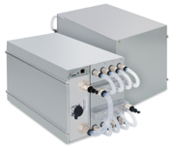
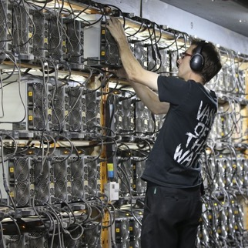
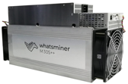
Blockchain mining hardware
ASIC = Application-Specific Integrated Circuit.
Your regular computer can calculate at speeds ~ 2 Kilo-hashes per second.
The specialized devices (an ASIC bitcoin miner) - will do 200 Terahashes per second (1 Terahash = 1 trillion hashes) while consuming 5.5KWatts of electricity.
Bitmain, one of the world’s largest bitcoin mining rig manufacturers, has launched the Antminer S19 Pro+ Hyd.
This new mining machine will have a hashrate of 198 TH/s (Tera-Hash/sec) and consume 5.5 KW. It uses liquid cooling.

Slide 17

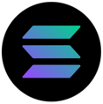
Solana
blockchain platform – using Proof of Stake, written in Rust
Solana is a public blockchain platform
Very fast: 50,000/sec (vs 15 ETH or 7 BTC)
Very cheap: 0.00025 per transaction (vs $2-$50 for ETH,BTC)
Initial – 2019, growing very fast
Written in Rust, developer friendly
It achieves consensus using the proof of stake mechanism.
Its internal cryptocurrency is SOL (Symbol: ◎)
Developer(s): Solana Labs & Solana Foundation
In 2021, Bloomberg journalist Joanna Ossinger described Solana as "a potential long-term rival for Ethereum", citing superior transaction speeds and lower associated costs.
https://en.wikipedia.org/wiki/Solana_(blockchain_platform)
https://whitepaper.io/document/602/solana-whitepaper
https://solana.com –
https://www.youtube.com/watch?v=knBQXU7fetA – 3 min
Market cap: $46B (September 2021)
Circulating supply: 308,704,493.99 SOL (as 24th Dec 2021)
Exchange rate: US$203 (October 2021)
Anatoly Yakovenko
San Francisco Bay Area
anatoly@solana.io
https://www.linkedin.com/in/anatoly-yakovenko/
 | Solana | Ethereum
transactions per sec | 50,000 | 15
cost per transaction | $0.00025 | $70

Slide 18

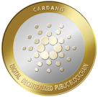
Cardano
blockchain platform – using Proof of Stake, written in Haskell
Cordano is a public blockchain platform, smart contracts
Fast: 250 /sec (it will be Millions)
Relatively cheap: $0.4 per transaction (will be much lower soon)
Initial – 2017, growing very fast
Written in Haskell, developer friendly
It achieves consensus using the PoS (Proof of Stake) mechanism
Its internal cryptocurrency is ADA
Developer(s): Charles Hoskinson, Ethereum co-founder
Cordano is named after famous italian scientist Gerolamo Cardano (1501-1576)
ADA is named after Ada Lovelace (1815-1852) - English mathematician and writer
Charles Hoskinson
Colorado,
Cardano Foundation based in Switzerland.

Slide 19
Concensus Mechanisms
Proof of Work (Bitcoin, Ethereum, ...) miners solve blocks, first winner is rewarded. Need fast specialized hardware (ASIC miners) and use lots of electricity. Complexity grows with time, transactions are slow. Miners consolidate their efforts (mining pools, staking) – thus leading to centralisation of miners
Proof of Stake (Peercoin 2012), Cardano, Avalanche, Polkadot, Solana, Ethereum 2.0, ... ) replaces miners with validators who stake their coins on the network to maintain it. Proof of Stake takes thousands times less electricity, and works much faster (and cheaper):
Proof of Stake networks in Transactions per Second (TPS): .. Solana – 65,000;
.. Cardano – 260 (projected up to 1 Mln);
.. Avalanche – 4,500;
.. Polkadot – 167;
.. Ethereum 2.0 (projected) – 100,000.

Slide 20
How Does Proof of Stake work ?
Owners of a cryptocurrency stake their coins and create their own validator nodes.
Staking is when you pledge your coins to be used for verifying transactions. Your coins are locked up while you stake them.
When a block of transactions is ready to be processed, the cryptocurrency's proof-of-stake protocol will choose a validator node to review the block.
The validator checks the validity of transaction, adds the block to the blockchain, and receives crypto rewards (or penalized if tried to add block with incorrect information).
Example: Cardano. Anyone who owns Cardano can stake it and set up their own validator node. When Cardano needs to verify blocks of transactions, its Ouroboros protocol selects a validator. The validator checks the block, adds it, and receives more Cardano for their trouble.
Mining power in PoS depends on the amount of coins a validator is staking. Stake more coins, and you will be more likely chosen to add new blocks.
Each proof-of-stake protocol works differently in how it chooses validators.
There's usually some randomization involved, also factors like how long validators have been staking their coins.

Slide 21
Staking Pools vs Mining Pools
In PoS (Proof-of-Stake) system you can increase your odds to be selected by joining a staking pool, which is simply a group of people pooling their coins together for a better chance of winning new blocks. One person (pool owner) sets the validator node for the pool. Rewards are split between participants, owner may take a small fee.
Note: you can not stake Bitcoin or other Proof-of-Work (PoW) Cryptocurrencies. You can only stake PoS cryptocurrencies.
But in PoW system like Bitcoin you can join one of Bitcoin Mining Pools, which are networks of miners cooperating to mine blocks together and distribute the payments based on each entity’s contribution to the pool. Contributions measured in hash rate (calculated hashes per second).
Whenever any miner in the pool finds a block, they pay the block reward to the mining pool coordinator. After taking a small fee, the coordinator pays each member of the pool based on their hash rate contribution.
For a small miner who has impossibly low chances of finding a block on their own, joining a mining pool will provide a steady stream of revenue (proportionaly to the miner’s size, so it will still be small, but consistent).

Slide 22
Transition from Ethereum to Ethereum 2.0 ("Proof of Stake").
Phase 0 - launch the beacon chain in the network, start managing registry of the validators, create frameworks for next steps.
Phase 1 (to be finished in mid-2022) - implement 64 shard chains and roll-ups. Sharding (distributing of transactions) should greatly increase the throughput of the network.
Phase 1.5 - the stopgap between phase 1 and phase 2. It is merging ("docking") of the two ecosystems. The merger will involve the docking of the ethereum 1.0 mainnet with the beacon chain, and then the ethereum 1.0 blockchain will become one of the 64 shard chains implemented in phase 1.
Phase 2 - initiate cross-shard interoperability and allow native decentralised application (dApp) development on the network.

Slide 23
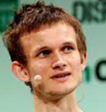
Transition to Ethereum 2.0
Vitalik Buterin (one of the founders Ethereum) tweeted in 2020:
"ETH2 scaling for data will be available *before* ETH2 scaling for general computation. This implies that rollups will be the dominant scaling paradigm for at least a couple of years:
first ~2-3k TPS with eth1 as data layer,
then ~100k TPS with eth2 (phase 1).
Adjust accordingly,"
Ethereum's upgrade may cause increase in its price mainly due to the fact that Ethereum and its DeFi network will become far more practical.
Transaction fees will likely drop significantly (to fractions of a cent).
And transaction speed will match or exceed that of VISA cards.
Those who stand to benefit the most from Ethereum's upgrade are those who do not have access to the modern banking system that exists today (nearly 2 billion people).
With low fees and a lowered barrier to entry, DeFi has the potential to grow significantly, and Ethereum's price along with it.
Vitalik Buterin
https://vitalik.ca
EndGame: https://vitalik.ca/general/2021/12/06/endgame.html

Slide 24
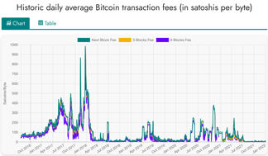
Fees (Proof of Work)
Bitcoin
Fees are calculated in "satoshi" named after Satoshi Nakamoto, creator of bitcoin.
1 satoshi = 0.00000001 BTC = 1e-8 BTC
(Jan 2022) Estimated transaction fee $2.34 = 5,056 satoshi
https://www.btcsatoshi.com/
https://www.buybitcoinworldwide.com/fee-calculator/
https://bitcoinfees.earn.com/
https://mempool.space/
https://bitcoinbriefly.com/how-to-use-mempool-space-block-explorer/
Miners are rewarded for calculating next block
in a blockchain's mempool. The reward is calculated per the length of the record and complexity of calculation – and in values native to the blockchain.
When converting to dollars, the fees are very volatile.
Here is what Wall Street Journal says about fees in 2021:
""" On the Bitcoin network, the average daily transaction fee this year has been as low as $1.78 and as high as $62, according to bitinfocharts. On Ethereum, the average fee has been as low as $1.59 and as high as $70. """
https://www.wsj.com/articles/crypto-and-its-many-fees-what-to-know-about-the-hidden-costs-of-digital-currency-11639825202
Ethereum
https://cryptotesters.com/blog/ethereum-gas
https://automatedwebtools.com/usd-eth-gas-fee/
https://etherscan.io/
Cost of transaction is measured in "Gwei" – named after Wei Dai, best known as the creator of the bitcoin predecessor "b-money" and as the developer of the Crypto++ library.
1 gwei = 0.000000001 ether = 1/1Bln part of Ether
(Jan 2022) Estimated transaction fee $5.61 = 70 Gwei

Slide 25
Crypto Payment Services
The 5 Most Popular Crypto Payment Gateway & Processors
https://www.merchantmaverick.com/best-cryptocurrency-payment-gateway/
Coinbase - mainstream brand in the US market. Integrates with Shopify and WooCommerce - https://www.coinbase.com –
BitPay - Bitcoin and Bitcoin Cash payment services for merchants. US, since 2011. Versatile payout options - https://bitpay.com -
CoinGate - Supports payment in more obscure coins, Integrates with a large number of eCommerce platforms - https://coingate.com –
NOWpayments - Supports payment in more obscure coins, Integrates with a large number of eCommerce platforms, Low fees for simple transactions - https://nowpayments.io –
AlfaCoins - Flexible payment options, Easy to use - https://www.alfacoins.com -

Slide 26
Crypto Exchanges (and Wallets)
Best Crypto Exchanges in 2021: - https://www.investopedia.com/best-crypto-exchanges-5071855 -
Coinbase - 89+ Mln users, 100+ countries, USA-based - https://www.coinbase.com - Transaction Fees: 0.04% to 0.50% (taker orders); 0% to 0.50% (makers orders), Wallet included. Very high liquidity, variety of coins
Binance - https://www.binance.com - Cayman Islands (Caribbean) & Seychelles (island near Africa). Hindreds of cr.currencies. Not available in US. Low fees, large variety of cryptocurrencies and trading pairs, geared for more advanced users
Binance.US - https://www.binance.us – US-regulated, 50 cryptocurrencies, not all states supported
Abra - https://www.abra.com - Mountain View, CA - operates a comprehensive, custodial cryptocurrency wallet and exchange
Cash App - https://cash.app – easy to use, peer-to-peer money transfer (like Venmo or Zelle), ability to withdraw Bitcoin, supports only one crypto-currency – the Bitcoin. has daily and weekly withdrawal limits. Charge when sending money via credit card
bisq – decentralized exchange - https://bisq.network – non-KYC platform, 18 crypto-currencies, but transaction speeds may be slow, trading volumes can be low
Kraken – Bitcoin & Crypto Exchange - https://www.kraken.com -
Gemini - https://www.gemini.com -
Robinhood - https://robinhood.com -

Slide 27

Fees – BitPay.com
BitPay is a payment gateway
since 2011, 100+ Mln global customers,
https://www.owler.com/company/bitpay
https://bitpay.com/blog/welcome-to-the-september-cryptie/
BitPay fees ( https://www.cryptowisser.com/wallet/bitpay/ )
1. Miner fees (unavoidable, built into the blockchain, depends on crypto, very volatile)
2. Network Cost (additional operations' cost imposed by BitPay starting in 2017)
3. Processing Fee (1%) added by BitPay for their service
4. Refund fees (if you receive a refund)
In 2017 when Bitcoin blockchain fee were very high (more than $30),
BitPay made a rule to refuse transactions smaller than $100
Some alternatives to BitPay:
https://www.finextra.com/blogposting/21322/the-best-cryptocurrency-payment-gateways-for-2022
https://technicali.com/top-7-payment-gateways-that-accept-cryptocurrency/
https://wpengine.com/resources/wordpress-and-bitcoin/
https://www.nerdwallet.com/article/small-business/accepting-bitcoin-crypto

Slide 28

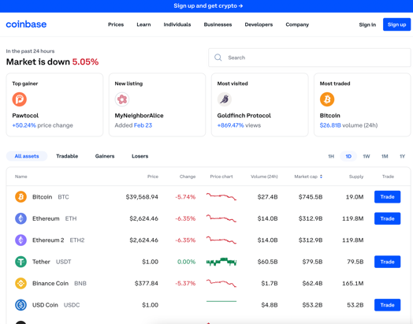
Coinbase
https://www.coinbase.com
https://en.wikipedia.org/wiki/Coinbase
buy, sell, and manage crypto
89 Mln users in 100+ countries
Public company (traded on Nasdaq)
Founded in 2012 by Brian Armstrong
1000+ employes

Slide 29
Convert BitCoin into USD
https://icoholder.com/blog/how-to-turn-bitcoin-into-usd/
If you and your buyer know and trust each other – you can do it by yourselves. Buyer can give you money – and you can send BTC from your account to his. You need to be aware of fees on both sides
You can also use facilitating service like LocalBitcoins which lists buyers (expect 1-3 days to complete transaction) - https://localbitcoins.com/sell_bitcoins
Otherwise you can use some (big) exchange – but for additional fee 1-2% fee. For example, Coinbase Exchange - https://icoholder.com/blog/how-to-turn-bitcoin-into-usd/ , https://www.youtube.com/watch?v=60Rjdv2Z_Gg
You can also trading platforms (like Kraken). Expect more background checks and higher fees. The process also will generally take longer ( ~5 days ) - https://support.kraken.com/hc/en-us
Currency Converters – many places, faster processing - https://wealthpay.org - https://www.bestchange.com - https://www.okchanger.com
Direct Electronic Payment System – like https://www.worldcore.eu - it uses BitPay under the hood - https://bitpay.com

Slide 30


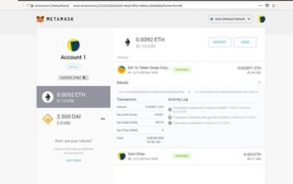
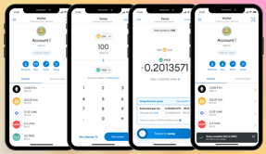
MetaMask
https://metamask.io/
https://en.wikipedia.org/wiki/MetaMask
A software cryptocurrency wallet for Etherium blockchain
A secure browser extension or mobile app (iOS, Android)
Allows to interact with decentralized applications
Since 2016
More than 20 Mln users
Developed by ConsenSys - a blockchain software technology company founded by Joseph Lubin with headquarters in Brooklyn, New York
Bitcoin cannot be stored on MetaMask, but you can store a "Wrapped Bitcoin" (WBTC) – which is an ERC-20 token that represents Bitcoin on the Ethereum blockchain
Joseph Lubin
ConsenSys
Brooklyn, New York

Slide 31
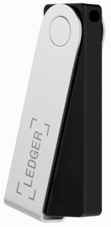

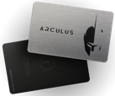
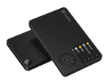
Best Hardware Wallet
Ledger Noan X - https://www.ledger.com –
Trezor - https://trezor.io –
Arculus - https://www.getarculus.com –
SafePal - https://safepal.io -

Slide 32


Uniswap Protocol
https://uniswap.org/
https://github.com/Uniswap/v3-core
Uniswap (2018) is a decentralized open source finance protocol that is used to exchange cryptocurrencies on Ethereum blockchain. Written in Solidity.
Uniswap is also the name of the company that initially built the Uniswap protocol.
The Uniswap protocol facilitates automated transactions between cryptocurrency tokens on the Ethereum blockchain through the use of smart contracts.
As of October 2020, Uniswap was estimated to be the largest decentralized exchange and the fourth-largest cryptocurrency exchange overall by daily trading volume
Uniswap has been one of the shining stars of the crypto market. Investors are looking to buy UNI due to its impressive performance.
Hayden Adams
Inventor of Uniswap Protocol
CEO at Uniswap Labs
New York
https://www.linkedin.com/in/haydenadams/

Slide 33
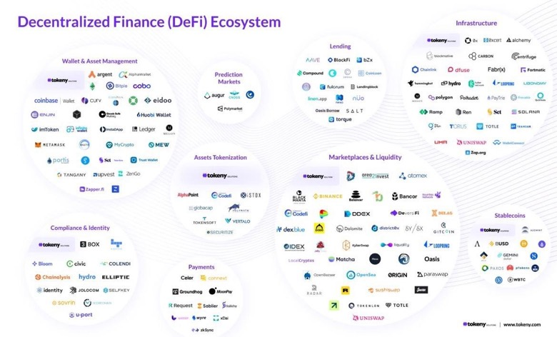

Slide 34

Web 3.0
The term "Web3" was coined by Polkadot founder and Ethereum co-founder Gavin Wood in 2014, referring to a "decentralized online ecosystem based on blockchain."
web1 (1994-2004): content provided by website owner, visitors are consumers.
web2 (a.k.a. Web 2.0, 2004 - present) – "social web", "web as a platform". Content created by website users (social media - blogs, facebook, youtube, etc.). Amazon market place and even Wikipedia can be considered as web2 websites too. Content is stored in big "central" repositories (web sites).
web3 (a.k.a. Web 3.0) – data is stored and interconnected in decentralized way. .. using blockchain and other modern technologies to enable decentralized economics. .. DAOs - decentralized autonomous organizations (DAOs) .. DeFi - decentralized finance .. self-sovereign identity (without the need of authentication server) .. AI-driven interfaces understanding voice, human images, emotions, understand meaning ("semantic web"), 3D-graphics, virtual reality .. AI-driven bots for data discovery and operations
Gavin Wood

Slide 35
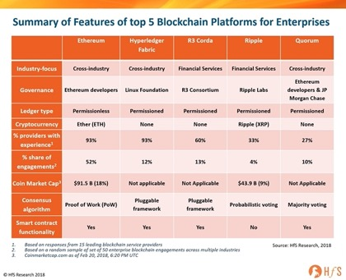
Blockchain networks, platforms, companies
Page Under Construction
Number of nodes (2021):
Bitcoin: 12K+
Ethereum: 7K
Some Blockchain companies
BRD
BitMEX
Chainalysis
Coinme
Netki
Paxful
Republic
Spring Labs
SALT Lending
TQ Tezos
Mythical Games
Gemini
Circle
Coinbase
Chronicled
IBM
Voatz
Steem
Shipchain
Some Blockchain Platforms:
IBM Blockchain
Corda
Ethereum
MultiChain
Tron
Stellar

Slide 36
Blockchains
Page Under Construction
public blockchains
- https://www.gartner.com/reviews/market/blockchain-platforms
BitCoin
Etherium
Solana
IBM Blockchain
Hyperledger Fabric
Binance Smart Chain
NEO (Antshares)
WAVES
EOS
Stellar
Monero (XMR)
Bitcoin Cash (BCH)
Ripple ?
private blockchains
consortium blockchains
hybrid blockchains

Slide 37
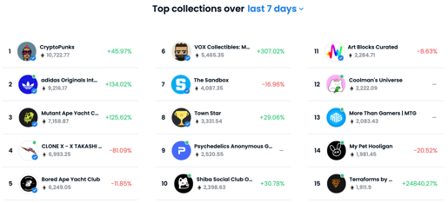


NFT = Non-fungible token
https://en.wikipedia.org/wiki/Non-fungible_token
NFTs can be sold or bought on many crypto market places https://www.fool.com/investing/stock-market/market-sectors/financials/non-fungible-tokens/nft-marketplaces/
OpenSea - https://opensea.io - first and largest. Helps to mint yor own NFTs, supports 150+ different payment tokens.
Axie Marketplace - video game Axie Infinity. Ethereum.
Larva Labs/CryptoPunks - digital art, Ethereum
NBA Top Shot Marketplace (Basketball collectibles), Flow blockchain
Rarible - similar to OpenSea, its own token Rarible built on Ethereum
SuperRare - similar to Rarible. Ethereum. New token announced
Foundation.app - use Etherium to buy/sell digital art
Nifty Gateway - the art curation platform, uses Gemini. Ethereum
Mintable - similar to OpenSea. Ethereum. Minting of NFTs
Theta Drop - video and TV, its own blockchain, Theta Token
With NFTs, artwork can be "tokenised" to create a digital certificate of ownership that can be bought and sold (sometimes for millions of $$)
NFTs are cryptographic assets on a blockchain with unique identification codes and metadata that distinguish them from each other
NFT provide a public certificate of authenticity or proof of ownership
NFT is separate from a copyright
NFT differ from crypto-currencies: there is no trading, no interchangeability (fungibility)
NFT do not restrict the sharing or copying of the underlying digital files

Slide 38
Stable Coins
- https://www.investopedia.com/terms/s/stablecoin.asp -
Stablecoins are cryptocurrencies
that attempt to peg their market value
to something external, like a currency (USD),
or commodity's price (gold), etc.
Stablecoins achieve their price stability via
either collateralization (backing)
or through algorithmic mechanisms of buying
and selling the reference asset or its derivatives
Currency | Market value
Tether / USDT | $ 73.32 billion
USD Coin / USDC | $ 34.35 billion
Binance USD / BUSD | $ 13.54 billion
Dai / DAI | $ 6.47 billion
TerraUSD / UST | $ 2.88 billion
TrueUSD / TUSD | $ 1.25 billion

Slide 39


Lightning Network
https://en.wikipedia.org/wiki/Lightning_Network
The Lightning Network (LN) is a "layer 2" payment protocol layered on top of a blockchain-based cryptocurrency such as bitcoin or litecoin.
It is intended to enable fast transactions among participating nodes and has been proposed as a solution to the bitcoin scalability problem
Cryptocurrency exchanges such as Bitfinex use Lightning Network to enable deposits and withdrawals.
Laszlo Hanyecz, who gained fame in the cryptocurrency community for paying 10,000 BTC for two pizzas in 2010, bought two more pizzas in 2018 using Lightning Network and paid 0.00649 BTC.
Zion (The Bitcoin Social Network) utilizes the Lightning Network running LND (LN Daemon) to send content peer-to-peer through channels.
Laszlo Hanyecz
Note about Litecoin : Litecoin (2011) is a bitcoin fork (faster block generation, larger max number of coins, different hashing algorithm, etc.) https://en.m.wikipedia.org/wiki/Litecoin

Slide 40
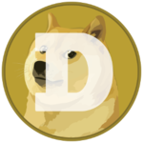
Dogecoin
https://en.wikipedia.org/wiki/Dogecoin -
https://dogecoin.com -
https://www.reddit.com/r/dogecoin/ -
Dogecoin - cryptocurrency created as a joke in 2013
started growing via online community (Reddit, ...)
Market cap $85 Billion in 2021
authors - Billy Markus and Jackson Palmer
known as a "meme coin" or "dog coin"
(Shiba Inu dog from the "Doge" meme)

Slide 41
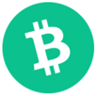
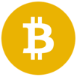
Bitcoin Cash, Bitcoin SV
https://en.wikipedia.org/wiki/Bitcoin_Cash
Bitcoin Cash:
2017 – hard fork of Bitcoin (spin-off, altcoin)
increased block size to 8 MB
faster throughput for transactions (60 tr/sec)
BCH – currency code
Bitcoin Cash
BCH
Prices (1/31/2022):
BTC – $38,300
BCH – $288
BSV - $91
Bitcoin SV:
2018 – hard fork chain split of Bitcoin Cash .. Bitcoin ABC (Adjustable Blocksize Cap) - 32 MB blocks .. Bitcoin SV (Satoshi Vision) – up to 128 MB blocks
2019 - Bitcoin SV expanded block size to 2 GBytes, enabling (theoretically) 10-15K transactions per second
The Bitcoin SV blockchain is the largest of all Bitcoin forks
Bitcoin SV
BSV

Slide 42
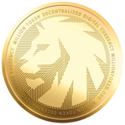

Million token
https://www.milliontoken.org
Million is a cryptocurrency:
limited supply of 1 Mln tokens, min $1 each
no upper bound on price
fully Web 3.0 capable
multi-chain currency supported across 6+ different blockchains
unlike first-gen memecoins (like Dogecoin or Shiba), Million is serious about supporting smart-contracts, DeFi, staking, NFTs, DAOs, Proof-of-Stake high scalability, fast transactions, and the gaming metaverse.
Decentralized Finance staking with the Million Pool, including a decentralized governance DAO for stakeholder rights
Metaverse - strong community, developer ecosystem of social media, digital art, gaming, chat spaces, avatars, and NFT metaverse
Transparency & Trust - 100% transparent with code fully audited by Certik, Million was founded by ex-Google/ex-Facebook TechLead
The Web 3.0 memecoin ("King of the Jungle of dog coins")
Patrick Shyu
TechLead
QUICKSTART GUIDE
Create a Metamask Wallet using either a desktop computer or mobile device. http://metamask.io
Send Ethereum to your wallet. You can buy Ethereum on MetaMask directly, or through sites like Coinbase, Crypto.com, or Binance and then send them to your wallet.
Connect to Uniswap and trade for Million.

Slide 43
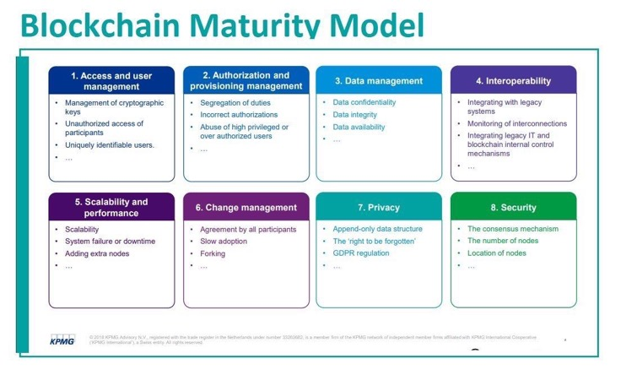

Slide 44
Hyperledger
https://www.hyperledger.org/
open source tools (blockchains and related)
started in December 2015 by the Linux Foundation.
Hyperledger Fabric - a blockchain framework
Hyperledger Sawtooth - modular platform for building, deploying, and running distributed ledgers
Numerai
https://numer.ai/
new type of a hedge fund launched in 2015:
make competitions to do financial predictions
pay winners in cryptocurrency (their own currency - Numeraire)

Slide 45
JP Morgan
JPM Coin - a wholesale payment digital currency that is pegged 1:1 to the U.S. dollar. It is now transacting billions of dollars every day
JP Morgan uses blockchain unit Onyx: https://www.jpmorgan.com/onyx – organization & brand
JPMorgan built the Quorum blockchain using the ethereum network (software behind ether cryptocurrency). Quorum will remain open-source, it is being used by the bank to run the Interbank Information Network, a payments network that involves more than 400 banks. It is supported/developed by ConsenSys – a Brooklyn-based startup - https://github.com/ConsenSys/quorum -
Amazon Web Services (AWS)
AWS provides Ethereum on Amazon Managed Blockchain. AWS customers can easily provision Ethereum nodes in minutes and connect to the public Ethereum main network and test networks such as Rinkeby and Ropsten.

Slide 46
Links, Resources
Three main generations of blockchain technologies - https://www.investopedia.com/tech/blockchain-technologys-three-generations/ -
But how does bitcoin actually work? ( youtube channel "3Blue1Brown" ) - https://www.youtube.com/watch?v=bBC-nXj3Ng4 –
Bitcoin Cash, Bitcoin SV - https://en.wikipedia.org/wiki/Bitcoin_Cash
Roger Ver - https://en.wikipedia.org/wiki/Roger_Ver
Cayman Islands and taxes, Binance - https://en.wikipedia.org/wiki/Binance – - https://decrypt.co/19204/top-7-crypto-companies-based-in-tax-havens –
The CHEAPEST Way to Buy Crypto. Period. - https://www.youtube.com/watch?v=D11waRlecrg –
Cardano - public open-source decentralized blockchain platform, internal cryptocurrency called "Ada". founded in 2015 by Charles Hoskinson - https://en.wikipedia.org/wiki/Cardano_(blockchain_platform)
Yield farming = lending or staking cryptocurrency in exchange for interest and other rewards. Yield farmers measure their returns in terms of annual percentage yields (APY). While potentially profitable, yield farming is also incredibly risky.
Crypto Mortgage - https://www.prnewswire.com/news-releases/milo-launches-first-us-crypto-mortgage-301462342.html
. . .

Slide 47
More Links
Melania Trump – NFT - https://blockchain.news/news/former-us-presidents-wife-melania-trump-releases-the-first-nftpriced-at-1-sol
Blockchain explorer - https://www.blockchain.com/explorer
Cryptopedia - https://www.gemini.com/cryptopedia
Book: "Platform Revolution: Blockchain Technology as the Operating System of the Digital Age" - https://www.amazon.com/gp/product/1988025737/
Fed Digital Currency Report - https://time.com/nextadvisor/investing/cryptocurrency/expert-reaction-to-fed-digital-currency-report/amp/
DeFi Decoded - Why fortunes are made in bear markets - 40min video - https://youtu.be/joy4-QbG0Rw
Wharton Accepts Cryptos as Tuition Fees for Blockchain Courses - https://blockchain-news.cdn.ampproject.org/c/s/blockchain.news/postamp?id=wharton-accepts-cryptos-as-tuition-for-blockchain-courses
3 Ways NFT Gaming Is Building New Wealth Opportunities - http://entm.ag/Q1CCQp?fbclid=IwAR0vyM7BHpG6gEk_3y0codMBlgtOB-C_YhJLXGtkILiPSkYJHoqIAE4gdcM
Inidia - tax on crypto in 2022 - https://www.bloomberg.com/news/articles/2022-02-01/india-to-launch-central-bank-digital-currency-next-fiscal-year
Laws for stablecoins - https://www.americanbanker.com/news/democrats-circulate-bill-to-rein-in-stablecoins
Stablecoin - https://www.linkedin.com/posts/theblockchainforum_stablecoin-regulatory-update-feb-2022-activity-6895248259149893632-9Og3
Blockchain glossary for accountants - https://jofacc.libsyn.com/a-blockchain-glossary-the-cpa-firm-of-the-future-and-excel-malware
Feds & Digital Currency - https://news.mit.edu/2022/digital-currency-fed-boston-0203
KPMG is a global network of professional firms providing Audit, Tax and Advisory services - https://www-marketwatch-com.cdn.ampproject.org/c/s/www.marketwatch.com/amp/story/crypto-is-volatile-but-kpmg-canada-just-added-bitcoin-and-ether-to-its-balance-sheet-heres-why-11644270913
Cryptocurrency, Blockchain - IRS forms & how to file - https://open.spotify.com/episode/4BA08KV2257tlygMglcqyc
Google & Crypto - https://sg.finance.yahoo.com/news/google-blockchain-crypto-ecosystem-sundar-pichai-nfts-000111560.html
PayPal & Crypto - https://blockchain-news.cdn.ampproject.org/c/s/blockchain.news/postamp?id=paypal-establishes-advisory-committeefocusing-on-crypto-affairs
Apple and crypto payments - https://finance-yahoo-com.cdn.ampproject.org/c/s/finance.yahoo.com/amphtml/news/apple-enable-crypto-payments-tap-150300322.html
Coinbase - Earn crypto while learning about crypto - https://www.coinbase.com/earn
Coinbase - Get paid in crypto with zero fees, get your paycheck deposited into Coinbase - https://www.coinbase.com/direct-deposit
Ukraine Legalizes Bitcoin amid Intensified Tension with Russia - https://blockchain-news.cdn.ampproject.org/c/s/blockchain.news/postamp?id=ukraine-legalizes-bitcoin-amid-intensified-tension-with-russia
Fed Designs Digital Dollar That Handles 1.7 Million Transactions Per Second - https://www-forbes-com.cdn.ampproject.org/c/s/www.forbes.com/sites/jasonbrett/2022/02/07/fed-designs-digital-dollar-that-handles-17-million-transactions-per-second/amp/
BNB Chain - https://www.binance.com/en/blog/ecosystem/introducing-bnb-chain-the-evolution-of-binance-smart-chain-421499824684903436
Salesforce - NFT cloud service - https://www-cnbc-com.cdn.ampproject.org/c/s/www.cnbc.com/amp/2022/02/09/salesforce-tells-employees-its-working-on-nft-cloud-service.html
JPMorgan - Quantum Key Distribution (QKD) secure network - https://www-pymnts-com.cdn.ampproject.org/c/s/www.pymnts.com/blockchain/2022/jpmorgan-announces-viable-quantum-secure-blockchain-network/amp/
Paris Hilton on Tonight Show - NFTs - https://www.youtube.com/watch?v=5zi12wrh5So
Proof-of-Stake - Cardano, Solana, Algorand, Ethereum - https://www.technologyreview.com/2022/02/23/1044960/proof-of-stake-cryptocurrency/
What's on Tap? - Putin - and Crypto - https://youtu.be/a0ryBK2UgTQ
It's all about crypto and Blockchain - https://www.inaa.org/accounting-industry-trends-for-2022/
Good Glossary - https://data-flair.training/blogs/distributed-ledger-technology/

