Slide 1
Astronomer
Managing Airflow

Slide 2

About the Speaker
Makani Cartwright
Data Scientist/Engineer @ Vareto
makani.cartwright@gmail.com
Enthusiastic builder of data products
Predictive Modelling
Forecasting
Business Intelligence
Data Pipelining

Slide 3
The History of Astronomer - A Timeline
2008 - Brian Chesky, Joe Gebbia, and Nathan Blecharczyk found AirBnB
2015 - Airflow is launched by Maxime Beauchemin to handle the scale of data generated by AirBnB
2015 - Astronomer founded as a data routing tool
April 2016 - Airflow joins Apache Foundation Incubator
July 2018 - Astronomer pivots to focus on Airflow
January 2019 - Airflow becomes full-fledged Apache project
December 2020 - Airflow 2.0 is released
2022 - Astronomer employs 16 (of 47) airflow contributors and 7 (of 27) PMC members

Slide 4
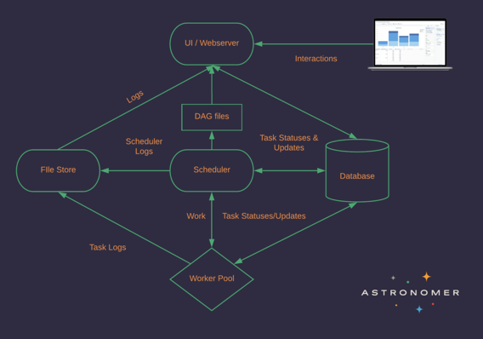
Airflow - A Recap
Orchestration should be
Flexible
Extensible
Scalable
Modular
Enable security
Custom Logging
Rerunnable
With individual step isolation
Open Source
Notes:
Flexible - all built off of individual execution steps which can be combined into arbitrary workflow DAGs Extensible - open source integrations with all sorts of data stores and APIs
Scalable - modular architecture scales leveraging kubernetes

Slide 5
Problems with Self-Hosting
Doing Airflow Setup is Non-Trivial
At a minimum requires: webserver, scheduler, executor, database
Managing Airflow adds to DevOps tasks
Because Airflow is modular, each component will need separate management
Security management
Environments management
Logging/Monitoring
Airflow is not automatically set up to scale
Enabling local development requires additional implementation work

Slide 6

Astronomer
Managed Service for Airflow
Built to work on big 3 cloud platforms
Handles
Environment Management
Project Deployment
Permissions
Monitoring
Developed by Airflow Contributors, will stay ahead of competitors with the latest Airflow versions

Slide 7
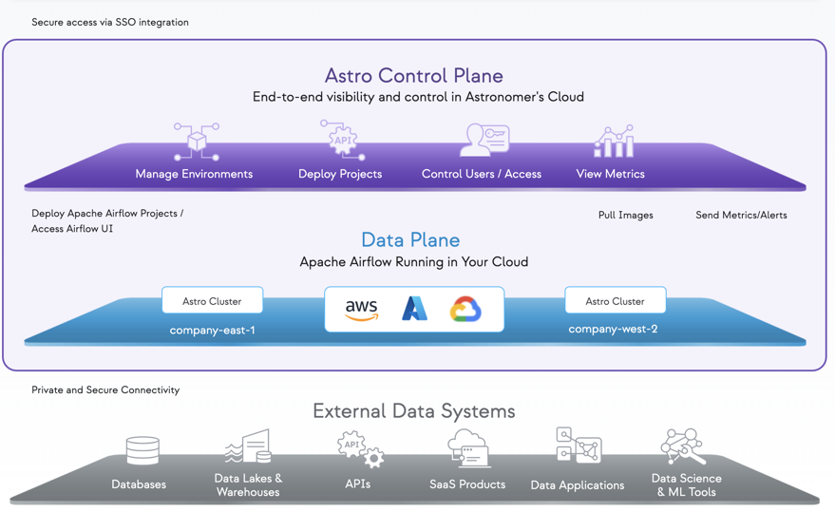

Slide 8
Security
Single Tenant Data Plane
Astronomer is limited to a single user with restricted access to your data
Role Based Access
Single Sign On

Slide 9




Deployments
Isolated deployment environment creation
Can be spun up and down in less than a minute
AstroCLI allows for local testing with confidence
Enables Automated CI/CD
Monitoring

Slide 10


Performance
Auto-scaling
Celery Executor & Kubernetes both enabled
Can run across multiple clusters

Slide 11
Performance: A Closer Look at Executors
Celery Executor
Distributes tasks among standing celery workers
Tunable worker_concurrency
Kubernetes Executor
Each task run in separate pod - with individual resource specs
Enables autoscaling
Tunable number of pods created per scheduler

Slide 12
Performance: Tuning Parameters
Environment Level
Parallelism, DAG Concurrency, Timeout, DAG Refresh Cadence, Scheduler kickoff cadence
DAG Level
Max active runs, Max active tasks, Concurrency
Task Level
Task concurrency, pool size

Slide 13
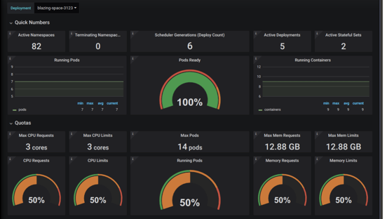
Monitoring
Metrics generated by StatsD and Prometheus drive Grafana dashboard
Real time alerts configured through cloud platform

Slide 14
The Astro CLI
Allows for local running of fully fledged Airflow environment
Local airflow running 3 docker containers (postgres, webserver, scheduler)
Ensures local environment matches deployment environments
Also can be used for deployment tasks
Authentication
Managing Environments
Deployment

Slide 15
The Competition
Self-hosted
Fully flexible
Requires SIGNIFICANT Operations Bandwidth
Google Cloud Composer
Simple deployment - even less setup than astronomer
Limited options (Celery only, no access to the underlying systems)
Does not have autoscaling
AWS Managed Workflows for Apache Airflow (MWAA)
Simple deployment - even less setup than astronomer
Limited options (Celery only, no access to the underlying systems)
Has autoscaling

Slide 16
Questions?

Slide 17
A Quick Walkthrough

Slide 18
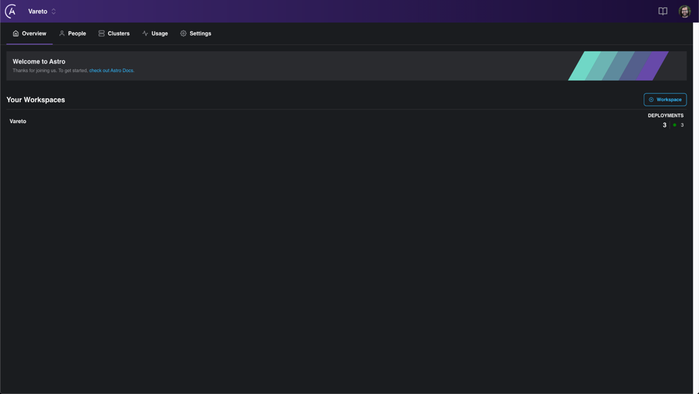

Slide 19
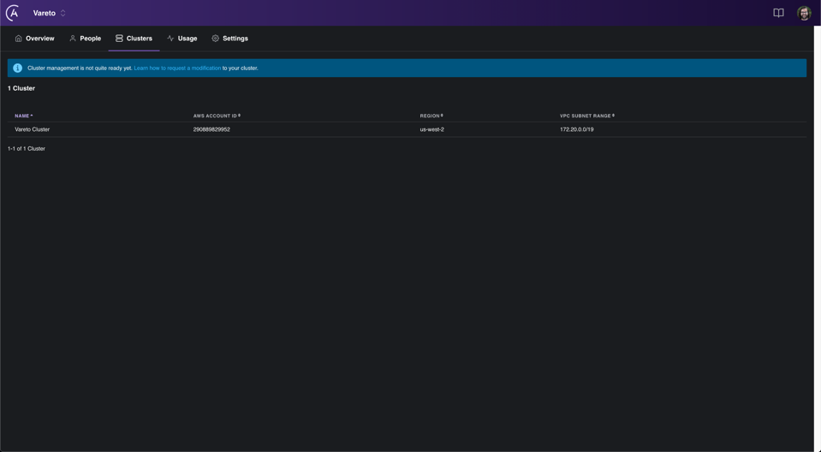

Slide 20
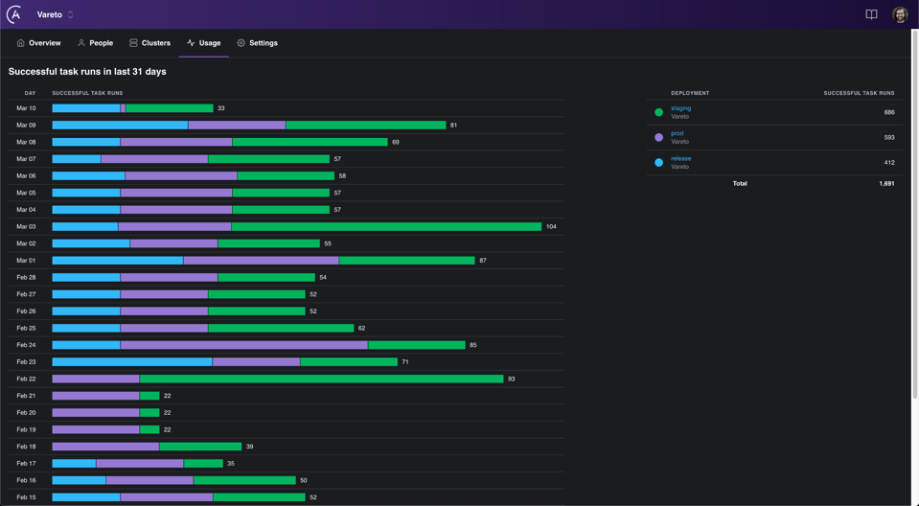

Slide 21
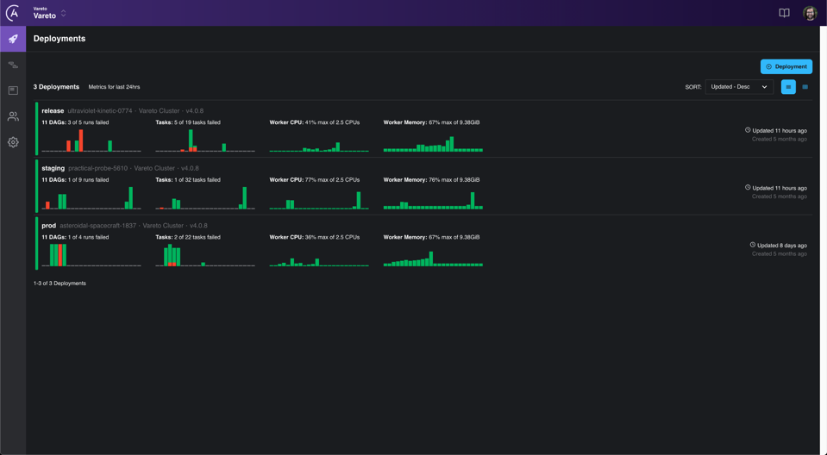

Slide 22
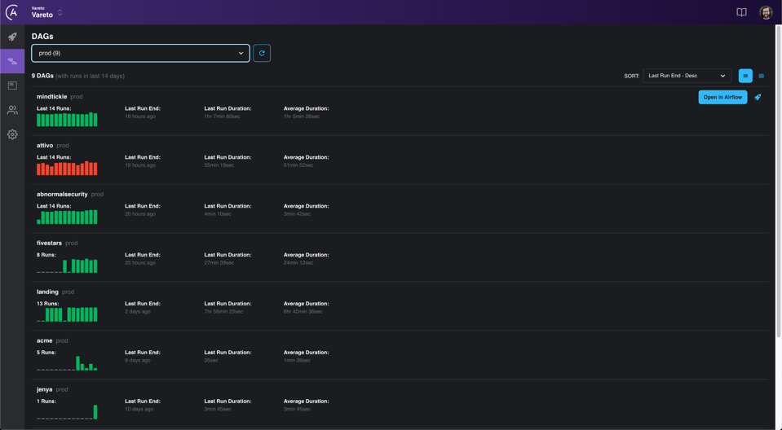

Slide 23
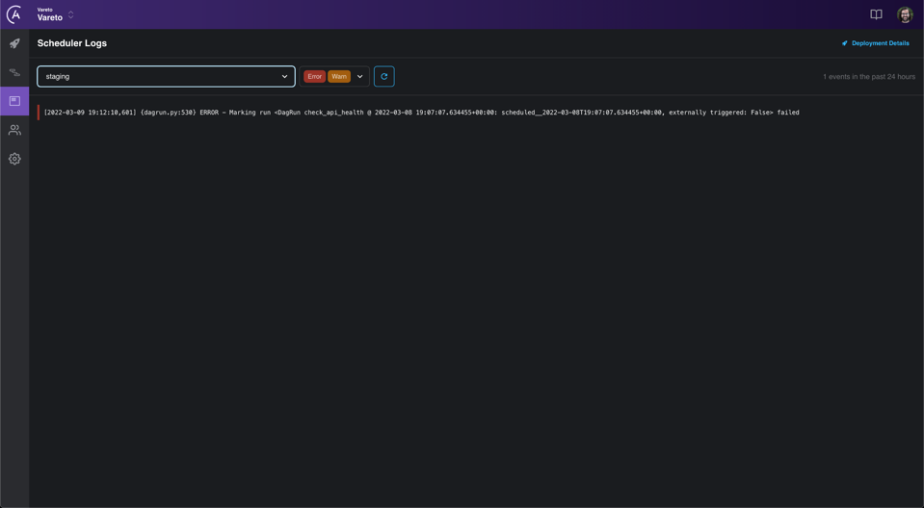

Slide 24
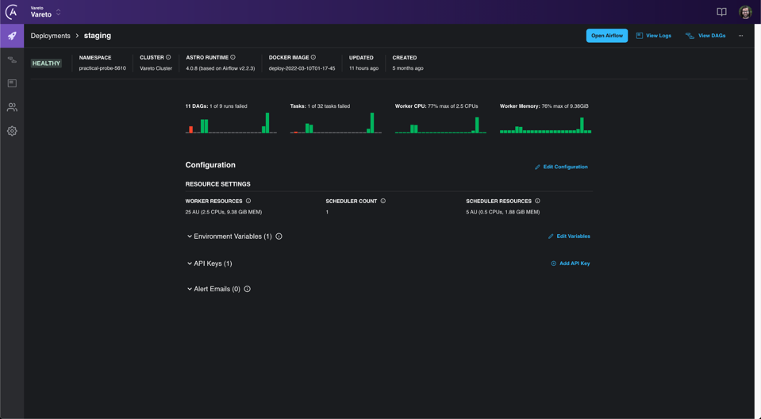

Slide 25
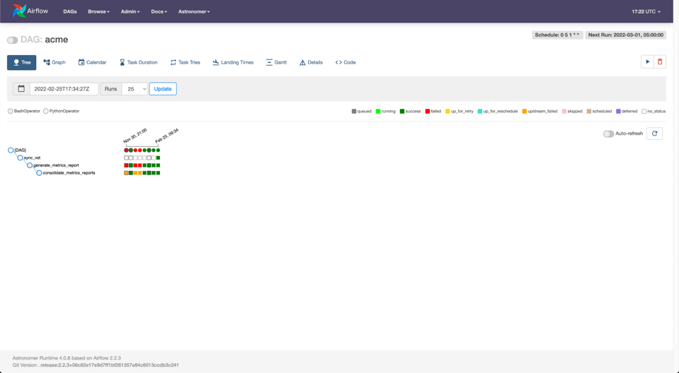

Slide 26
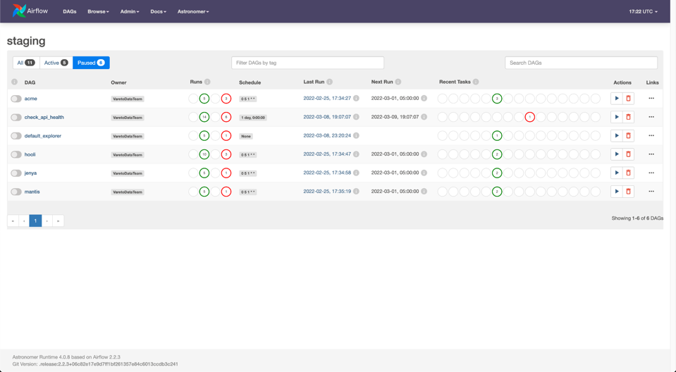

Slide 27
Resources
Airflow: https://airflow.apache.org/
History: https://medium.com/airbnb-engineering/airflow-a-workflow-management-platform-46318b977fd8
Astronomer: https://www.astronomer.io/
Astro CLI: https://docs.astro.build/en/reference/cli-reference/
CI/CD: https://docs.astronomer.io/software/ci-cd/
Amazon MWAA: https://aws.amazon.com/managed-workflows-for-apache-airflow/
Google Cloud Composer: https://cloud.google.com/composer/docs
Other Articles:
https://towardsdatascience.com/managed-apache-airflow-on-aws-new-aws-service-for-data-pipelines-91908ee9e5fc
https://dev.to/seattledataguy/scaling-airflow-astronomer-vs-cloud-composer-vs-managed-workflows-for-apache-airflow-4ppb

